Slide 1




Data Visualisation and Evaluation:
CIS and beyond
CLARIFY science meeting 07/02/2017
Duncan Watson-Parris, Nick Schutgens, Philip Stier
Department of Physics, University of Oxford
Notes:
With this talk I just want to very quickly recap what CIS is and how we intend to use it, but I really want to try and get an understanding from you all as to how we could use it both during and after the campaign.

Slide 2
CIS overview

Slide 3
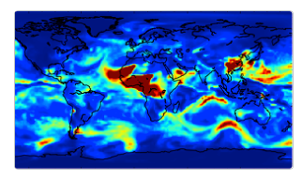
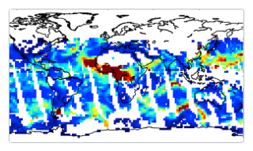
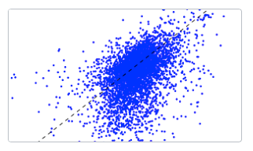
What is CIS?
Read
Analyse
Visualise
Read your data
Analyse your data
Visualise your data

Slide 4
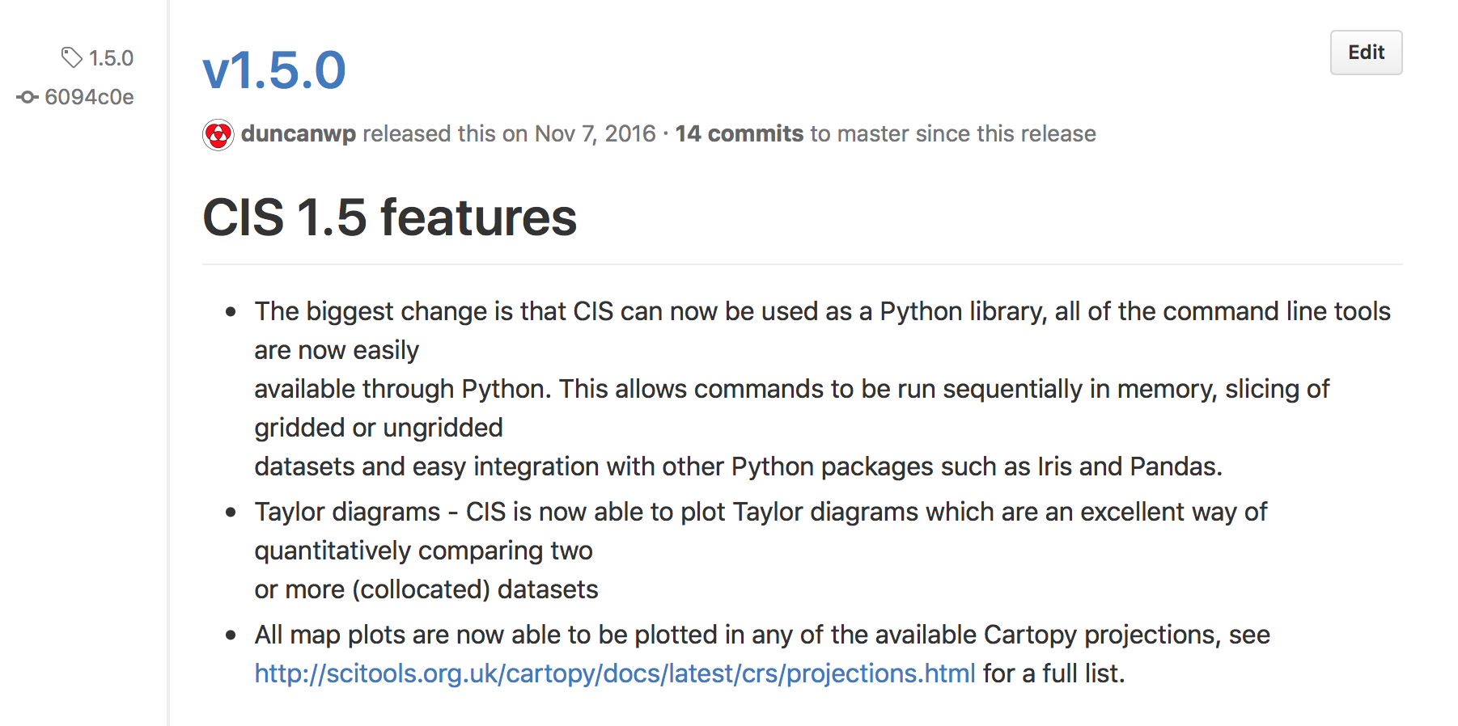
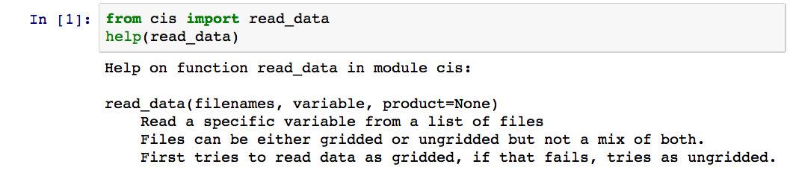
Latest CIS developments
Notes:
Talk about the 1.5 features, in particular the full API, and plotting improvements.
Also discuss Auto-asses

Slide 5
Beyond CIS: CIS-ESP Demo

Slide 6
Campaign requirements
Notes:
Should the tool be hosted at CEDA with access to JASMIN, or at Ascension running the collocations locally? Satellite stuff should probably be done at CEDA.
We should also start the process of setting up a group workspace – do we have a feeling of how much space we’ll want?
Maybe we actually just do this on MONSOON and send snapshots of the collocated data along with the model output?

Slide 7
Spare slides

Slide 8
Web browser
JASMIN
Un-managed cloud
LOTUS
WMS Client Server
Synthesis catalogue
Synthesis setup interface
Job submission / management
Platform LSF
WMS
OpenDAP
Managed cloud
THREDDS
ARC-CE
CIS
Synthesis
Metadata DB
Other gridded
data
Processed data
Raw EO
data

Slide 9
IMAPLA group workspace
The group workspace is large, high speed data store (100Tb)
Access through an ssh connection to JASMIN
Note, this is not backed up but we have tape storage available if required.
Group workspaces
Users
IMPALA
Shared
Public
Notes:
Describe the layout, the size of space available (100Tb).

