Slide 1
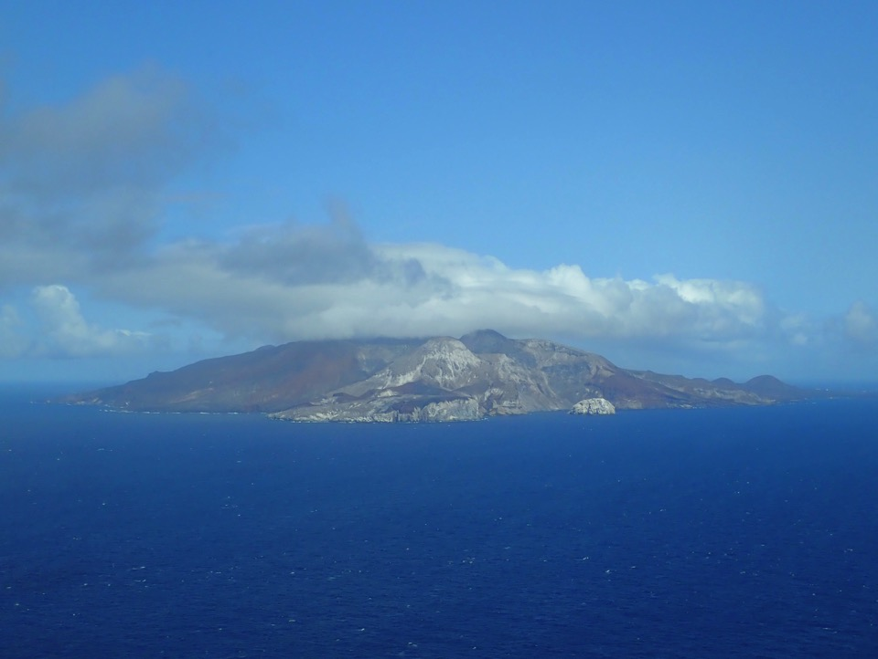
Progress with the groundbased UV-depolarisation lidar on Ascension Island.
M. De Graaf^{1,2}, K. Sarna², J. Brown³, E. Tenner², M. Schenkels⁴, and D. Donovan^{1,2}
(1) Royal Netherlands Meteorological Institute (KNMI) R&D Satellite Observations, De Bilt, The Netherlands, martin.de.graaf@knmi.nl; (2) Geosciences & Remote Sensing Department, Delft University of Technology (TUD), Delft, The Netherlands; (3) Wageningen University, Meteorology and Air Quality Department, Wageningen, The Netherlands; (4) Utrecht University, Institute for Marine and Atmospheric Research, Utrecht, The Netherlands.
UV depol lidar on Ascension – M de Graaf ELC Thessaloniki 4 July 2018

Slide 2
UV-depolarisation lidar measuments of aerosol and cloud microphysical properties over Ascension Island.
Cloud retrievals from UV-depol lidar
AOT retrievals from UV-depol lidar
Aerosol-Cloud interactions
UV depol lidar on Ascension – M de Graaf ELC Thessaloniki 4 July 2018

Slide 3
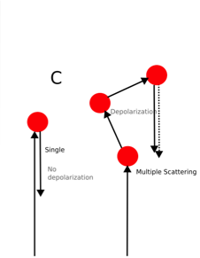
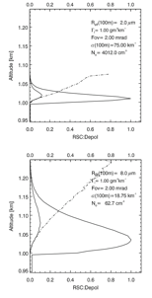
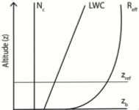
UV depol lidar cloud retrieval
Assume simple cloud model and make look-up tables using MC code.
Depol signal➔ multiple scattering is occurring
More Depol➔More MS➔Larger cloud particles
Donovan, et al., 2015
Simple cloud model:
N₀ : fixed
LWC : linear
Depol lidar
Observations
LUT profiles of
||, | and depol
as function
of LWC slope
and N₀ for
different cloud
base heights and
lidar FoVs
Lidar MC
model with
Polarisation
Optimal Estimation
Inversion, minimizing
LUT and obs. difference
Best estimate of
Number concentration
LWC lapse rate
in cloud base region
UV depol lidar on Ascension – M de Graaf ELC Thessaloniki 4 July 2018

Slide 4
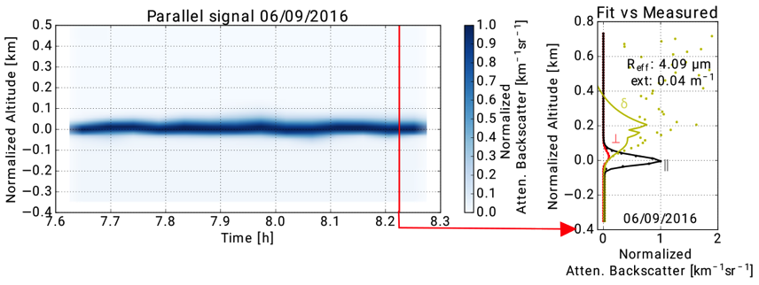
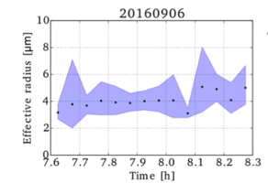
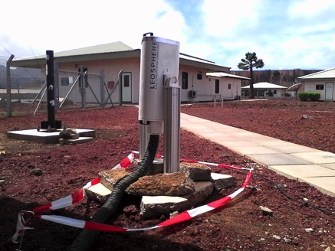
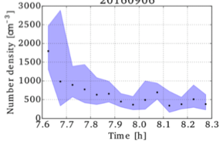
UV depol lidar on Ascension – M de Graaf ELC Thessaloniki 4 July 2018

Slide 5
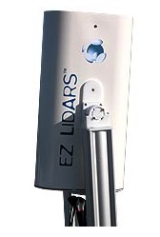
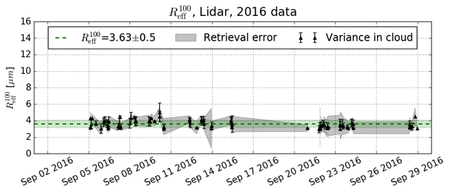
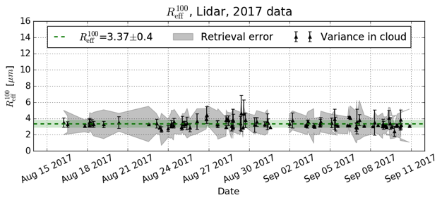
UV depol lidar cloud retrieval validation – Ascension Island
ASCII-1: 2-29 Sept 2016,
15 days with cloud retrievals
ASCII-2: 15 Aug-9 Sept 2017,
23 days with cloud retrievals
UV depol lidar on Ascension – M de Graaf ELC Thessaloniki 4 July 2018

Slide 6
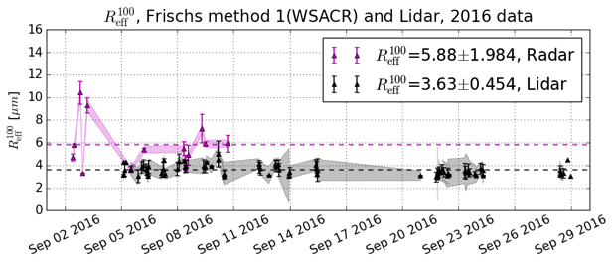
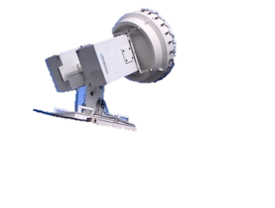
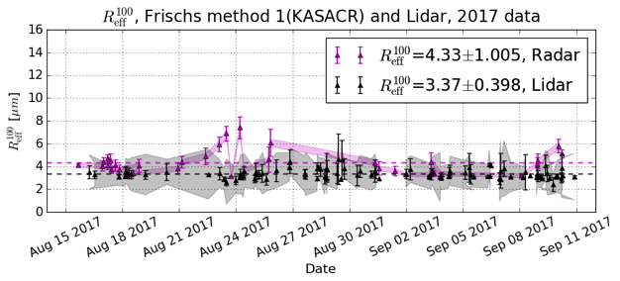
UV depol lidar cloud retrieval validation – Ascension Island
2016: W-band Radar
(9 days only),
N_{d} from UV-lidar
2017: K-band Radar,
N_{d} from UV-lidar
drizzle
UV depol lidar on Ascension – M de Graaf ELC Thessaloniki 4 July 2018

Slide 7
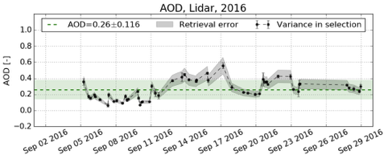
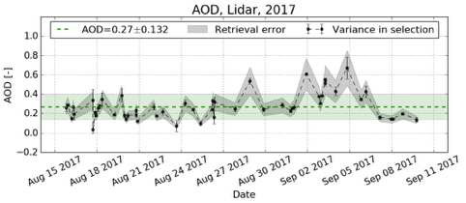
UV depol lidar AOT retrieval results – Ascension Island
UV depol lidar on Ascension – M de Graaf ELC Thessaloniki 4 July 2018

Slide 8
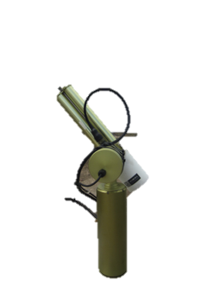
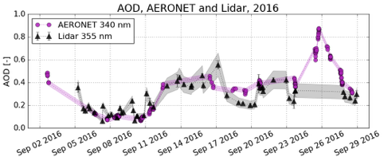
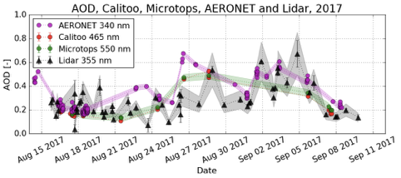
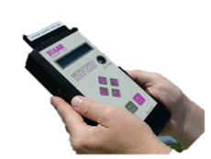
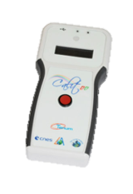
UV depol lidar AOT retrieval results – Ascension Island
AERONET
Sunphotometer
Microtops
AERONET
Calitoo

Slide 9
Aerosol profiles
Jonny Taylor
Measurements
Model

Slide 10
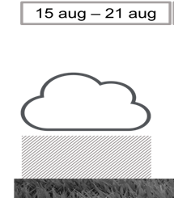
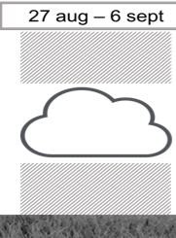
Jonny Taylor

Slide 11
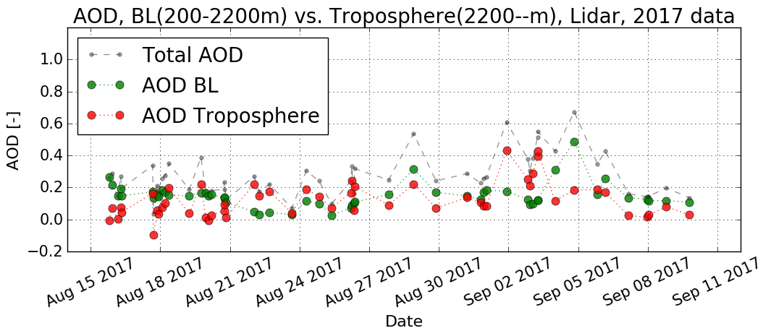
AOT measurements Ascension Island

Slide 12
Aerosol profiles
Jonny Taylor
Model

Slide 13
Aerosol profiles
Jonny Taylor
Model

Slide 14
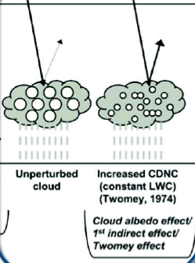
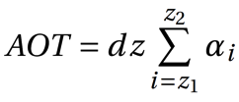
Aerosol-Cloud Interactions Ascension Island
Indirect Effect quantity
Twomey effect
A
R_{eff}
A
Cloud effective radius
Aerosol proxy
Aerosol proxy:
Aerosol optical thickness (AOT)
z Altitude
α Aerosol extinction coefficient
13
UV depol lidar on Ascension – M de Graaf ELC Thessaloniki 4 July 2018

Slide 15
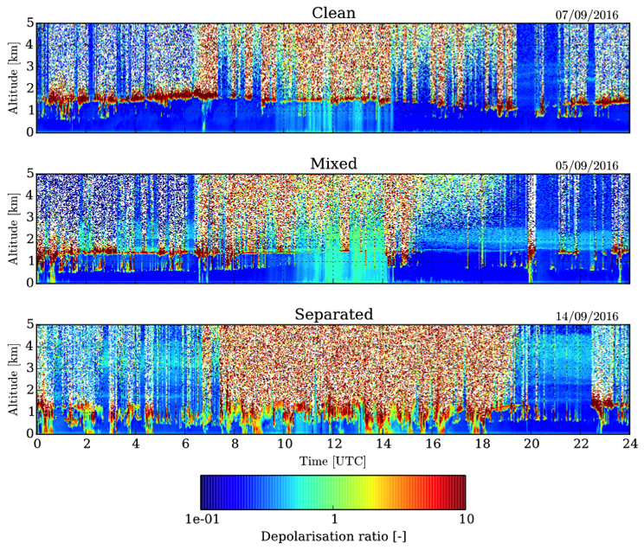
Aerosol-Cloud Interactions Ascension Island
Clean
07/09/2016
Cases
Mixed
22/09/2016
Separated
15/09/2016
UV depol lidar on Ascension – M de Graaf ELC Thessaloniki 4 July 2018

Slide 16
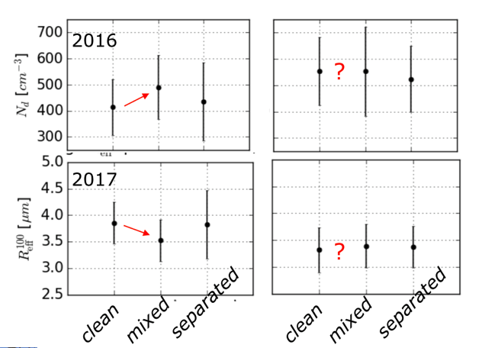
Aerosol-Cloud Interactions Ascension Island
Cases
Average total column AOT per day, if available
Average cloud parameters of all clouds, per day.
Clean
2017
Mixed
2016
2017
Separated
UV depol lidar on Ascension – M de Graaf ELC Thessaloniki 4 July 2018

Slide 17
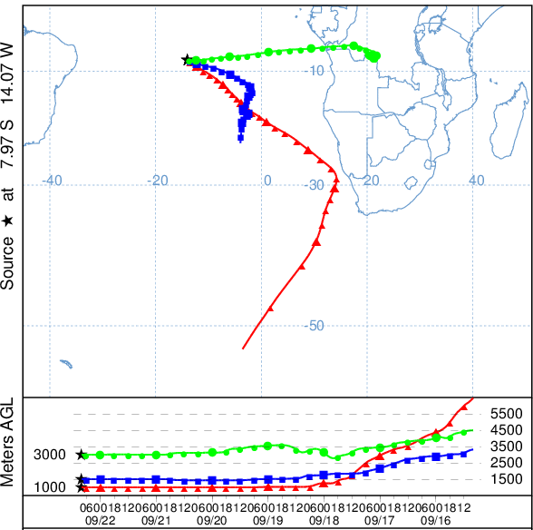
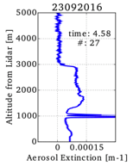
Ascension
Example of a ‘mixed’ case,
23 Sept. 2016.
Main flow direction in the boundary layer is from the south-east.
High altitude air from the continent.
7 day back-trajectories
Mixed
0 5
0 altitude [km] 5
12
UV depol lidar on Ascension – M de Graaf ELC Thessaloniki 4 July 2018

Slide 18
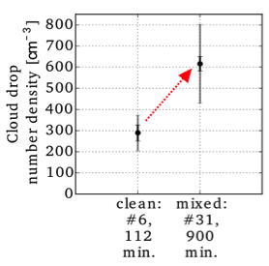
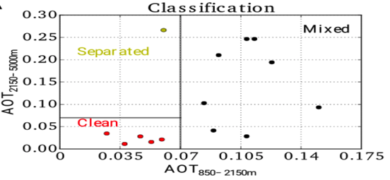
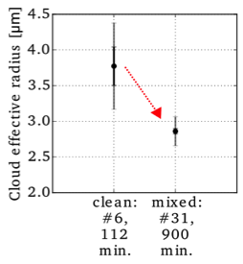
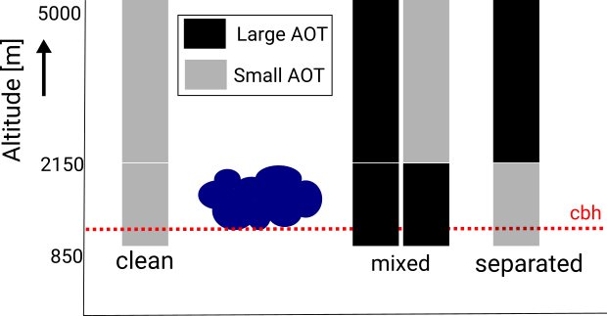
Aerosol-Cloud Interactions
Ascension Island
Case 1: Untangling smoke and marine aerosols, average all days
Classification per cloud period,
AOT clear-sky per day
Twomey Effect
cloud drop number density
cloud effective radius
Figures by Elma Tenner
13

Slide 19
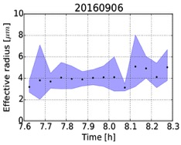
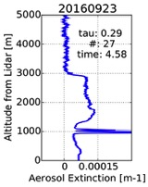
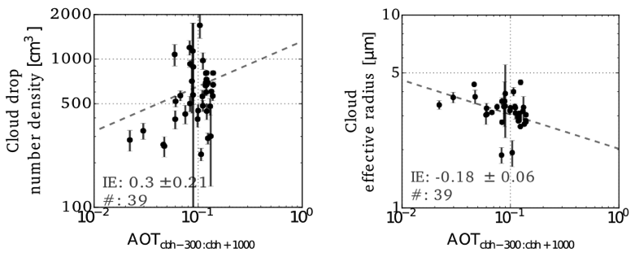
Aerosol-Cloud Interactions
Case2: at cloud level
Cloud properties: R_{eff} and ND
Mean values for each cloud part
Aerosol proxy
Daily profile clear sky:
AOT cloud level→ 300m below cloud
base till 1000m above cloud base
Lidar ratio: 50sr
14
UV depol lidar on Ascension – M de Graaf ELC Thessaloniki 4 July 2018

Slide 20
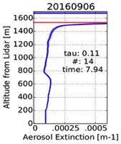
Aerosol-Cloud Interactions Ascension Island
Case 3: below cloud level Marine
Aerosols
Cloud properties: R_{eff} and ND
Values as retrieved →
time resolution 3 minutes
Aerosol proxy
AOT below clouds → 200m : cbh-300
(Exclude overlap and wet aerosols)
S_{below cloud}=50 sr, S_{cloud}=20 sr, corrected
for multiple scattering.
extinction-to-backscatter ratio S_{cloud} = (1-η)α/β
cbh
14
UV depol lidar on Ascension – M de Graaf ELC Thessaloniki 4 July 2018

Slide 21
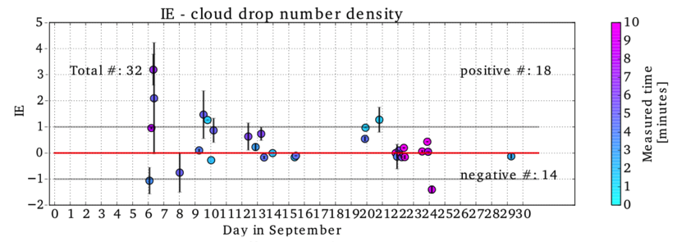
Aerosol-Cloud Interactions Ascension Island
Case 3: below cloud level Marine
Aerosols
Cloud properties: R_{eff} and ND
Values as retrieved →
time resolution 3 minutes
Aerosol proxy
AOT below clouds → 200m : cbh-300
(Exclude overlap and wet aerosols)
S_{below cloud}=50 sr, S_{cloud}=20 sr, corrected
for multiple scattering.
extinction-to-backscatter ratio S_{cloud} = (1-η)α/β
cbh
IE > 0 →Twomey effect
IE = 0 →No aerosol effect
IE < 0→No/Unclear aerosol effect
14
UV depol lidar on Ascension – M de Graaf ELC Thessaloniki 4 July 2018

Slide 22
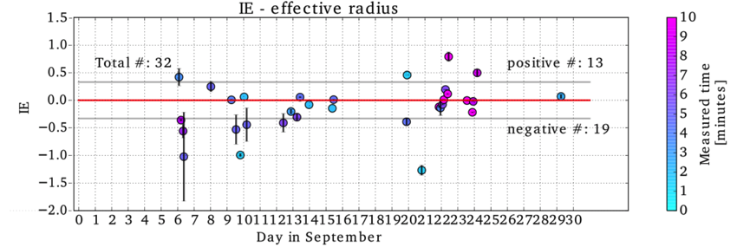
Aerosol-Cloud Interactions
Case 3: below cloud level Marine Aerosols
Figures by Elma Tenner
14
UV depol lidar on Ascension – M de Graaf ELC Thessaloniki 4 July 2018

Slide 23
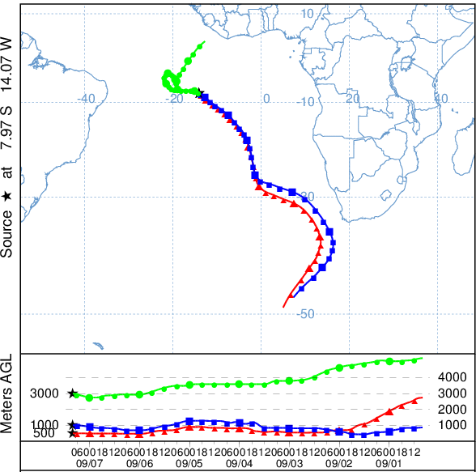
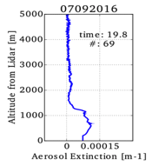
Ascension
Example of aerosol below clouds only,
7 Sept. 2016.
Main flow direction in the boundary layer is from the south-east.
7 day back-trajectories
Clean
0 altitude [km] 5
12
UV depol lidar on Ascension – M de Graaf ELC Thessaloniki 4 July 2018

Slide 24
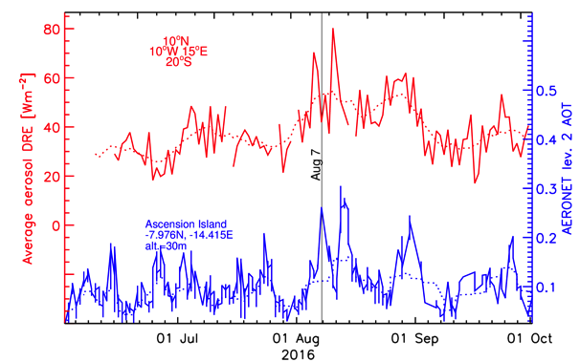
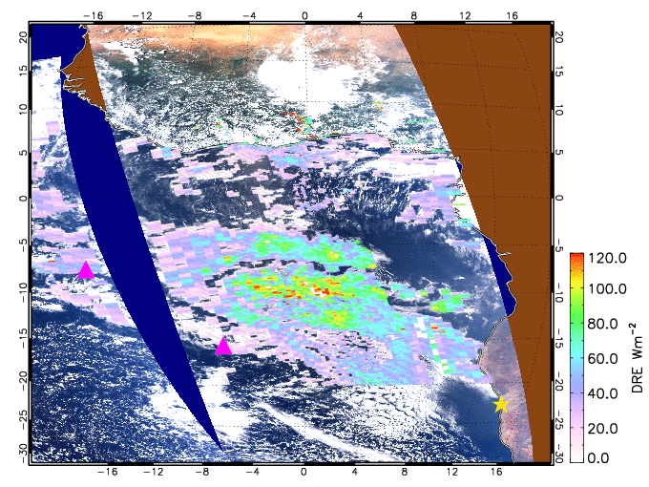
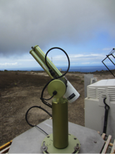
De Graaf, et al.
2018, in prep.
MODIS-OMI Aerosol
Direct Radiative Effect
AERONET station
Ascension Island
AOT
UV depol lidar on Ascension – M de Graaf
Notes:
However, we do now have 2016 data to use, and here ar etwo examples.

Slide 25
Conclusions
UV depol measurements from Ascension Island (Sept. 2016 and Aug-Sept. 2017) show clear aerosol – cloud interactions. Smoke in cloud layer reduces droplet size and increases number densities (IE)
Marine aerosols in BL show less clear IE.
Cloud parameter retrieval from UV depol lidar shows good correlation with radar.
AOT shows good correlation with AERONET, handheld sunphototmers and in-situ instruments.
UV depol lidar on Ascension – M de Graaf ELC Thessaloniki 4 July 2018

Slide 26
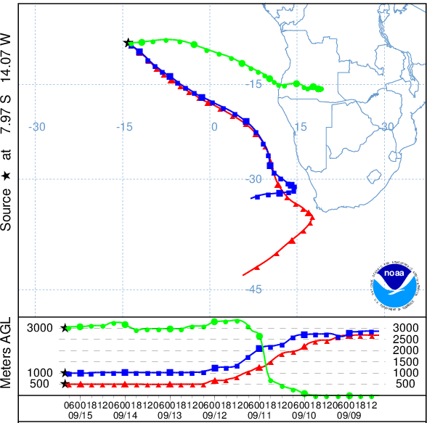
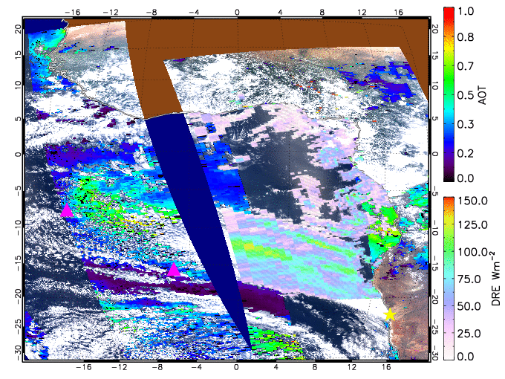
Ascension
Aerosol DRE over clouds and
Aerosol Optical Thickness
15 Sept. 2016
7 day back-trajectories
Ascension
UV lidar measurements on Ascension 15 Sept .
15
0
10
-1
Log₁₀ (depol)
Altitude [km]
-2
5
-3
Aerosols
0
Cloud base
0
15
20
5
10
Time [hrs UTC]
10
Notes:
This is a case of smoke being transported from the African continent to Ascension Island. You can see the DRE is rather high, due to absorption (only over clouds!). This absorption is assumed to be from aerosols. The 7 day back-trajectories confirm the transport of air masses from the continent to our lidar station on Ascension Island, 3500 km away. This air apparently departed the continent at about ground level, rising to over 3000 m and ending up over Ascension at 3000 km. The air layers arriving at 500 and 1000 m are from the south-east direction, which is the dominant wind direction of the boundary layer in this region.
Our lidar confirms the different layers at 1000 m and 3-4 km. The different colors indicate the depolarisation of the returned lidar signal, which gives information about the particles that were responsible for the backscatter, in this case we see a cloud base at 500-1000m, and smoke at 3-4 km.

