Slide 1
CLARIFY-2017 Radiation Measurements and Aerosol Optical Properties: Preliminary Findings
Anthony Jones, Jim Haywood, Alan Vance, Claire Ryder, Fanny Peers
E: a.jones3@exeter.ac.uk; anthony.jones@metoffice.gov.uk
NERC research grant: NE/L013797/1

Slide 2
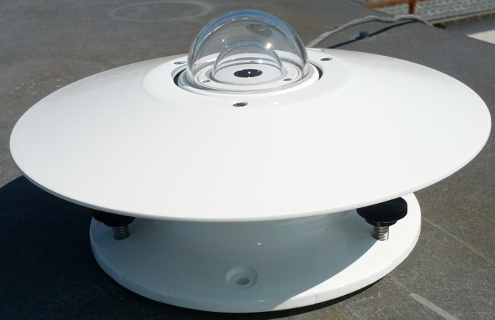
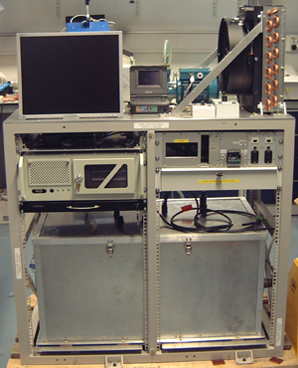
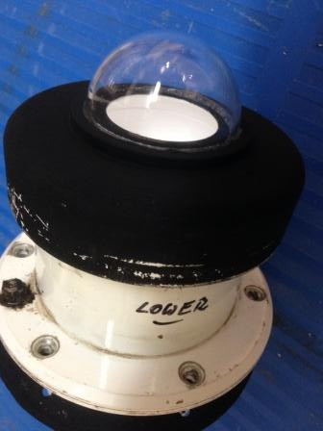
Instruments
Clear and red dome thermopile pyranometers or broad-band radiometers (BBRs)
0.3-3 μm (clear dome) and 0.7-3 μm (red dome) – measure Wm⁻²
Measures radiation by change to instrument temperature (thermoelectric effect)
SLR runs only
BBRs
Shortwave Hemispherical Integrating Measurement System (SHIMS)
2 temperature controlled Zeiss spectrometer modules (visible/ near-infrared) and an in-house designed integrating head – interior rack is primarily for cooling
Measures Wm⁻²μm⁻¹ from 0.3-0.95 μm for visible module and 0.95-1.7 μm for near-infrared module in 0.0033 μm increments
SWS-SHIMS

Slide 3
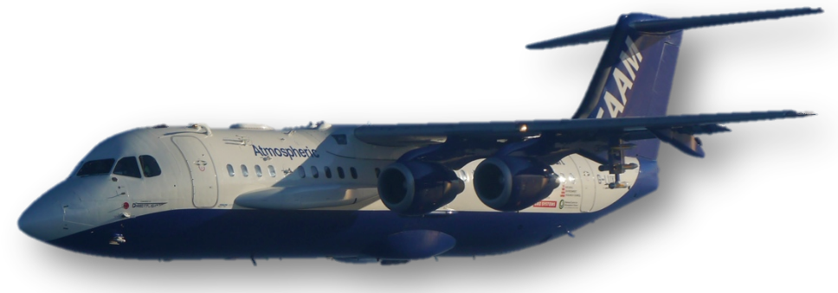
Pitch and roll calibration – both instruments
Pitch and roll corrections should be applied to data from the upper BBRs and SHIMS to account for direct sunlight deviations with aircraft attitude
This requires deriving baseline pitch (P) and roll (R) coefficients
Both instruments are approximately mounted at ~3º to the aircraft and the aircraft flies with pitch ~ 6º
We derive coefficients P and R from box patterns and pirouettes in clear-sky conditions
~3º
~6º
One input receiver for SHIMS so only one P & R needed
Two inputs for BBRs so we need separate P & R for each dome
Uncorrected flux
Corrected flux
Instrument dependent cosine correction
Ratio of direct to total sunlight

Slide 4
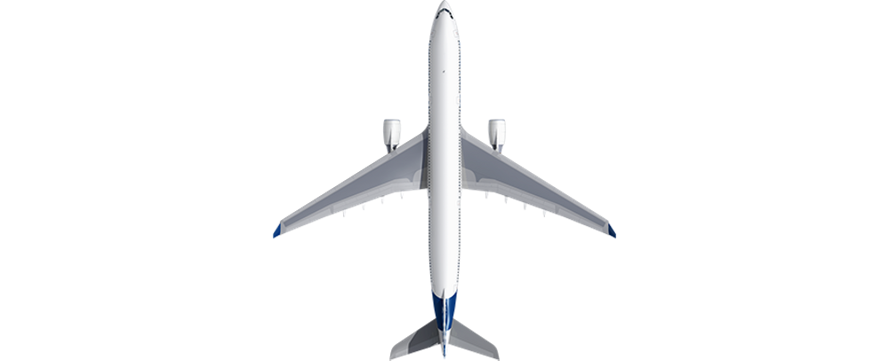
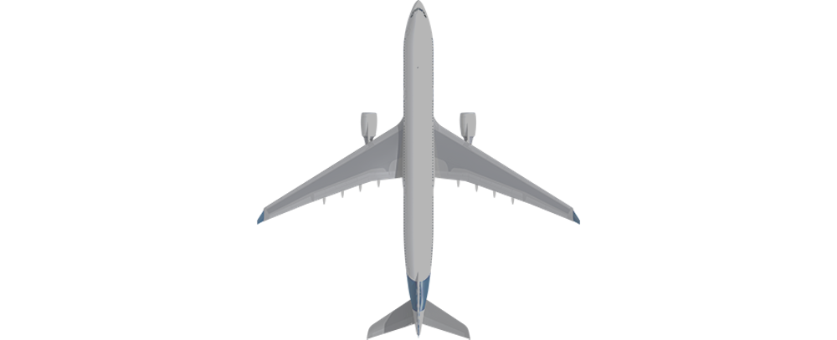
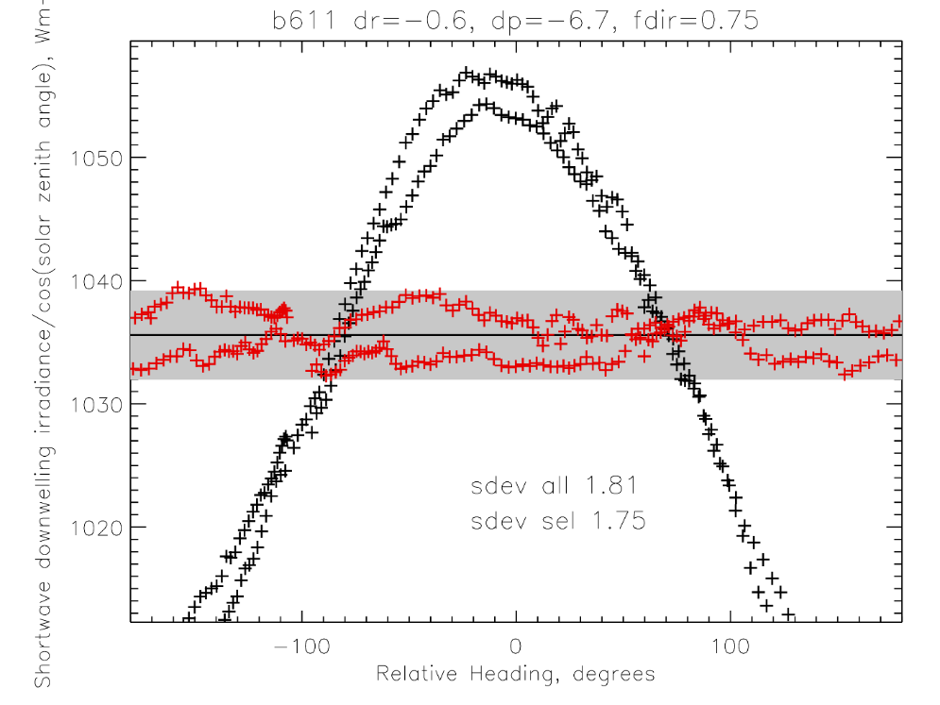
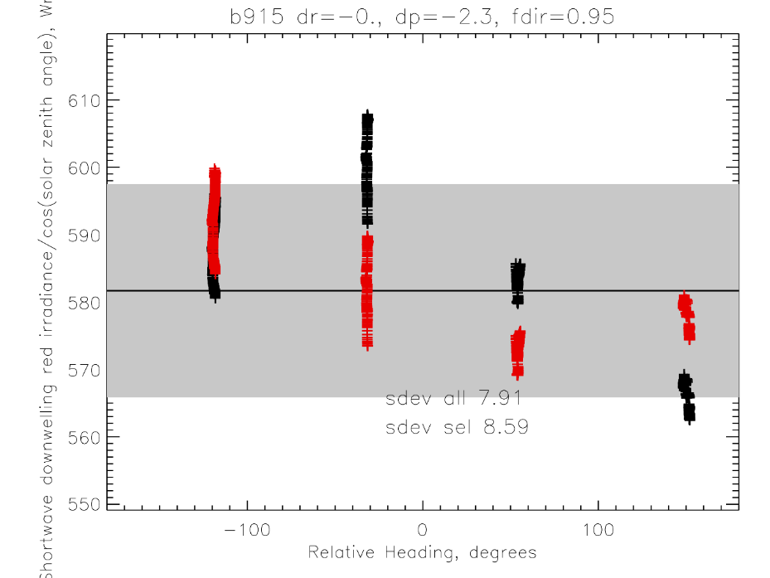
Pitch and roll manoeuvres
Credit: Clare Ryder
FENNEC/ICE-D campaign
Pirouette (at surface)
Box pattern (n > 3 legs at high altitude)
Cosine like response
(black uncorrected)
Pitch and roll removes solar zenith angle dependency
Radiation measurements

Slide 5
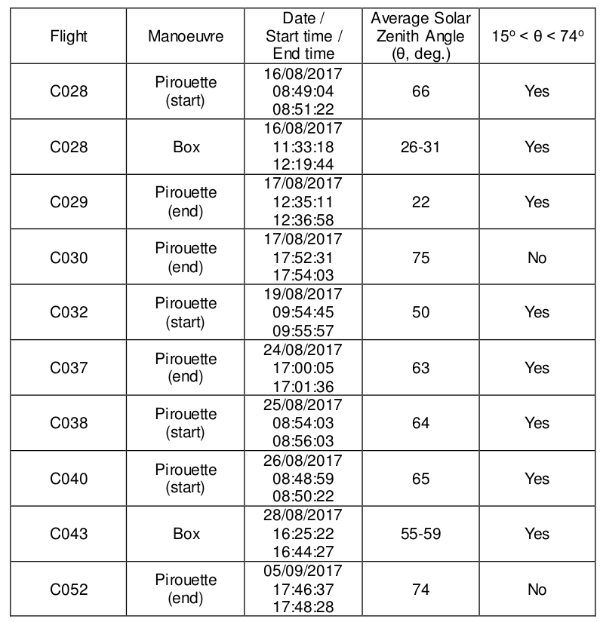
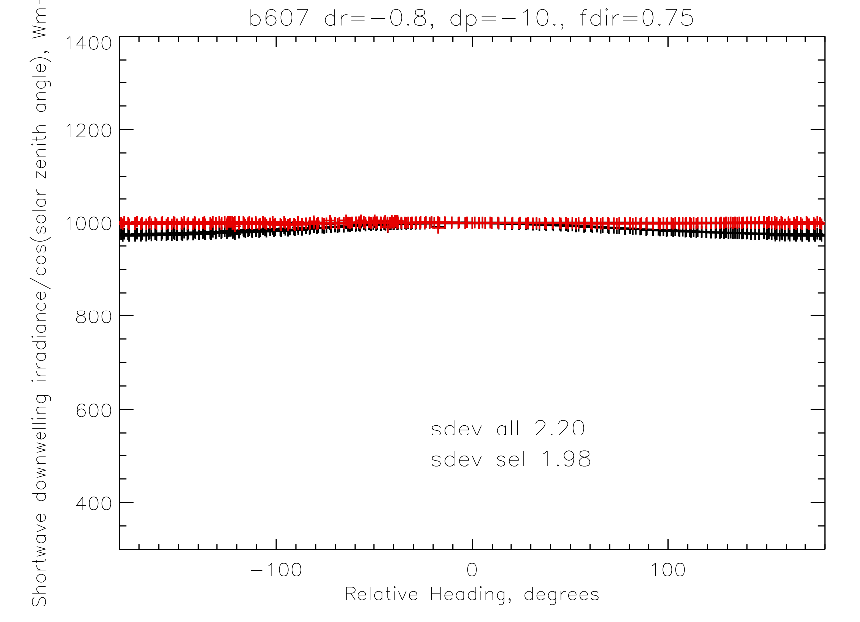
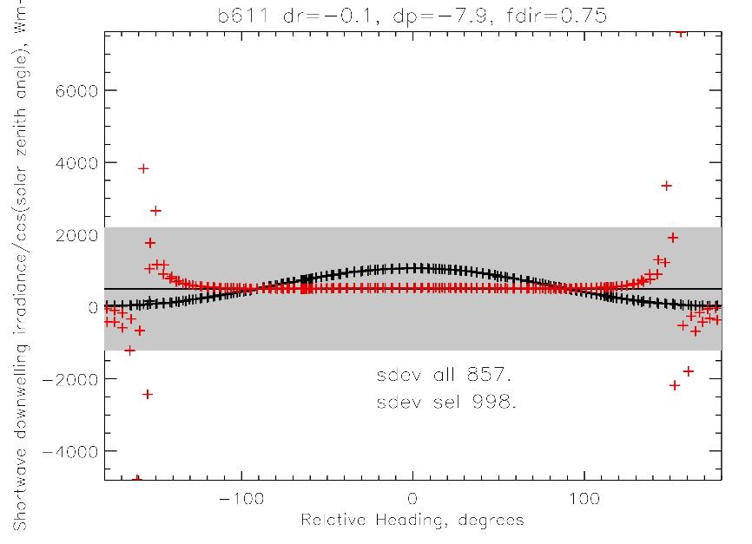
CLARIFY pitch and roll manoeuvre details
If the sun is too high or too low then the radiation may be insensitive to aircraft dimension or affected by tail shadowing
Θ thresholds are from FENNEC-2011 and ICE-D campaigns
Sun too high
Sun too low

Slide 6
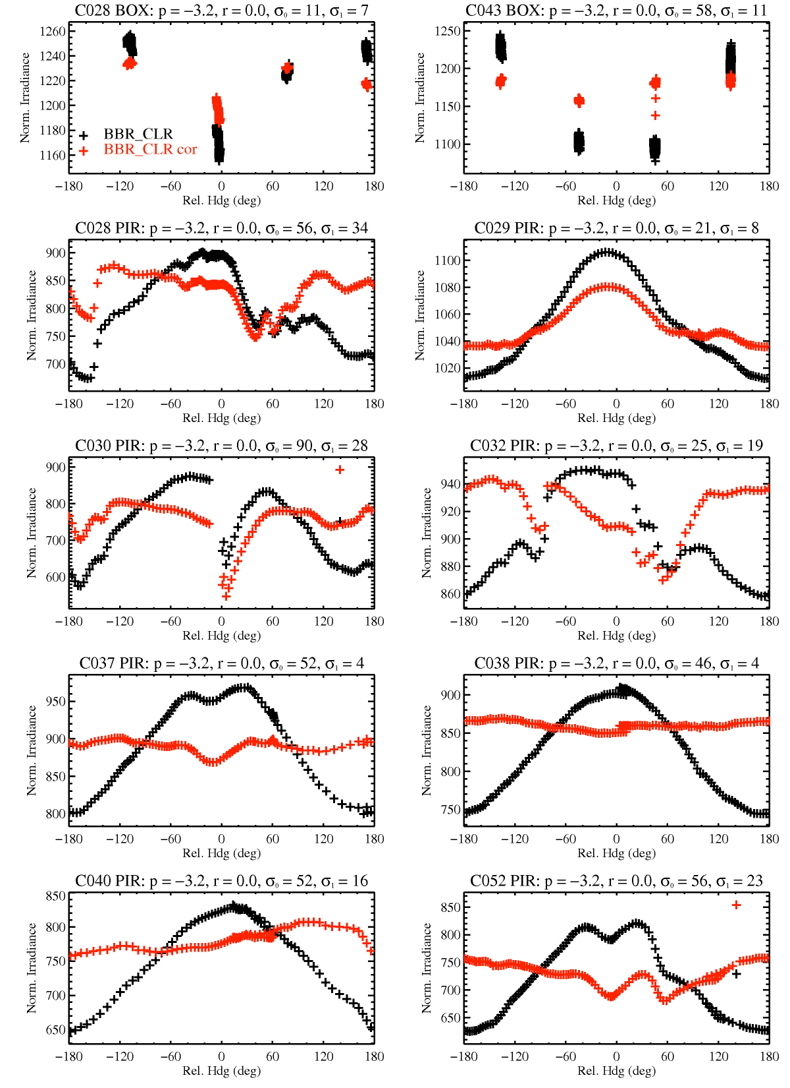
BBR Clear Dome
Optimal pitch and roll of P=-3.2º and R=0º are similar to previous campaigns
C029 performed at low solar zenith angle perhaps explaining low sensitivity to P&R
C037 and C052, pirouettes performed at the end of the flight, show evidence of “dirty dip” at low relative headings – aerosol deposited on dome?
“Dirty dip” also in C028 BOX
Unphysical responses
Cloud contamination?
Important: Use most recent FAAM core data from CEDA – problematic r0 data had a 20s time delay
NOTE: FAAM perform their own corrections (P=-2.8º and R=+0.3º) which needs to be reversed before optimization

Slide 7
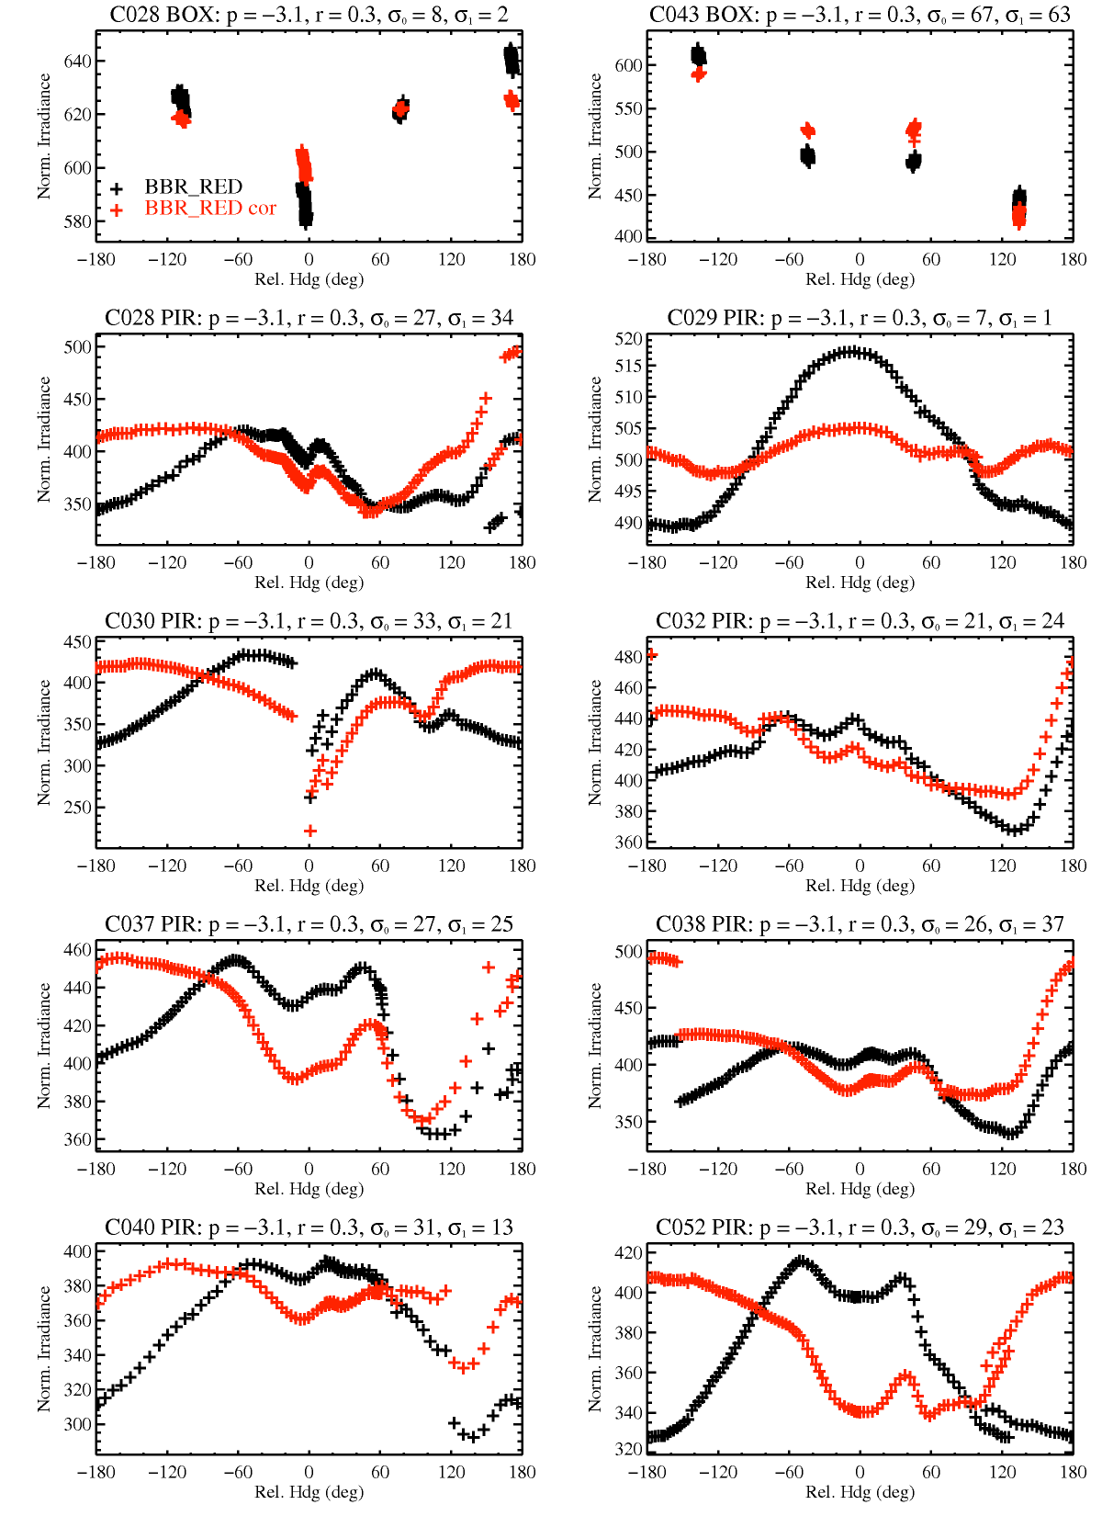
BBR Red Dome
Optimal pitch and roll of P=-3.1º and R=+0.3º are similar to previous campaigns
Oh dear, oh dear! Only 3 “good” manoeuvres – issue seems to be more than cloud contamination
NOTE: FAAM perform their own corrections (P=-3.2º and R=-0.1º) which needs to be reversed before optimization
Evidence of dirty dip here also

Slide 8
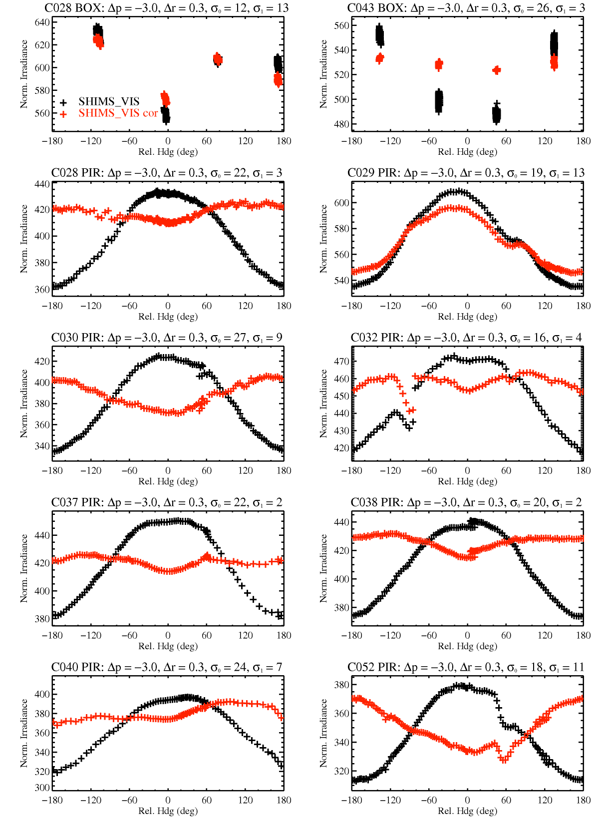
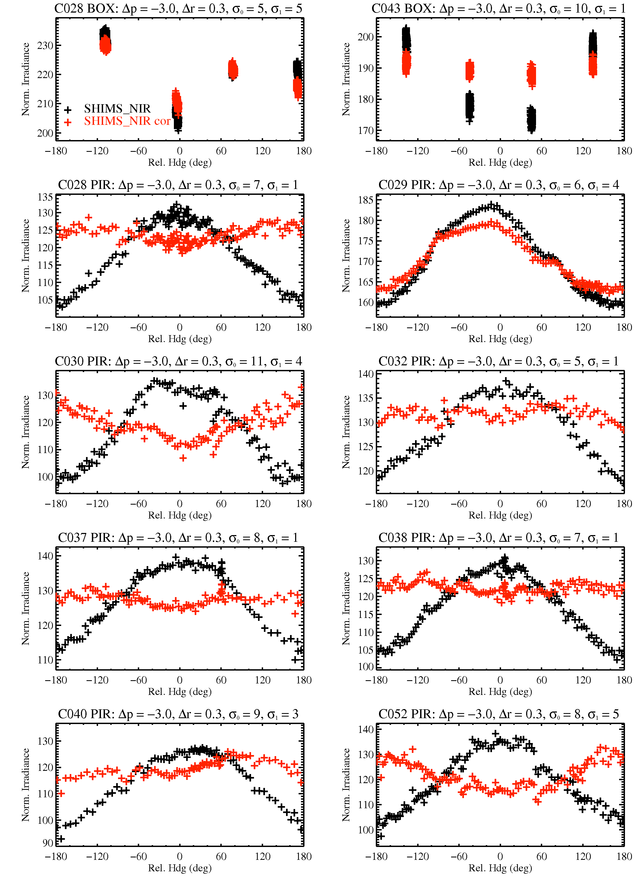
SHIMS
VISIBLE
NEAR-INFRARED
Optimal pitch and roll of P=-3.0º and R=+0.3º are similar to previous campaigns
The correction is acceptable for most of the manoeuvres
NOTE: FAAM does not perform their own corrections for SHIMS

Slide 9
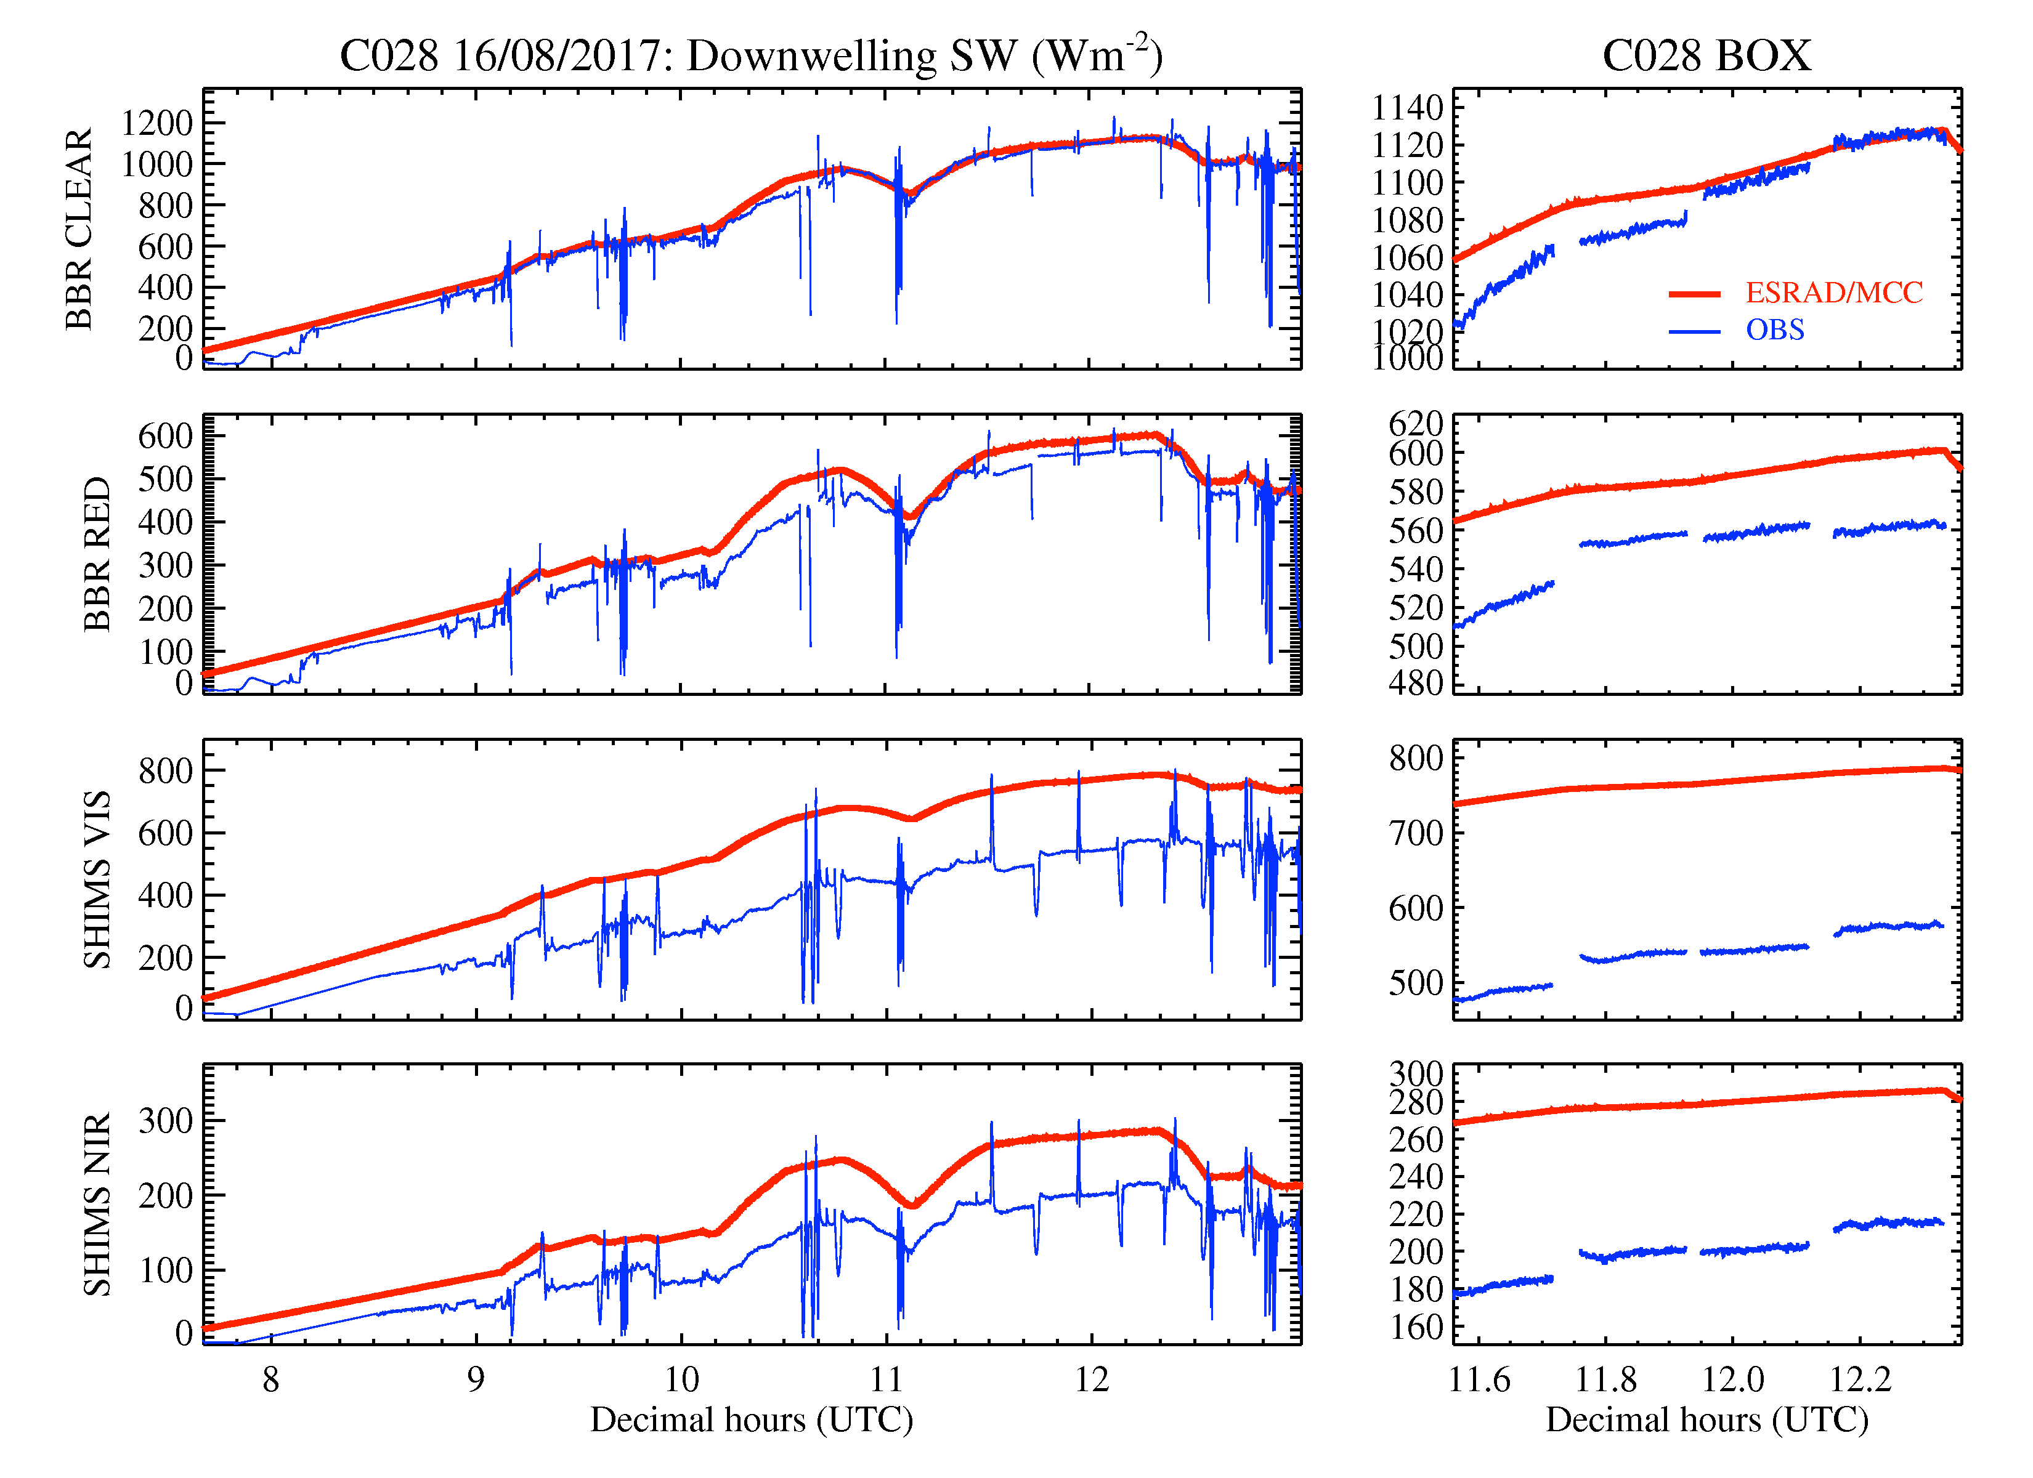
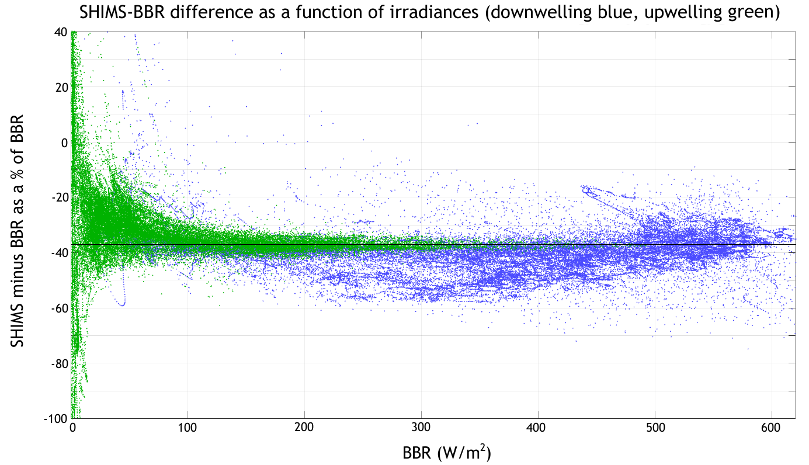
Correcting SHIMS irradiances to BBRs
Issue not seen in previous campaigns – SHIMS (upper and lower) irradiances are ~30 % less than BBRs and radiation code
Additionally BBR red measurements are ~10 % lower than predicted by radiation code
We correct SHIMS to BBRs using a campaign-constant multiplication factor of 1.43 (i.e. 1/(1-30%))

Slide 10
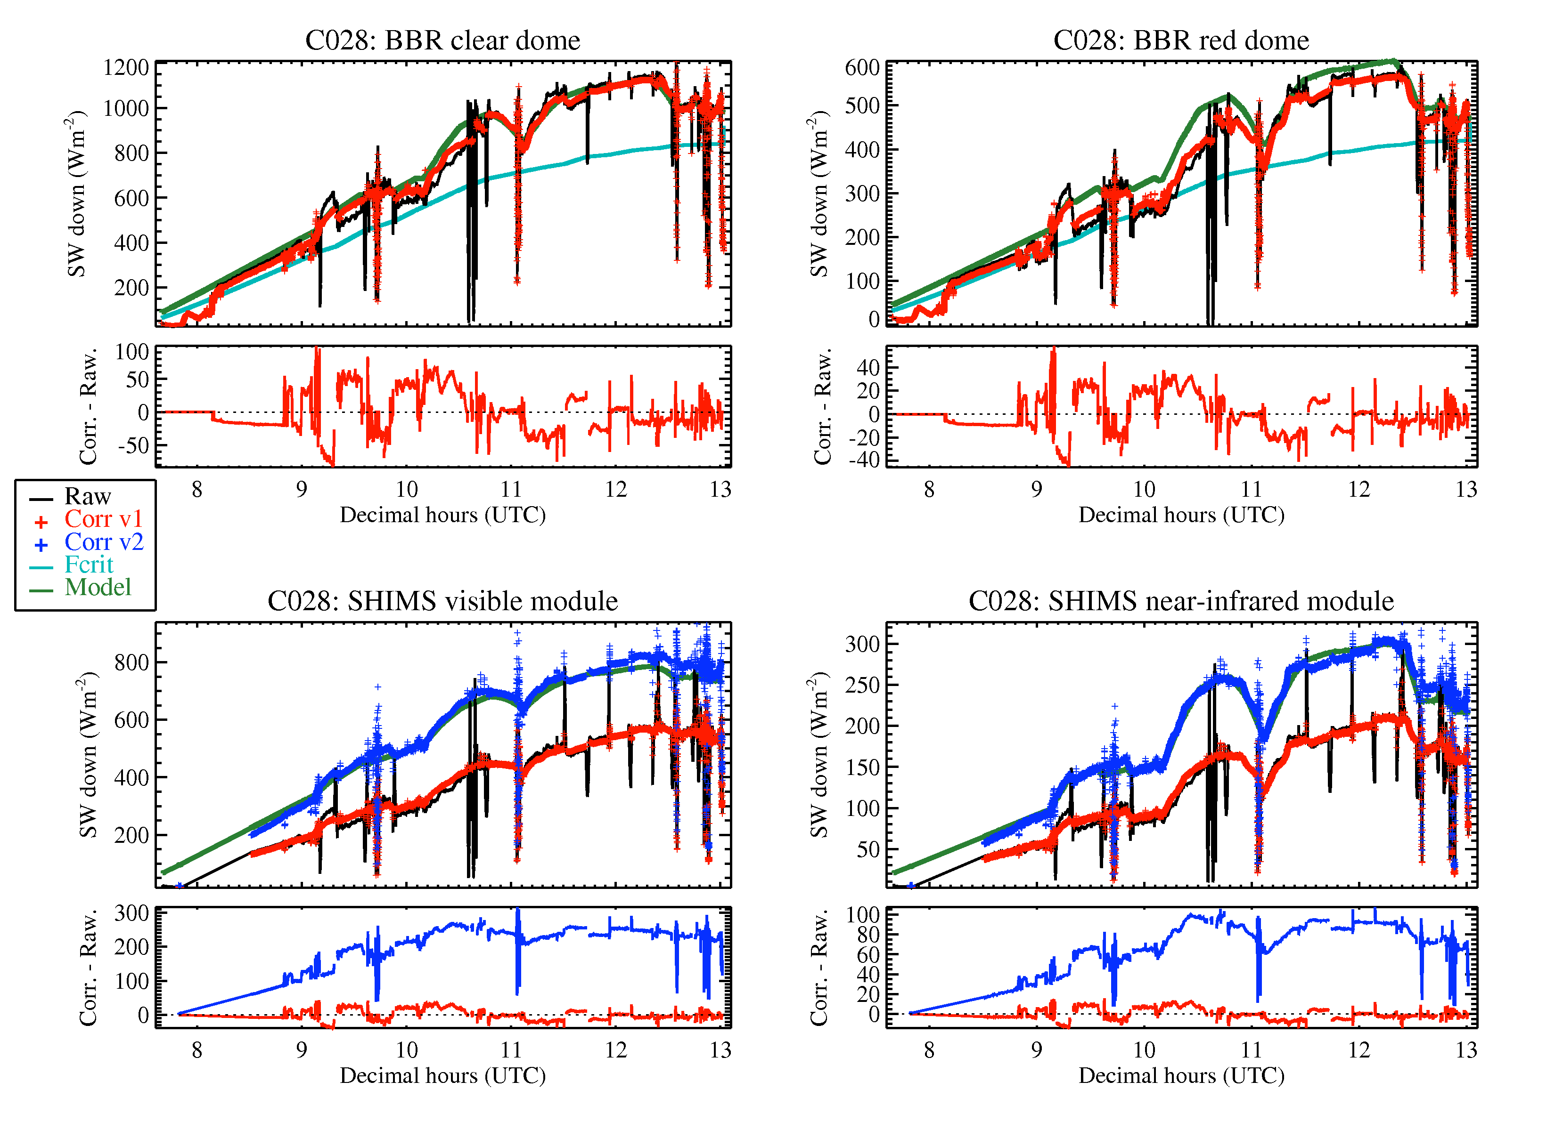
Example: C028
Upper
Instruments
Model: SOCRATES
With standard 1 km tropical atmosphere and assuming clear-sky conditions
Measurements are rejected if roll from GIN is > 7º and only P&R corrected if above a critical value
Corrected data matches model closely, except for BBR red which underestimates by 10 %

Slide 11
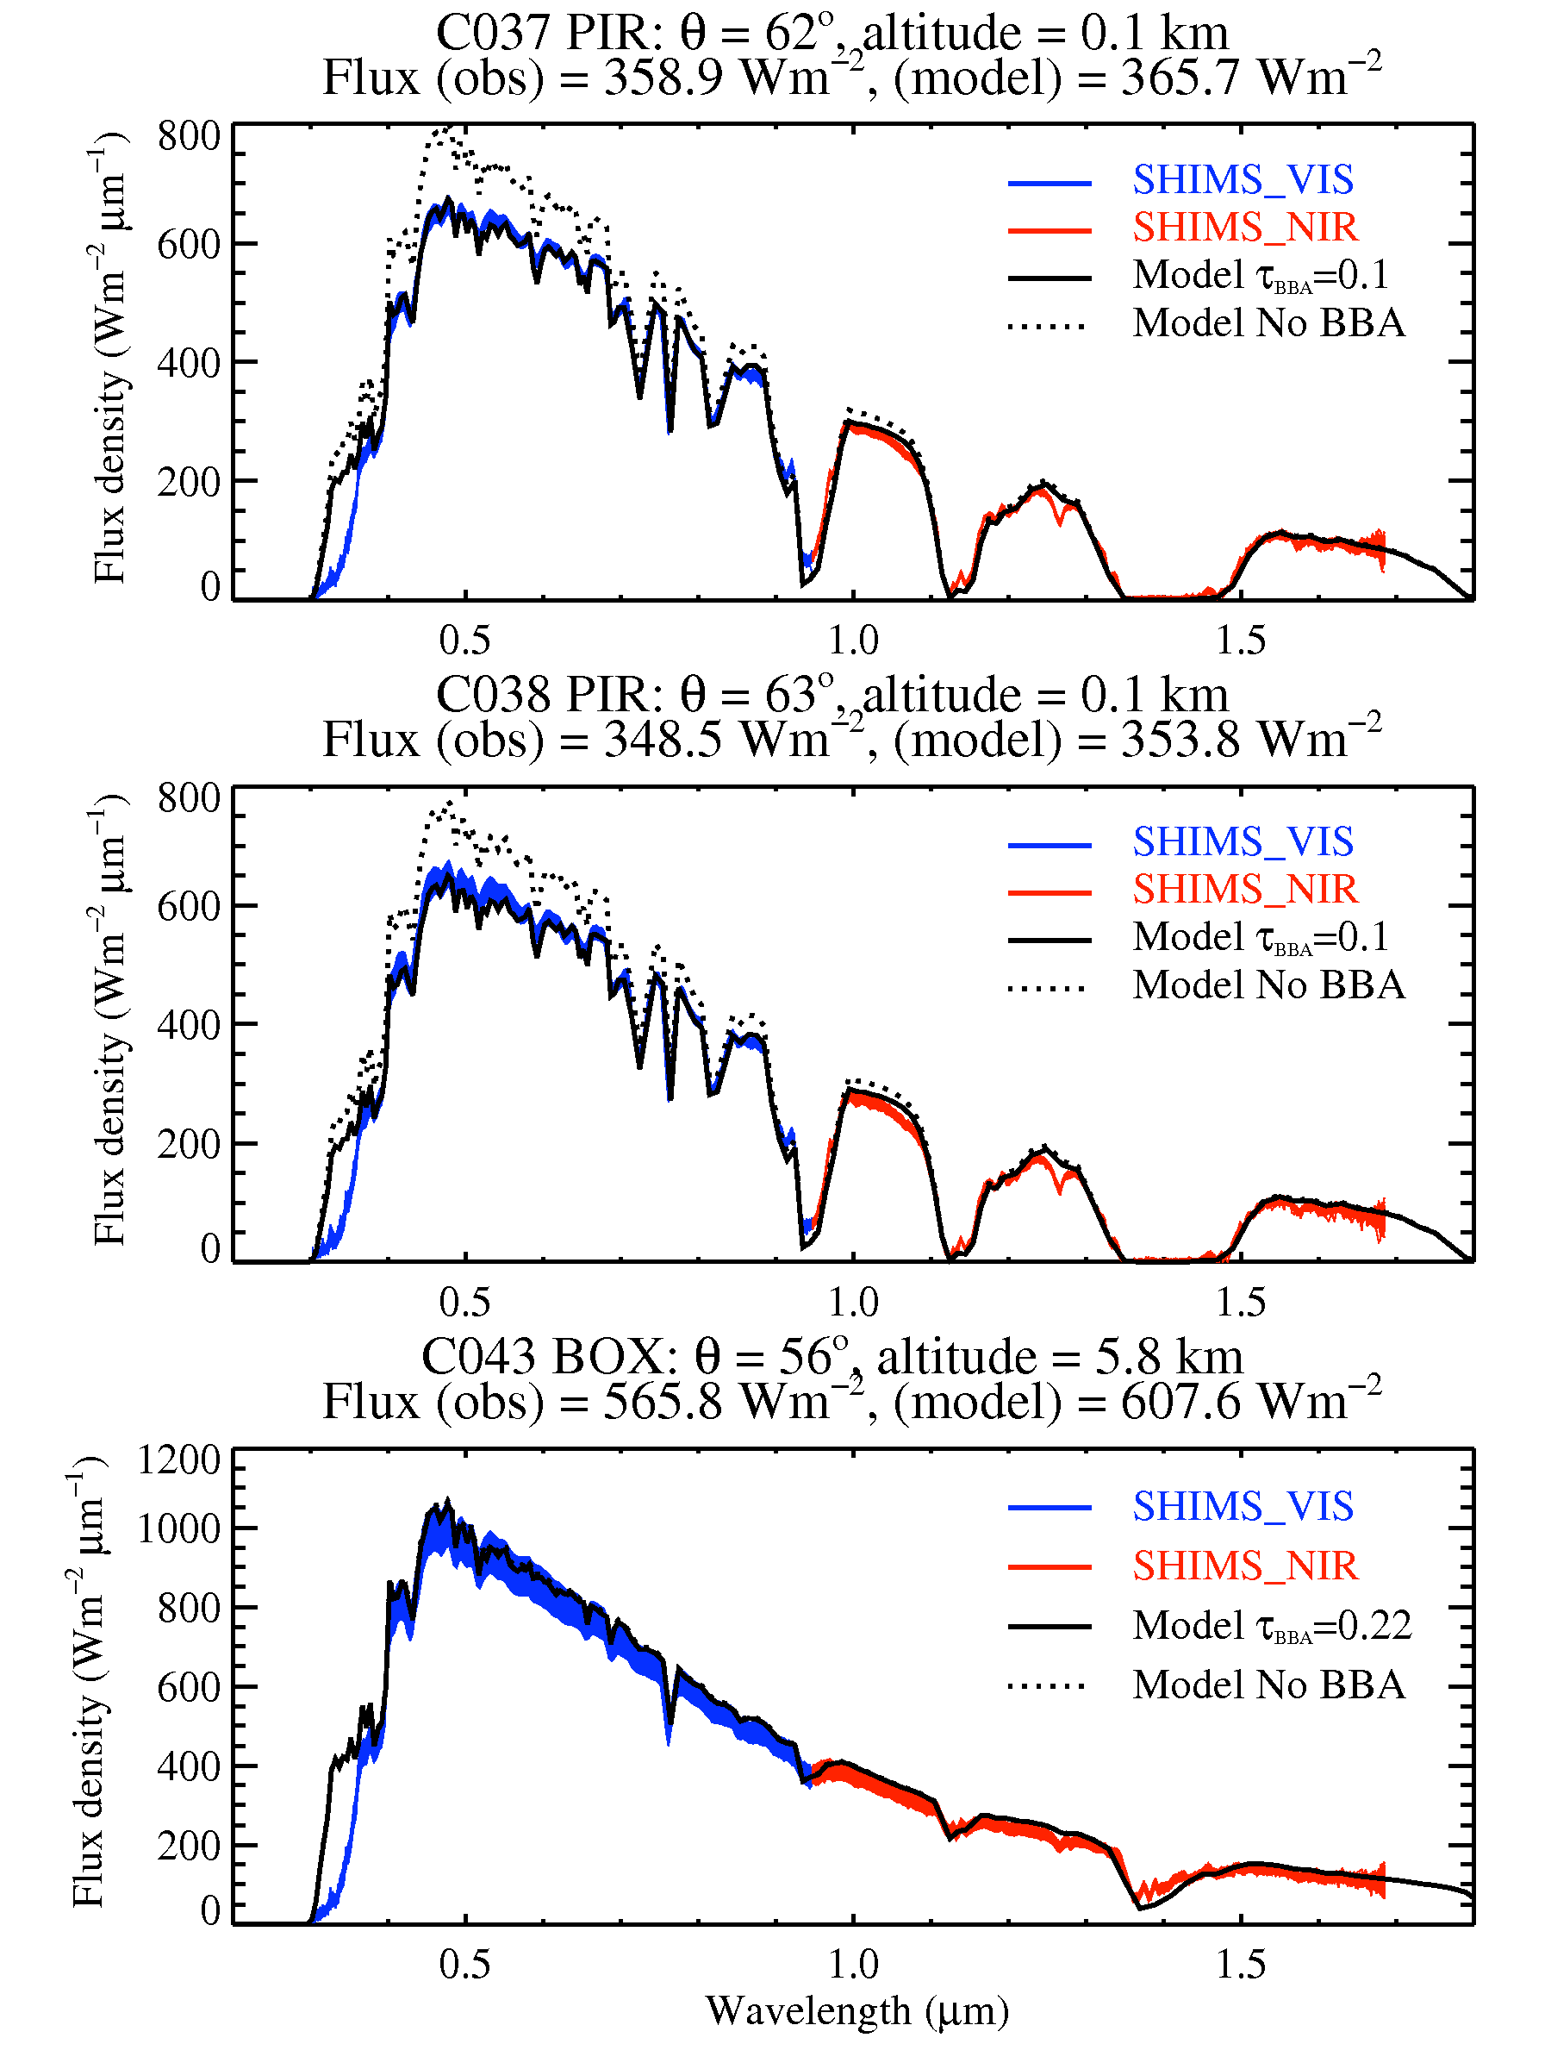
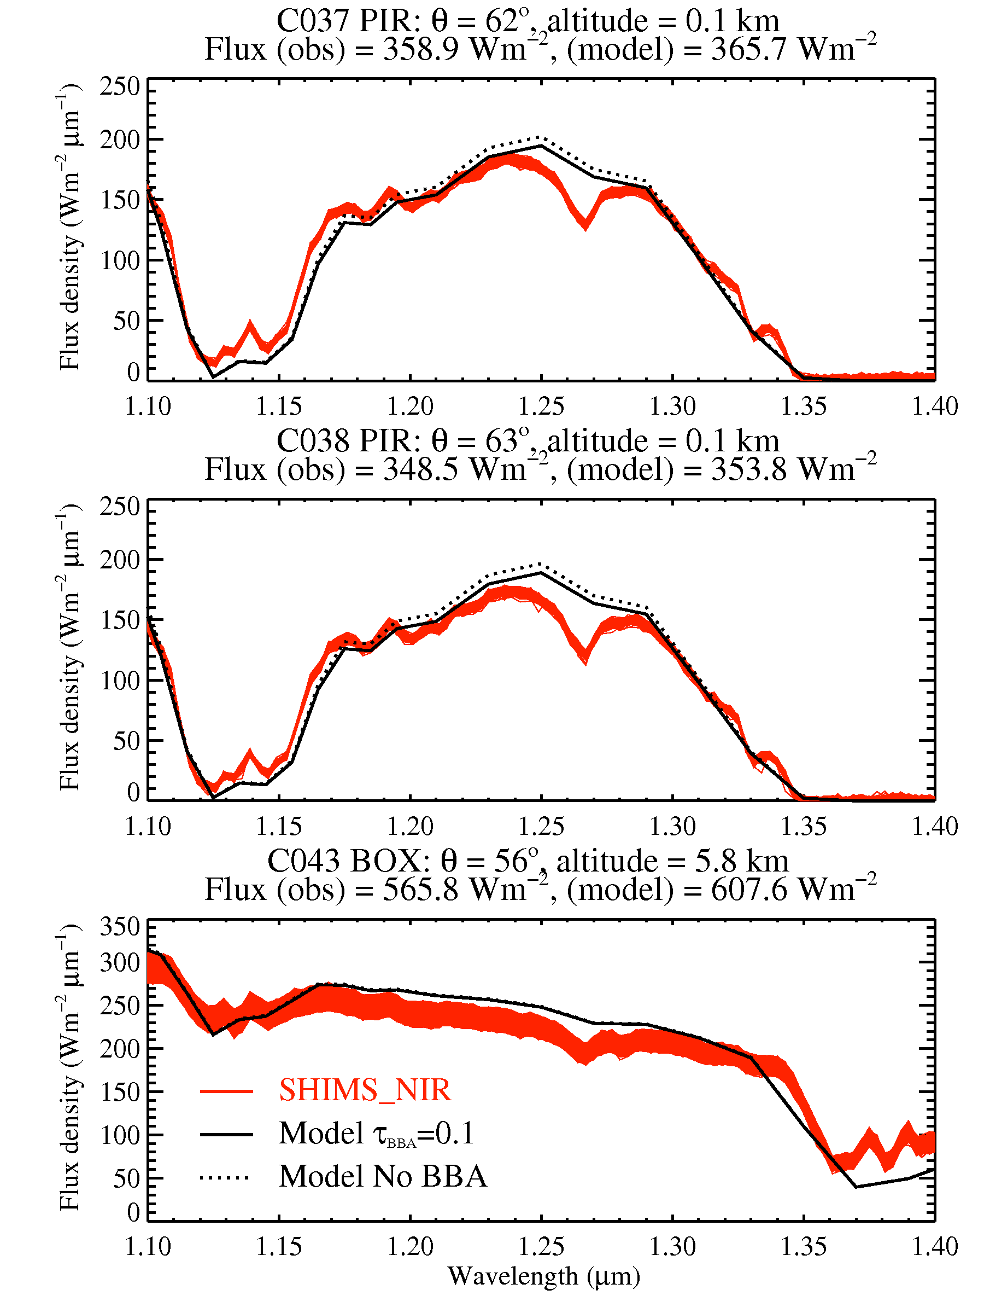
SHIMS spectra
We correct SHIMS to the BBRs (using SHIMS vis + SHIMS nir + ε = BBR clear) using a spectrally invariant factor (1.43)
Clear-sky spectra from successful P&R manoeuvres compare well with modelled spectra
There is a large difference in the UV spectrum (< 0.3 μm) suggesting an issue with SHIMS at extrema
Including a biomass aerosol layer in the model (τ=0.1) increases fidelity with obs
Curious mismatch between observations and model at 1.27μm is due to lack of O₂ continuum absorption in model – Keith Shine

Slide 12
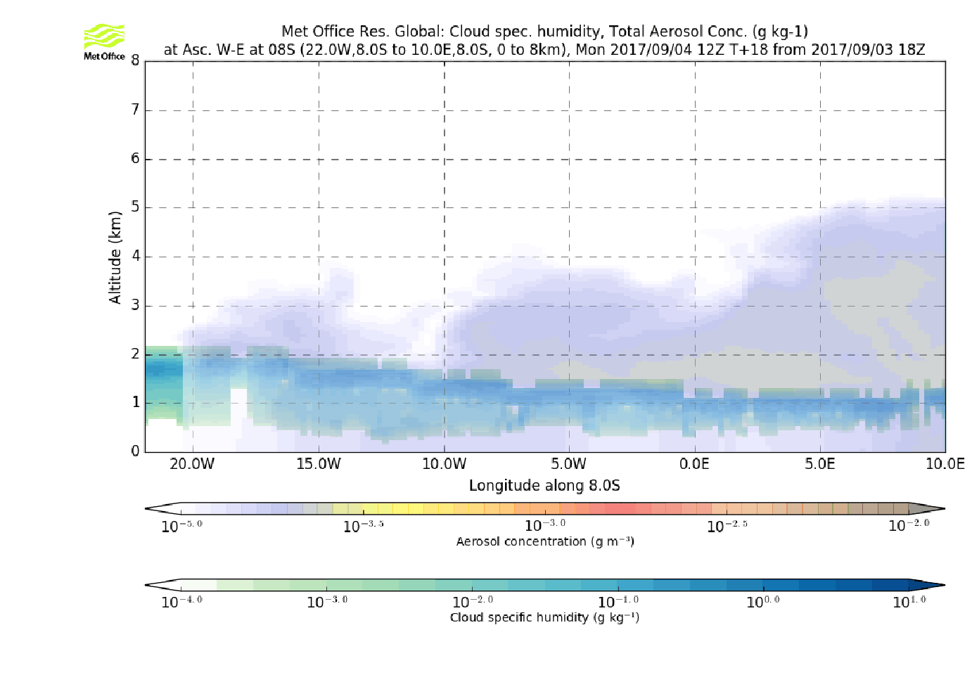
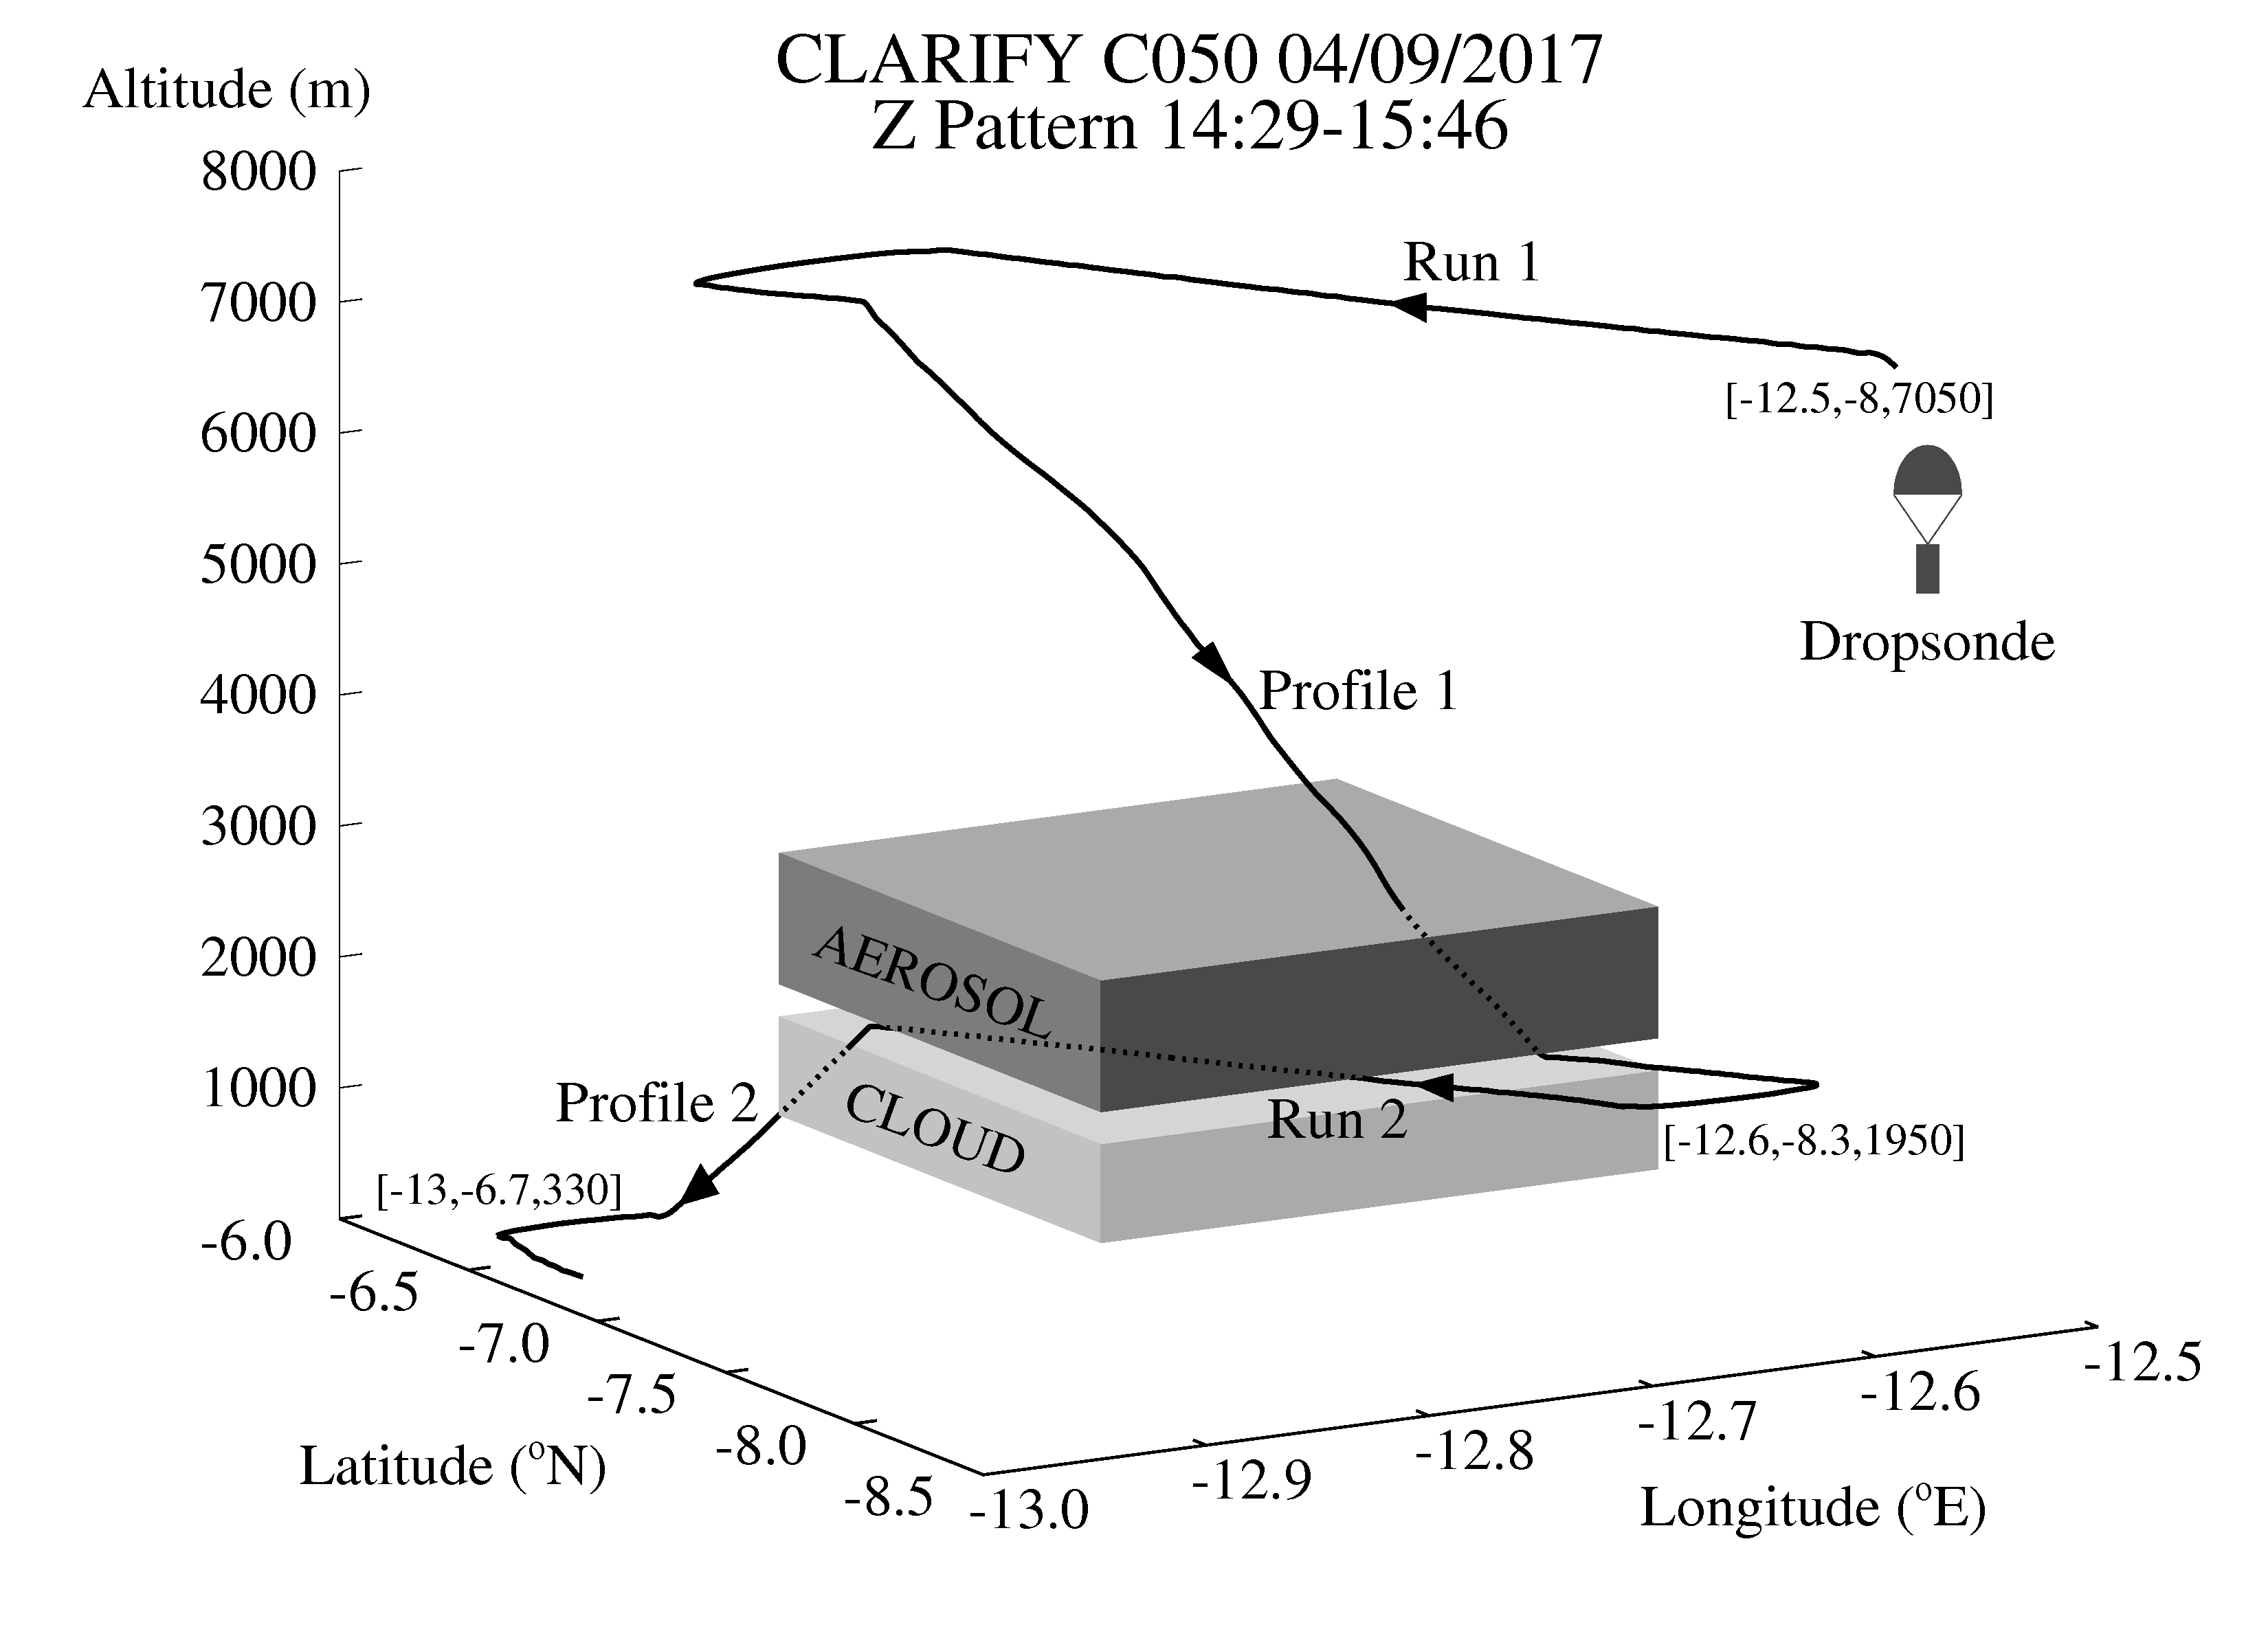
Radiative closure experiment: CLARIFY Flight C050
Biomass aerosol above and within Sc cloud
- Mostly above though …

Slide 13
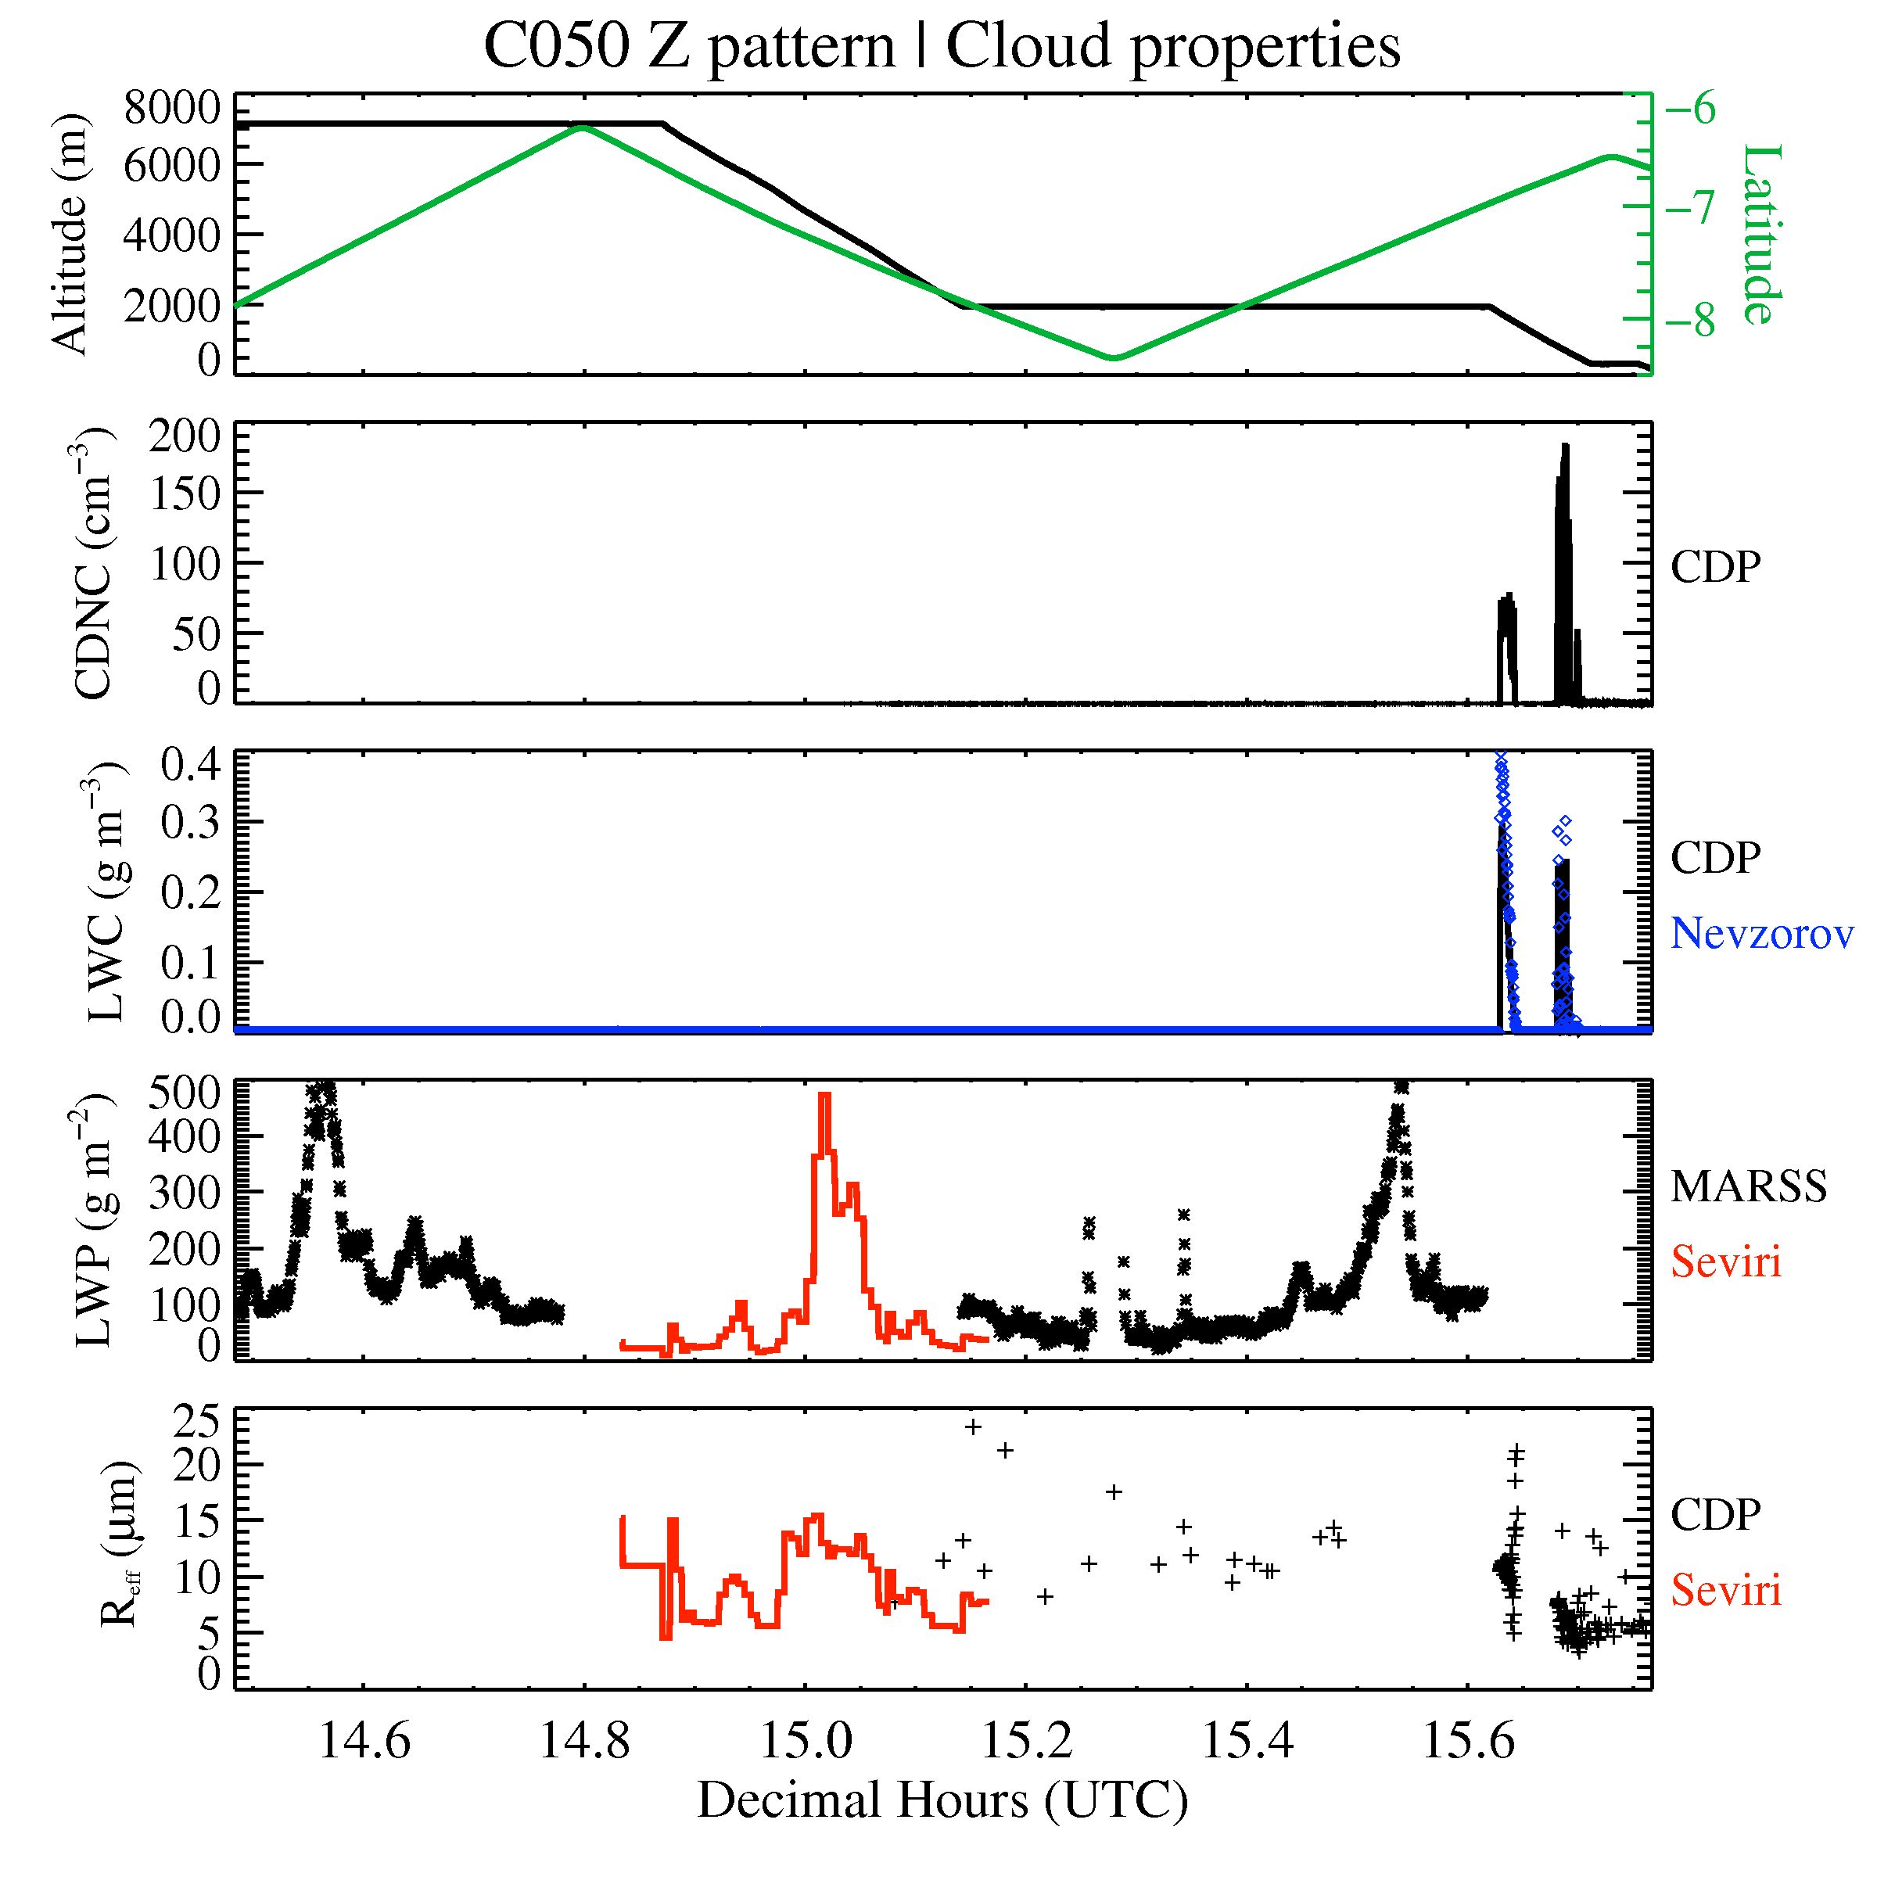
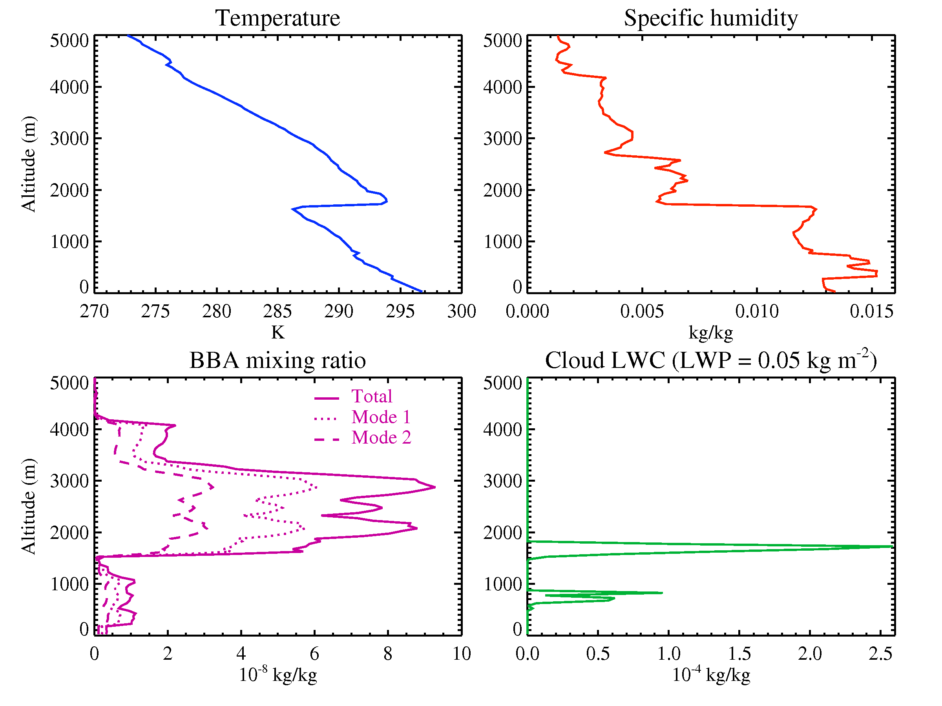
Radiative closure experiment: CLARIFY Flight C050
Model (single column): temperature, pressure and specific humidity profiles from dropsonde
Cloud properties from MARSS, CDP and Nevzorov sensors on- board
Biomass aerosol (BBA) mixing ratios from EXSCALABAR for 2 size modes and refractive index at 0.55 μm of m = 1.51 – 0.029i
Aerosol hygroscopic growth included
 | Mode 1 | Mode 2
r_{m} | 0.11893 | 0.61705
σ | 1.416 | 2.226
N | 0.999631 | 0.000369
BBA between 1.5-4 km
Cloud at 1.8 km
Credit: Fanny Peers for profiles

Slide 14
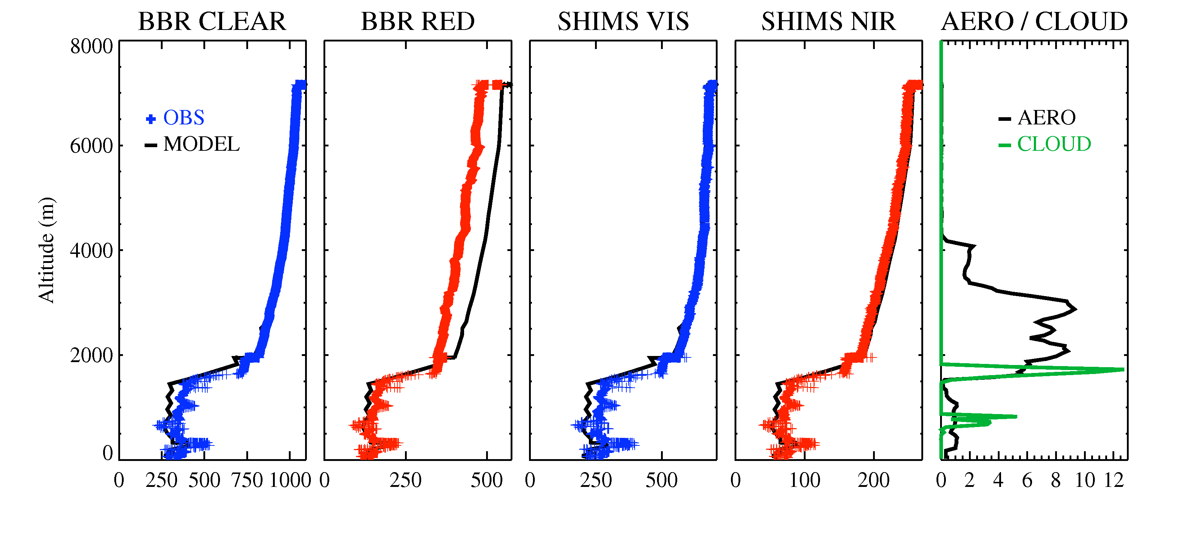
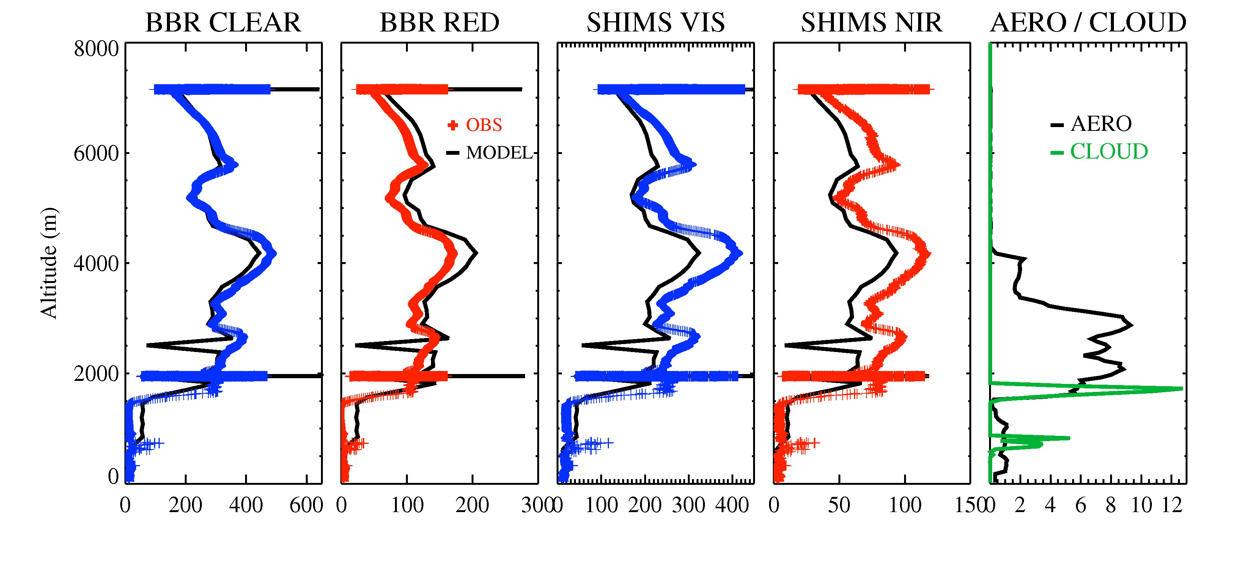
Radiative closure experiment C050: Results
Model compares well with the observations
The biggest disparity is with the BBR red dome as found during calibration phase
The upwelling flux patterns correlate with cloud LWP
To do: what effect does the aerosol layer have on outgoing radiation / heating rates?
Downwelling SW flux:
Upwelling SW flux:

Slide 15
Summary
SHIMS and BBR radiation data for CLARIFY is available – email a.jones3@exeter.ac.uk for specific flights. SHIMS has been corrected to BBRs pending a re-calibration. See OBR technical report 91 for more details
SHIMS spectra compares well with ORACLES P3 data and radiation code – interesting disparity at 1.27 μm due to lack of O₂ continuum absorption in model - to be corrected for GA8
Preliminary radiative closure experiment: upwelling/downwelling radiative fluxes are similar to BBR/SHIMS observations. Next step is to investigate aerosol heating rates and TOA radiative forcing
THANKS!

