Slide 1
Using Ground Based and in Situ Airborne Observations Collected during the CLARIFY 2017 and LASIC Field Campaigns to Explore Synoptic, Dynamical and Aerosol Constraints on Precipitation.
Paul Barrett (Met Office)
Steven Abel (Met Office), Jim Haywood (University of Exeter)
Reed Hall, Exeter, 2018
Notes:
Hugely experienced team in aircraft deployment and maximising the pull-through to modelling

Slide 2
Talk Outline
Vertical Profile: Decoupling
Aerosol, Cloud and Precipitation properties, in clean and perturbed regimes
Airborne and ground based observations: Next steps

Slide 3
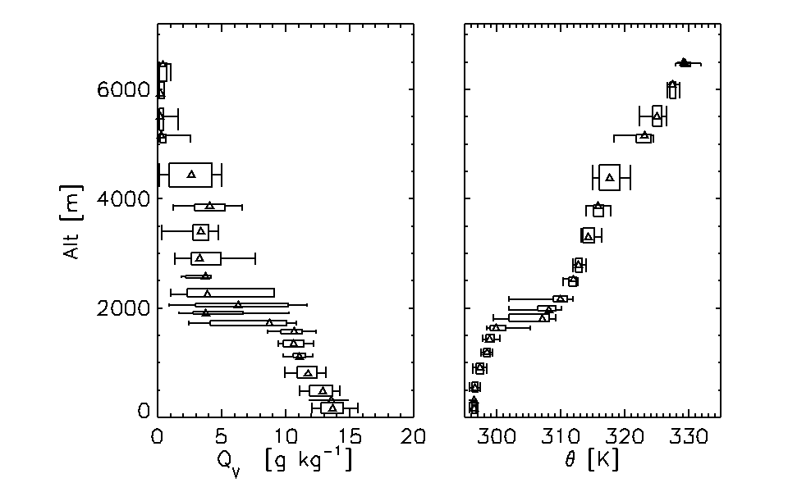
Mean Vertical Structure and Decoupling
Trade wind inversion at 2.0 ± 0.4 km
Humid layer in lower free troposphere
Can contain transported biomass burning aerosols
plume from continental Africa

Slide 4
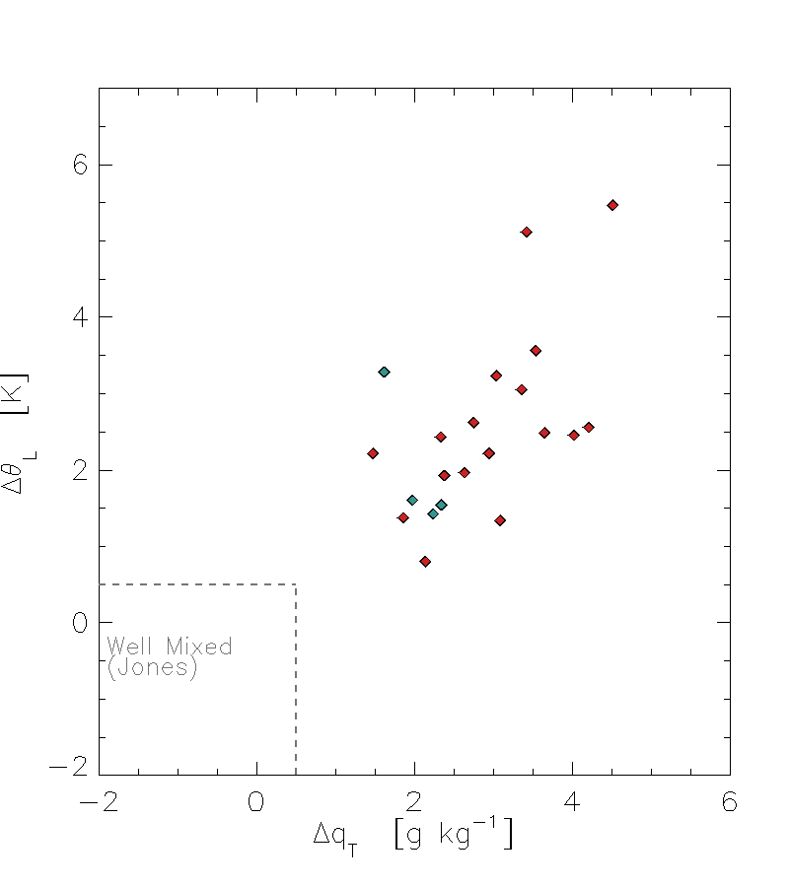
Mean Vertical Structure and Decoupling
Trade wind inversion at 2 km
Humid layer in lower free troposphere
Can contain transported biomass burning aerosols
plume from continental Africa
Boundary layer predominantly decoupled
(Jones et al, ACP2011 decoupling metric (VOCALS, SE Pacific)

Slide 5
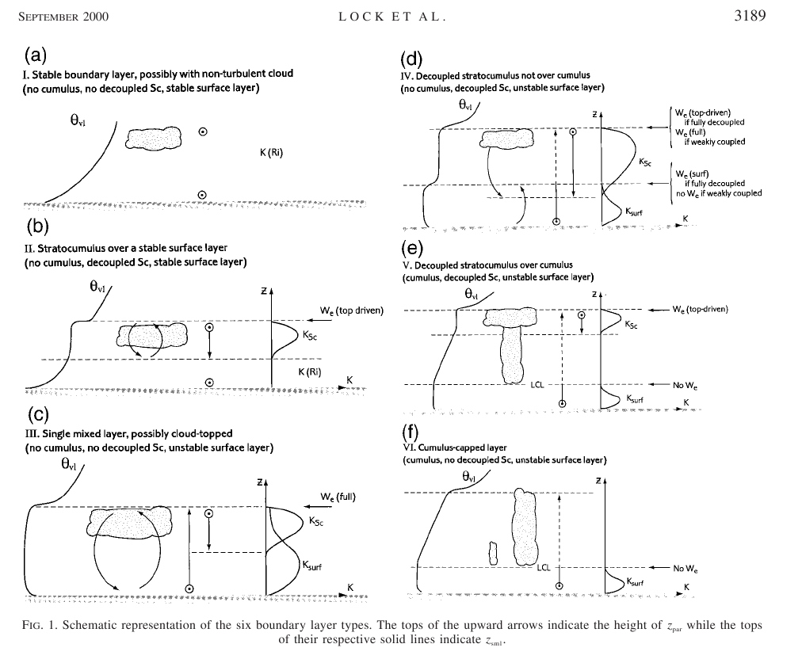

Slide 6
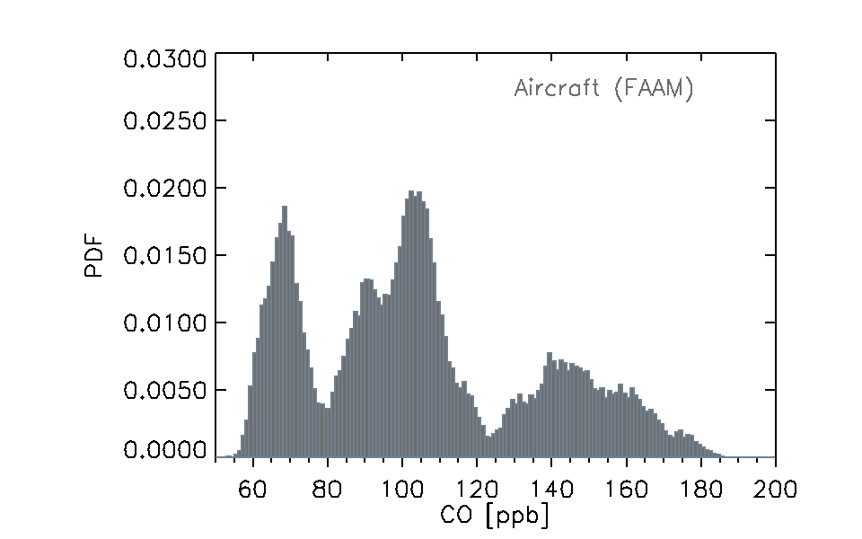
Large Scale Statistics from FAAM Aircraft Data
– Boundary Layer, All Flights (except POCs)
Boundary layer Carbon Monoxide is a tracer of airmass history.
Paul Barrett
Paul Barrett (AMS Vancouver 2018)

Slide 7
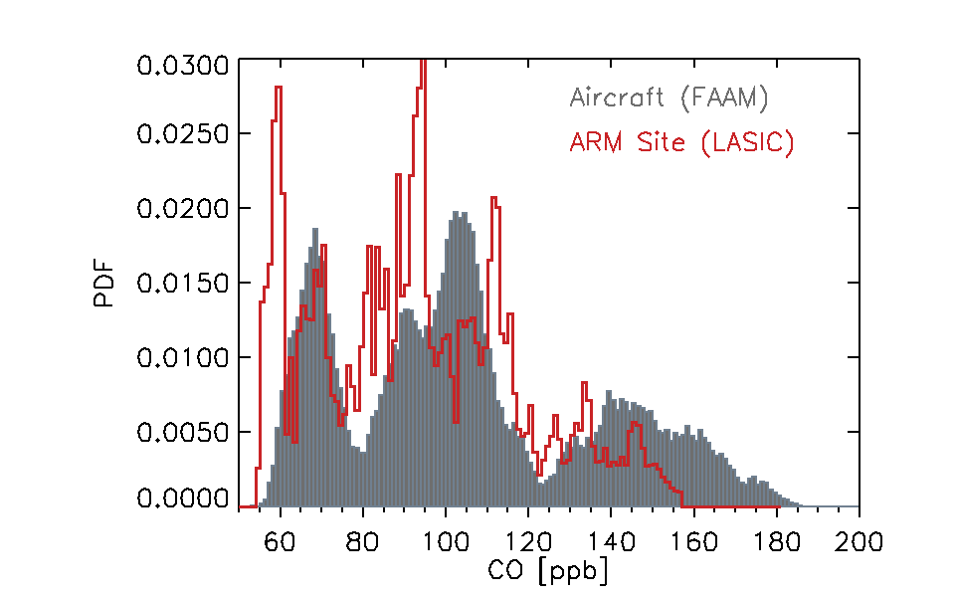
Large Scale Statistics from FAAM Aircraft Data
– Boundary Layer, All Flights (except POCs)
And LASIC ARM site data
Boundary layer Carbon Monoxide is a tracer of airmass history.
LASIC ARM site data for the same time period, 17th Aug – 7th Sept. Data not co-located
ARM site measured similar range at Ascension, at 350 m altitude
Paul Barrett
Paul Barrett (AMS Vancouver 2018)

Slide 8
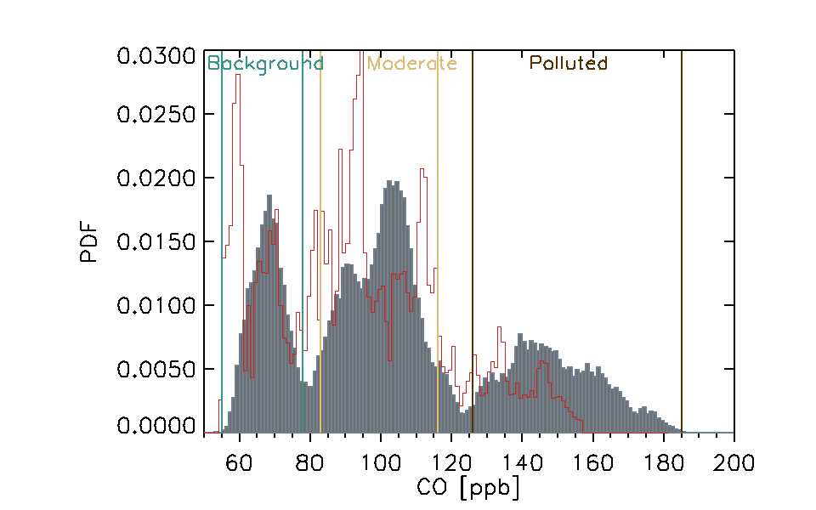
Large Scale Statistics from FAAM Aircraft Data
– Boundary Layer, All Flights (except POCs)
And LASIC ARM site data
Boundary layer Carbon Monoxide is a tracer of airmass history.
LASIC ARM site data for the same time period, 17th Aug – 7th Sept. Data not co-located
ARM site measured similar range at Ascension, at 350 m altitude
Possibly some biases to explore?
Aircraft data are Tri-modal:
Low: oceanic Background
Moderate
Heavily Polluted
55 < clean < 78
83 < moderate < 116
126 < polluted < 185
Paul Barrett
Paul Barrett (AMS Vancouver 2018)

Slide 9
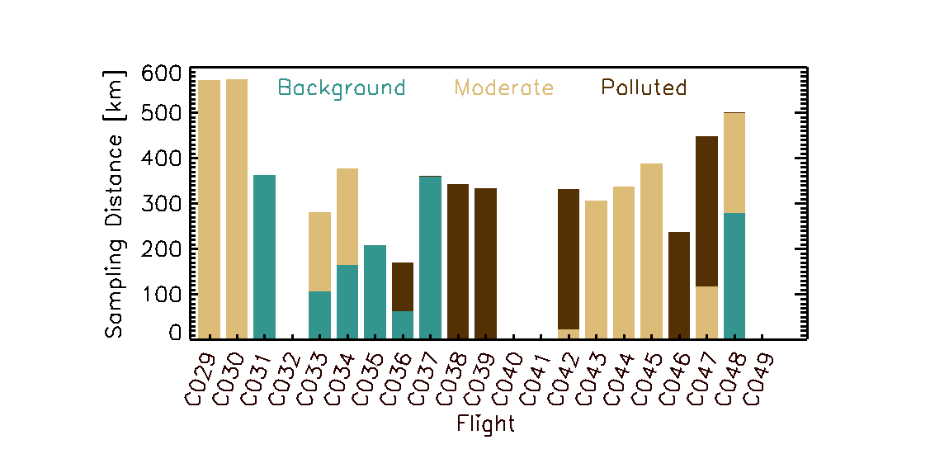
Aircraft data sampled three boundary layer regimes
– Background, Moderate and Polluted
Regimes distributed across the campaign – similar to the broad scale regimes.
Model mmr (µg m⁻³)
Paul Barrett
Paul Barrett (AMS Vancouver 2018)

Slide 10
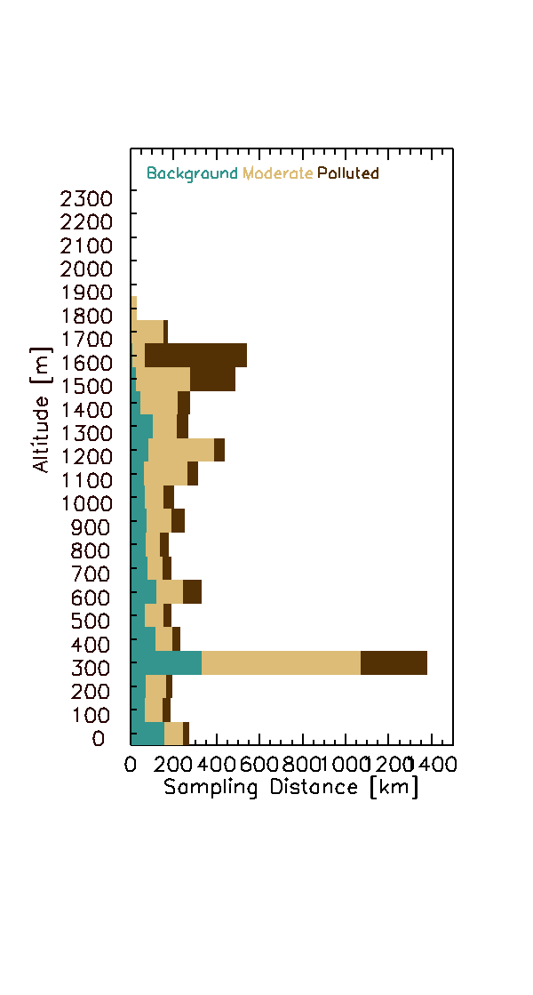
Aircraft data sampled three boundary layer regimes
– Background, Moderate and Polluted
Regimes distributed across the campaign – similar to the broad scale regimes.
Strongest pollution events tend to be higher in boundary layer- fresh entrainment?
Clean background conditions are always below 1500 m
Two stage mixing
through trade inversion
then to lower BL?
Model mmr (µg m⁻³)
Paul Barrett
Paul Barrett (AMS Vancouver 2018)

Slide 11
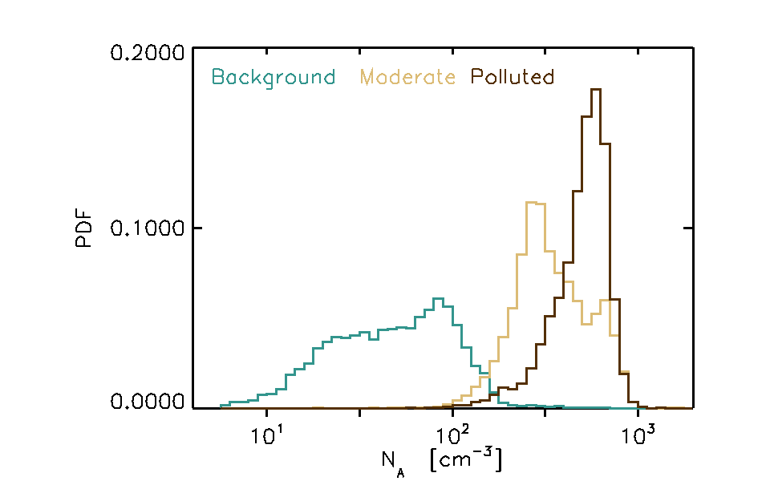
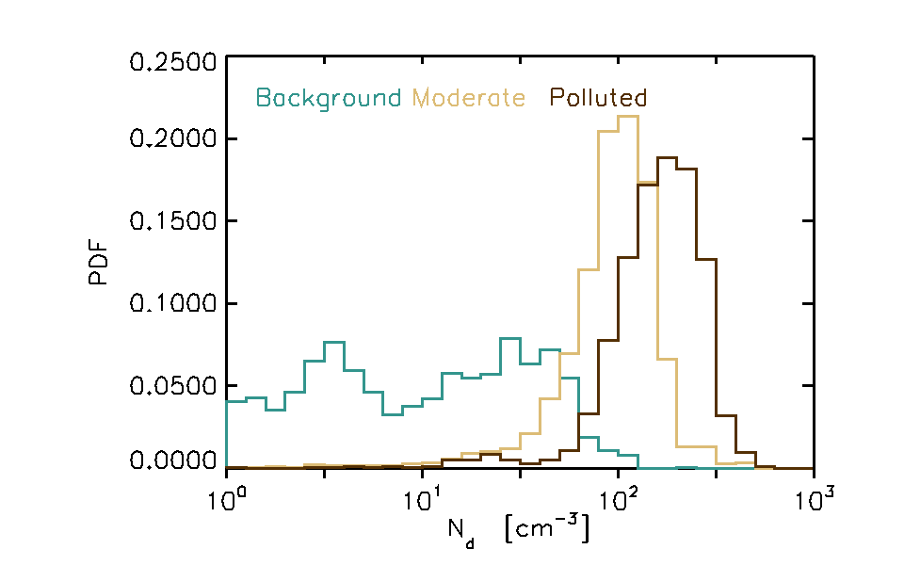
Mean Boundary Layer Aerosol Number and Cloud Droplet Number
- In three regimes
Strong microphysical change between background and polluted.
Non-linear once polluted
Clearly going to be Cloud Top Effective Radius impacts,
and hence → indirect effect climate response to biomass burning aerosol in SE Atlantic
Still to quantify
can’t distinguish semi-direct effect in these observations, as separate from meteorology

Slide 12
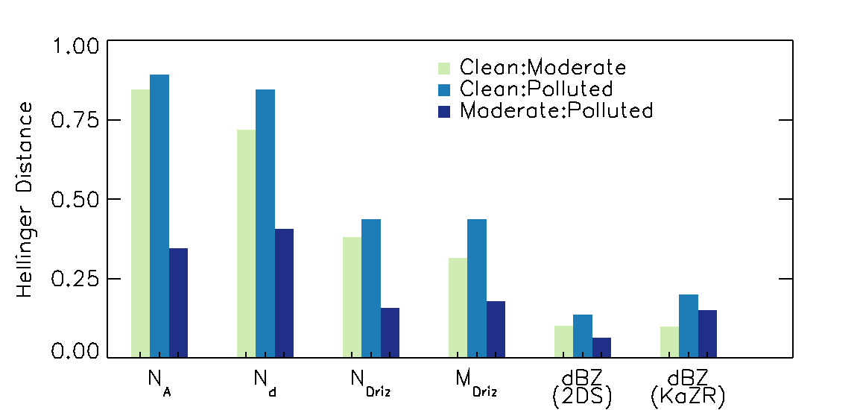
Statistical [Hellinger] Distances Between Distributions
“Moderate” and “polluted” are in fact statistically similar
More similarity for drizzle properties
Different …..
The Same …..
H E L L I N G E R D I S T A N C E S [segments]
Cln:Mod Cln:Dirty Mod:Dirty
Aerosol Number 0.912055 0.907573 0.332834
Cloud Drop Number 0.774887 0.886230 0.464939
Drizzle Drop Number 0.407608 0.430946 0.170320
Drizzle Mass 0.351925 0.422562 0.176838
H E L L I N G E R D I S T A N C E S
Cln:Mod Cln:Dirty Mod:Dirty
Aerosol Number 0.893940 0.904264 0.362848
Cloud Drop Number 0.755951 0.887914 0.489033
Drizzle Drop Number 0.379247 0.445914 0.194736
Drizzle Mass 0.334818 0.426128 0.197501

Slide 13
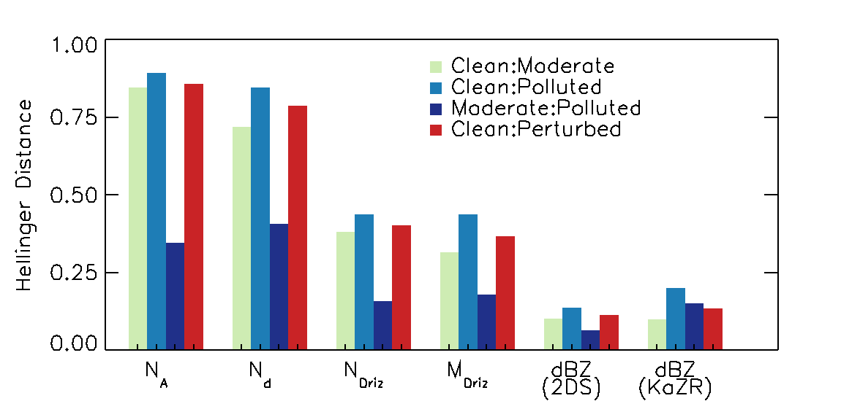
Statistical [Hellinger] Distances Between Distributions
Define a “Perturbed” regime, with CO > 83 ppb
Different …..
The Same …..
H E L L I N G E R D I S T A N C E S [segments]
Cln:Mod Cln:Dirty Mod:Dirty
Aerosol Number 0.912055 0.907573 0.332834
Cloud Drop Number 0.774887 0.886230 0.464939
Drizzle Drop Number 0.407608 0.430946 0.170320
Drizzle Mass 0.351925 0.422562 0.176838
H E L L I N G E R D I S T A N C E S
Cln:Mod Cln:Dirty Mod:Dirty
Aerosol Number 0.893940 0.904264 0.362848
Cloud Drop Number 0.755951 0.887914 0.489033
Drizzle Drop Number 0.379247 0.445914 0.194736
Drizzle Mass 0.334818 0.426128 0.197501

Slide 14
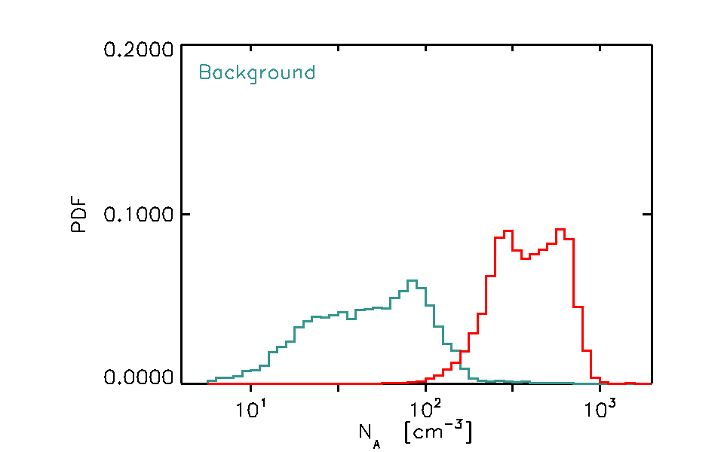
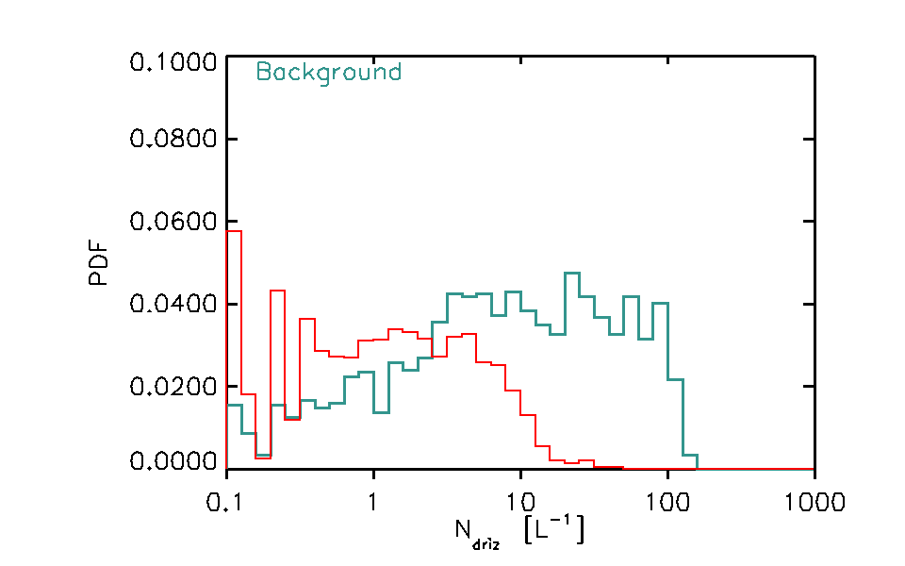
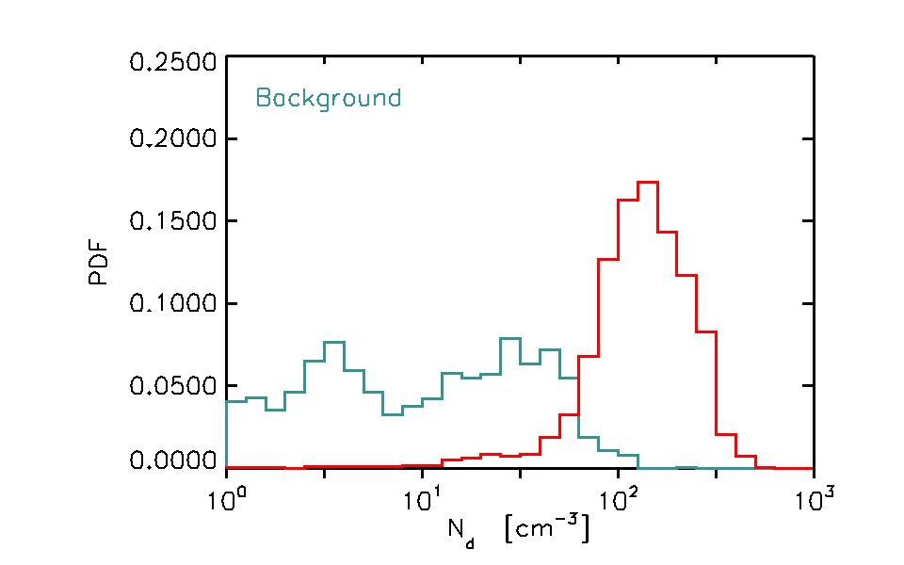
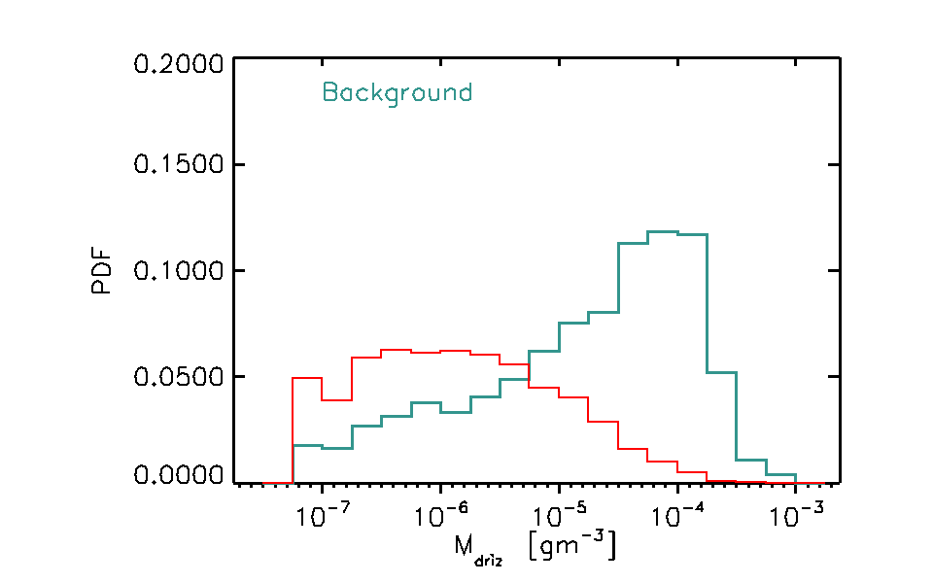
Aerosol, Cloud and Drizzle properties in clean and perturbed conditions,
Drizzle particles – larger than 100 μm
Higher frequency of drizzle number concentrations in background regime
Controlled by aerosol impacts on cloud
The mass contained in the drizzle size range is more frequently higher in the background regime
Possibly should include CDP data (<50micron) particles

Slide 15
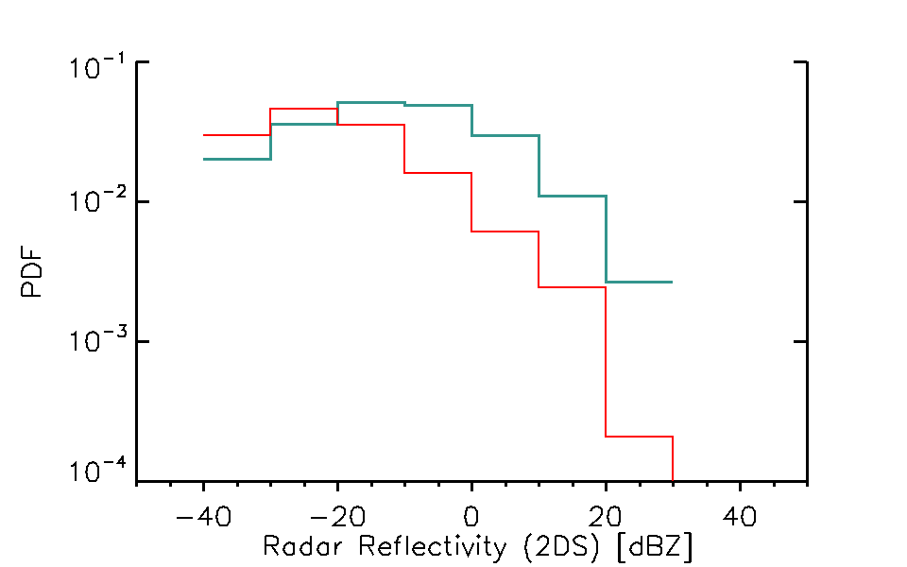
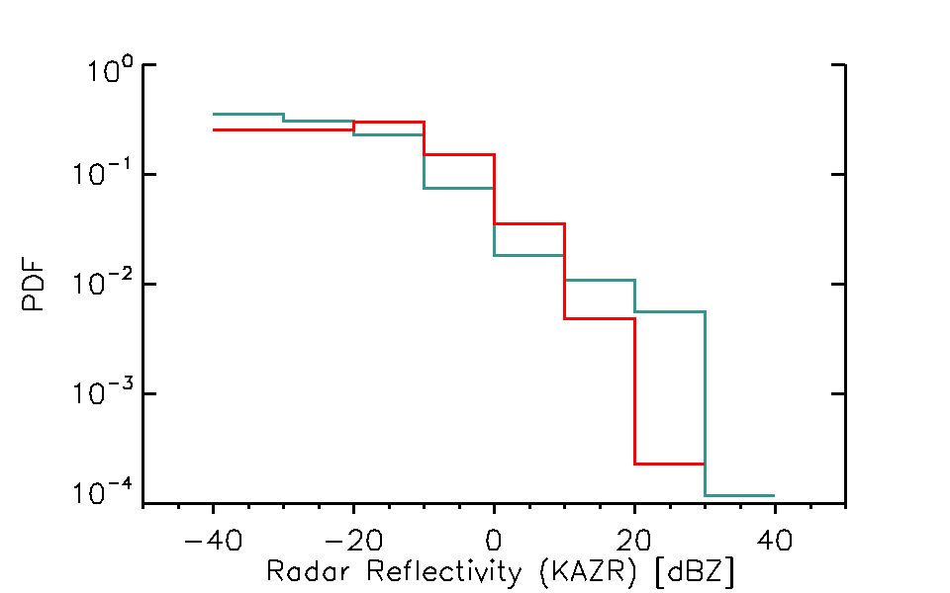
Aerosol, Cloud and Drizzle properties in clean and perturbed conditions, including ground base radar
LASIC: KaZR

Slide 16
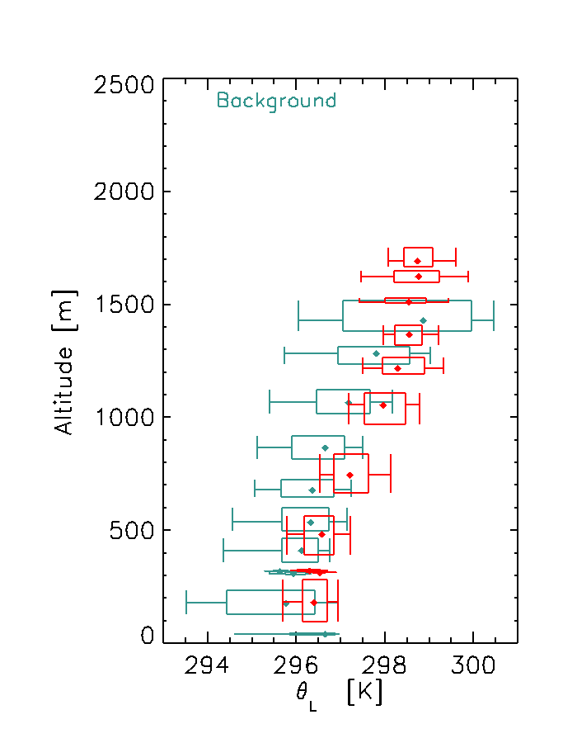
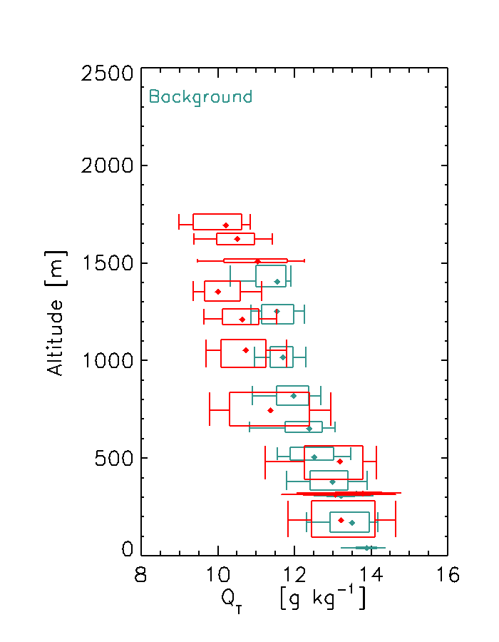
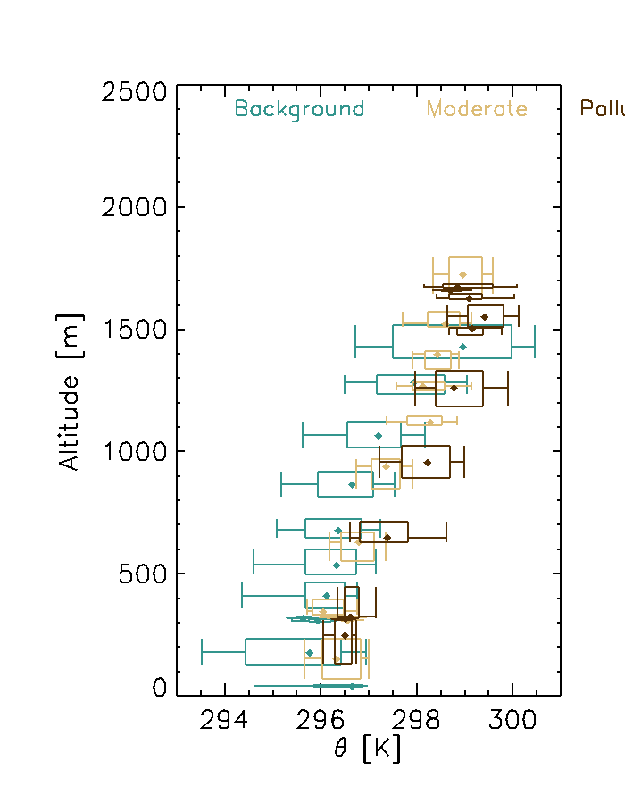
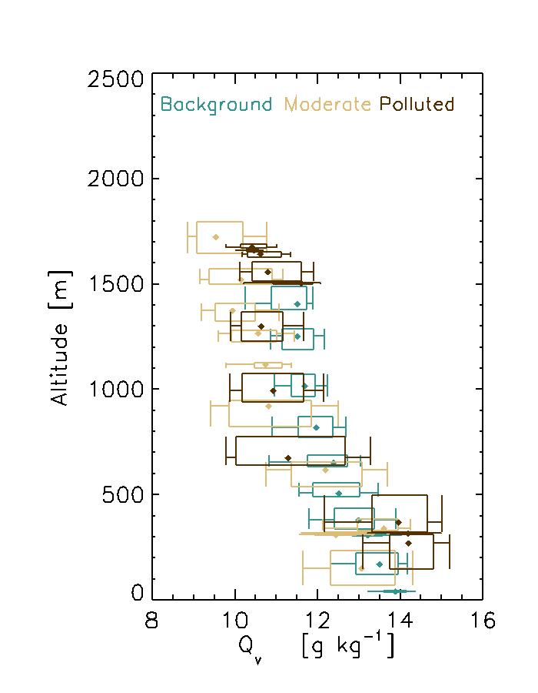
Mean Boundary Layer Thermodynamics profiles
Perturbed case: “Warmer” and Drier (q_{t}) above LCL, below Trade inversion,
Hence reduced RH, and higher cloud base
Also – Deeper boundary layers, Statistically significant in aircraft obs?
Perturbed boundary layer promotes stronger decoupling
Tendency for:
more polluted regimes to be warmer,
indicative of the continental source from the east, c.f. the clean remote marine boundary layer from the south east
Upper boundary layer (above 500 m - above surface layer) is drier in polluted regimes – entrainment of free-tropospheric air?
Deeper boundary layers in polluted regimes?
Is entrainment more likely when the wind shear between BL and FT is low?
Also cloud cover properties…
~Surface Layer

Slide 17
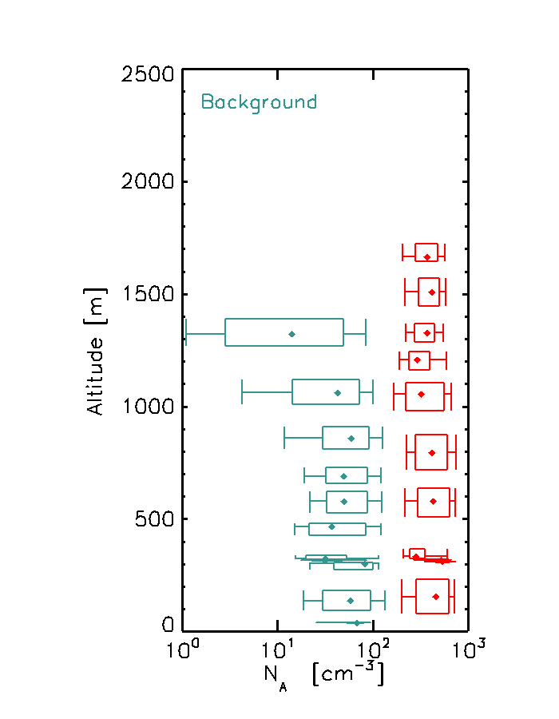
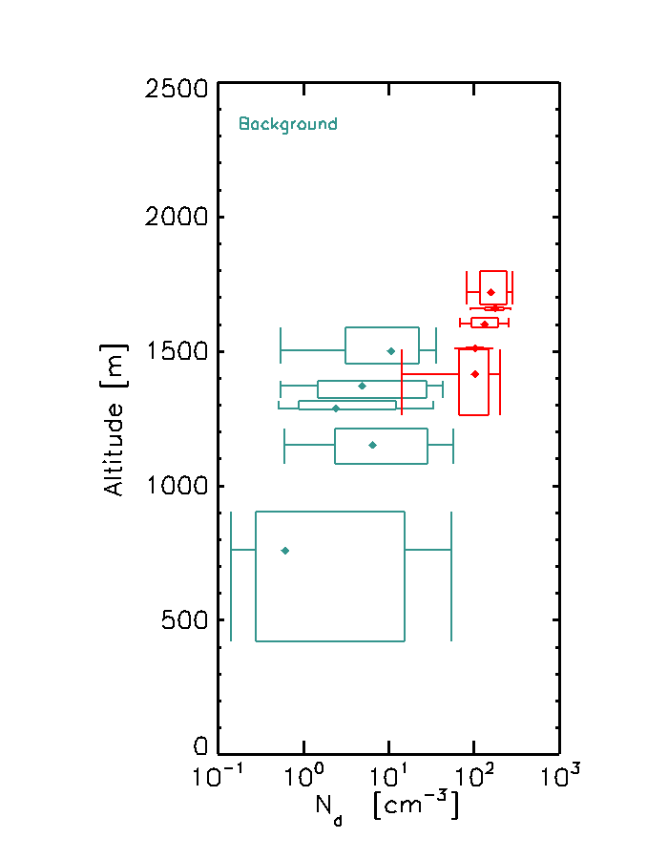
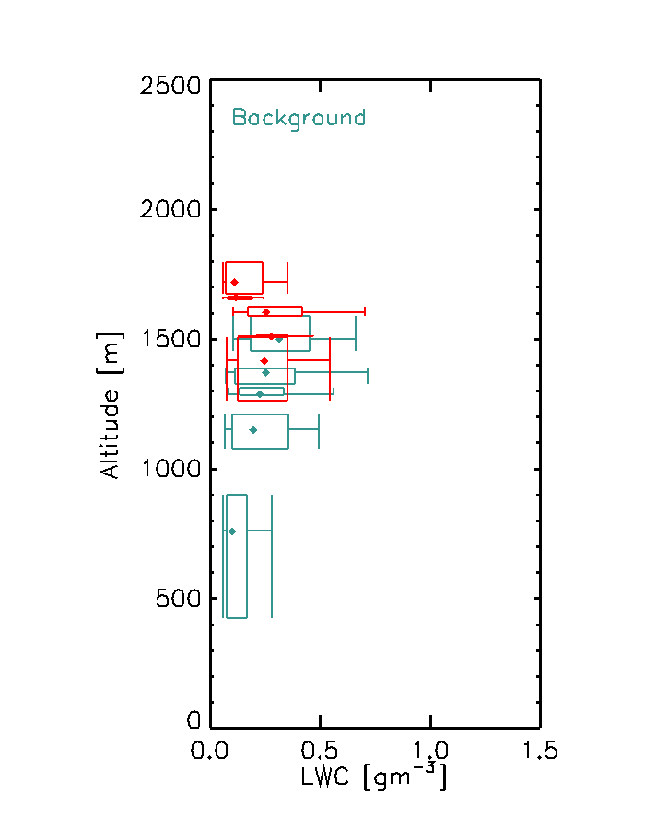
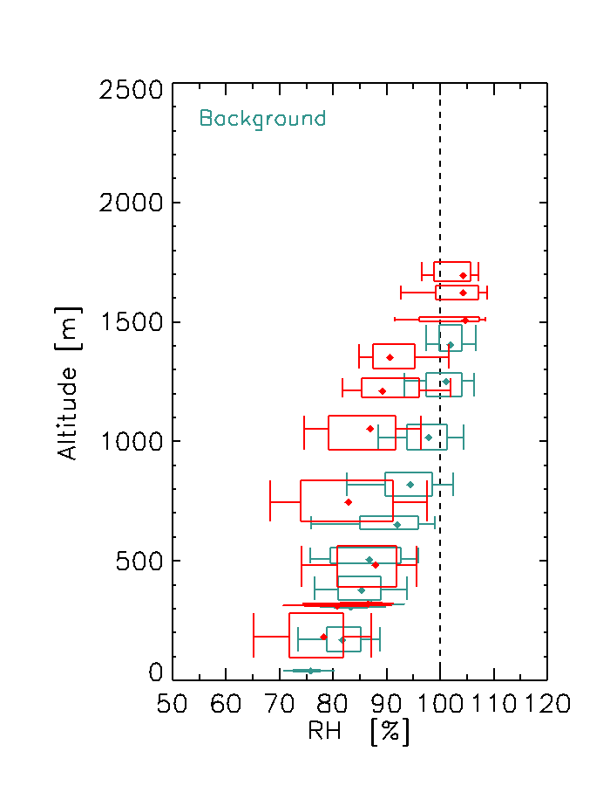
Profiles of Boundary Layer Na, Nd, LWC in Clean and Perturbed Conditions
Profiles of aerosol cloud properties
Perturbed clouds have higher bases, lower LWC (and presumably LWP), more (smaller) drops.
Cloud top, and inversion top is higher altitude
No low level cumulus sampled by aircraft in perturbed conditions – statistically robust? (no, but…)

Slide 18
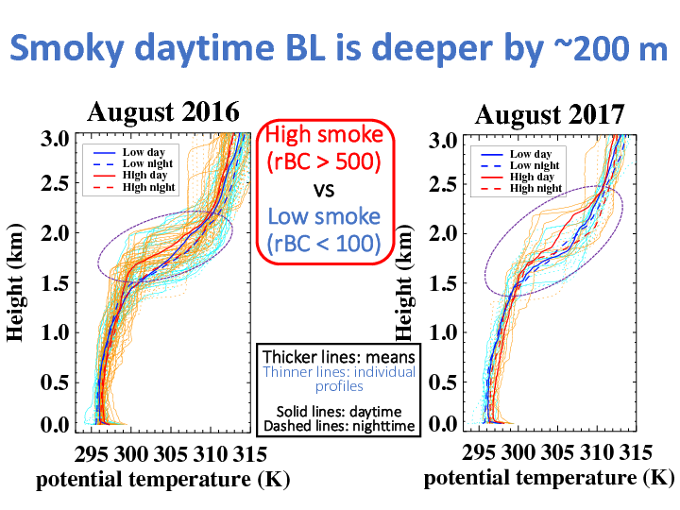
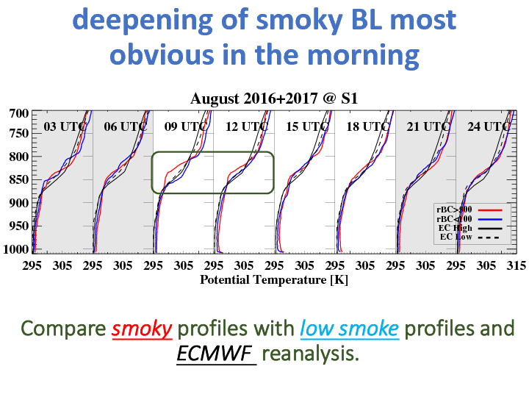
LASIC Observations
Jianhoa Zhang, Paquita Zuidema
Broadly similar picture, with added diurnal capability

Slide 19
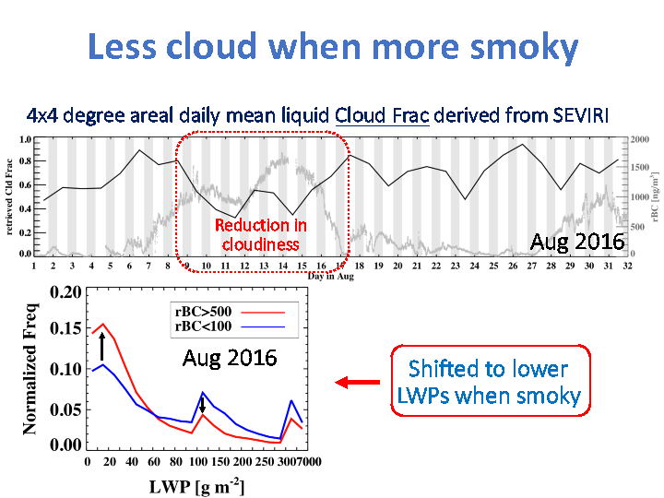
LASIC Observations
Jianhoa Zhang, Paquita Zuidema
Aircraft didn’t sample diurnal cycle

Slide 20
LASIC Observations
Jianhoa Zhang, Paquita Zuidema
Aircraft didn’t sample diurnal cycle

Slide 21
Aircraft samples full range of conditions as epr LASIC, and can add cloud and aerosol properties
Pristine Background
Perturbed
θ
θ
Δθ_{TI}
Δθ_{TI}
Z_{BL}
Z_{BL}
Z_{BL}
LCL
Marine background
N_{A} < 100 cm⁻³ ,
Larger particles near surface
Well mixed to LCL
No or limited smoke / CO
Next Steps:
Determine BL heating rates from aerosol PSD
(also size distribution tomorrow)
Polluted / Perturbed
100 < N_{A} < 1000 cm⁻³ ,
Pollution strongest towards top of BL, under trade inversion
Recent entrainment event? Long time since entrainment allows for mixing throughout BL. Smoke, CO

Slide 22
NEXT STEPS
Inversion Properties, cloud boundary investigations
Aerosol PSD (tomorrow…) and heating rates, then:
Cloud / Drizzle properties in pristine, and perturbed cases
LES studies, either internally, or with US groups.
ARM site LWP data, categorised by regime
Targeted MARSS retrievals for clean / perturbed, looking up through cloud cases?
Then get Pat Minnis SEVIRI LWP, Reff retrievals overhead ARM, - check it works, then – for aircraft data points if it does. (SJA – could be good at cloud fraction around the aircraft – better than the self-cloud-generating Island!)

Slide 23
Conclusions
The Boundary Layer pristine background regime was frequently perturbed by smoke intrusions from the free troposphere
Aerosol, cloud and thermodynamic properties fall into two categories, pristine, and perturbed
Need to disentangle Aerosol direct and semidirect effects from meteorology – scanning radar?, LES
Data were obtained from the Atmospheric Radiation Measurement (ARM) User Facility, a U.S. Department of Energy (DOE) Office of Science user facility managed by the Office of Biological and Environmental Research.

Slide 24
Aerosol Particle Size Distribution PCASP calibrations

Slide 25
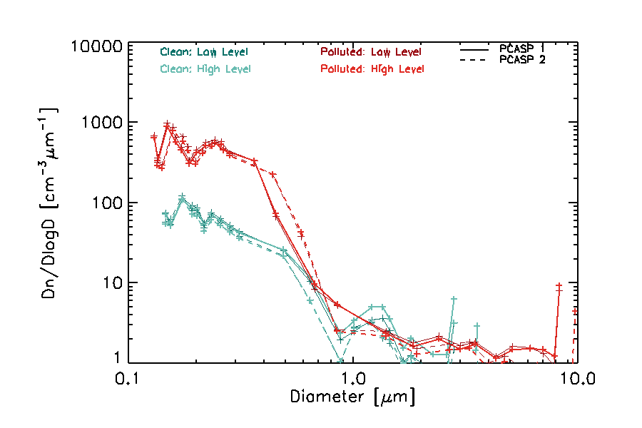
Particle Size Distributions
Within the boundary layer – check for cloud contamination
PCASP – Clean has RI=1.37, vaguely sea salt, AmSulphate.
PCASP –Polluted, includes moderate and dirty cases, and RI =1.51+i0.0029
Plotted for upper and lower Boundary layer (400m layer)
PCASP measures dry size anyway.
Dips in BOTH RI for both instruments ranges suggests an instrument “feature” – How to correct for this, smooth across even more? Both instruments look similar → Where is the mode?
More, larger high level pollution
Less clean high level sea salt, both sensible
Fits to follow next week
Δ

Slide 26
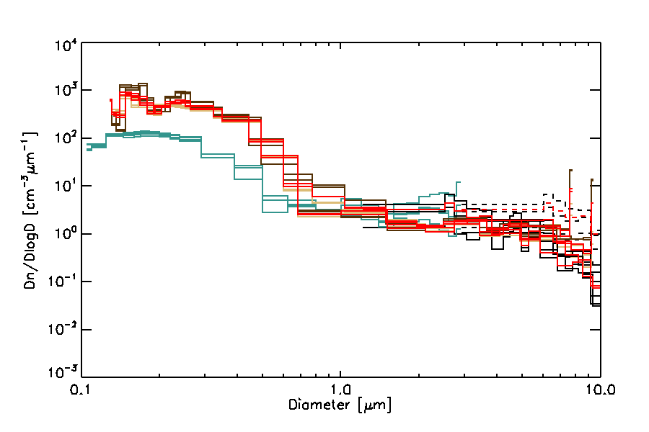
Particle Size Distributions
Within the boundary layer – check for cloud contamination
PCASP and CDP in aerosol regimes
Determined when Nevzorov LWC (1) is below 1e-2
Could do a better flag perhaps – but looks to be responding as expected.
Have new bin dimensions from Kate Szpek for PCASP using 1.59+0.029i from Fanny Peers. Looks sensible compared to my calcs using Phil R Mie code. Probably only valid for the sub-micron stuff in polluted cases where it is likely to be mostly biomass.
Probably sea-salt above 1 micron, in all cases.
Pristine case looks to be bi-modal and yhas

Slide 27
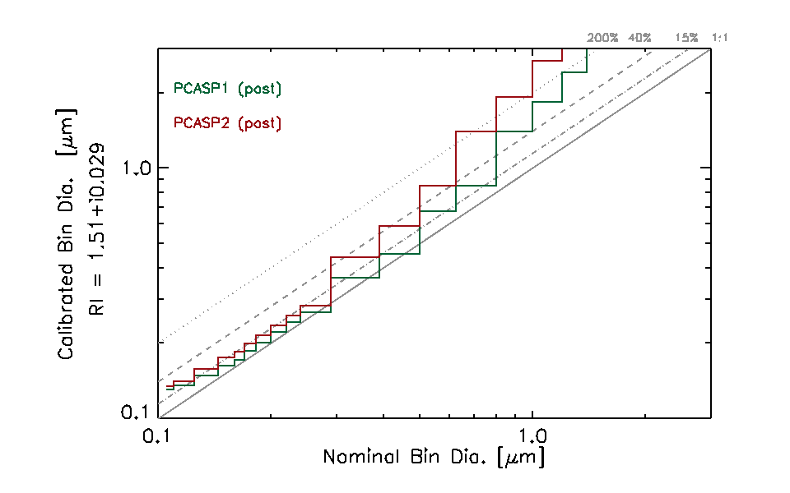
Bin Dimension Files
/net/spice/project/obr/CLARIFY/pcasp/pcasp_bins_P1P2_20170919_ks_pb_v1.csv
/net/spice/project/obr/CLARIFY/pcasp/P1_20170919_ri151_0029i_25bins_L1A_cal_adj_smoothbox.nc /net/spice/project/obr/CLARIFY/pcasp/P2_20170919_ri151_0029i_25bins_L1A_cal_adj_smoothbox.nc
PCASP Bin Edges.
Exclude lower bin, bin 0
Merged bins across gain stages: 4,5,6, 14,15,16
data produced by KS
file prodcued my PB
contact: paul.barrett@metoffice.gov.uk
P1_20170919,P2_20170919
0.1255,0.1274
0.1344,0.1405
0.1402,0.1484
0.1622,0.1745
0.1714,0.1836
0.1808,0.1930
0.2001,0.2130
0.2201,0.2344
0.2413,0.2572
0.2635,0.2813
0.2869,0.3070
0.4625,0.5966
0.5724,0.7345
0.8809,1.0950
1.1269,2.0673
1.9155,2.7495
2.5553,3.3067
2.8956,3.8126
3.4280,4.7423
4.0609,5.6135
5.2224,6.6186
6.1525,7.6032
7.0447,8.5282
7.8471,9.3015
8.6721,10.148
Bins dimensions for sub-micron for
PCASP1, PCASP2
Using the post-CLARIFY calibration on 20170919
These both look self-similar
The other two (pre-CLARIFY) look different (Dodgy?)
Differences are of the order 20% below 0.3 μm, 40% below 0.6 μm, Double above 0.7 μm.

Slide 28
Inversion Properties Cloud Boundaries

Slide 29
Inversion Boundaries, Cloud Boundary, Lidar

Slide 31
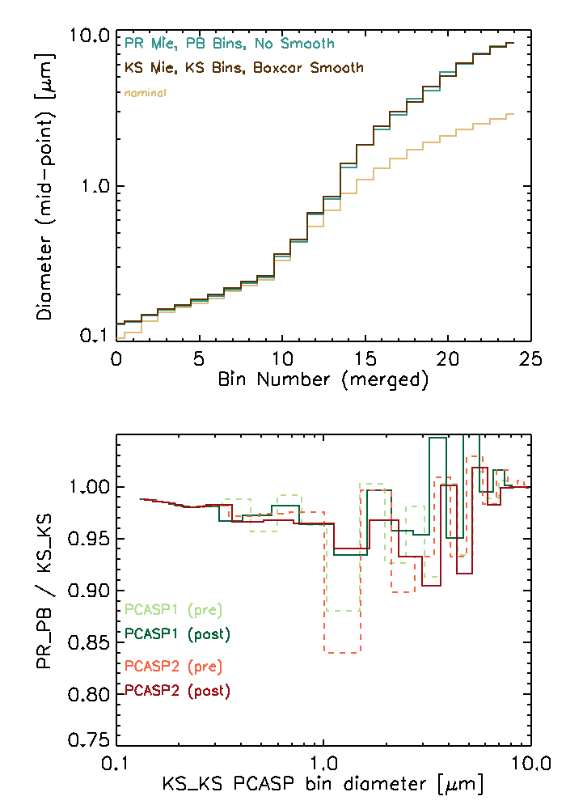
PCASP 1
Post-cal, 20170919
Bins for PCASP from PB (using PR Mie code) and KS (using KS Mie code) for RI = 1.51 + i0.0029 (from Fanny Peers)
Only few-% difference sub-micron
Needs explaining later but not huge…
Super-micron – larger, 15%, but don’t expect to see biomass here anyway

Slide 32
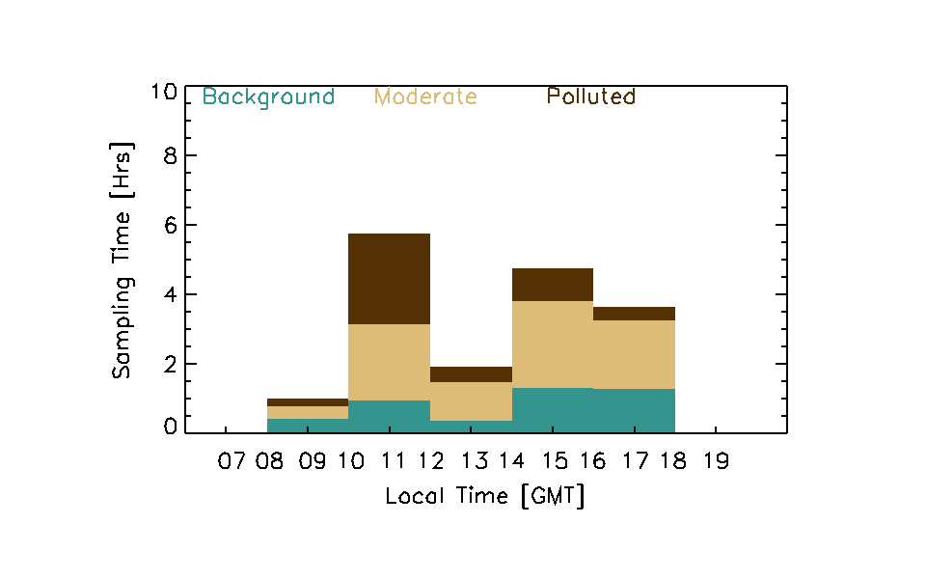
What time of day did we sample the three regimes?
Spread around throughout the day.
Paul Barrett

Slide 33
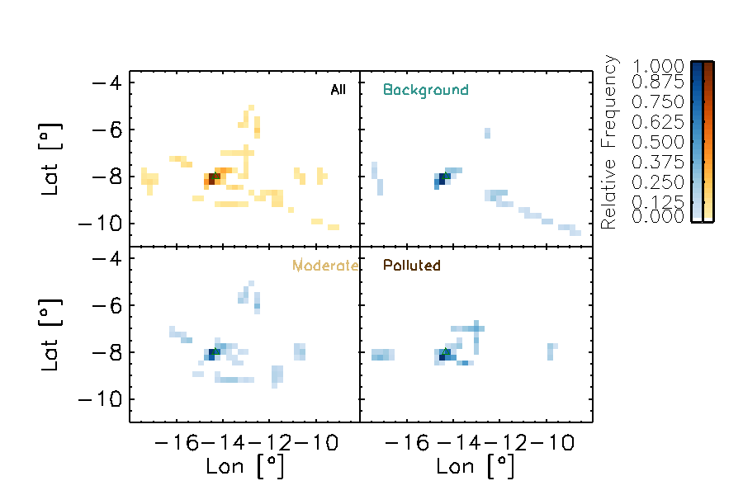
Large Scale Statistics
Three Regimes
Opportunistic targeting of regimes depending on daily conditions
Where are the
Low: oceanic Background
Moderate
Heavily Polluted
Ascension Island
Paul Barrett
Paul Barrett (AMS Vancouver 2018)

Slide 34
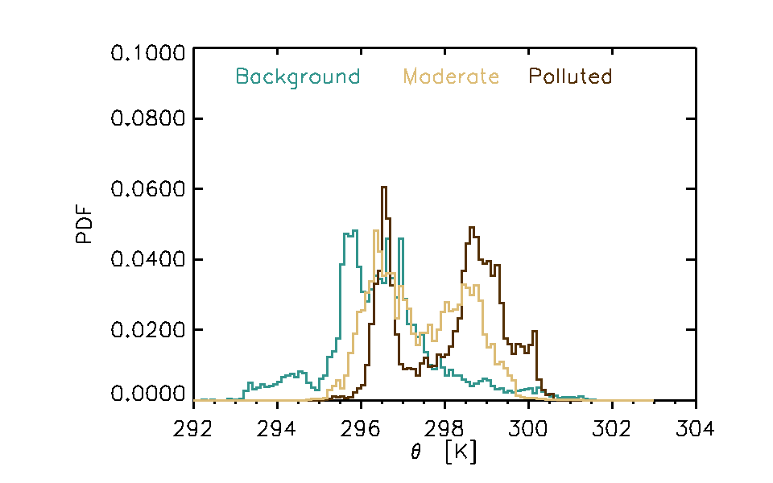
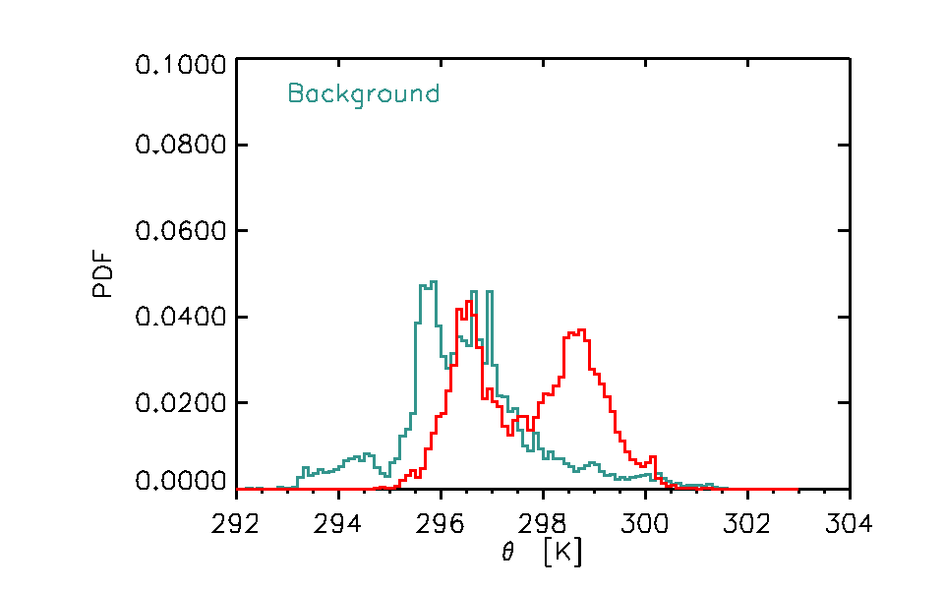
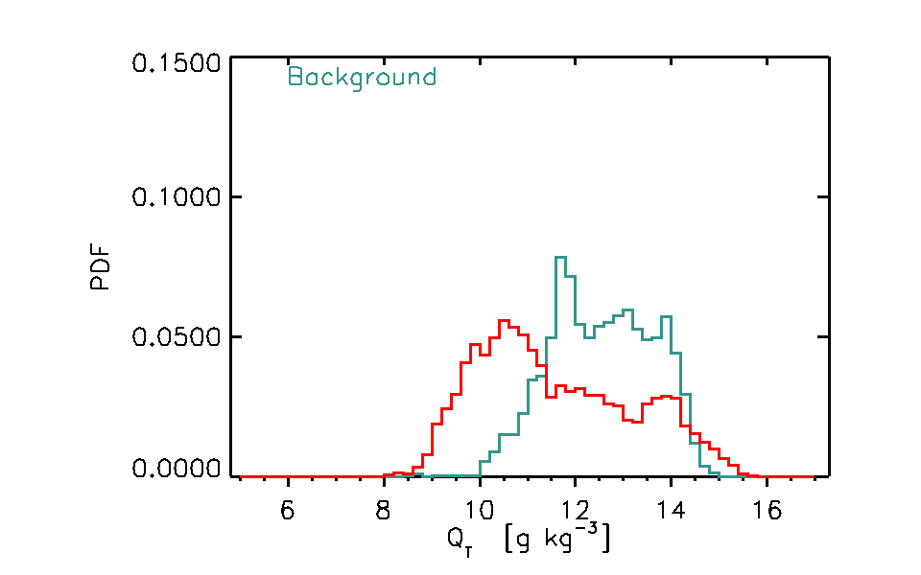
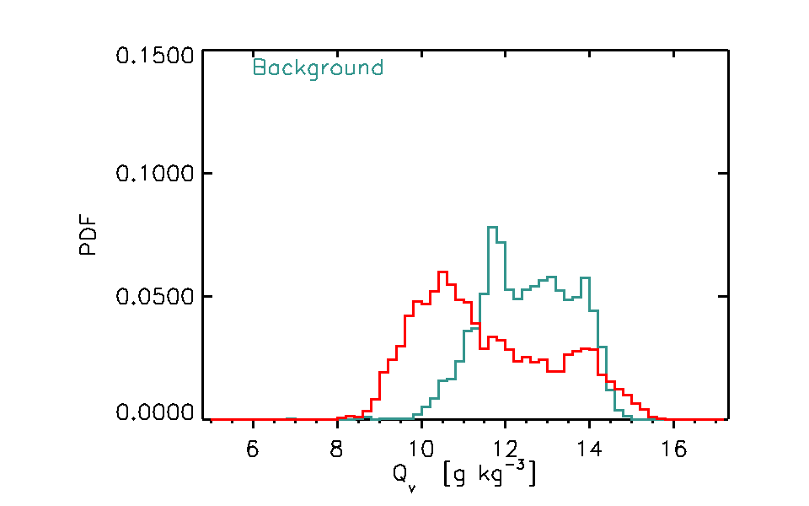
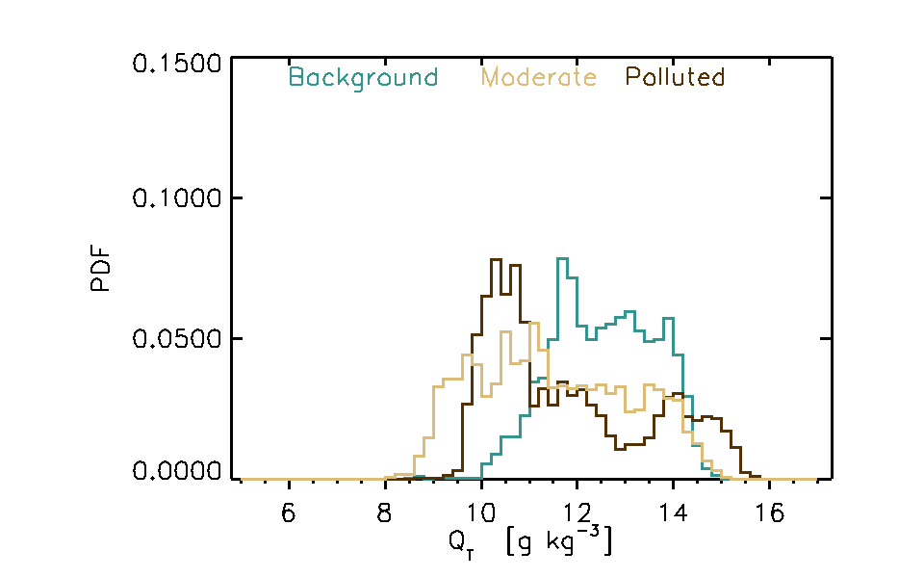
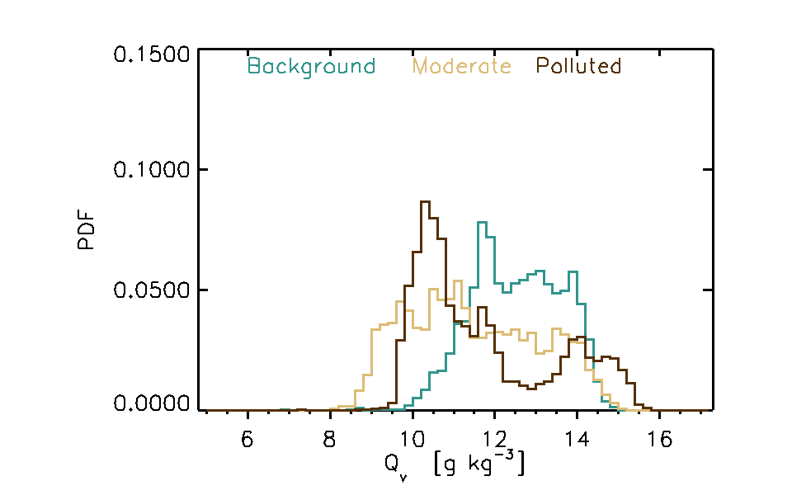
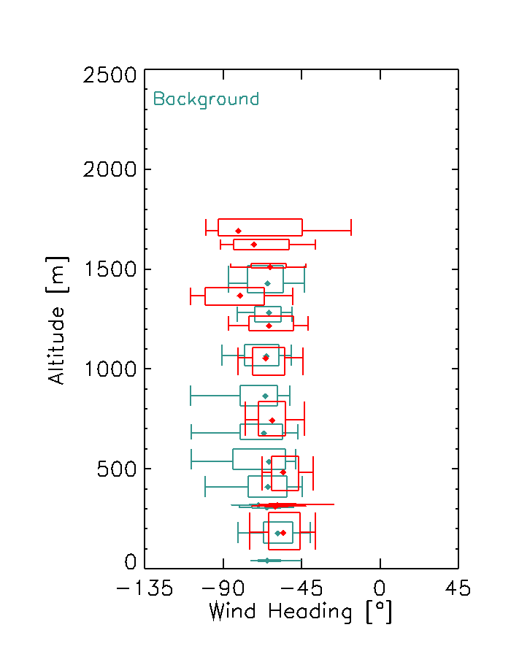
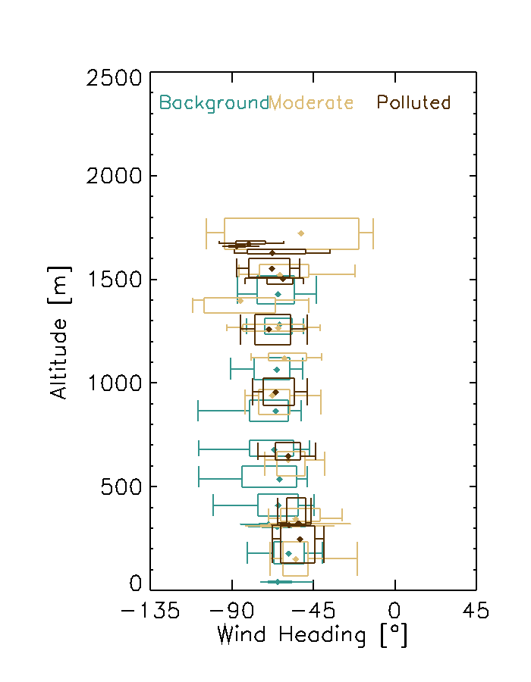
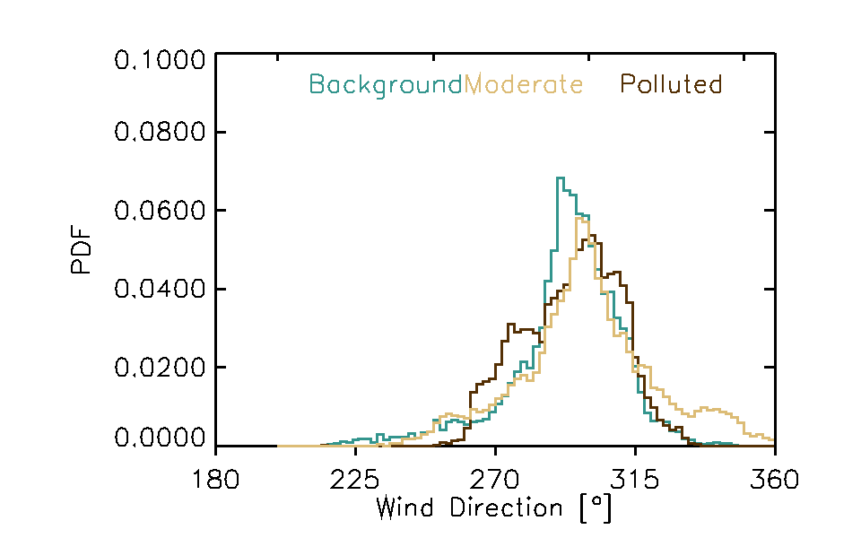
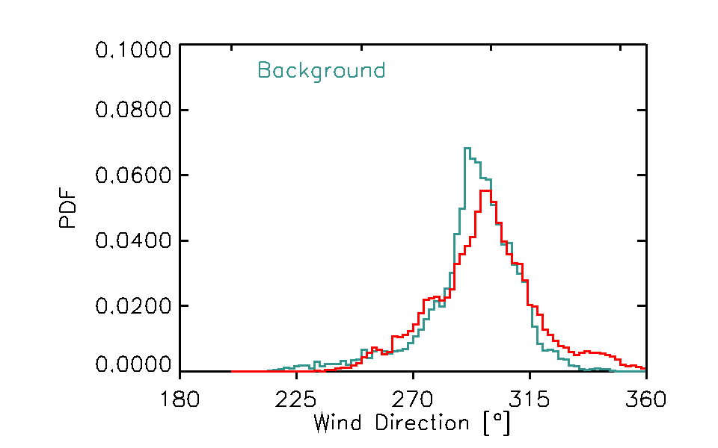

Slide 35
Correlations
Na | Ndriz -0.565368
Na(top) | Ndriz -0.618229
Na(base) | Ndriz -0.263098
co | Na 0.777072
co | Na(top) 0.715818
co | Na(base) 0.0370803
co | Nd 0.651854
co | Ndriz -0.411294
co | ThetaBL 0.708556
co | ThetaTOP 0.633245
co | ThetaBASE 0.166799
co | DeltaBL_Theta 0.498139
co | Qv 0.117416
co | QvTOP -0.125509
co | Qvbase 0.532186
co | QvDelta -0.606848
co | Qt 0.138398
co | QtTOP -0.0824605
co | Qtbase 0.532226
co | QtDelta -0.566172
Na | DeltaBL_Theta 0.190231
Theta | Ndriz -0.328314
Theta(top) | Ndriz 0.0410258
Theta(base) | Ndriz -0.565837
Theta(delta) | Ndriz 0.265200
Nd | Ndriz -0.530436
wa | Ndriz -0.151701
ws | Ndriz -0.241473
wa(FT) | Ndriz 0.207160
ws(FT) | Ndriz 0.221640
wa(top) | Ndriz 0.0284230
WA Shear(BL) | Ndriz 0.0431181
WA shear (FT)| Ndriz 0.161441
ws SHEAR (BL)| Ndriz 0.167460
ws SHEAR (FT)| Ndriz 0.306303
QvDeltaBL | ThetaDeltaBL 0.535373
Qt DEltaBL | ThetaDeltaBL 0.568714
N driz | Qt DElta BL 0.252545

