Slide 1







The CLouds-Aerosol-Radiation Interaction and Forcing: Year 2017 (CLARIFY-2017) programme: deployment, synergies with ORACLES/LASIC/AEROCLO-SA and initial results
Institutes and Investigators
Haywood, Collins
Blyth,Carslaw, Field
Coe, Gallagher, Choularton, Allan, Connolly, Dorsey
Stier, Washington
Bellouin, Highwood
Abel, Barrett, Lock, Jones, Milton
Partners (£1.2m matched support secured): Met Office
CLARIFY-2017: AGU 2017
Notes:
Hugely experienced team in aircraft deployment and maximising the pull-through to modelling

Slide 2
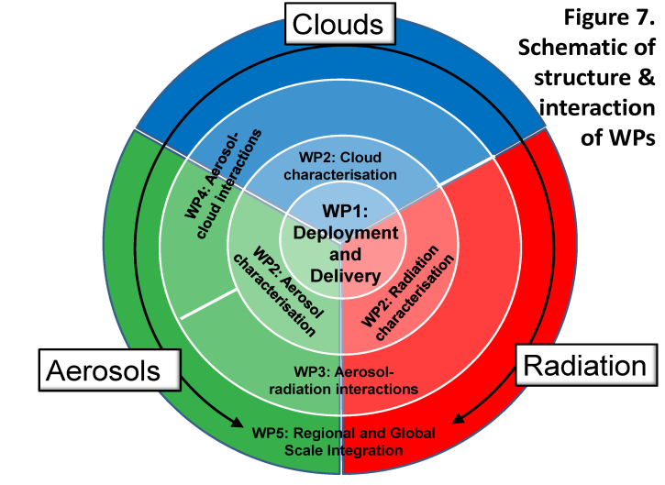
CLARIFY-2017: The Approach
Work-Package Structure:
WP1: Deployment and delivery: UoM (Coe, PI), UoE, UoO, UoL, Met Office, FAAM
WP2: Cloud, aerosol and radiation characterisation: UoL (Blyth, PI), UoM, UoE, UoO, Met Office
WP3: Aerosol-radiation interactions: UoE (Haywood, PI), Met Office, UoR, project partners
WP4: Aerosol-cloud interactions: UoO (Stier, PI), UoL, UoM
WP5: Regional and global scale integration: UoR (Bellouin, PI), UoL, UoM, UoO, UoE, Met Office
CLARIFY-2017: AGU 2017

Slide 3
Unified Model forecast support: to get the aircraft in the right place at the right time
Model forecasts and satellite products were be key for positioning aircraft. Need to know information on clouds, aerosols and where regions of ACI may occur.
Global model forecasts (17 km) of clouds and aerosols. Include prognostic biomass burning, dust aerosols, and industrial aerosols.
LAM model forecasts (1.5km) of clouds (no aerosols).
Vertical location relative to clouds
Geographic location
CLARIFY-2017: AGU 2017

Slide 4
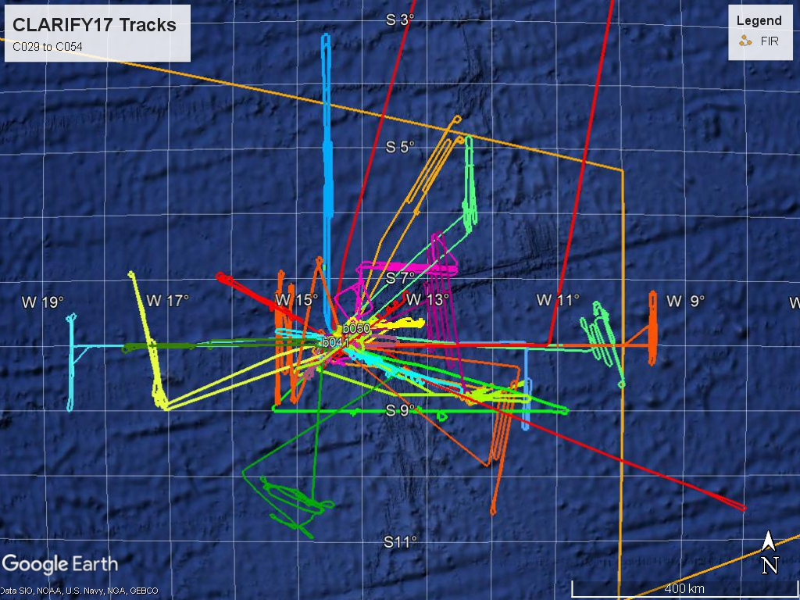
CLARIFY-2017: Deployment
Period of Operations:
August 16th 2017 – September 7th 2017
Total Sorties:
28 Science flights in 23 operational days
Total Flight Time:
99hours and 16minutes.
CLARIFY-2017: AGU 2017

Slide 5
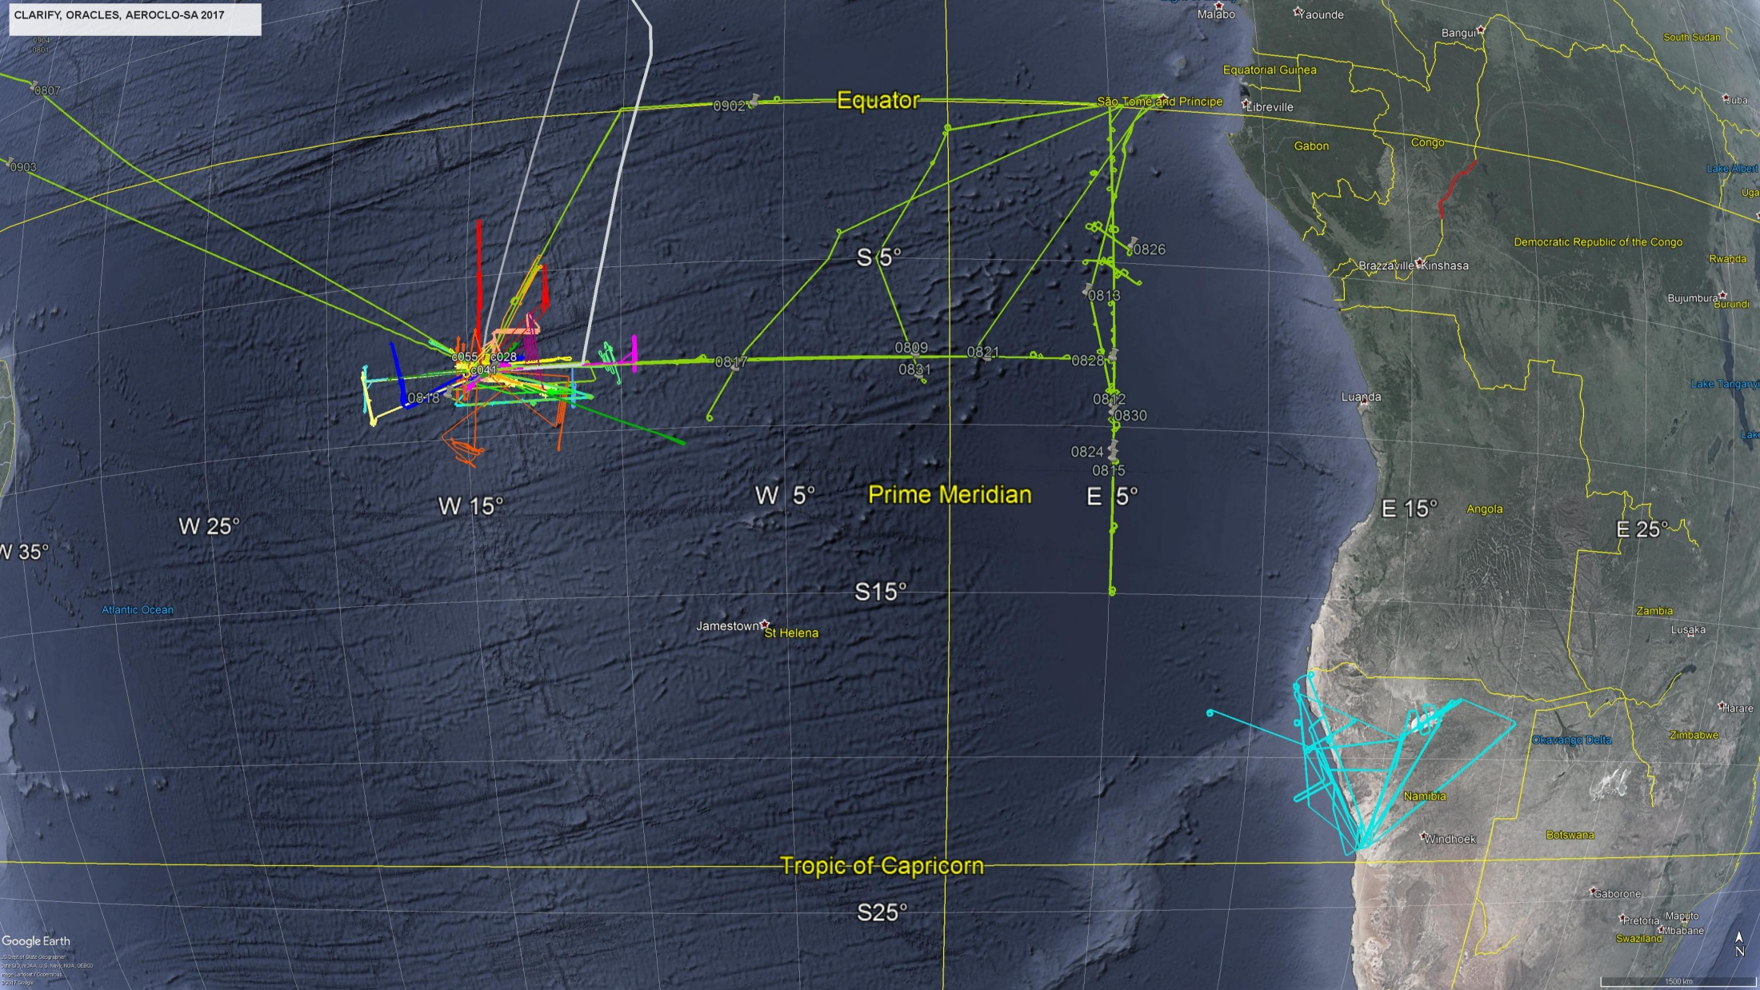
CLARIFY ORACLES AEROCLO-SA
2017
CLARIFY-2017: AGU 2017

Slide 6
Initial Analysis of Vertical Profiles

Slide 7
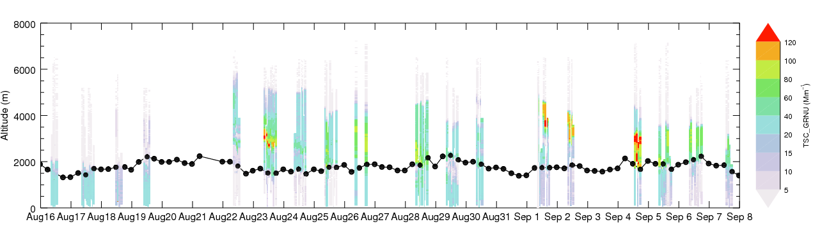
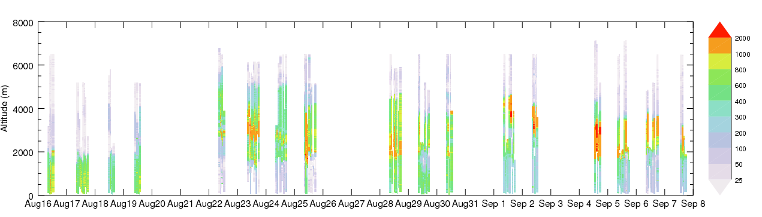
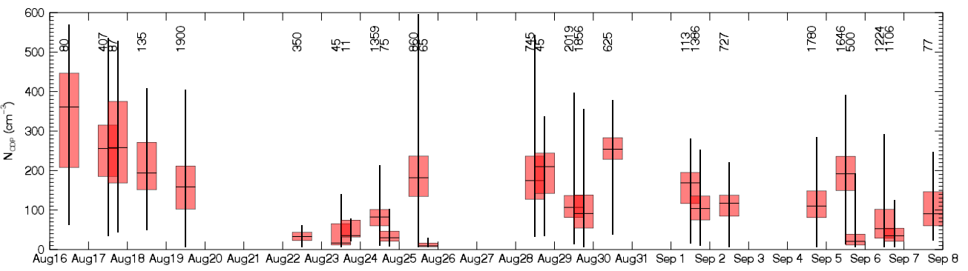
Overview of aerosol vertical structure and cloud drop concentrations
Nephelometer (Mm⁻¹)
PCASP (cm⁻³)
CDP (cm⁻³)
N > 5 cm⁻³
LWC > 0.05 g m⁻³
Steve Abel

Slide 8
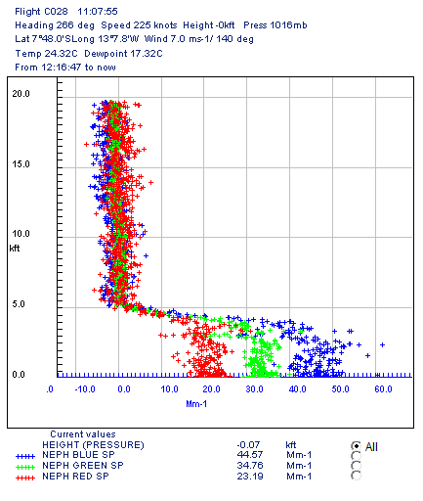
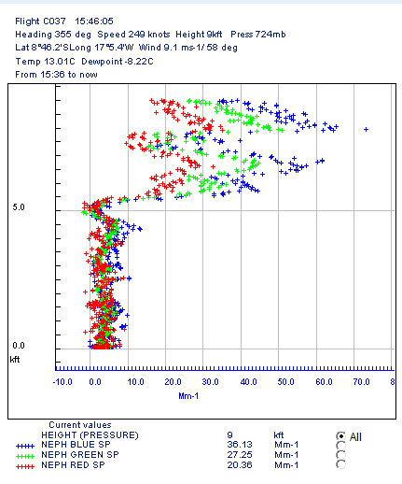
More details on the vertical profile
Regime 1: Aerosol only in MBL
Regime 2: Aerosol only above MBL
Regime 3: Aerosol in both
16th August
24th August
29th August
5000ft
5000ft
5000ft
Nephelometer profiles showing the three regimes.

Slide 9
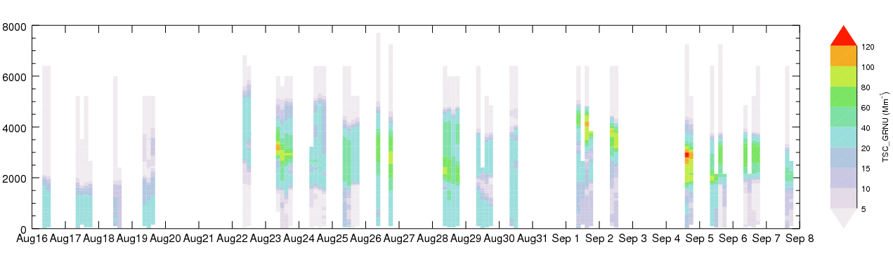
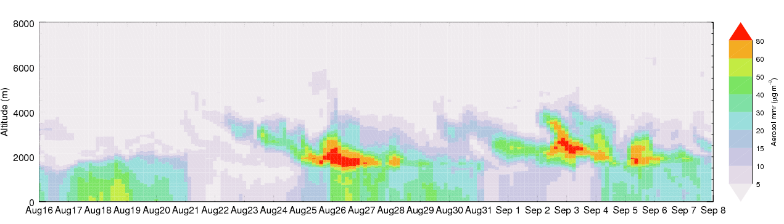
Met Office Unified Model forecast (17km): vertical profile of aerosol at Ascension Island
Nephelometer (Mm⁻¹)
POC
Model mmr (µg m⁻³)
POC
Model performs reasonably enough to address science questions except when a POC occurs – suggests missing processes under these conditions
Steve Abel/ Paul Barrett

Slide 10
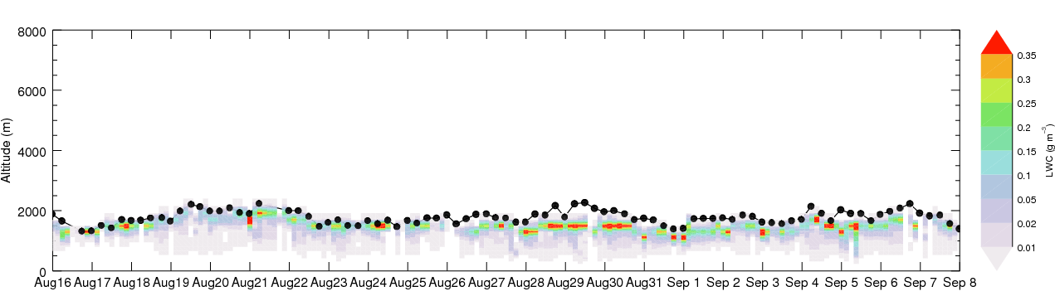
Met Office Unified Model forecast: the vertical position of cloud at the top of the MBL is represented reasonably well
Model LWC (g m⁻³)
Model did a reasonable job at forecasting the arrival of smoke plumes at Ascension
Captured the occurrence of elevated smoke plumes and/or the mixing of smoke into the boundary layer. Underestimates the top altitude of elevated smoke plumes though – related to emission height?
Good job at forecasting boundary layer depth → probably key to getting the mixing of smoke into the boundary layer correct and hence ACI correct
Steve Abel/ Paul Barrett

Slide 11
Note – not all models are able to represent the vertical structure that is critical in assessing the ACI and ARI.
Met Office Forecast Model: vertical profile about right
US WRF model: MBL does not deepen enough – below 1km for the same cross section. The aerosol invariably is transported above the MBL, when it should (sometimes) be mixed in.
ACI and ARI may not be well represented in WRF.

Slide 12
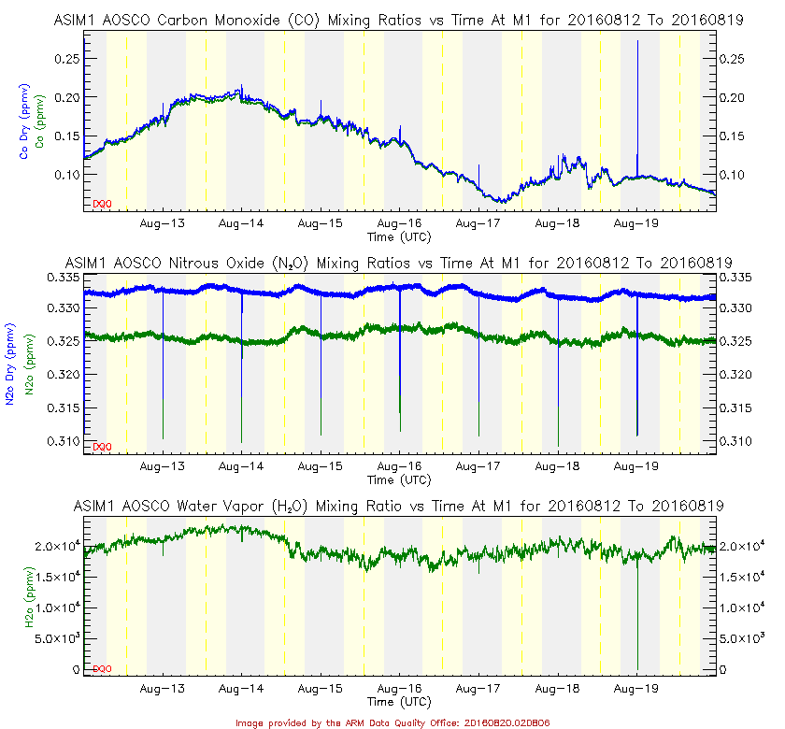
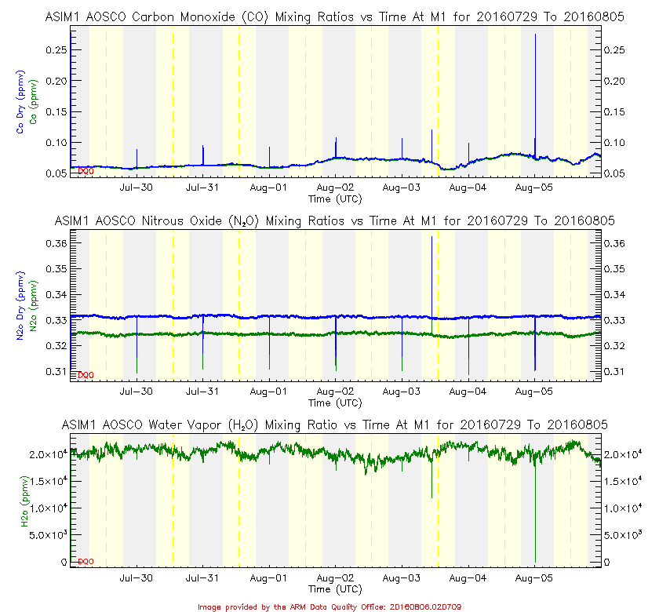
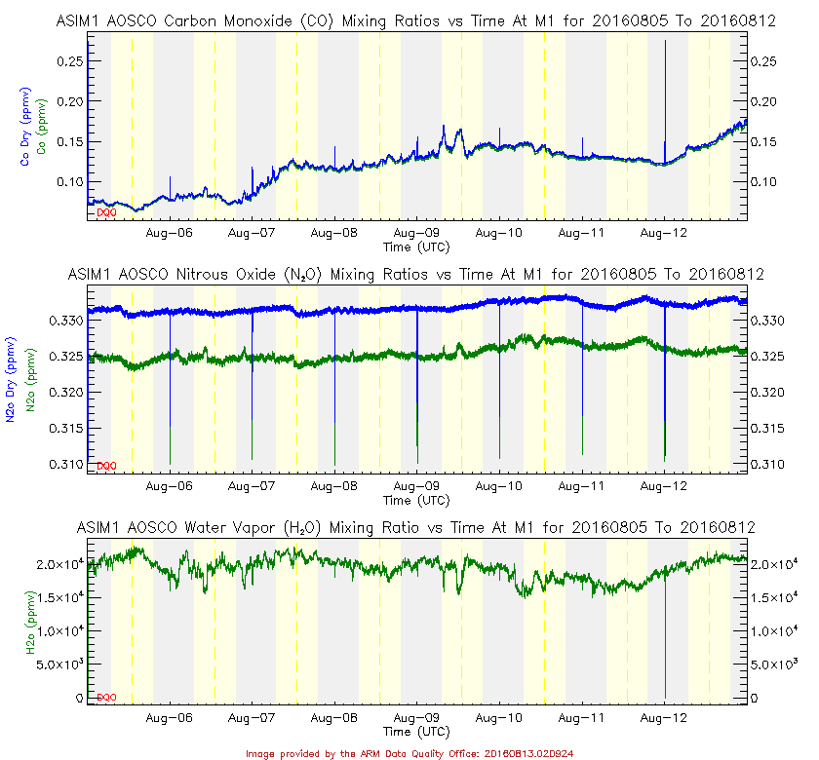
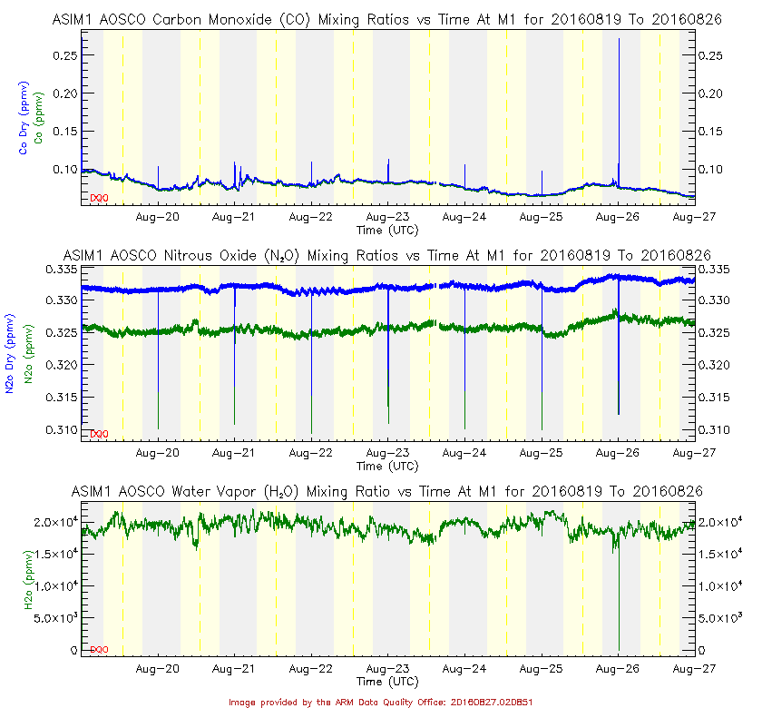
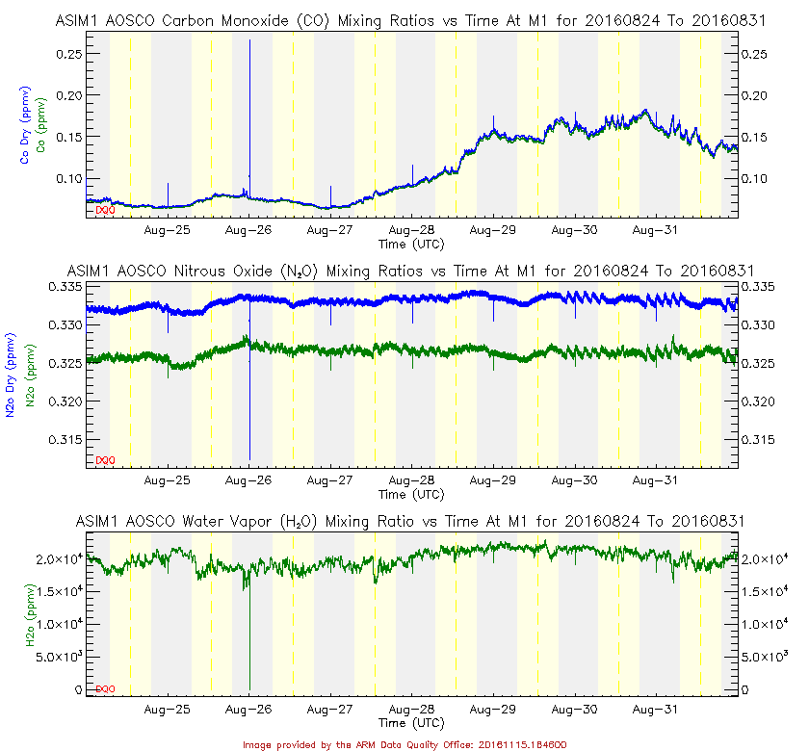
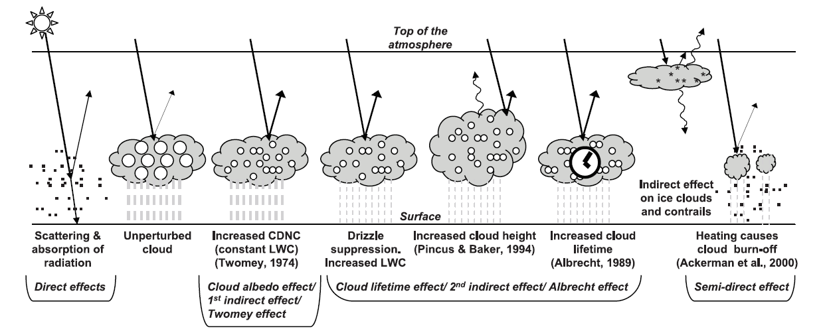
Vertical profile may be extremely important for precipitation.
Can a simple carbon monoxide sensor add to the skill of precipitation forecasts?
Terminal Area Forecast (TAF, NWP forecast + forecaster intervention)
Can’t rain
My forecast
Can’t rain
Can’t rain
Can’t rain
Actuals
Didn’t rain
Didn’t rain
Hypothesis: Rain suppression caused by the presence of aerosols?
Data for August 2016

Slide 13
Development of high temporal resolution Satellite Retrievals

Slide 14
Aerosol Above Cloud and Cloud retrieval from MSG-SEVIRI
SEVIRI has large spectral bands that are strongly impacted by atmospheric gas absorption (H₂O, O₃, CH₄ , CO₂…) .
Improvement of the Met Office atmospheric correction scheme based on forecast water vapor profile and fast radiative transfer calculation. (New corrections are applied to the operational retrieval of cloud properties with SEVIRI.)
Above Cloud AOD
SEVIRI retrieval of AOD above clouds and cloud properties (COT and r_{eff})
Work on 2016 case studies to adjust the retrieval (atmospheric correction, aerosol model …)
Comparison with the above cloud products from MODIS (K. Meyer)
SEVIRI
MODIS

Slide 15
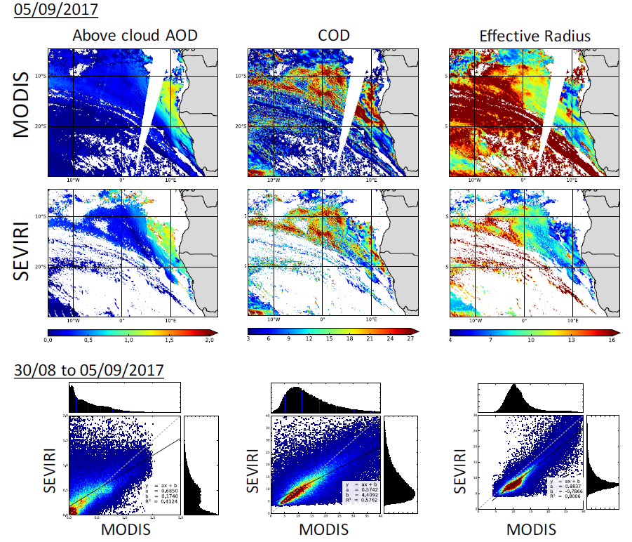
Fanny Peers – University of Exeter
MODIS vs. SEVIRI comparison : results for 05/09/2017
MODIS vs. SEVIRI 30/08/2017 – 05/09/2017
Encouraging and will enable comparison at any time of day…….

Slide 16
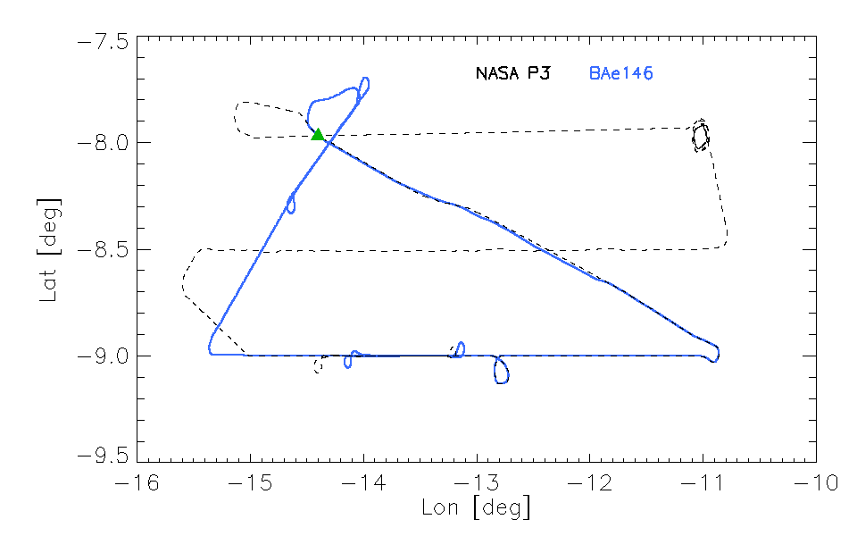
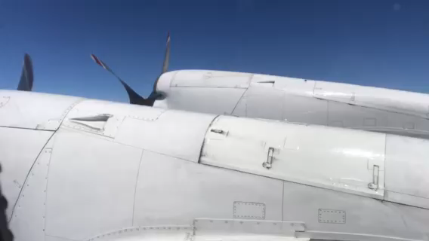
NASA P3, BAe146 Intercomparison
Segment | Start [UTC] | End [UTC]
Run 18 kft | 123850 | 130222
Profile | 130222 | 132001
Run 1000ft | 132018 | 133911
Track Plot 18 August

Slide 17
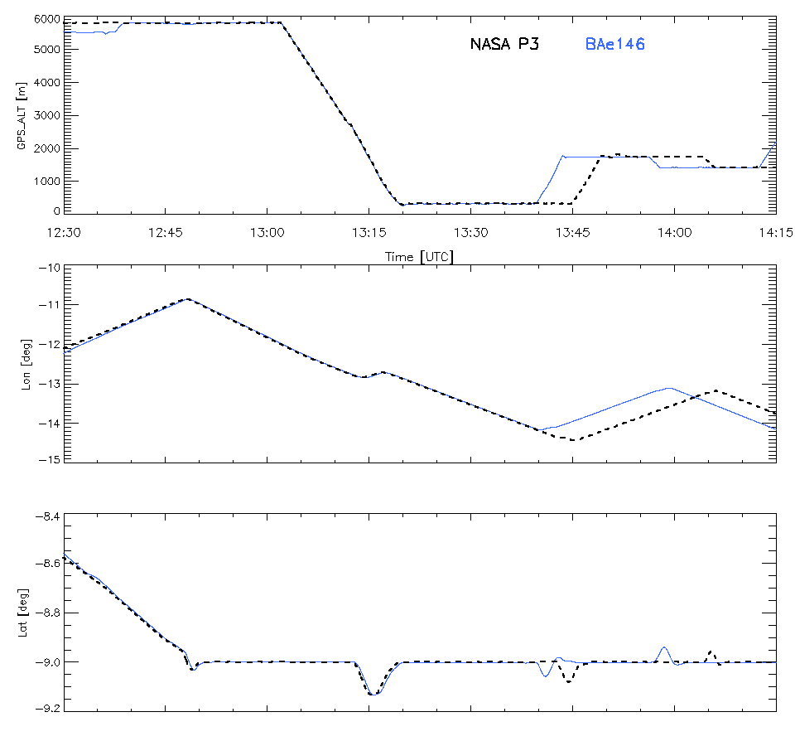
Run 18 kft
Profile
Run “Cloud”
Run 1 kft
Segment | Start [UTC] | End [UTC]
Run 18 kft | 123850 | 130222
Profile | 130222 | 132001
Run 1 kft | 132018 | 133911
Run “Cloud” | ? 5 min trailing | ?

Slide 18
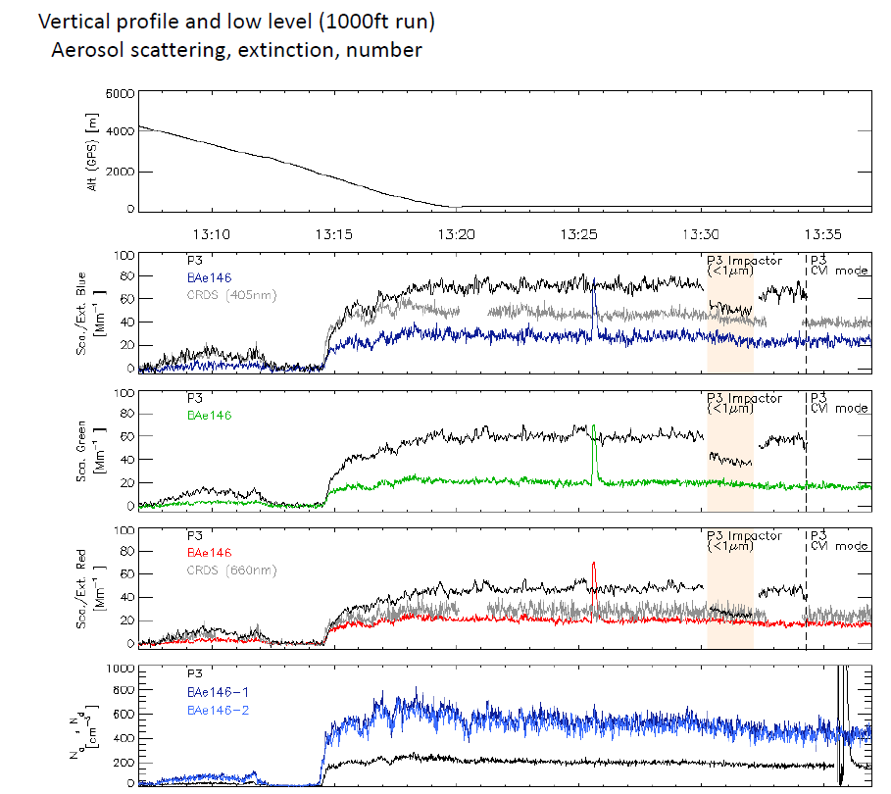
Take-home messages from inter-comparison of P3 and BAe146:
T, Td are in close agreement
Some difference in u,v,w
Question marks around:-
  FAAM nephelometer (too low)
  P3 PCASP (too low)
Update – we think that the neph is OK – see how the P3 impactor to remove particles < 1mm leads to agreement with the CRDS and nephelometer.

Slide 19
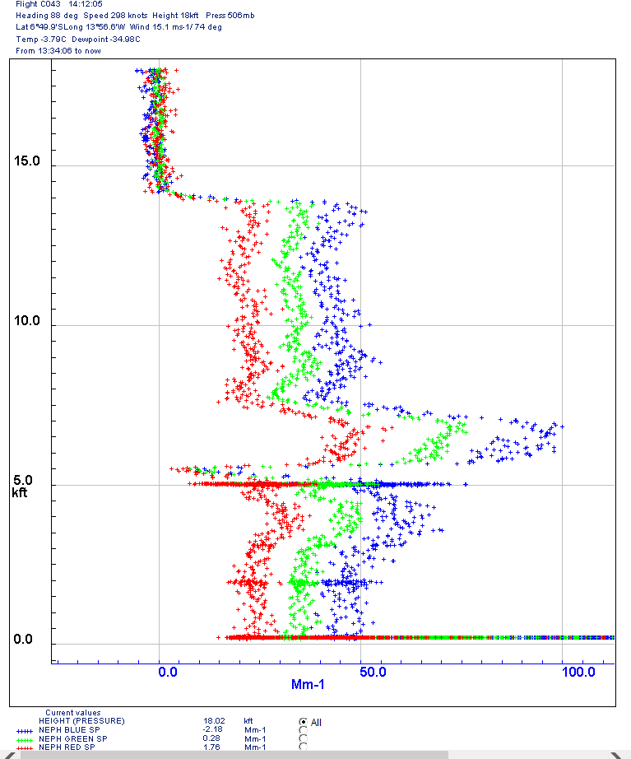
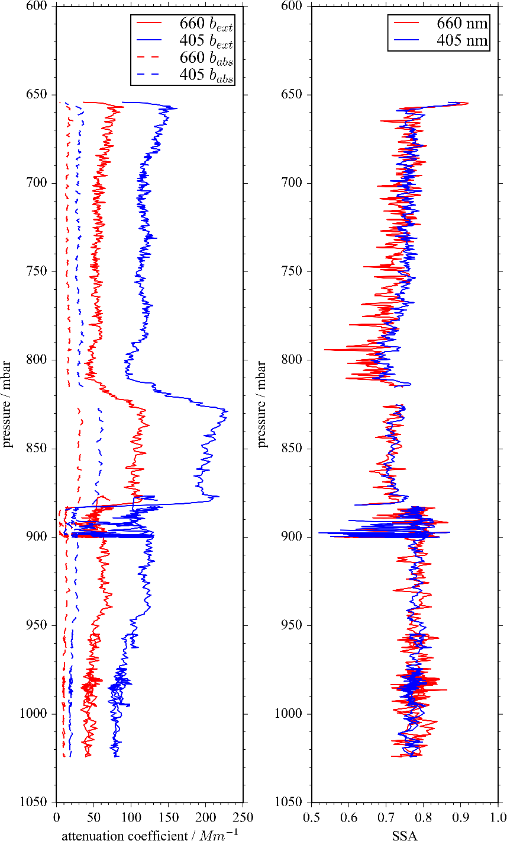
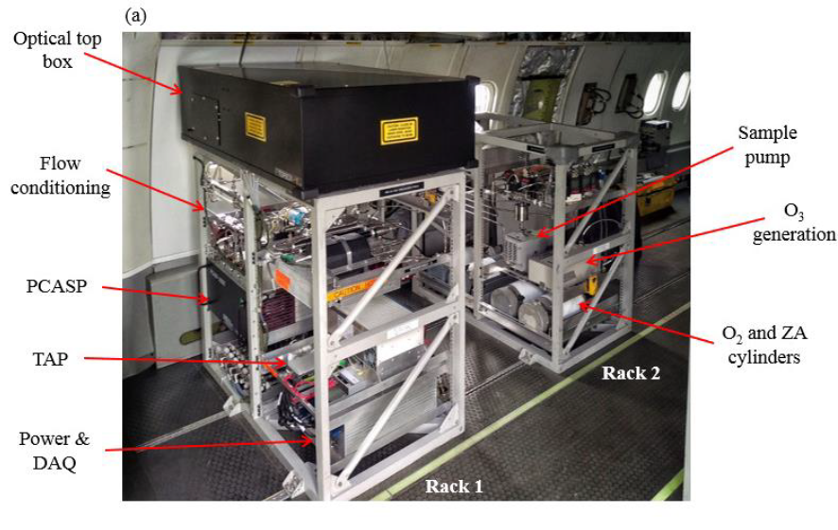
Comparison to Nephelometer Data
T/O
One of the state-of-the-art pieces of airborne equipment is the EXSCALABAR system – CRD with PAS (extinction and absorption).
These measurements confirm that the nephelometer appears to be biased low. Under investigation.
Single scattering albedo at 405-660nm typically ~0.80+/- 0.08. Needs updating!
Profile ascent from ASI (T/O)

Slide 20
Conclusions
The deployment was an overwhelming success
The vertical profile is very variable and very important in both the ARI and the ACI
Some models represent the vertical profile of aerosol and cloud adequately
We cannot be complacent about models: a CO sensor does better for rainfall than a £100m model and years of forecaster experience!
Satellite retrievals and a range of models are being used for further assessments

