Slide 1
Understanding CCN and ACI for CLouds and Aerosol Radiative Impacts and Forcing: Year 2016
2017
CLARIFY Project Meeting Exeter
04/10/2018
Haochi Che, Philip Stier, Duncan Watson-Parris & Matthew Christensen, Will Jones, Lucia Deaconu, Laurent Labbouz
Atmospheric, Oceanic and Planetary Physics Department of Physics
University of Oxford

Slide 2
Simulations
HadGEM-UKCA simulation in UKESM1 setup:
Nudged runs for 2016-2017
PD using GFAS biomass burning emissions (additional runs using CMIP6 2014 emissions)
PI using CMIP6 emissions
CCN source attribution through sensitivity runs: no wildfires (BBA), DMS, sea salt, dust, emissions, no SOA formation, no nucleation
(Haochi Che, Duncan Watson-Parris, Philip Stier)

Slide 3
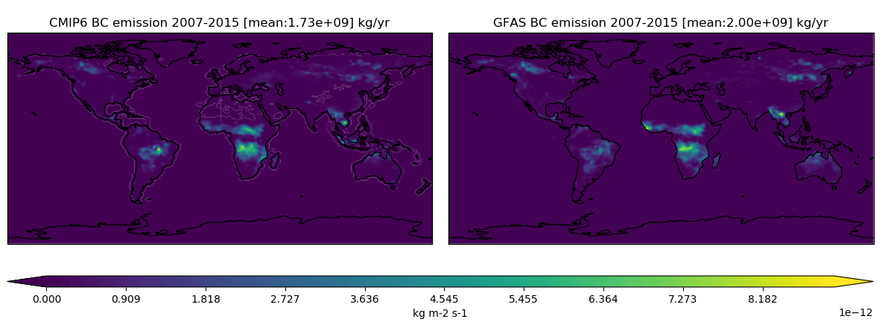
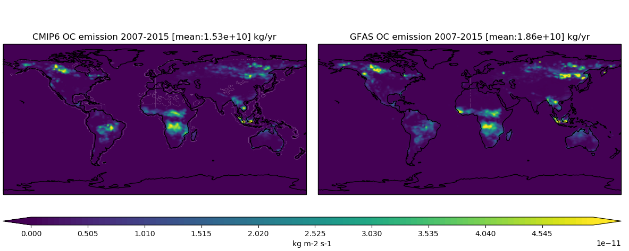
Emissions
(Haochi Che, Duncan Watson-Parris, Philip Stier)

Slide 4
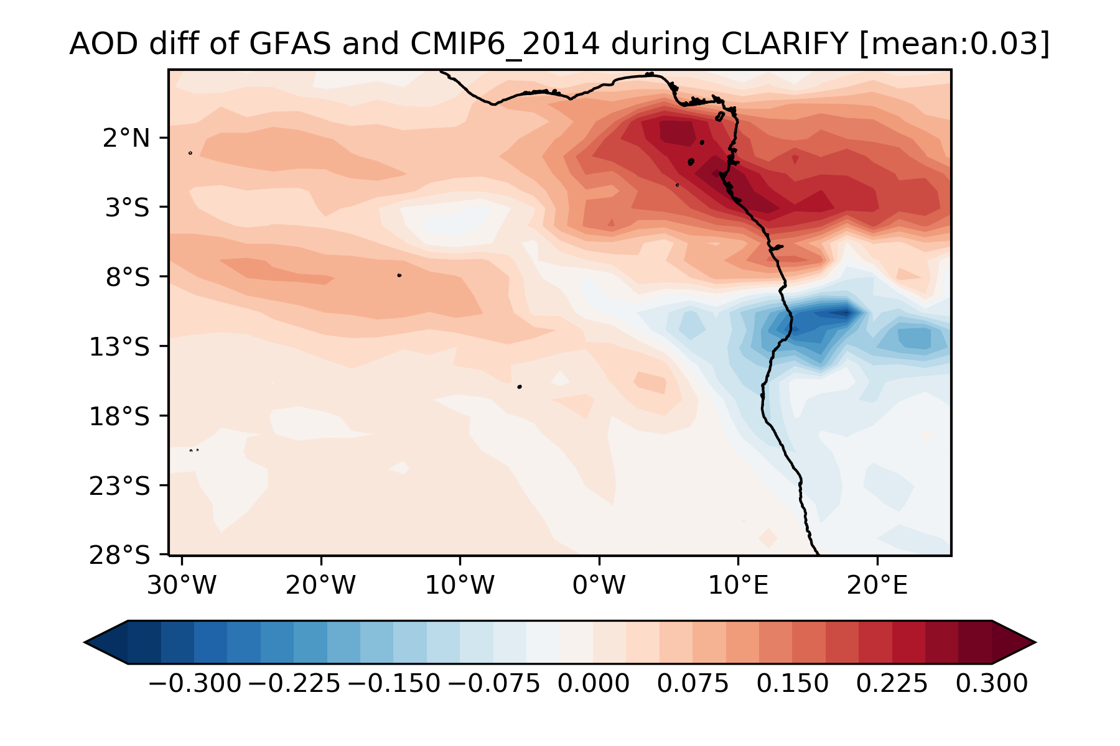
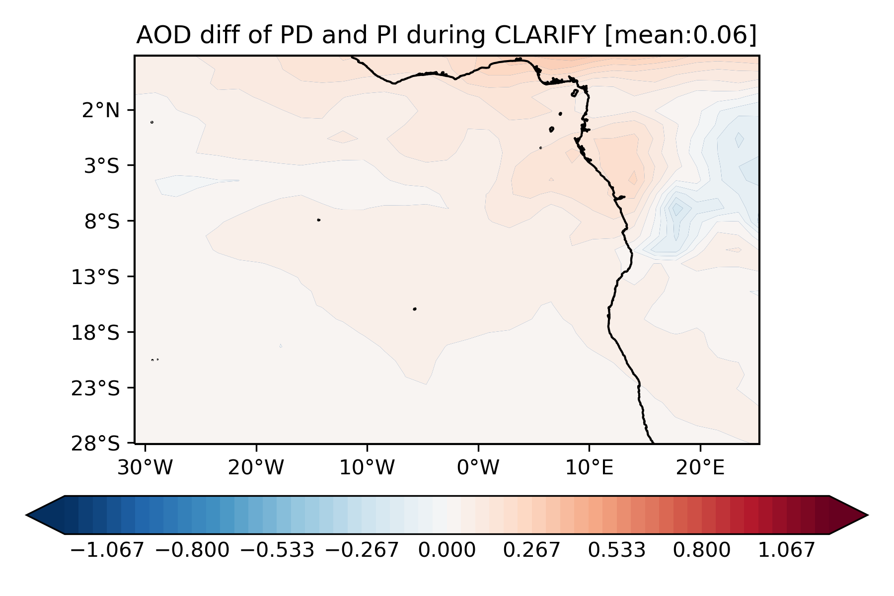
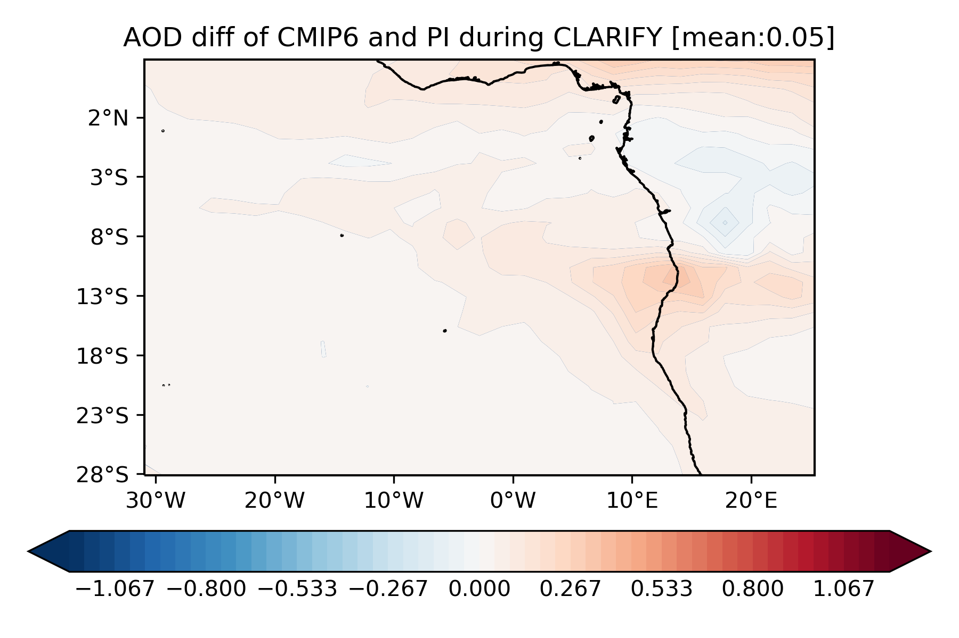
AOD
AOD difference between GFAS and CMIP present day emissions
AOD difference PD(GFAS)-PI(CMIP)
AOD difference PD(CMIP)-PI(CMIP)
CMIP6 PD
(Haochi Che, Duncan Watson-Parris, Philip Stier)

Slide 5
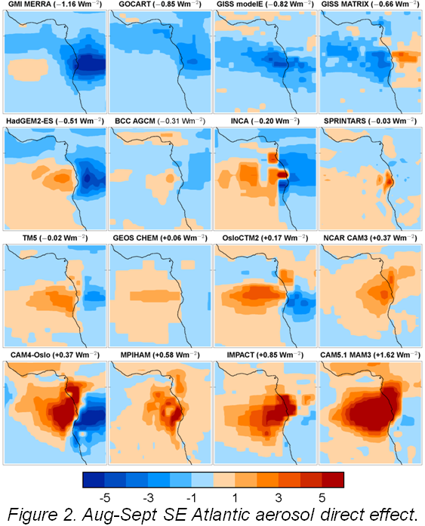
AOD
AOD difference between GFAS and CMIP present day emissions
Emission differences could explain part of AeroCom model forcing diversity
CMIP6 PD

Slide 6
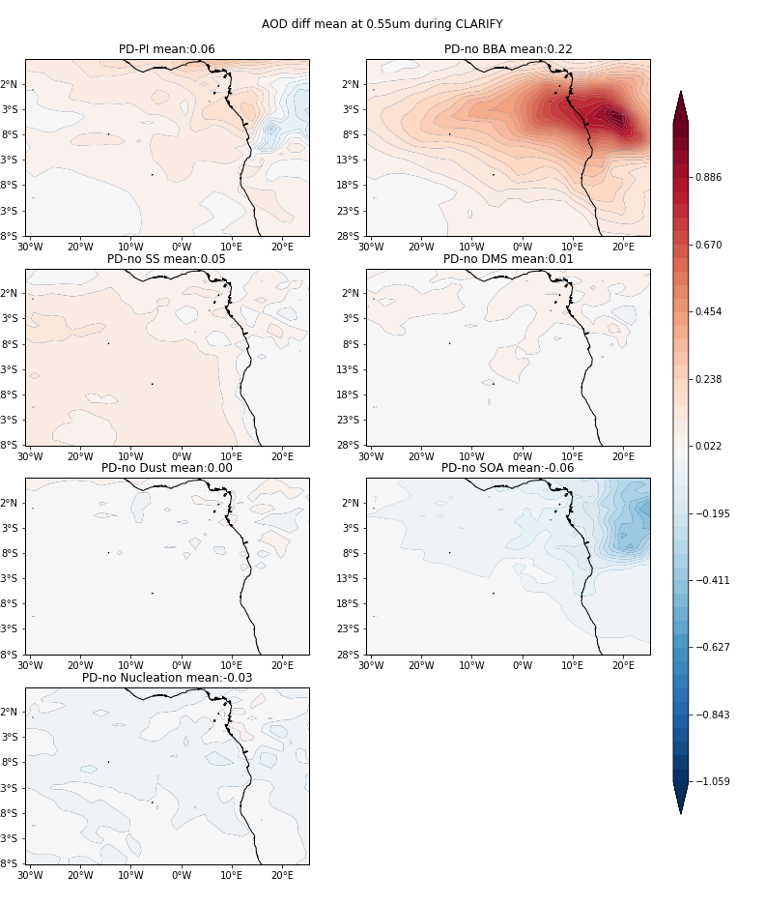
AOD by source
PD-PI
BBA
Complex pattern of anthropogenic AOD
Biomass burning aerosol dominates AOD over CLARIFY region (surprise)
Significant “natural” component of BB aerosol
SS
DMS
Dust
SOA
CMIP6 PD
Nucleation
(Haochi Che, Duncan Watson-Parris, Philip Stier)

Slide 7
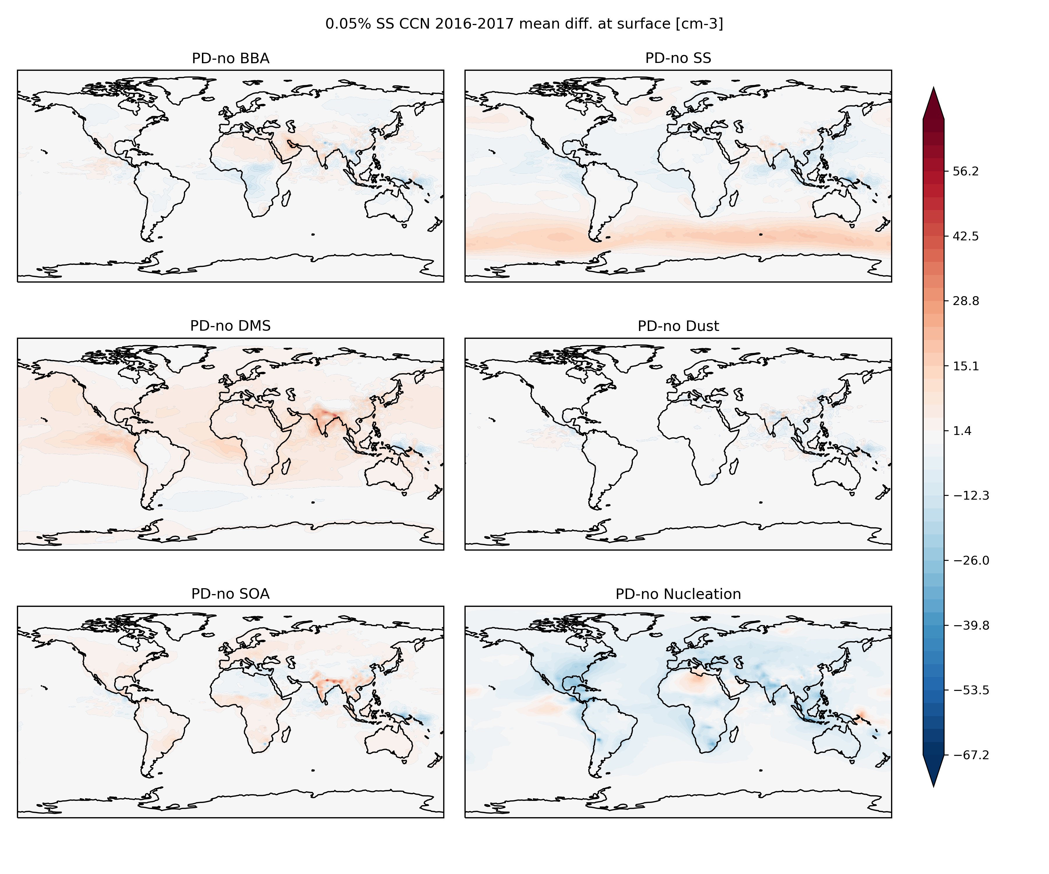
CCN by source
Surface CCN_{0.05%} by source
BBA
SS
Complex contribution of aerosol sources to CCN_{0.05%}
Overall contribution to CCN small
DMS
Dust
CMIP6 PD
SOA
Nucleation
(Haochi Che, Duncan Watson-Parris, Philip Stier)

Slide 8
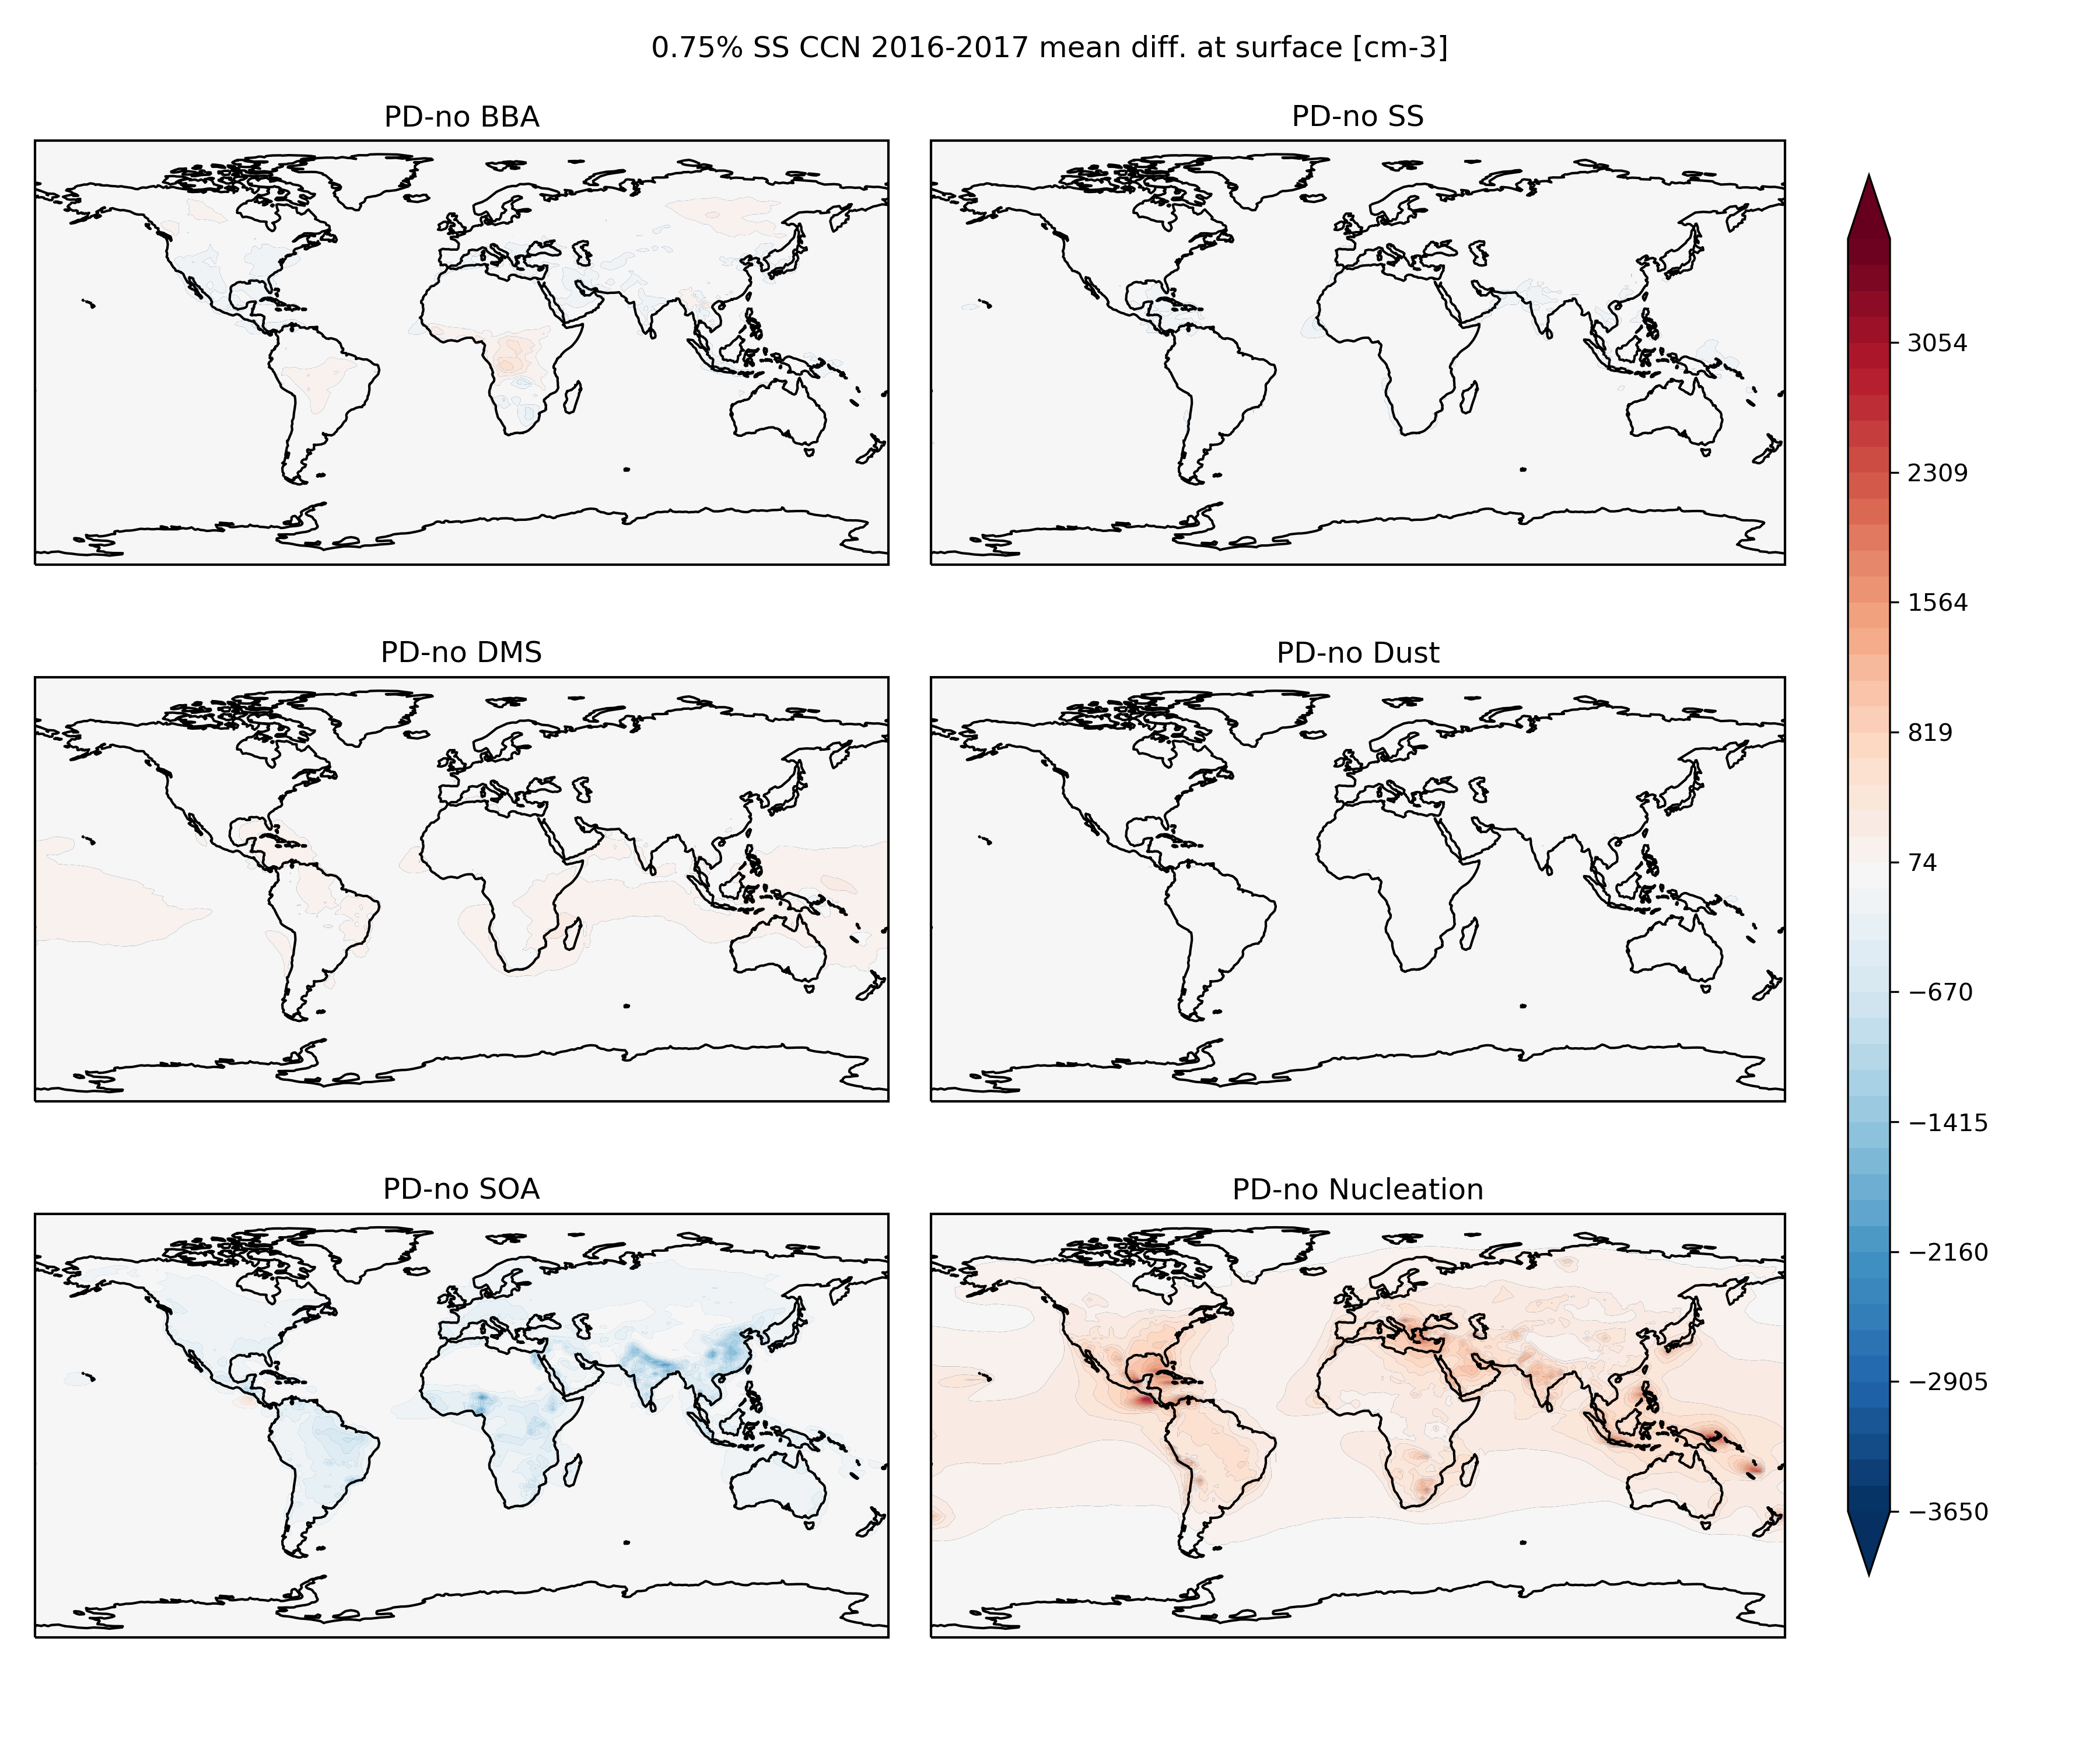
CCN by source
Surface CCN_{0.75%} by source
BBA
SS
Significant contribution of nucleation to CCN_{0.75%}
DMS
Dust
SOA
Nucleation
(Haochi Che, Duncan Watson-Parris, Philip Stier)

Slide 9
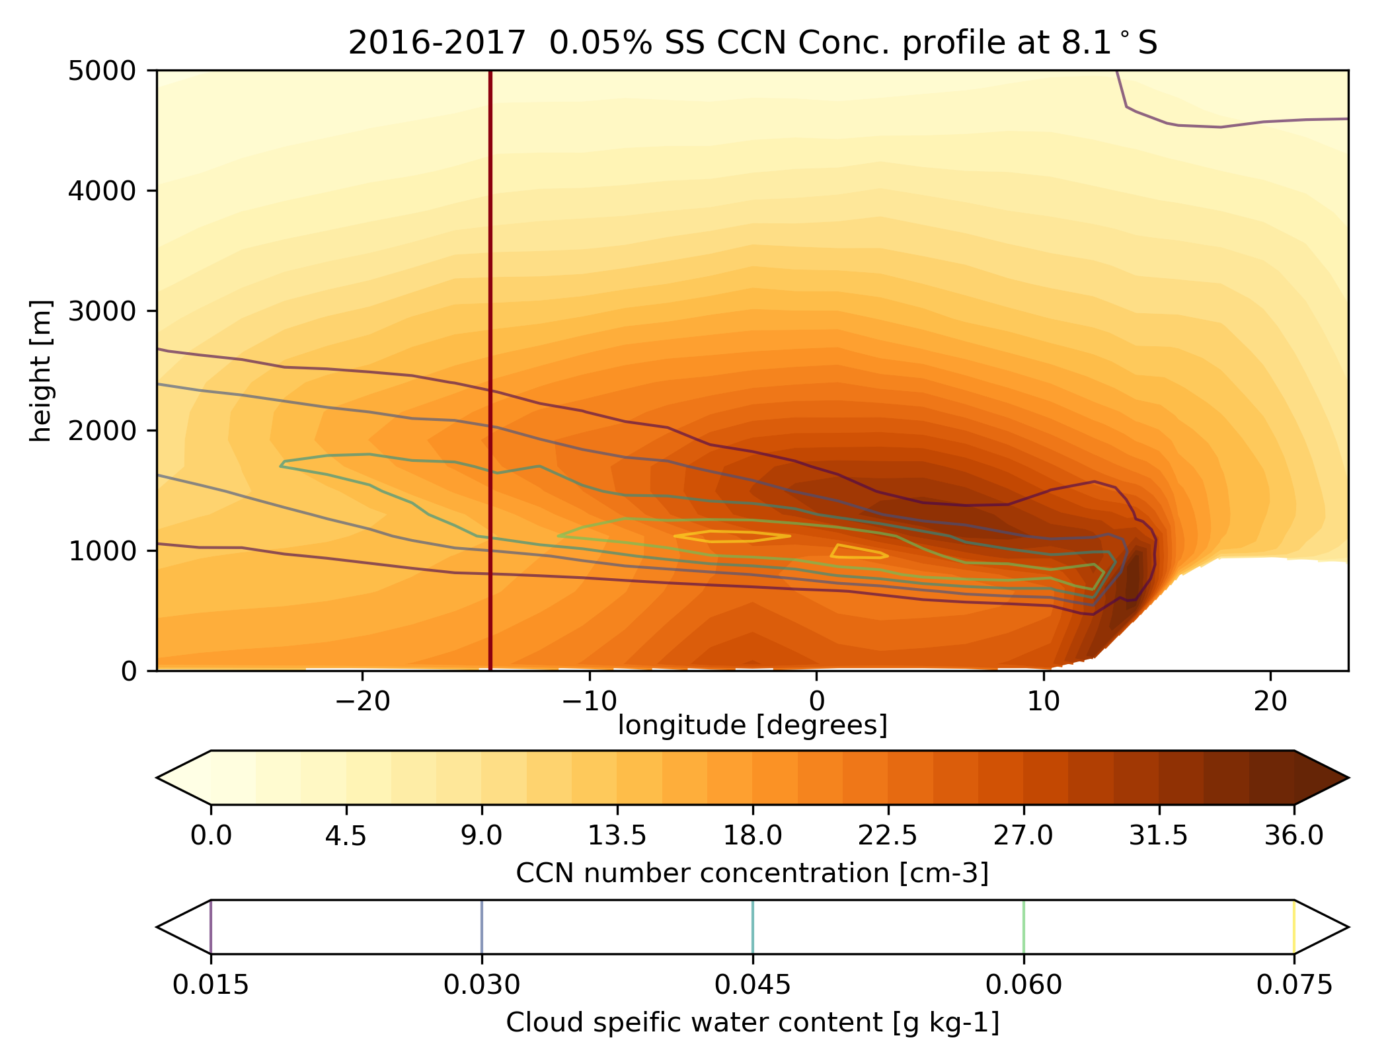
CCN along 8.1°S
Complex contribution of aerosol sources to CCN_{0.75%}
(Haochi Che, Duncan Watson-Parris, Philip Stier)

Slide 10
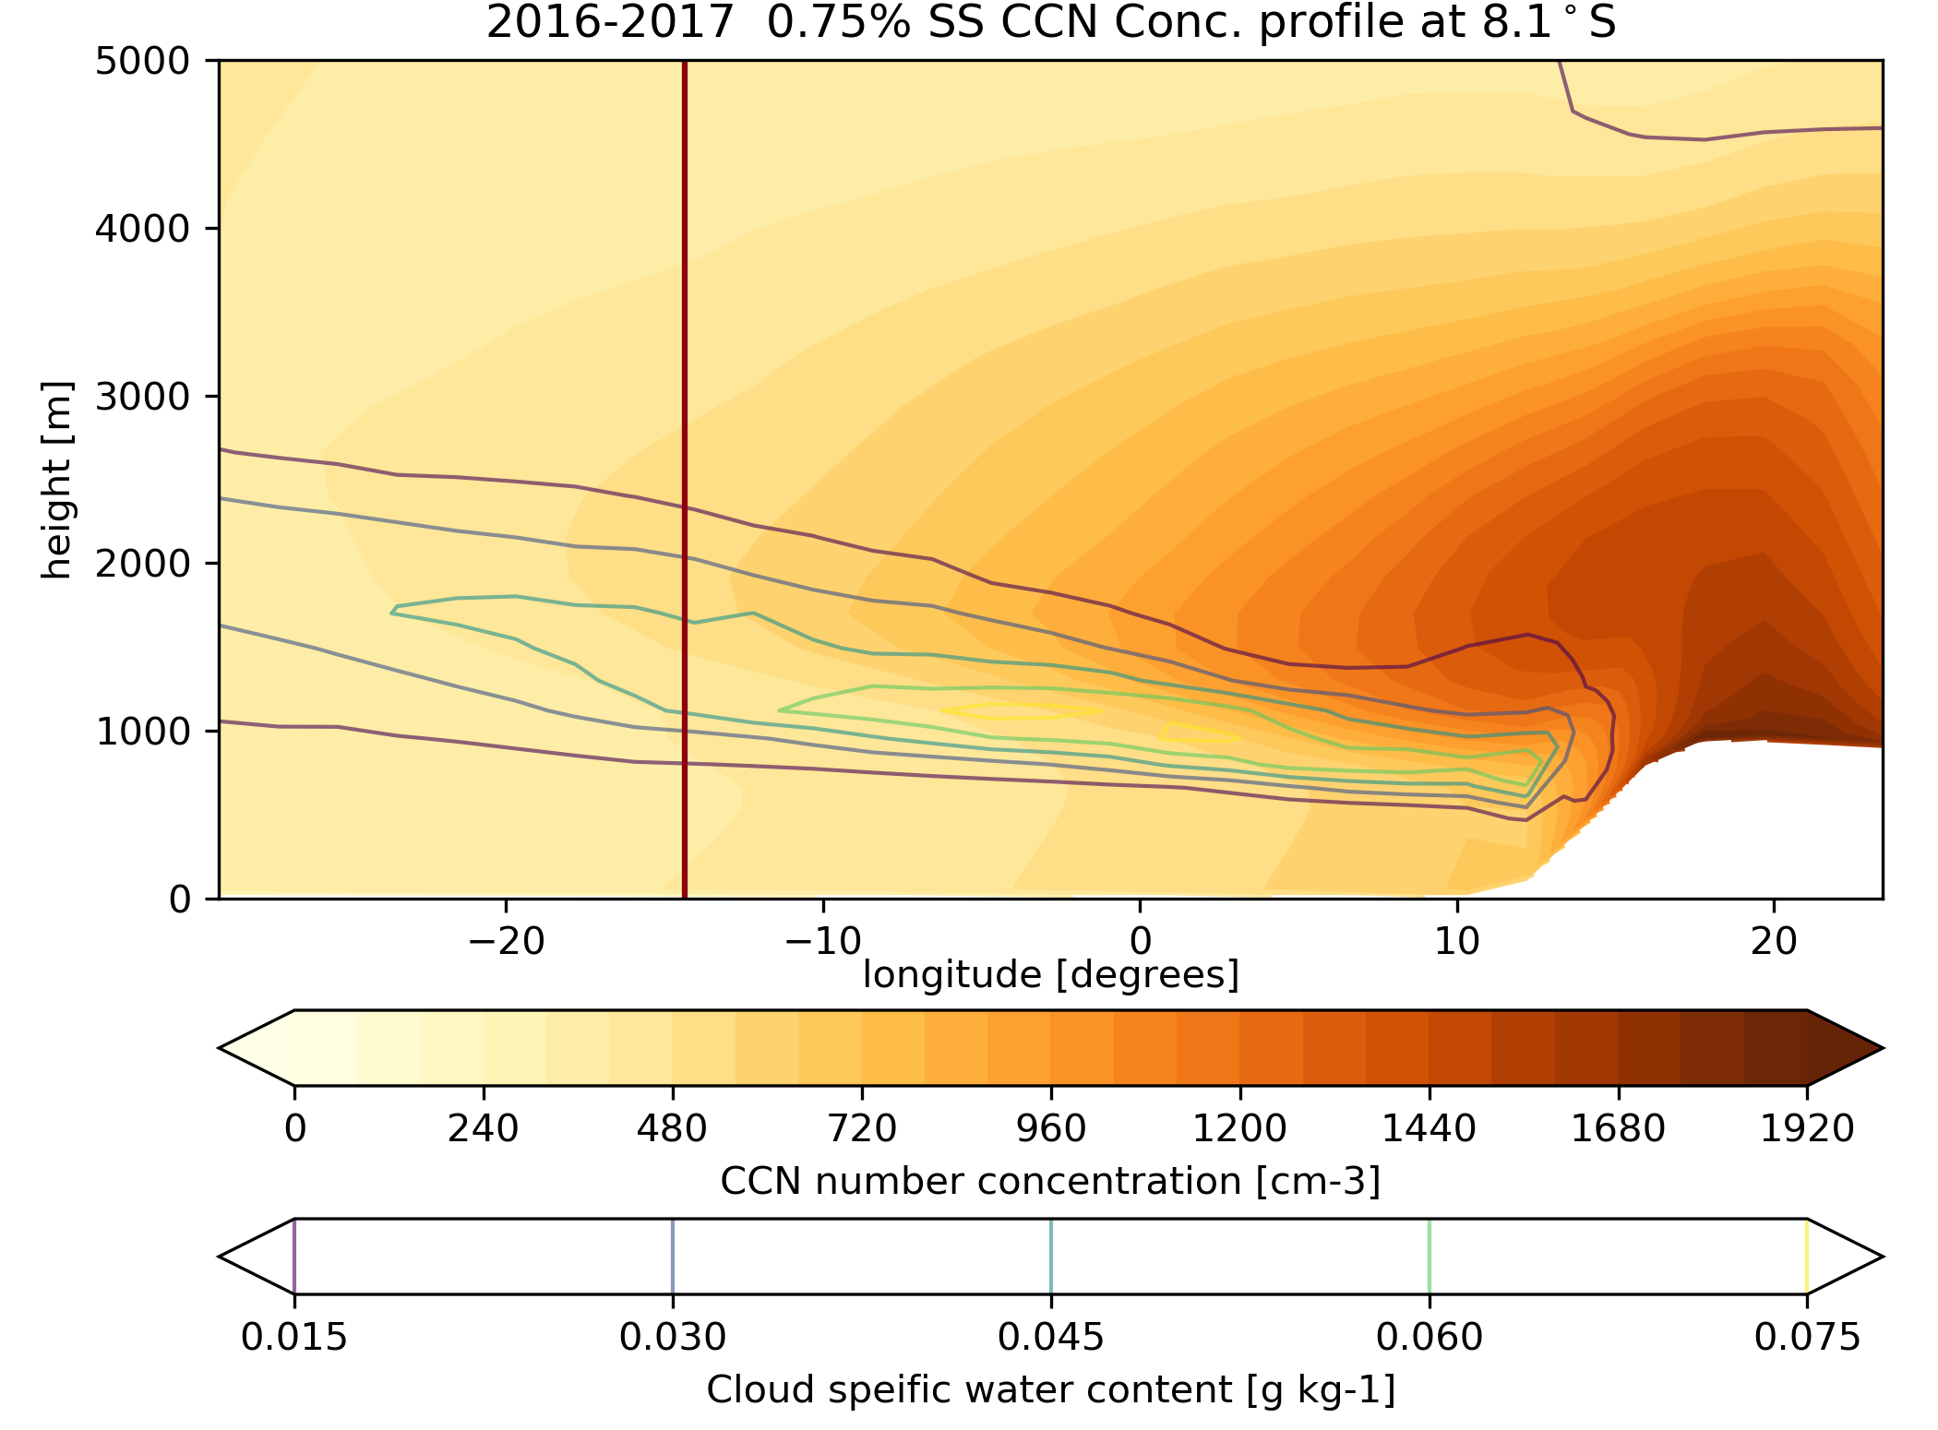
CCN along 8.1°S
Complex contribution of aerosol sources to CCN_{0.75%}
(Haochi Che, Duncan Watson-Parris, Philip Stier)

Slide 11
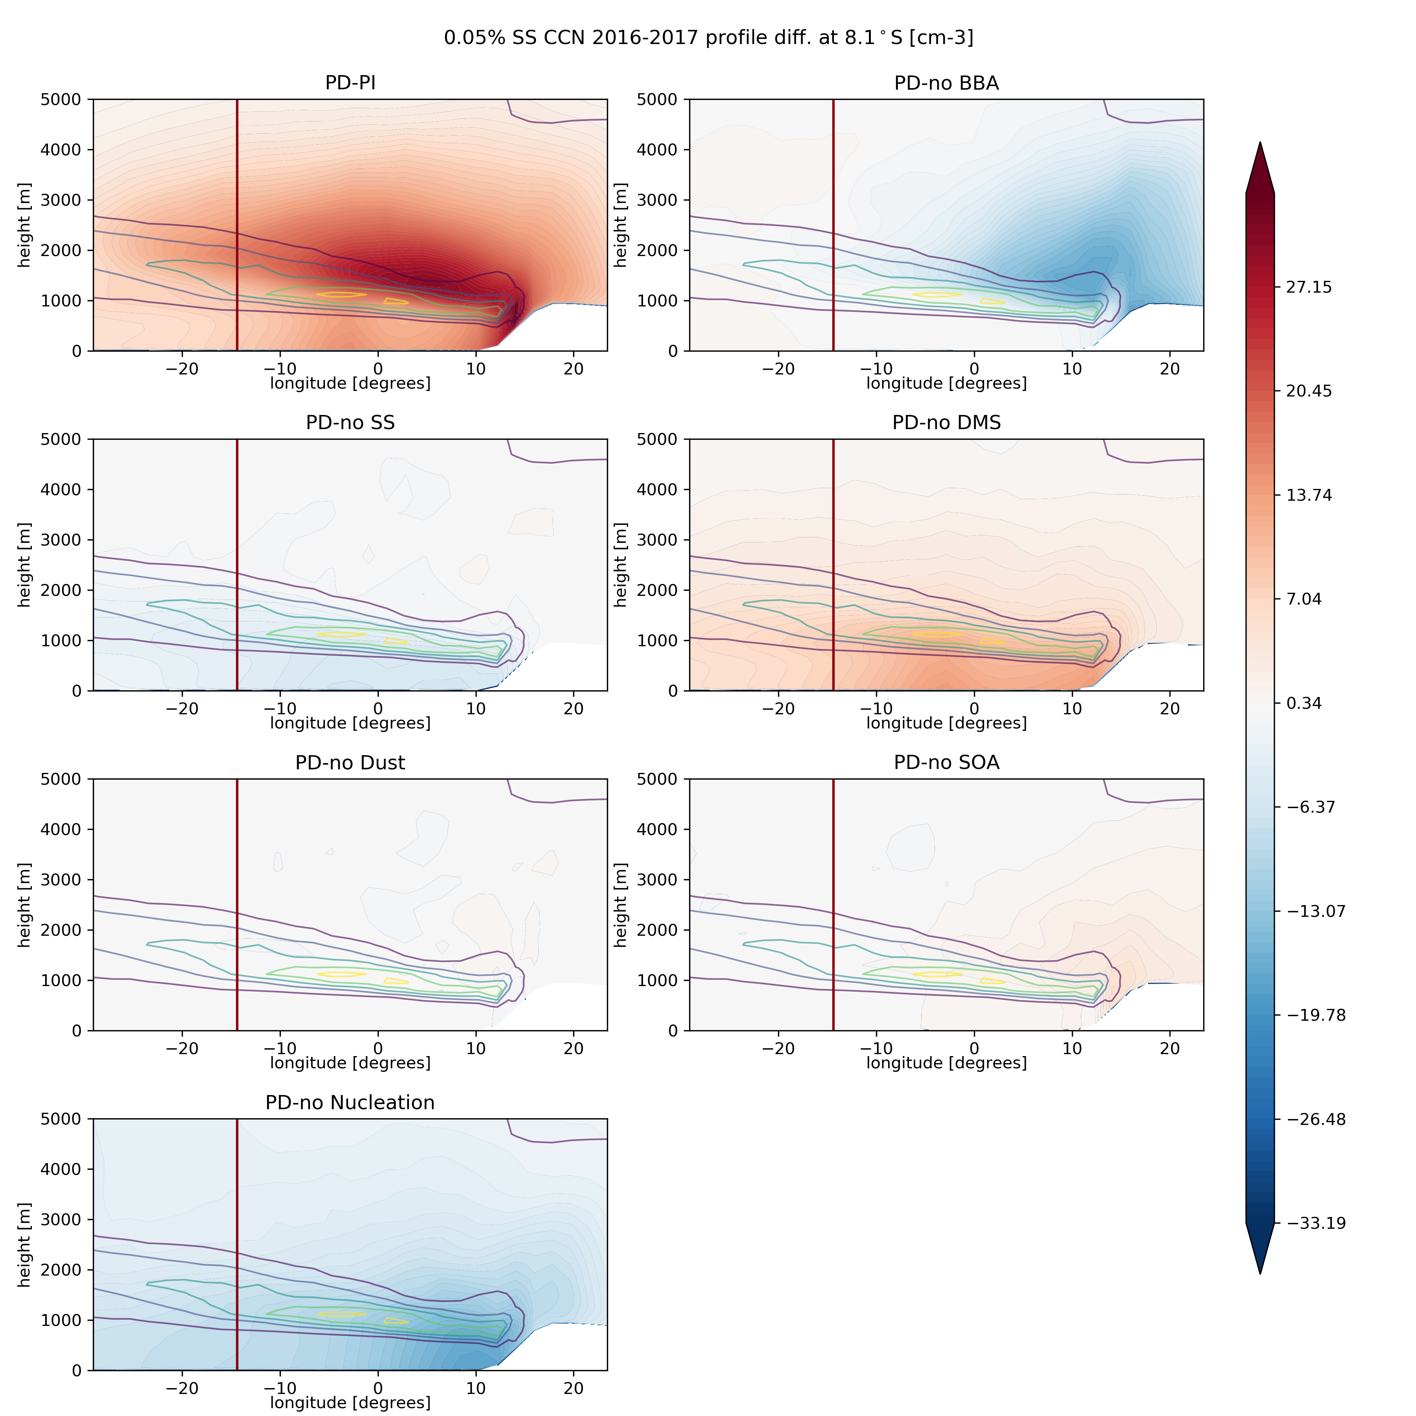
CCN along 8.1°S
Complex contribution of aerosol sources to CCN_{0.05%}
PD-PI
BBA
SS
DMS
PD
Dust
SOA
Nucleation
(Haochi Che, Duncan Watson-Parris, Philip Stier)

Slide 12
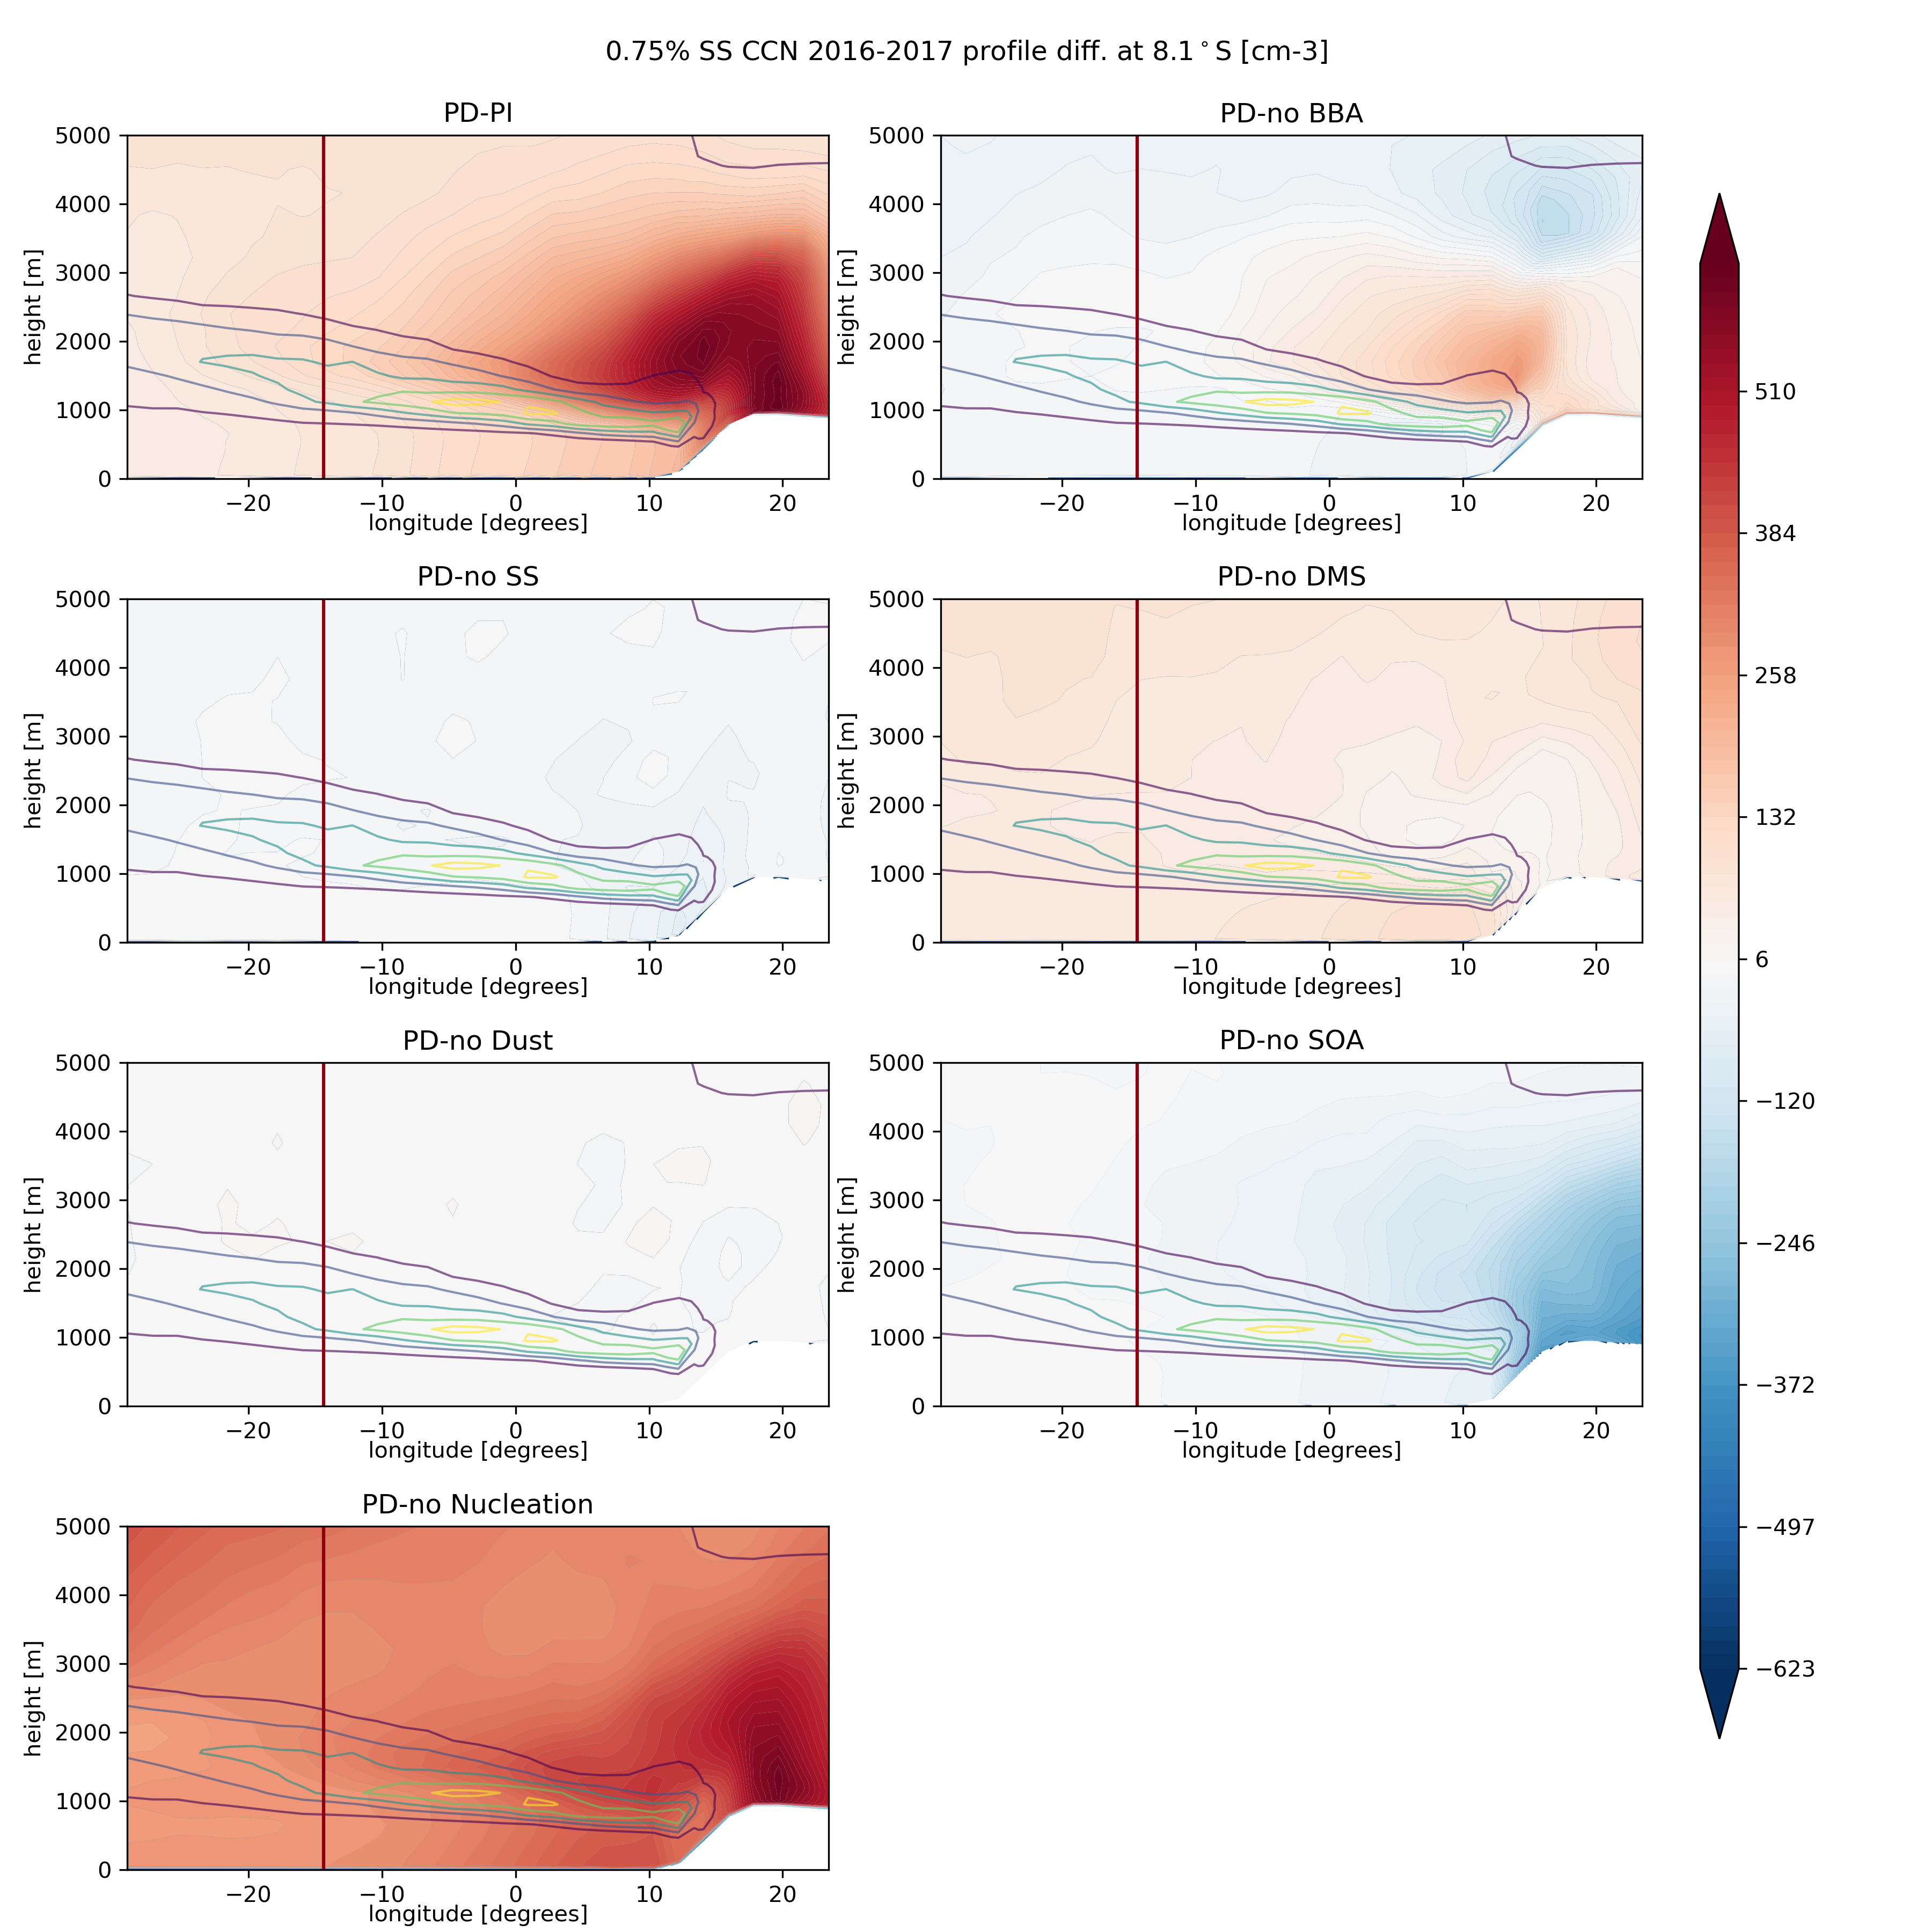
CCN along 8.1°S
Complex contribution of aerosol sources to CCN_{0.75%}
PD-PI
BBA
SS
DMS
PD
Dust
SOA
Nucleation
(Haochi Che, Duncan Watson-Parris, Philip Stier)

Slide 13
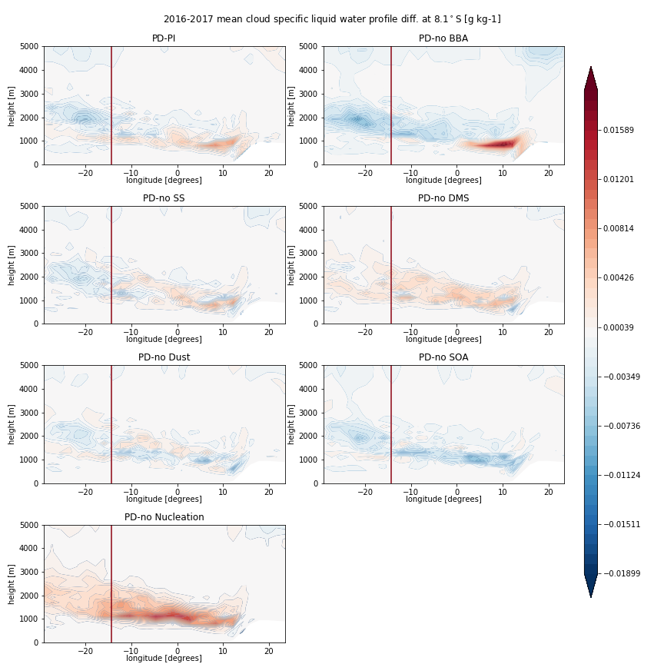
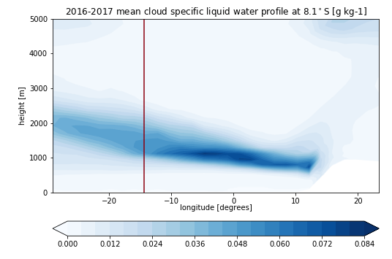
Cloud Liquid Water along 8.1°S
Complex contribution of aerosol sources to CCN_{0.75%}
PD-PI
BBA
SS
DMS
PD
Dust
SOA
Nucleation
(Haochi Che, Duncan Watson-Parris, Philip Stier)

Slide 14
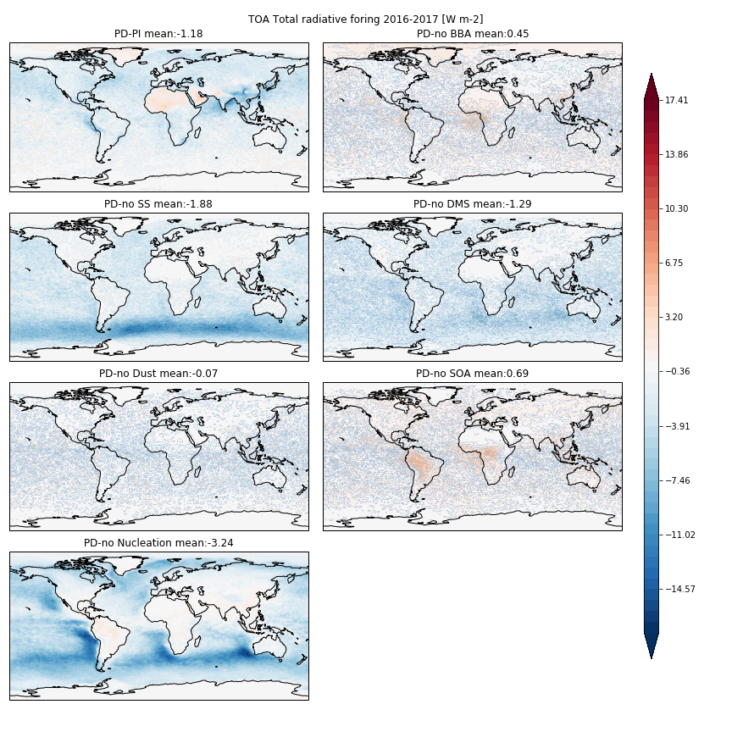
Effective Radiative Forcing
PD-PI
BBA
SS
DMS
Dust
SOA
Nucleation
[Wm⁻²]
(Haochi Che, Duncan Watson-Parris, Philip Stier)

Slide 15
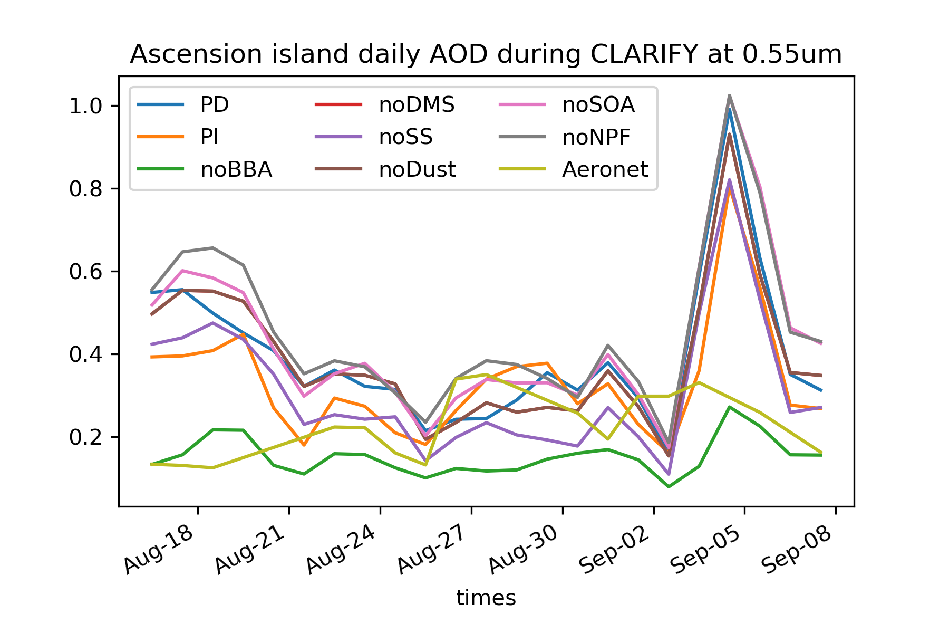
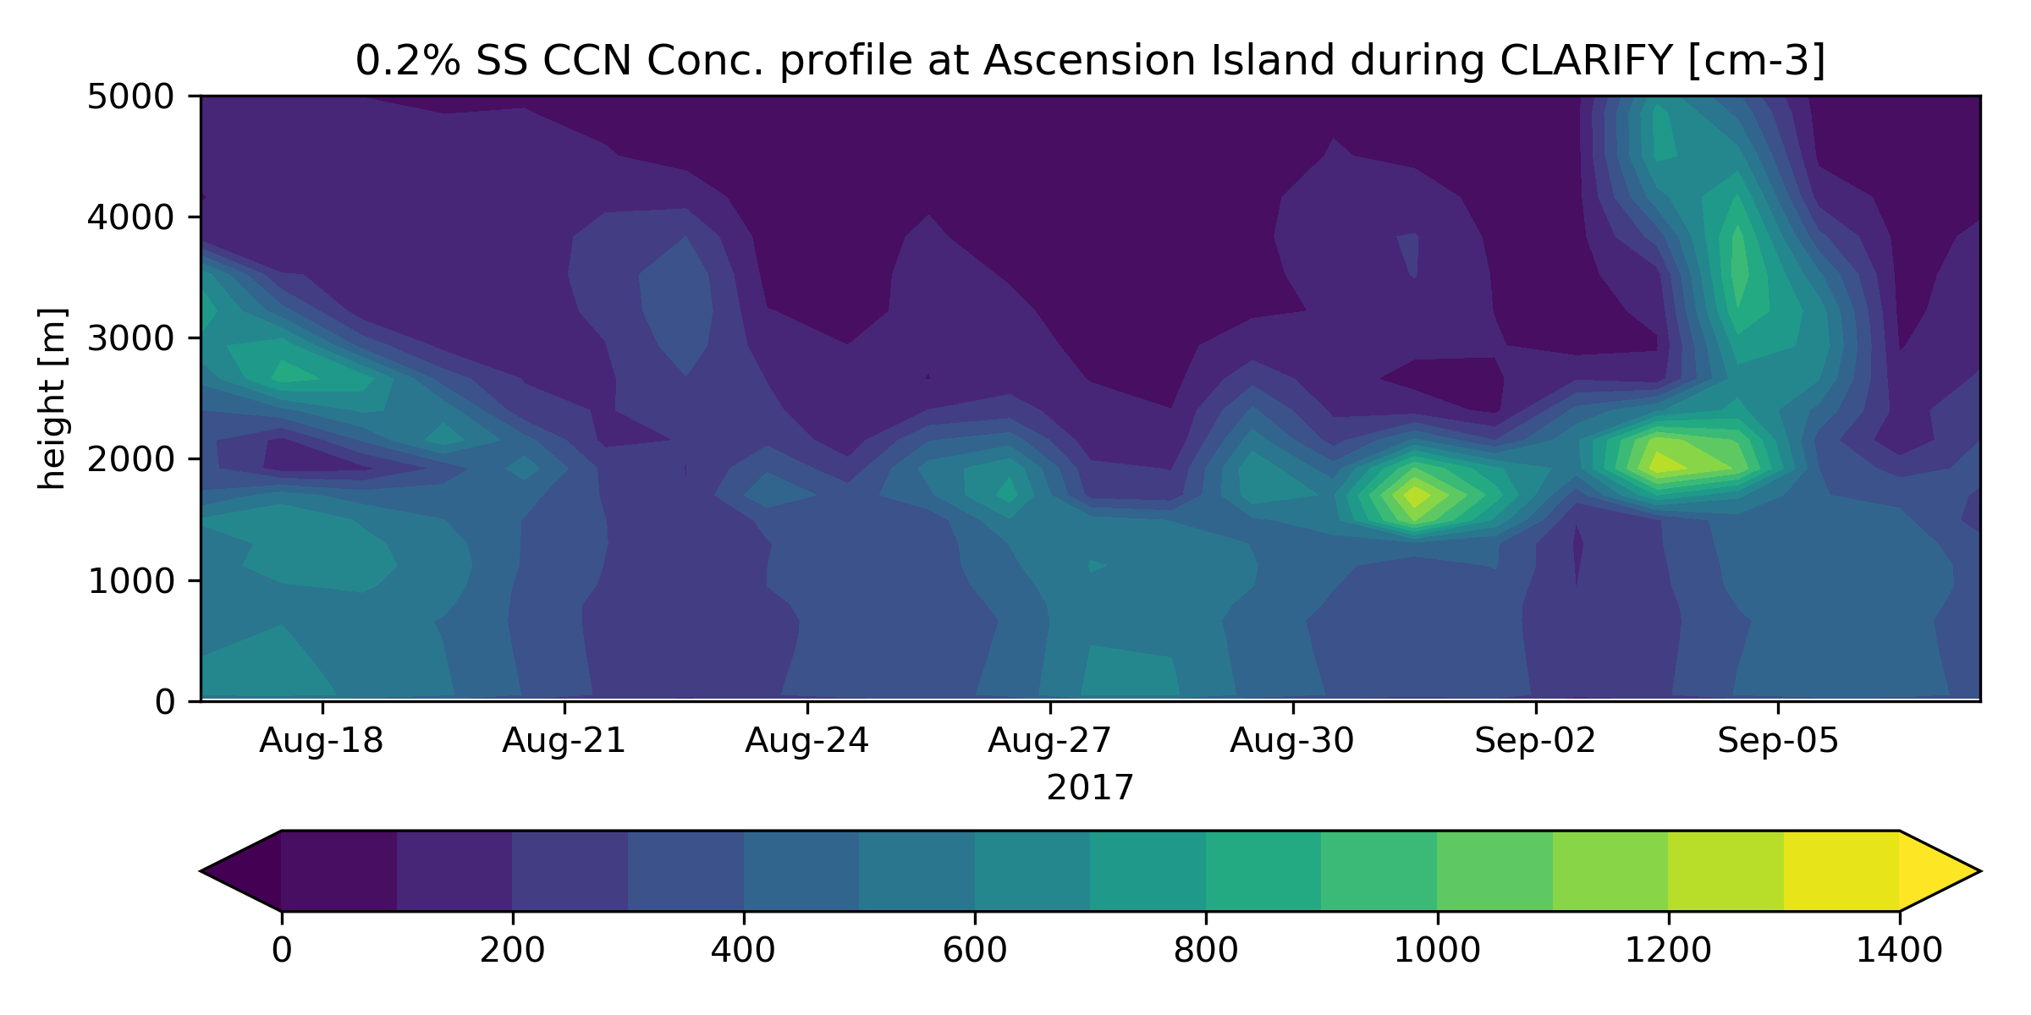
Evaluation
Obvious next step!
CMIP6 PD
Overestimation of AOD at Ascension island with exaggerated BB peaks
(Haochi Che, Duncan Watson-Parris, Philip Stier)

