Slide 1
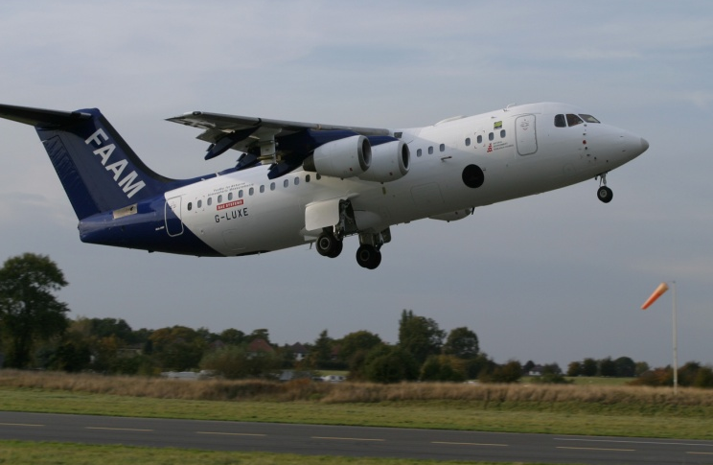
Chemical and Physical Properties of Aged Biomass Burning Aerosols over the South Atlantic During CLARIFY
Huihui Wu, Jonathan Taylor, James Allan, Dantong Liu, Michael Flynn, Paul Williams, James Dorsey, Hugh Coe, Steve Abel, Jim Haywood

Slide 2
Aerosol data products
AMS (aerosol mass spectrometer)
Processed: C028-39, C042-44(pinhole blocked), C045-51, C053, C052/54/55(half part pinhole blocked) Basic: Aerosol mass concentrations of organics, NO₃, SO₄, NH₄
Higher level: Organic composition (f₄₄, f₄₃, f₆₀)
SP₂ (single-particle soot photometer)
Processed: C028-C055
Basic: Black carbon mass concentration
Higher level: BC size distributions and coatings
SMPS (scanning mobility particle sizer)
Aerosol size distributions 20 – 350 nm
PCASP (passive cavity aerosol spectrometer probe)
Aerosol size distributions 0.12 – 2 µm

Slide 3
Internal measure comparison
AMS: C042-44, Pinhole blockage
C052,54,55, the start of these flights is OK, but then AMS pinhole got blocked.

Slide 4
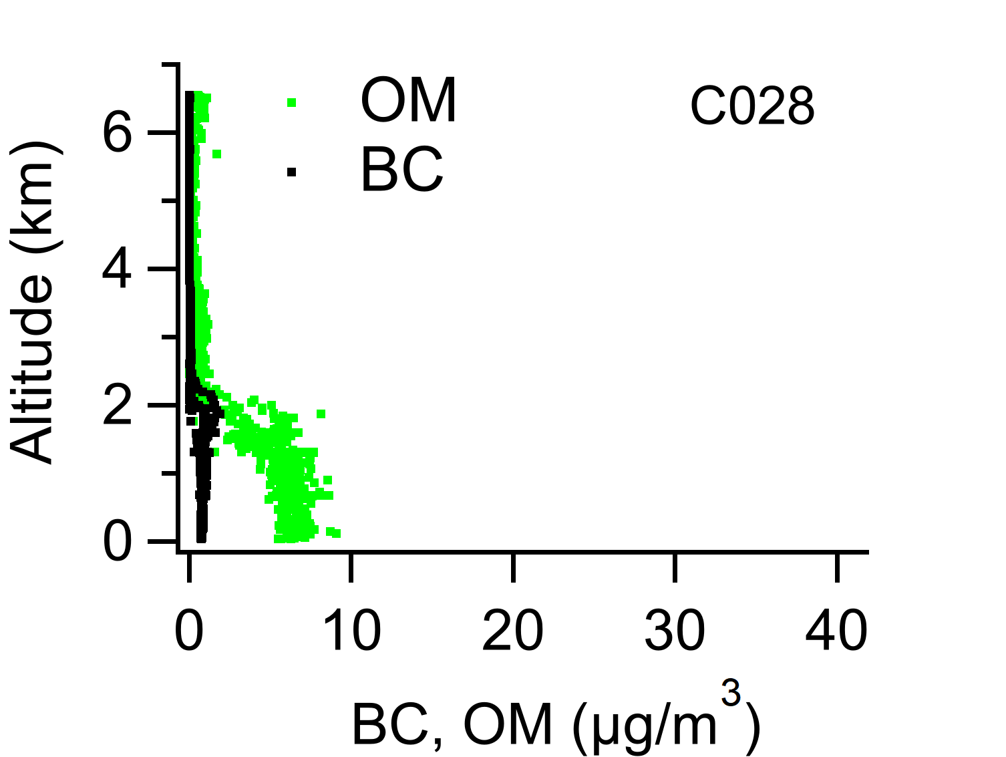
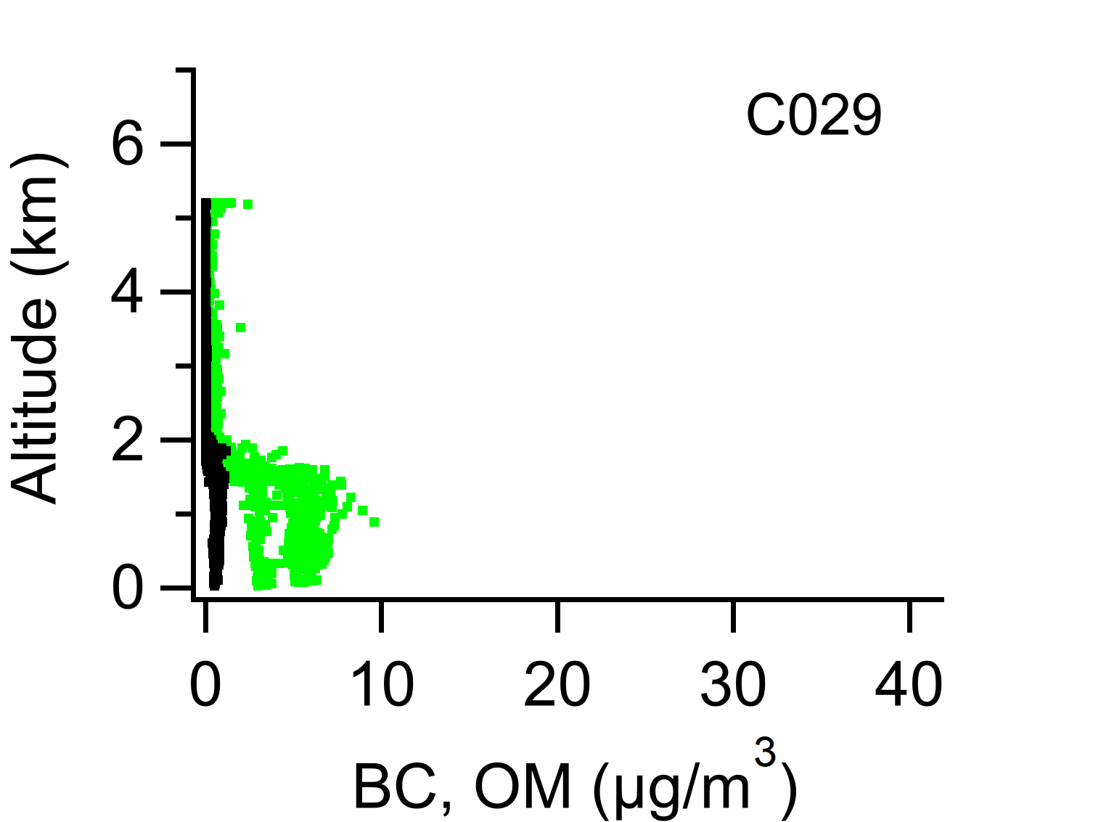
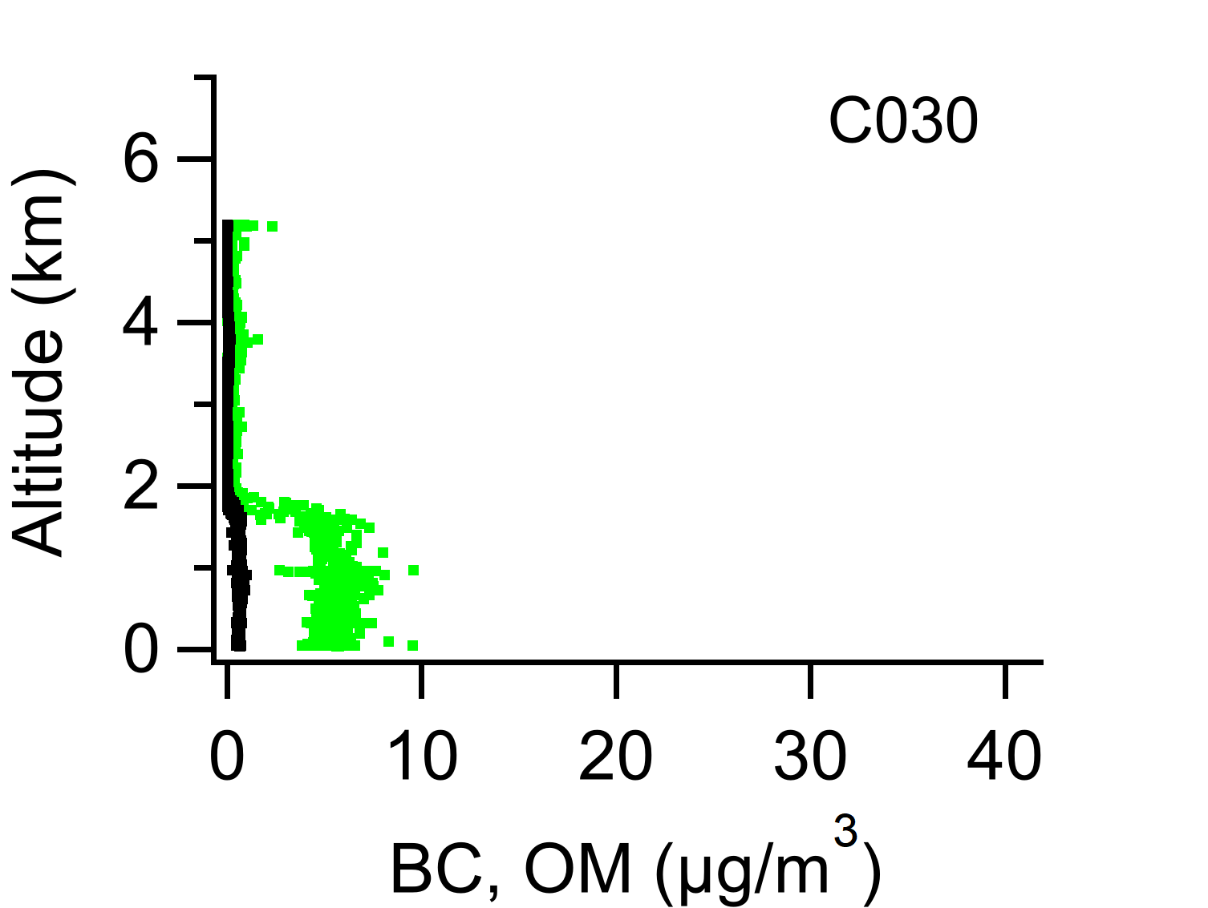
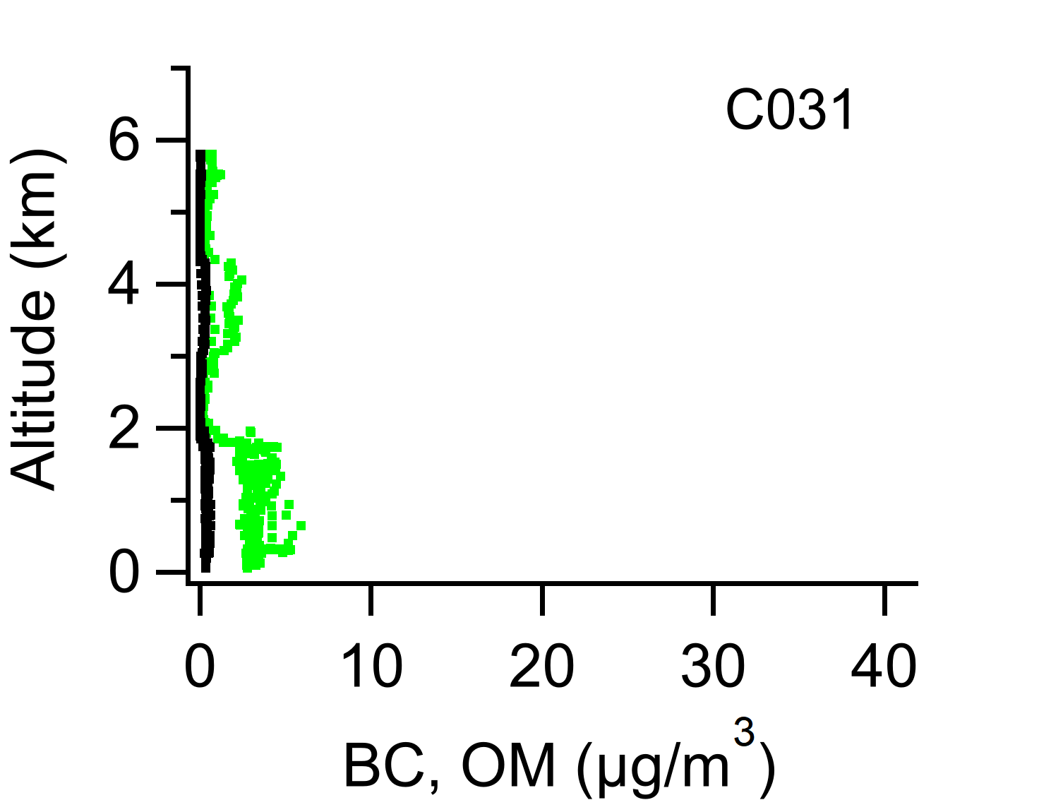
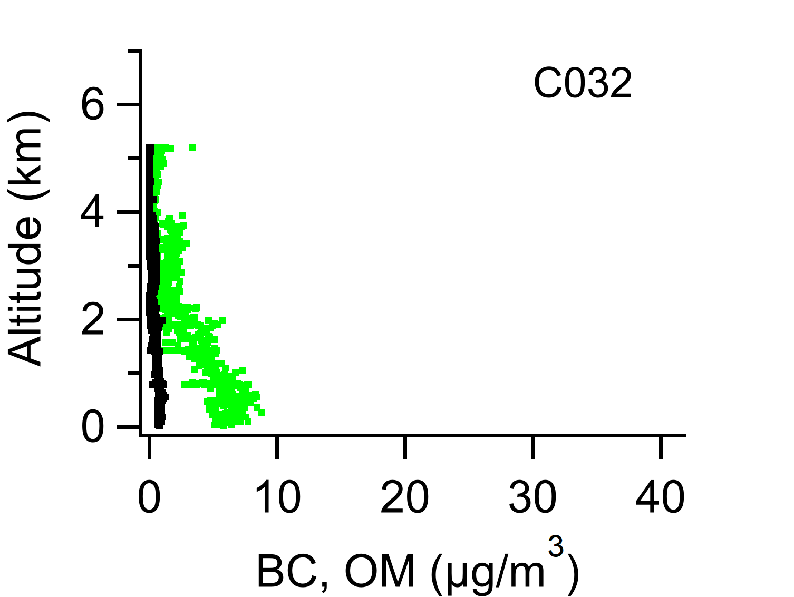
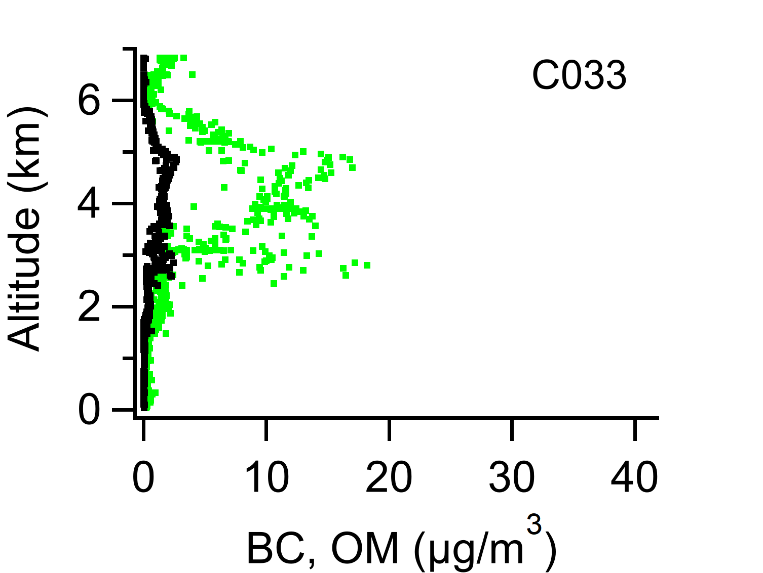
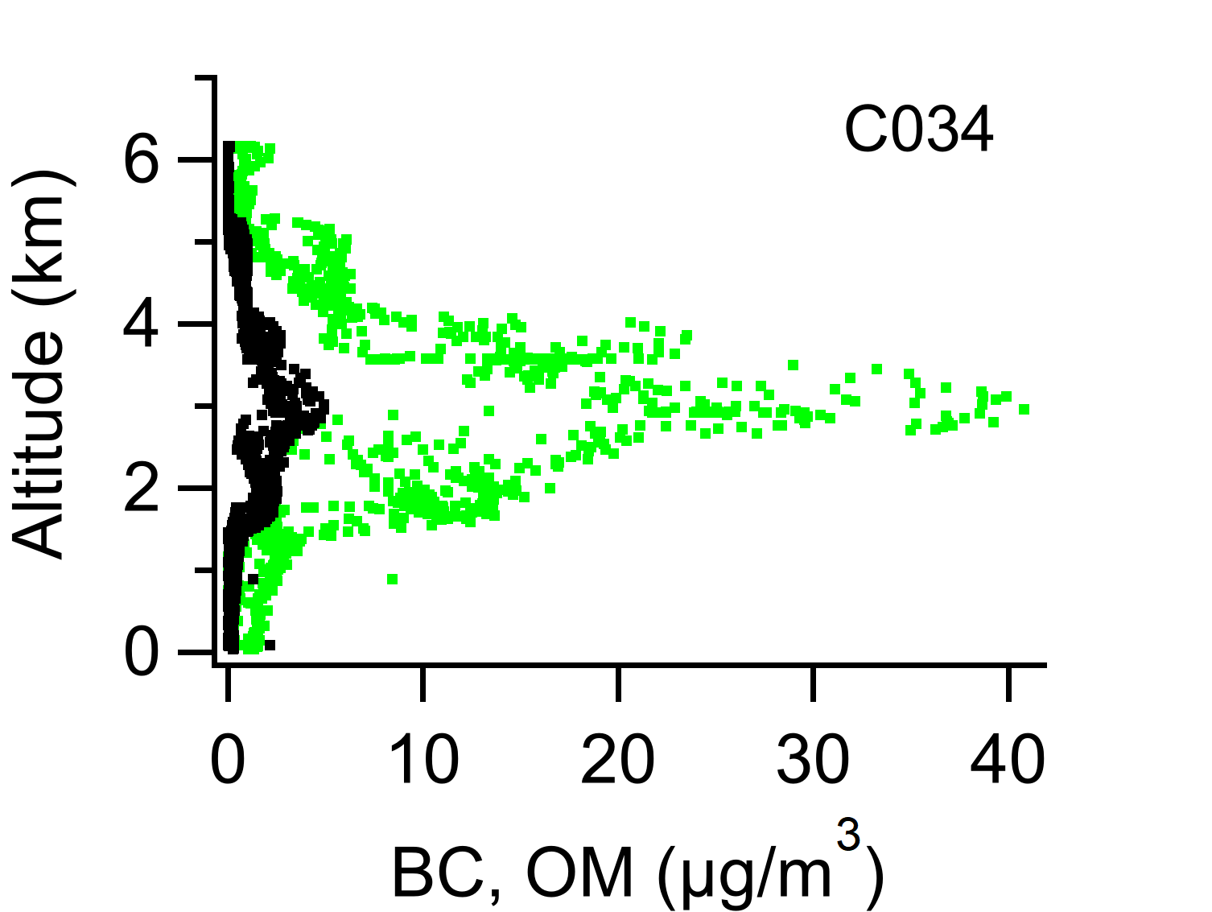
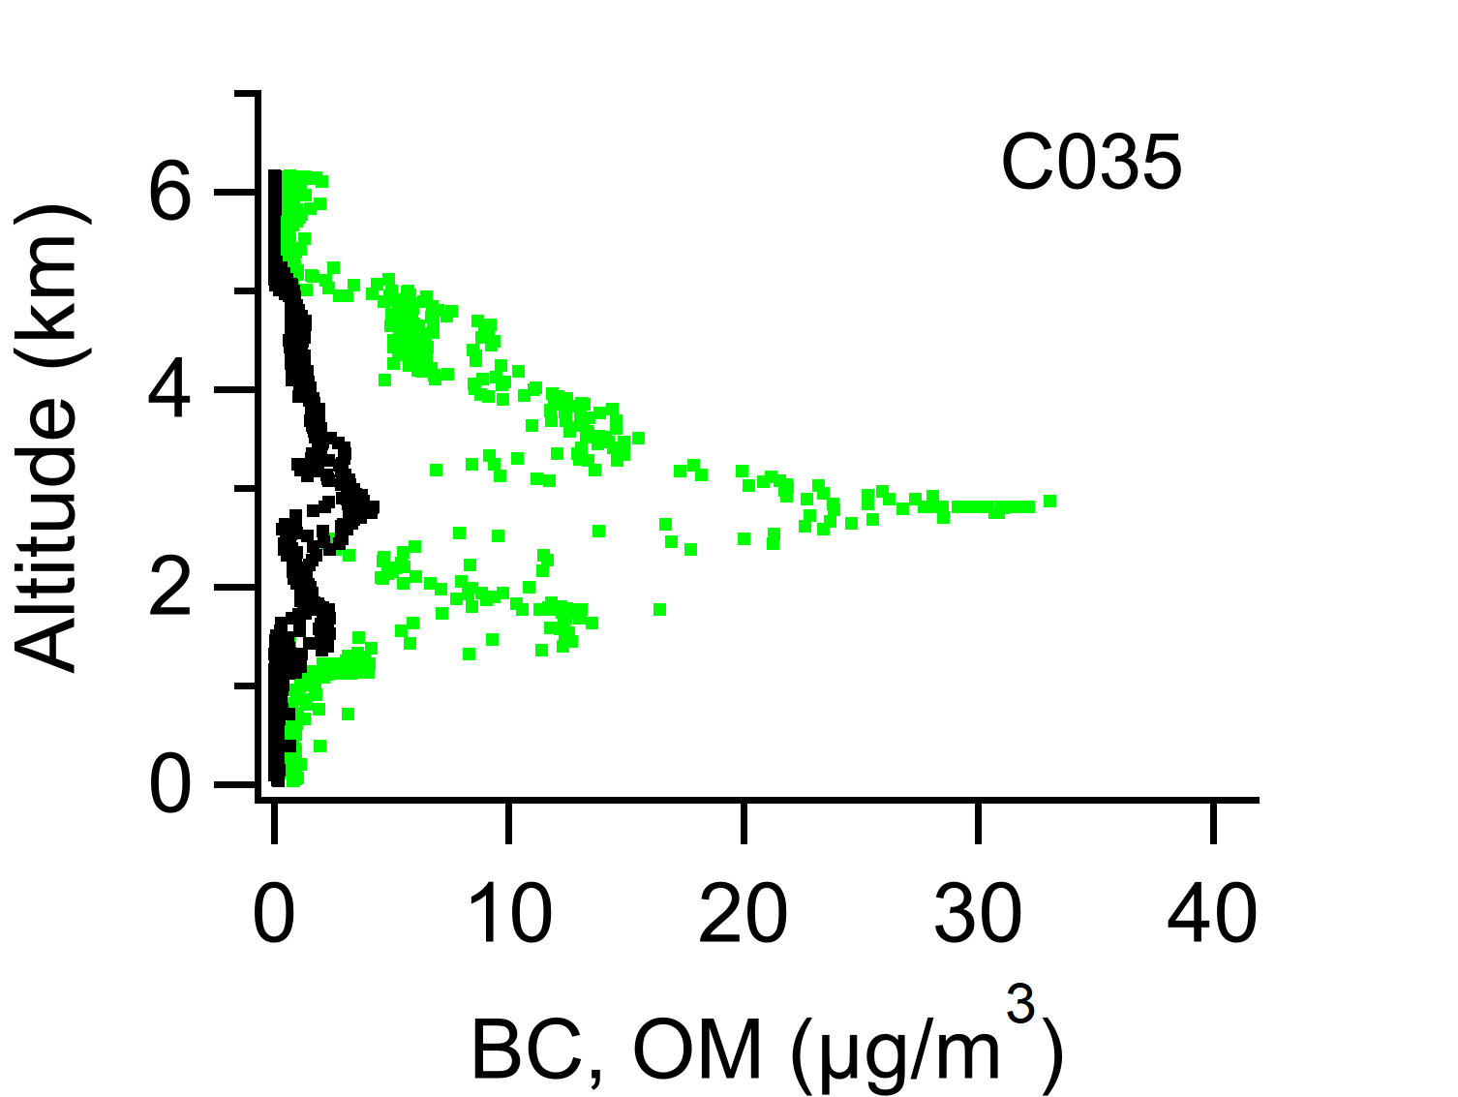
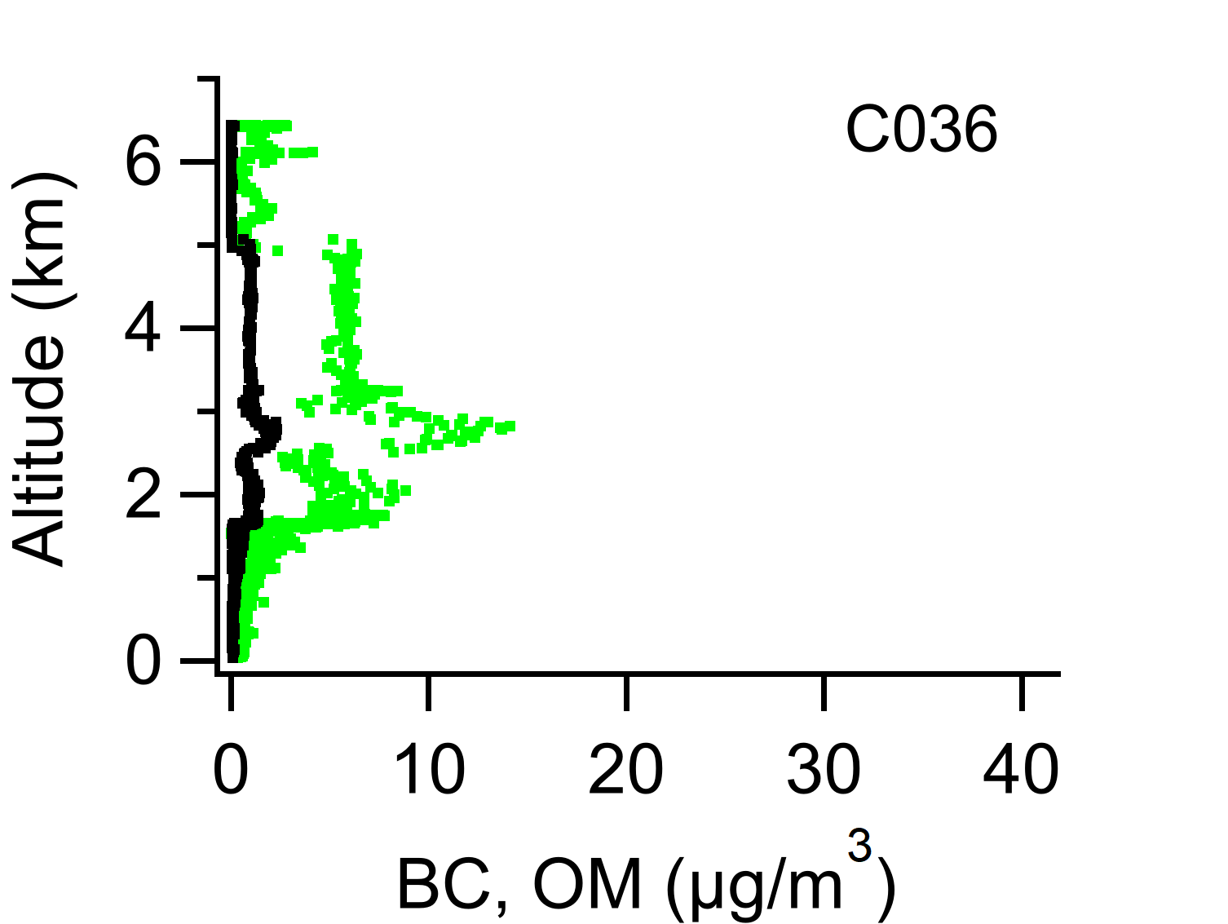
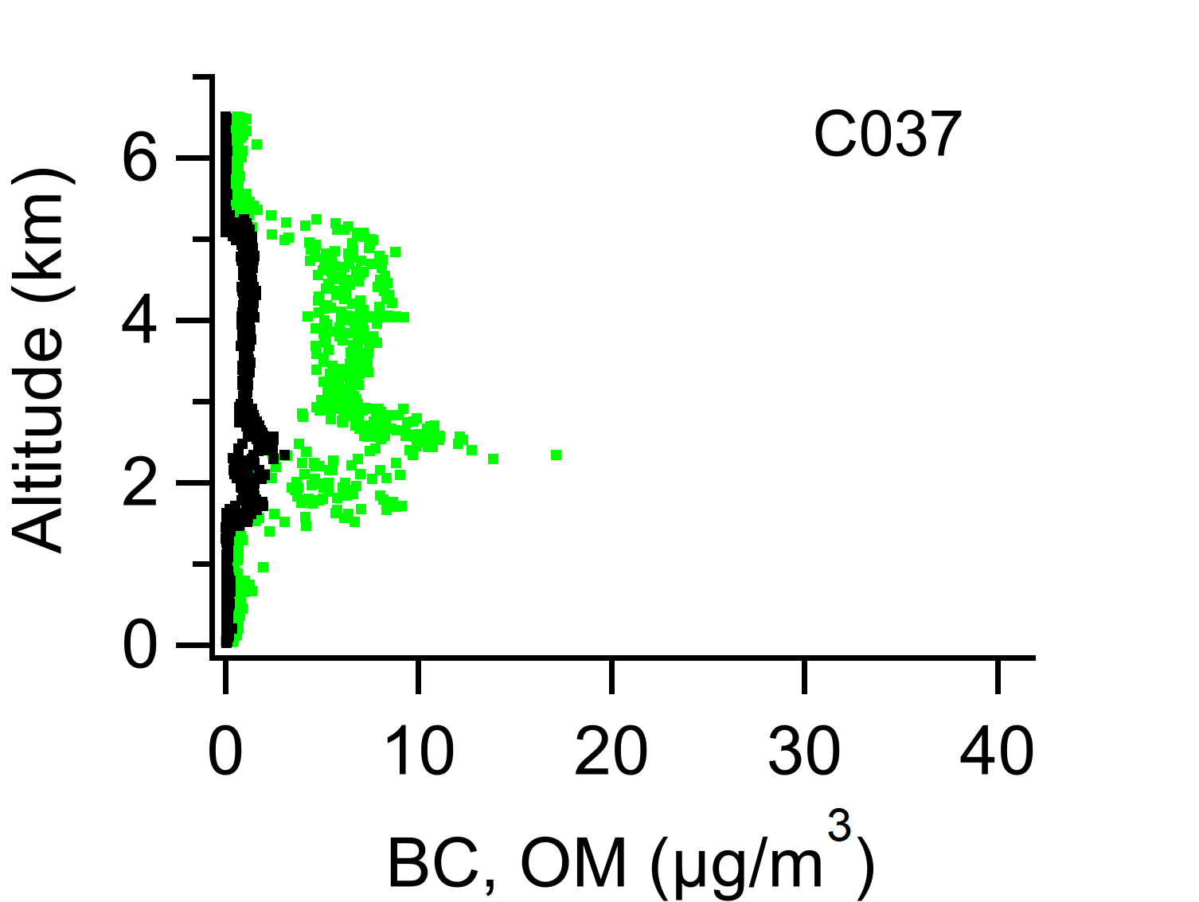
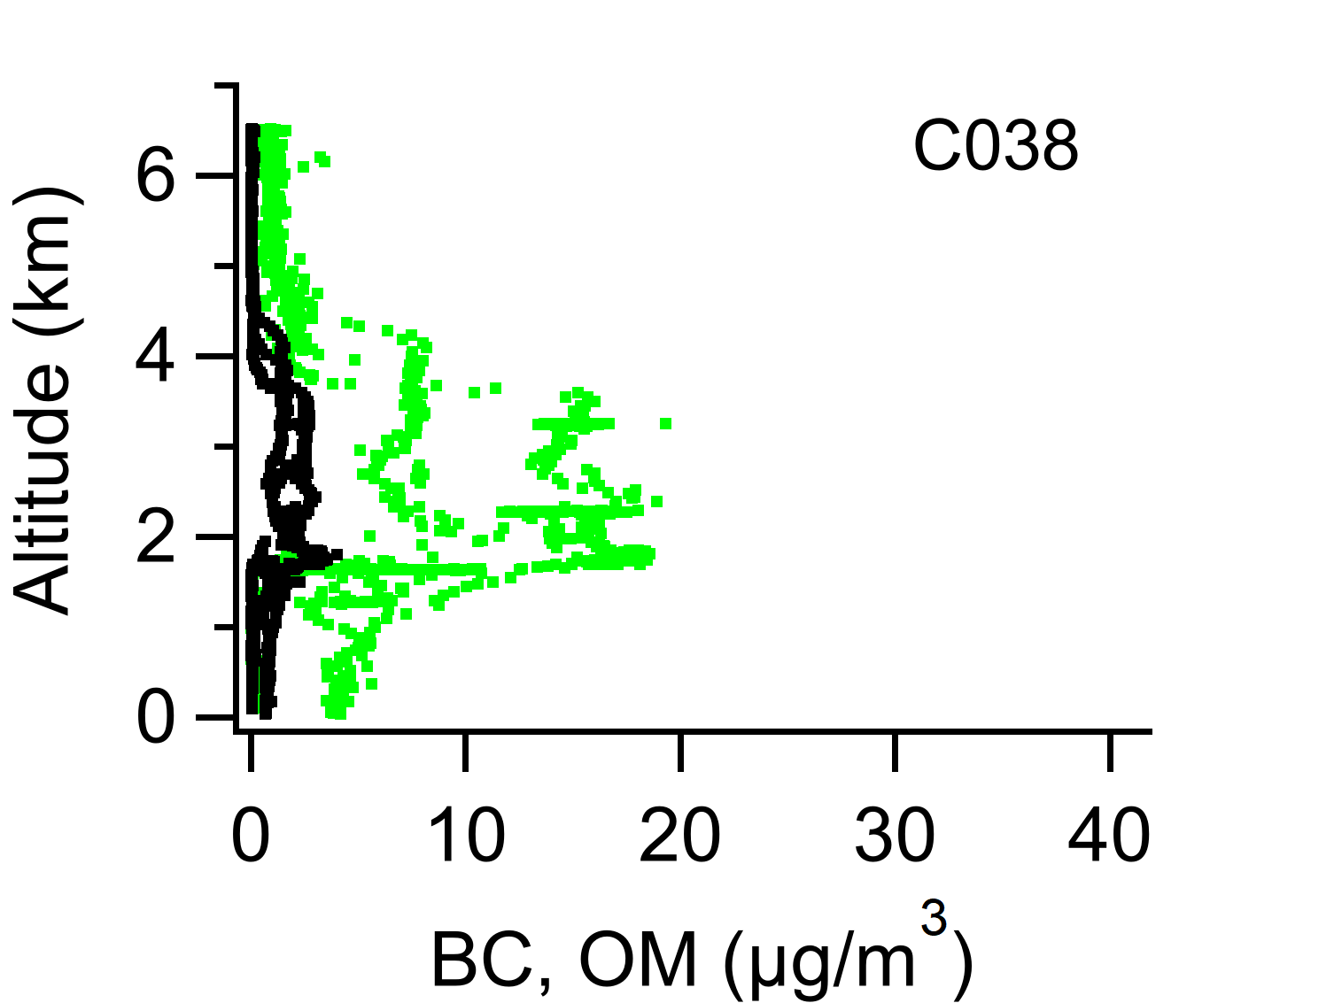
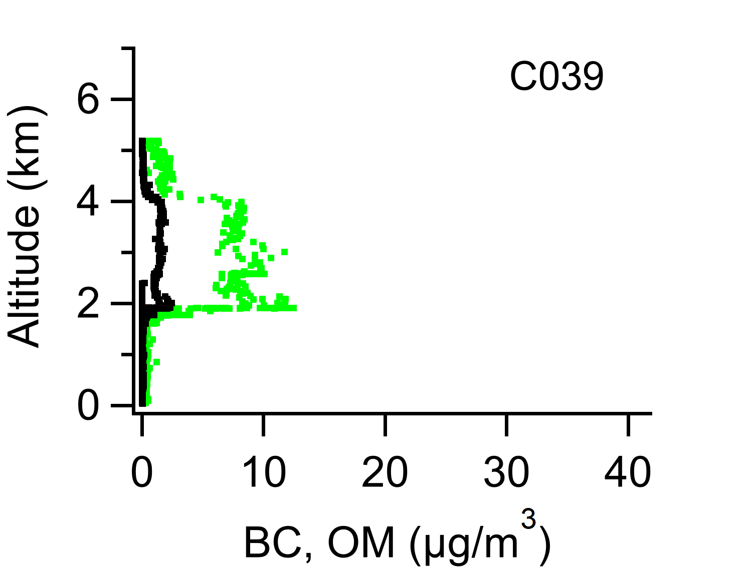
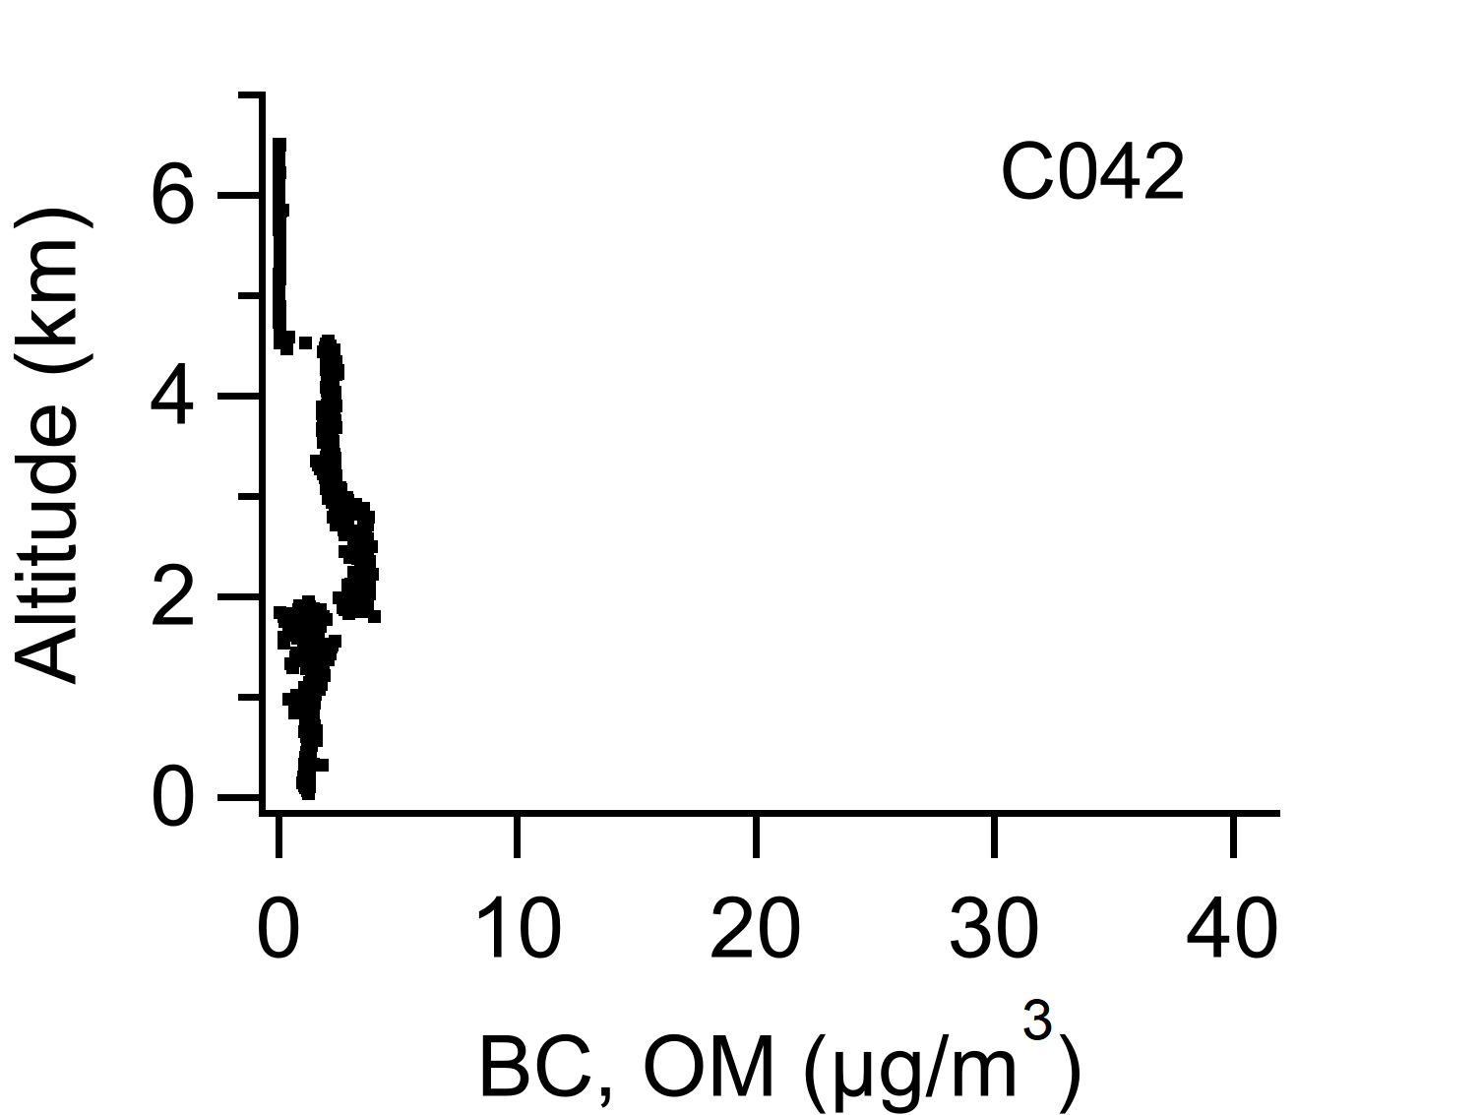
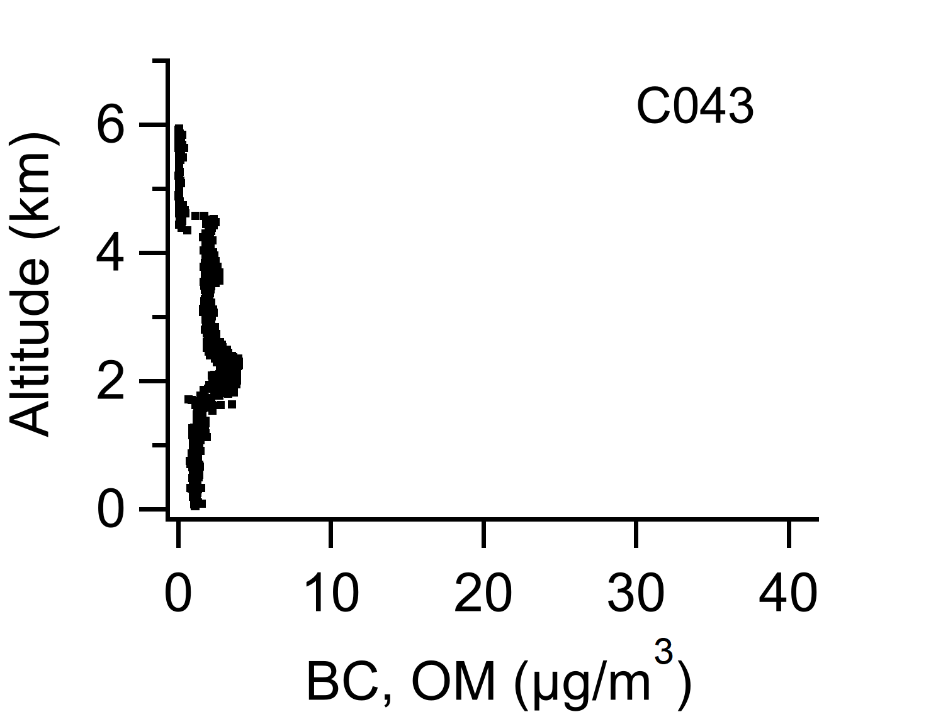
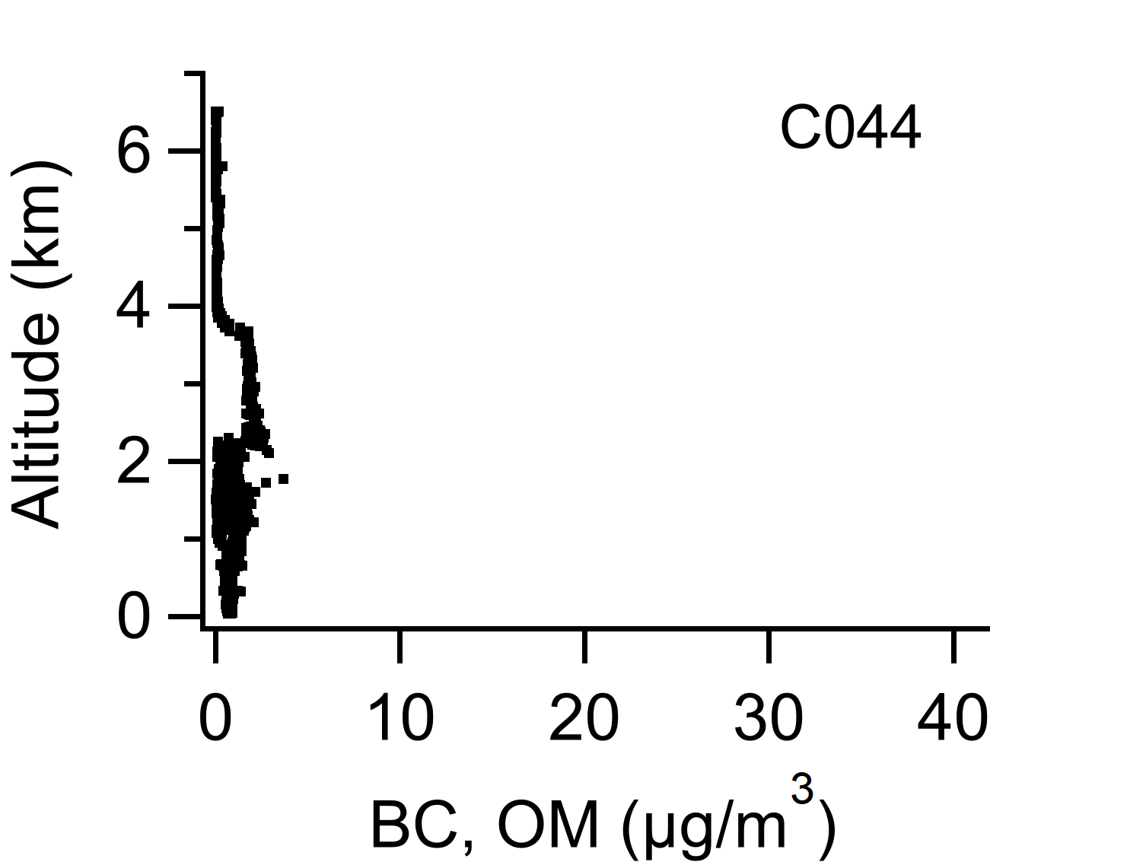
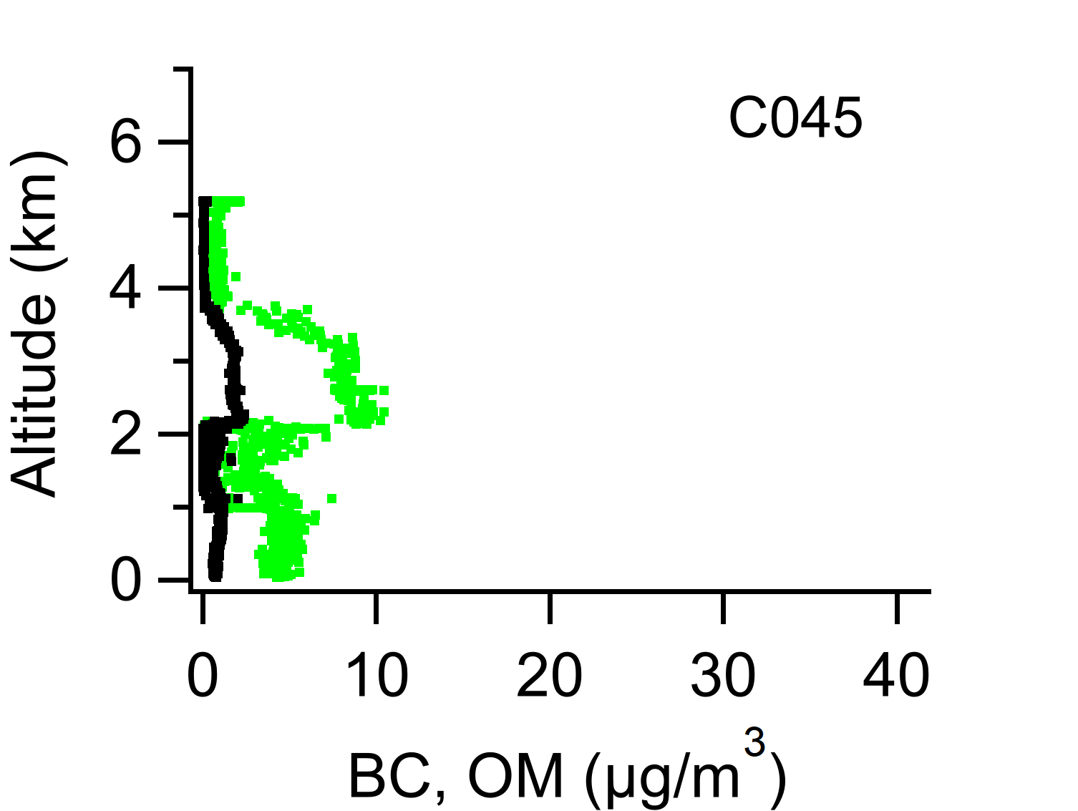
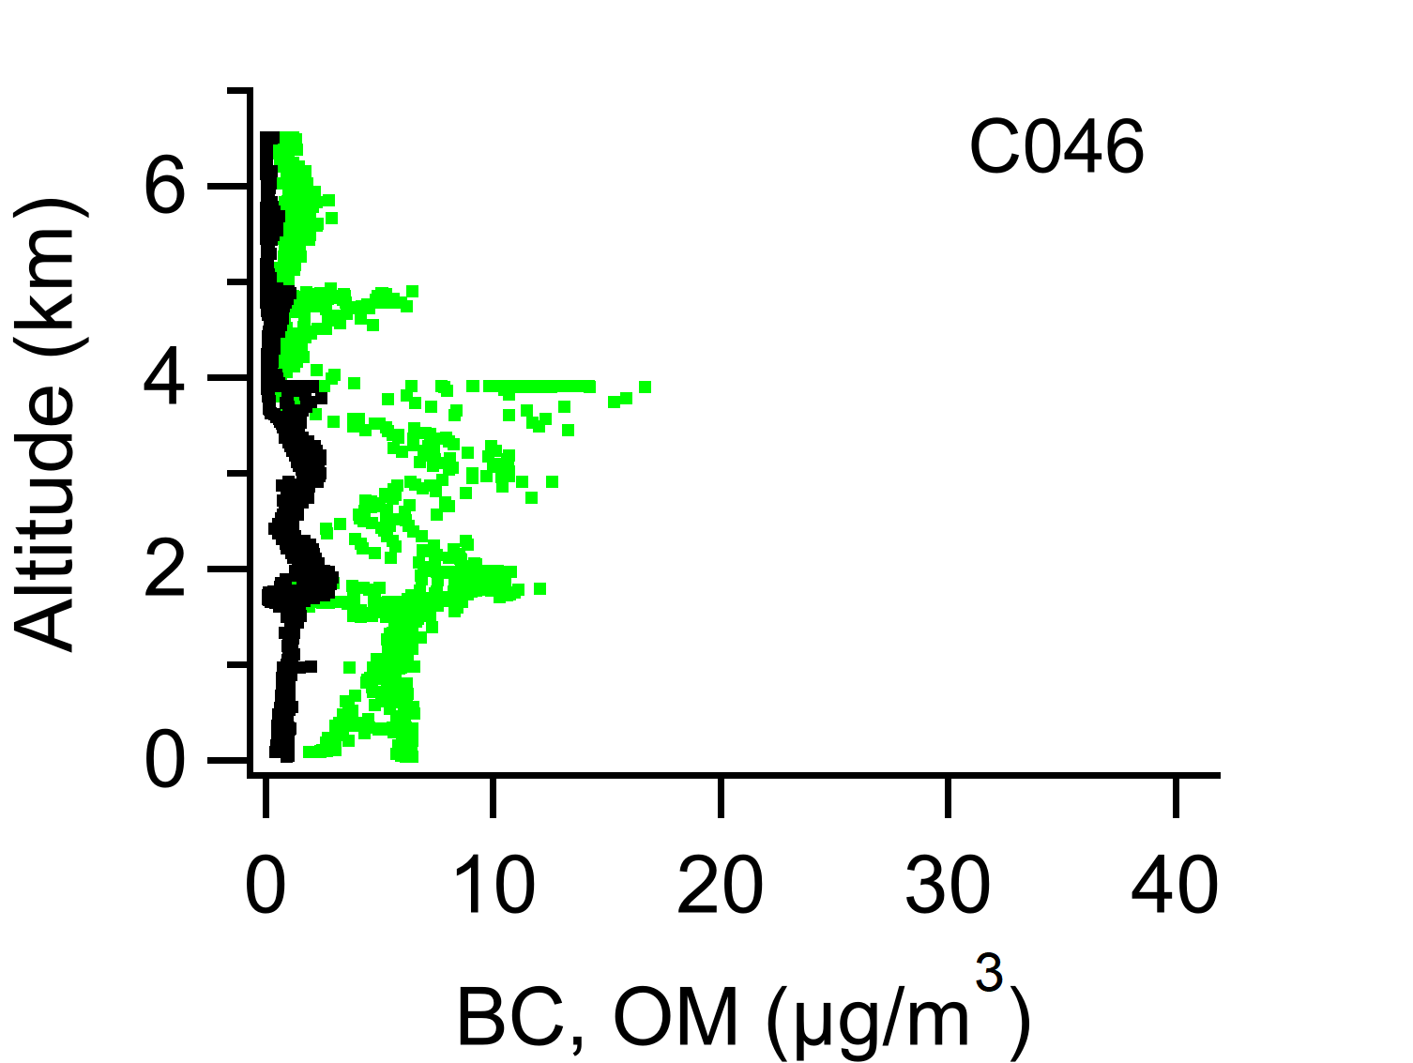
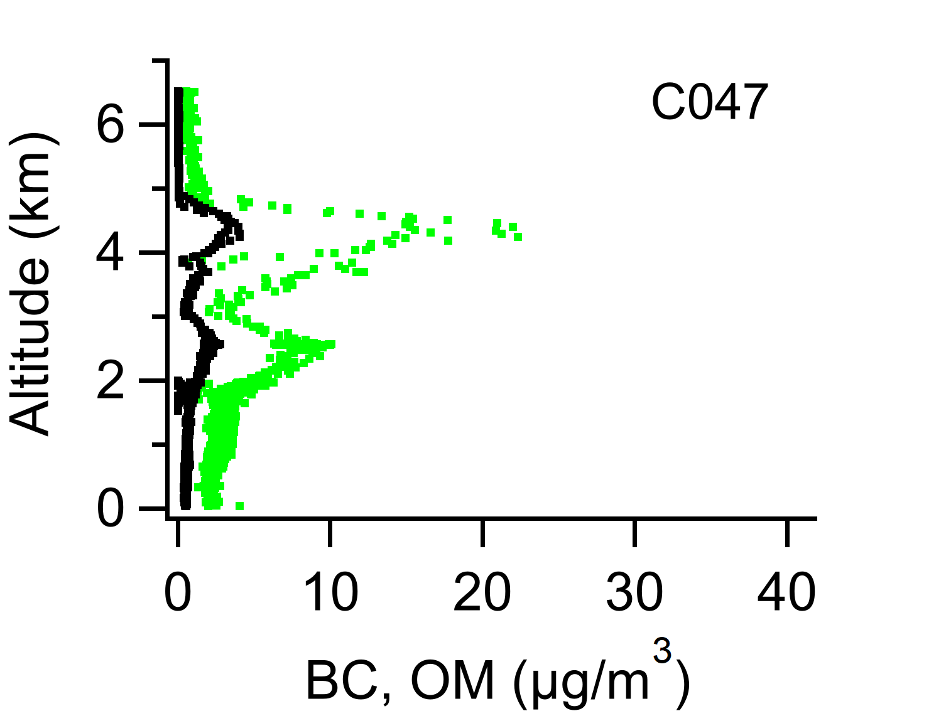
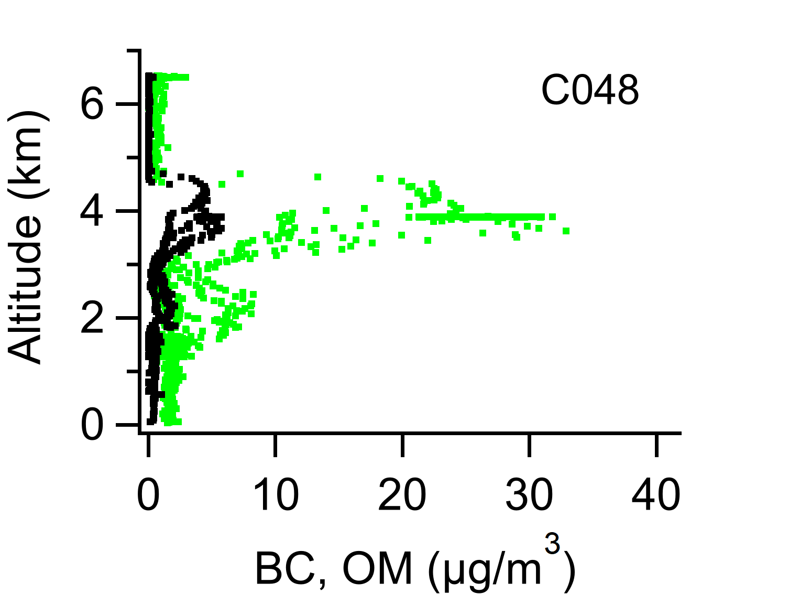
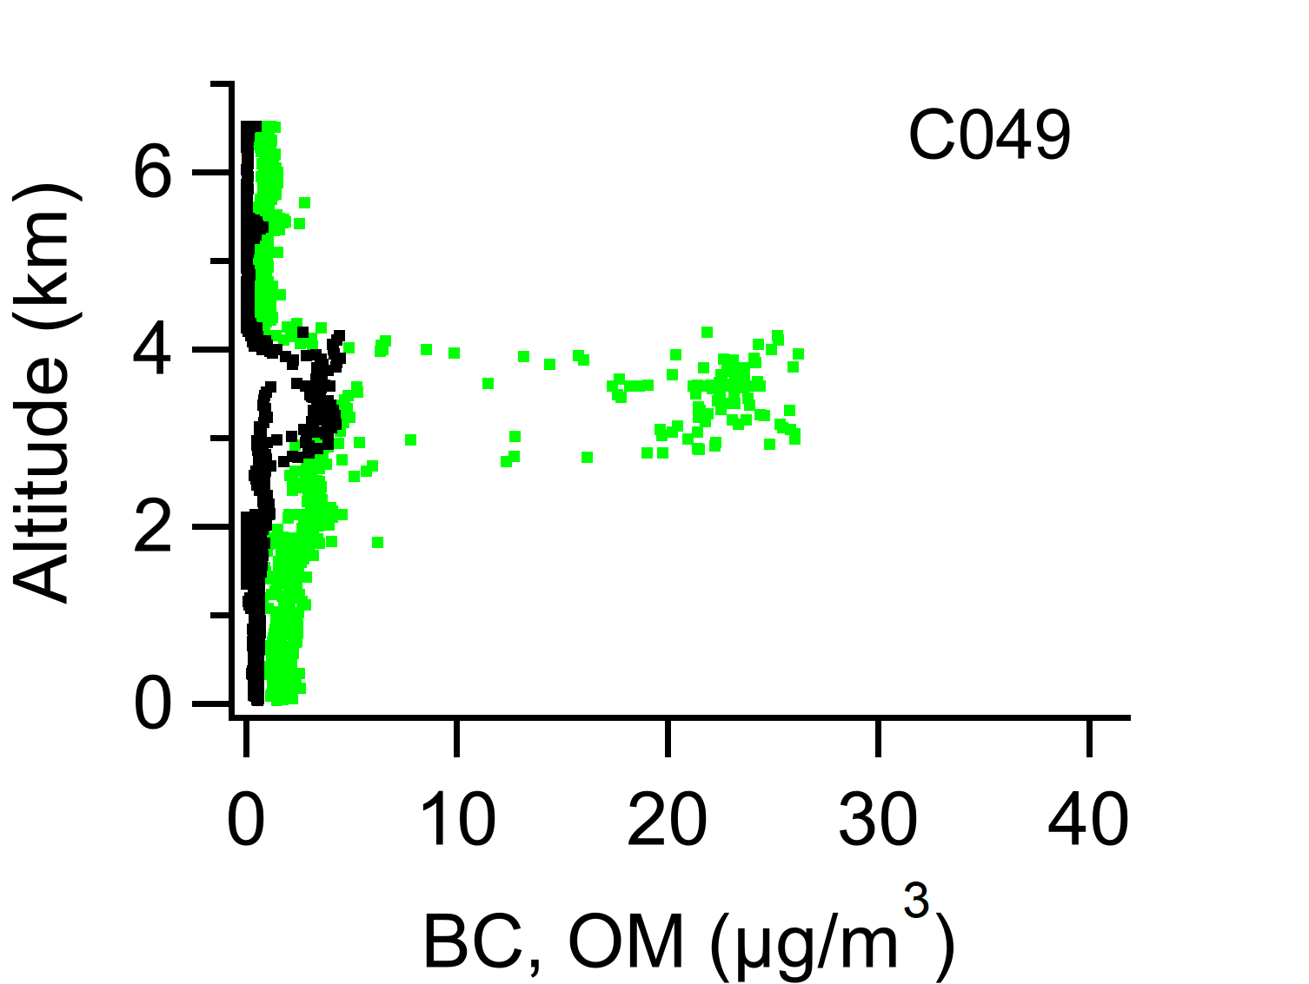
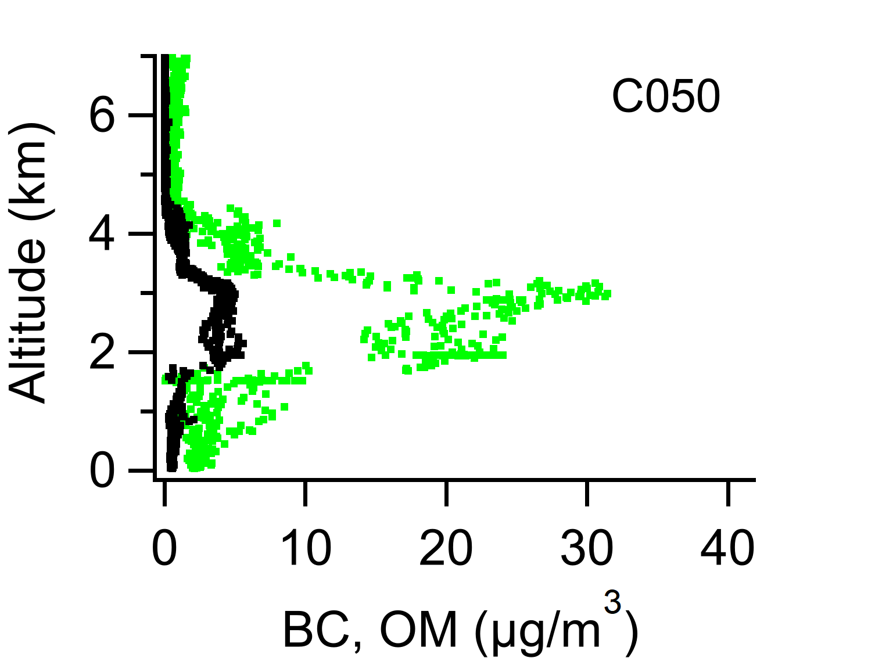
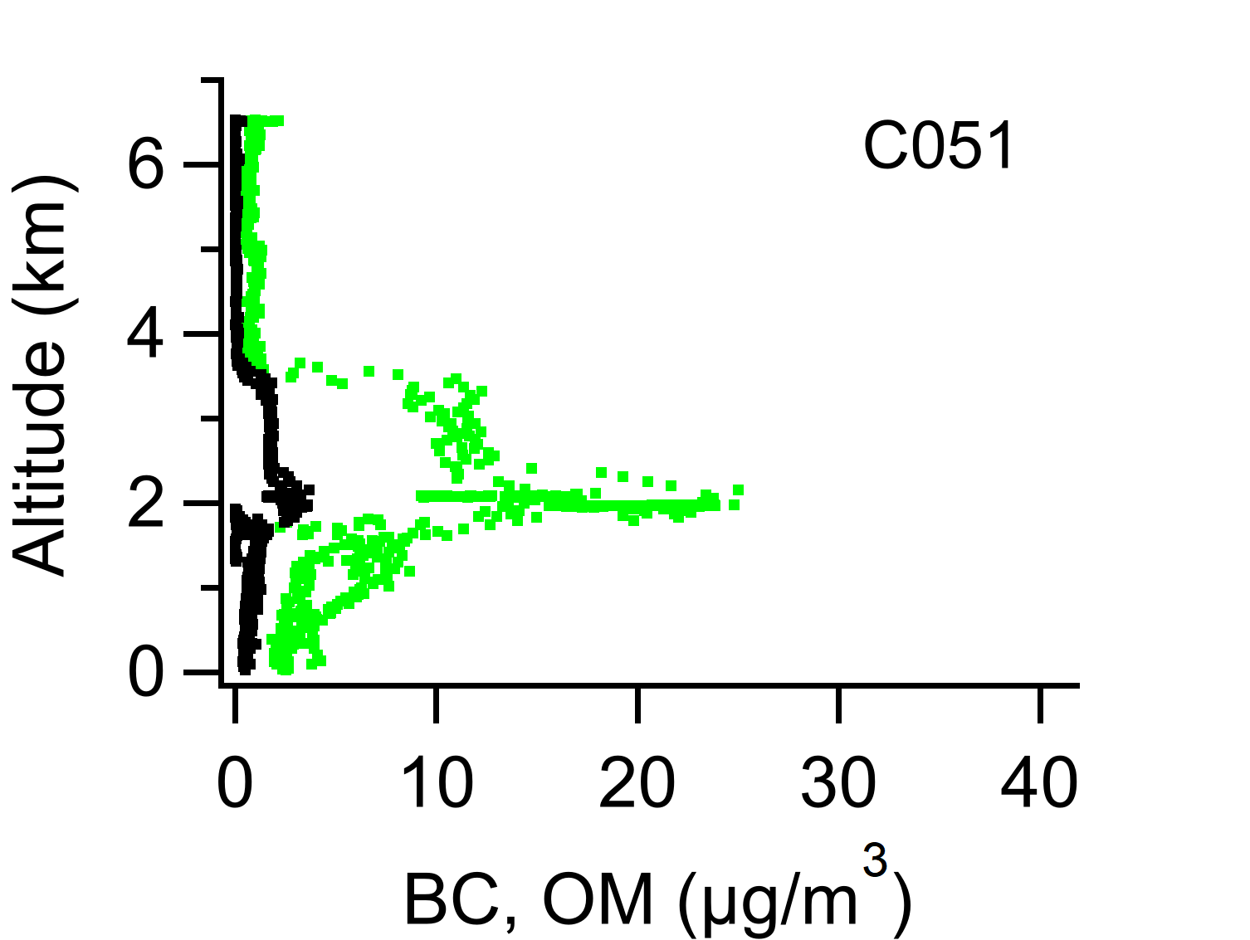
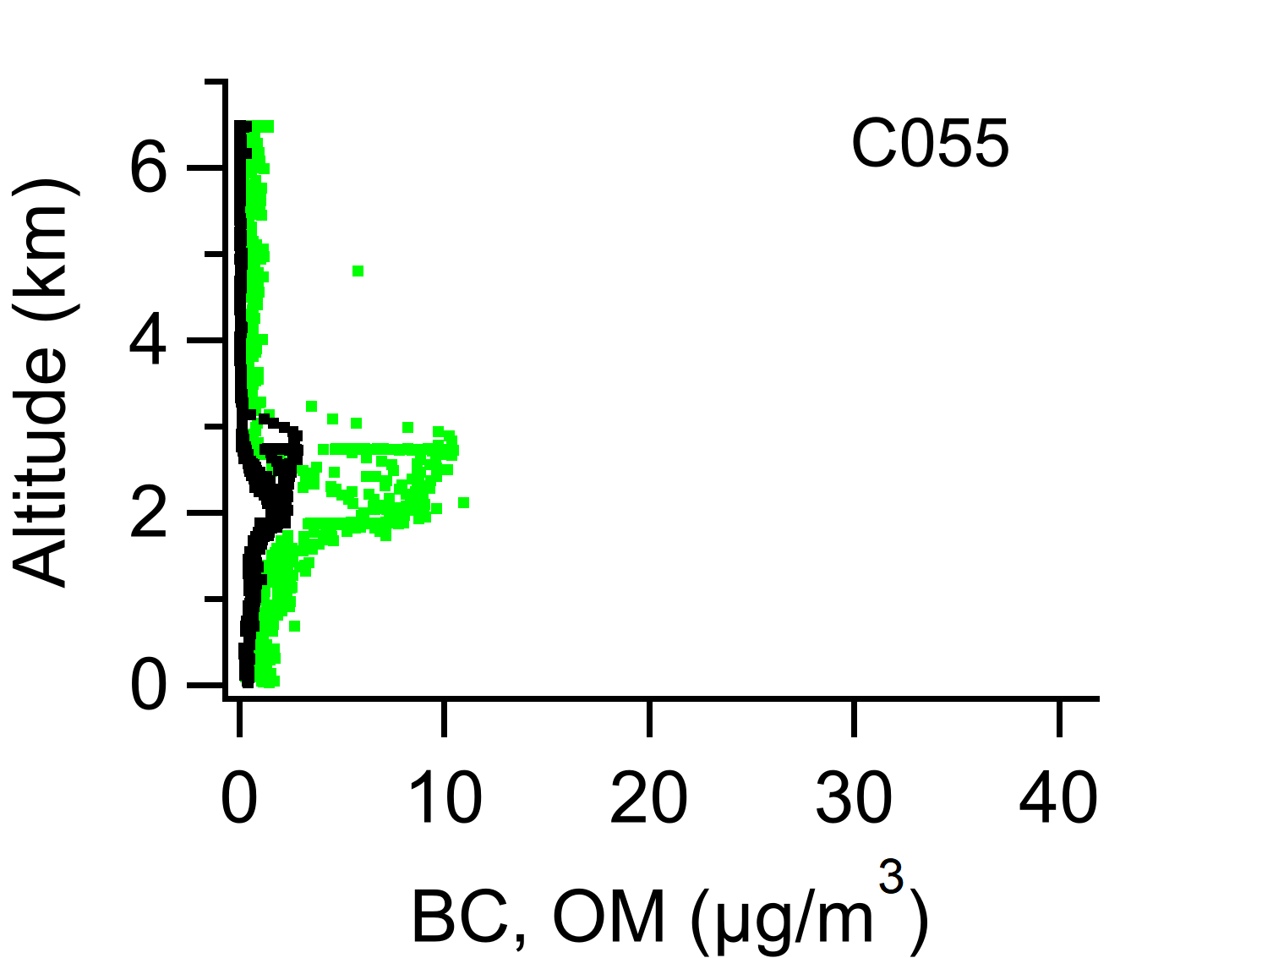
Aerosol Profiles
Notes:
For analysis, we mainly divided the whole campaign into 3 periods.

Slide 5
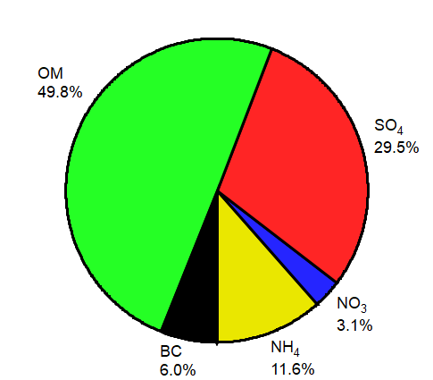
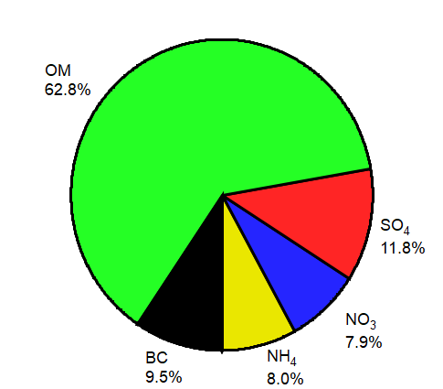
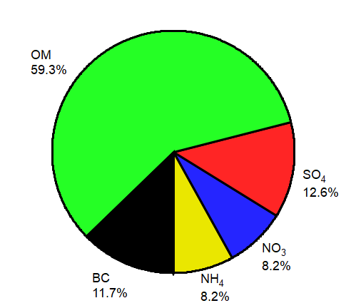
Aerosol Ratios
Average composition
Period 1
Period 2
Period 3
Notes:
Period 1 had higher SO₄, and lower BC and OM.
The aerosols in Period 1 were concentrated in the boundary layer, indicating prior mixing of aloft BB aerosols and advection northwards in the boundary layer. These aerosols are likely to mix with the pristine marine aerosols, i.e. sulphate, resulting in the higher SO₄ fraction.

Slide 6
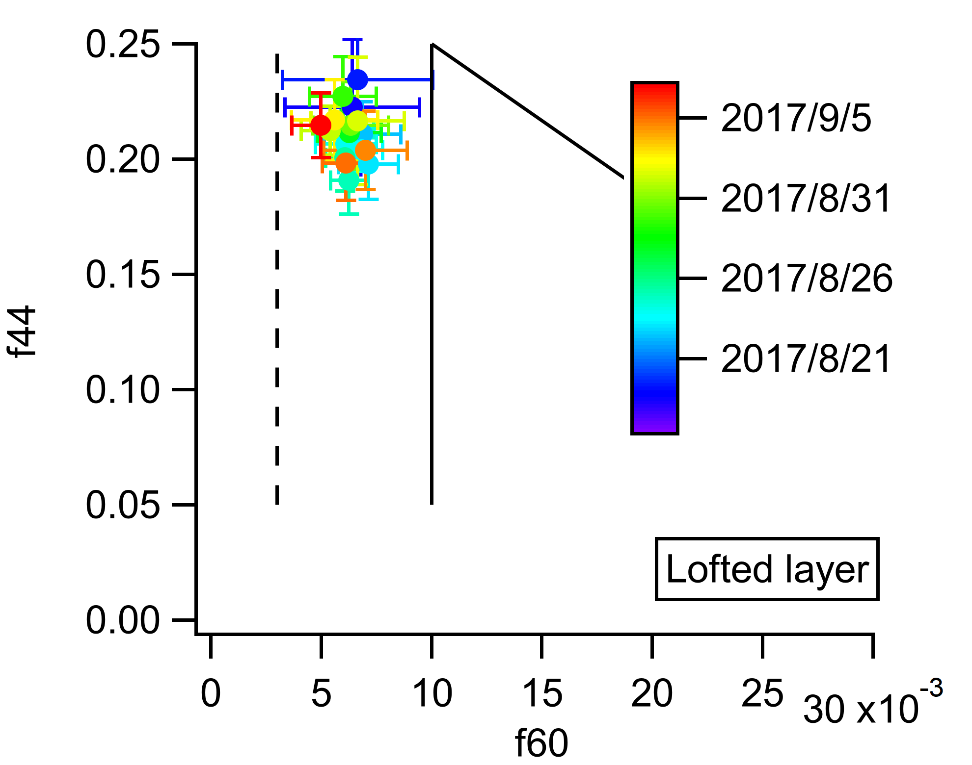
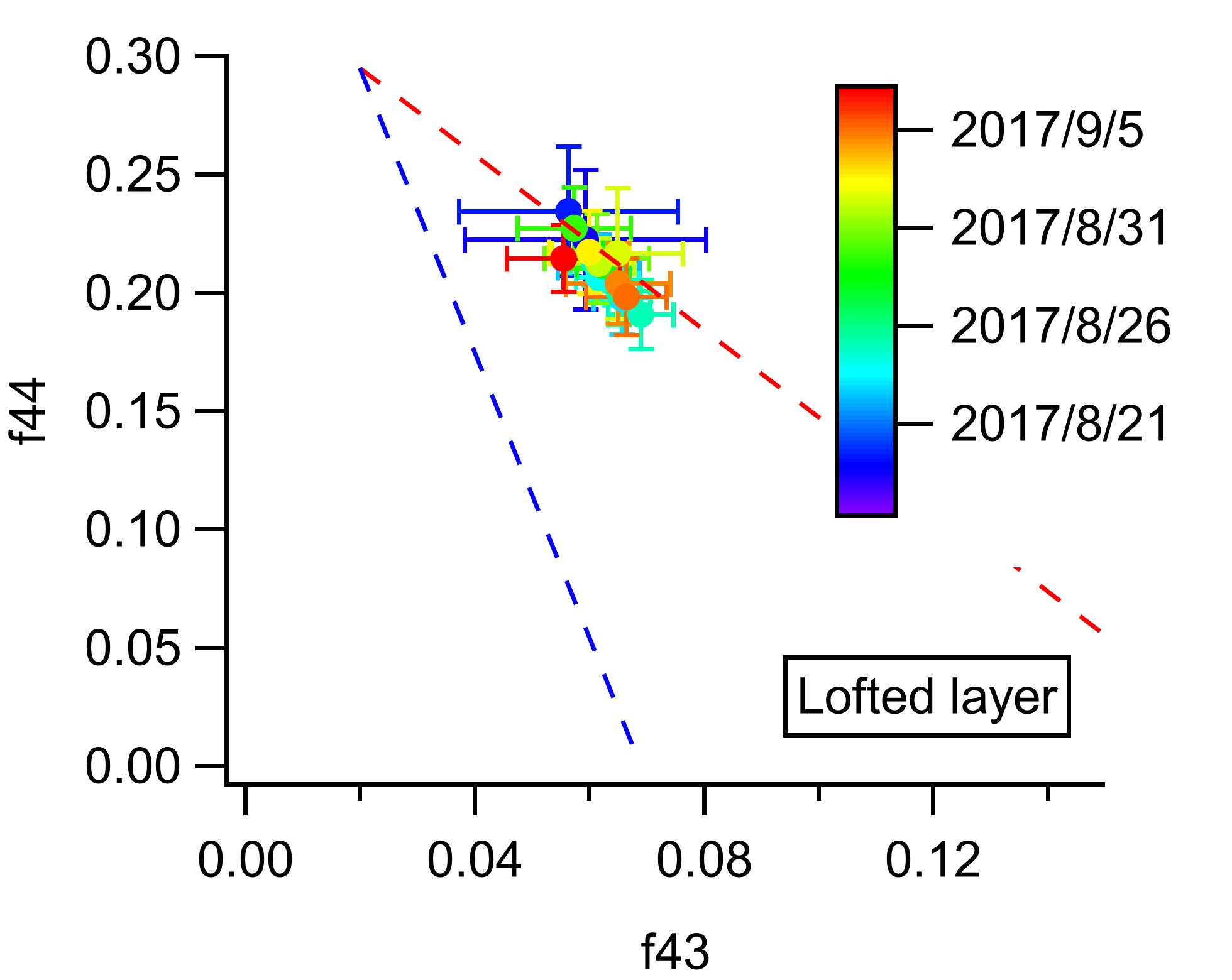
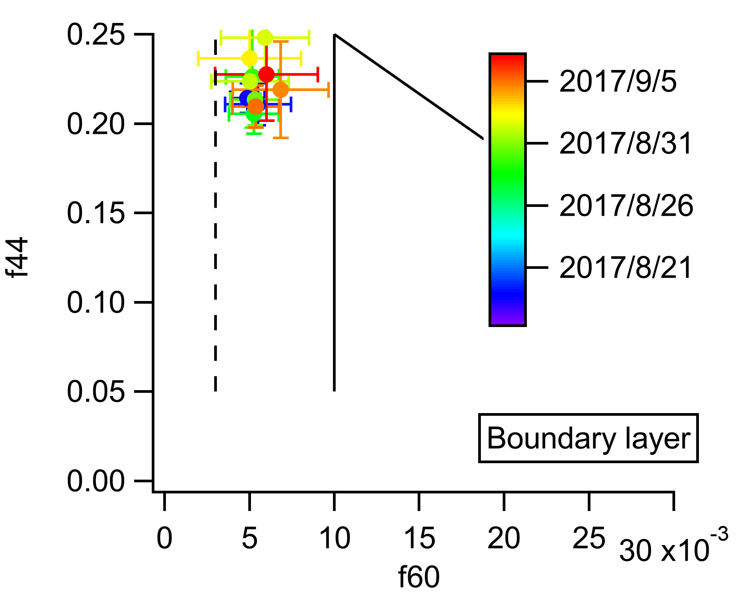
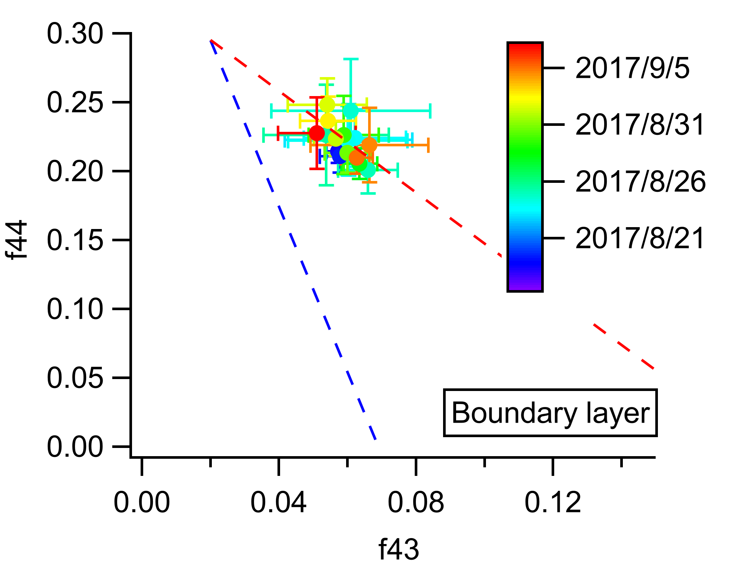
Organics
LV-OOA range
Low f60, BBOA tracer
Notes:
Through deconvolution of OA mass-spectra from the AMS, the results show that the OA during campaign is very aged. f60 reached a stable and low endpoint. Although aerosols in CLARIFY have undergone a considerable aging and transport process, f60 still persisted above the background level, 0.3%. The average f60 mainly falls within a narrow range of 0.5-0.7%, indicating that the BB signature of f60 may still be used as a tracer after prolonged aging. The f44 vs. f43 also shows a similar trend in the lofted and boundary layer, concentrated in the left-top of the panel. The endpoint for the oxidized plumes within these data appears to be f44 ~0.19–0.25, the very high f44 indicates that the observed BBOA has been oxidized into LV-OOA range.
It seems that the boundary layer aerosols are more aged.
The very aged aerosols data in CLARIFY may represent the background aerosol tracer information in transport region.

Slide 7
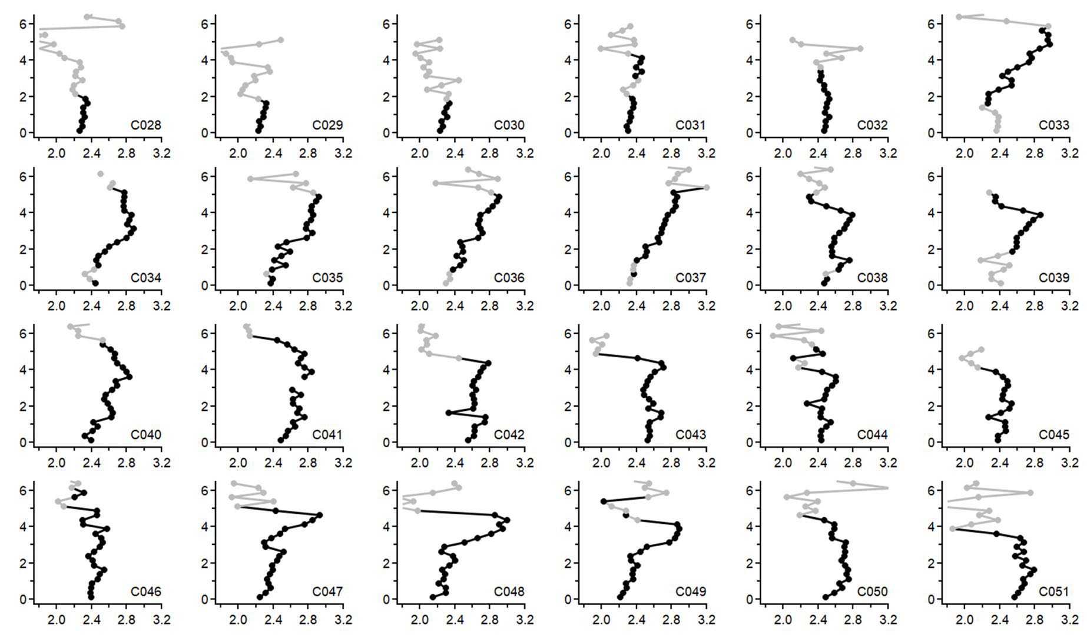
BC coatings
Thickly coated BC
Urban emission:1.23±0.13
BB emission: 1.41±0.06
(Schwarz et al., 2008)
London: 1.45±0.20
(Liu et al., 2014)
BC bulk shell/core ratio (From total coating volume/core volume)
Notes:
The very thickly coated BC, aged BC

Slide 8
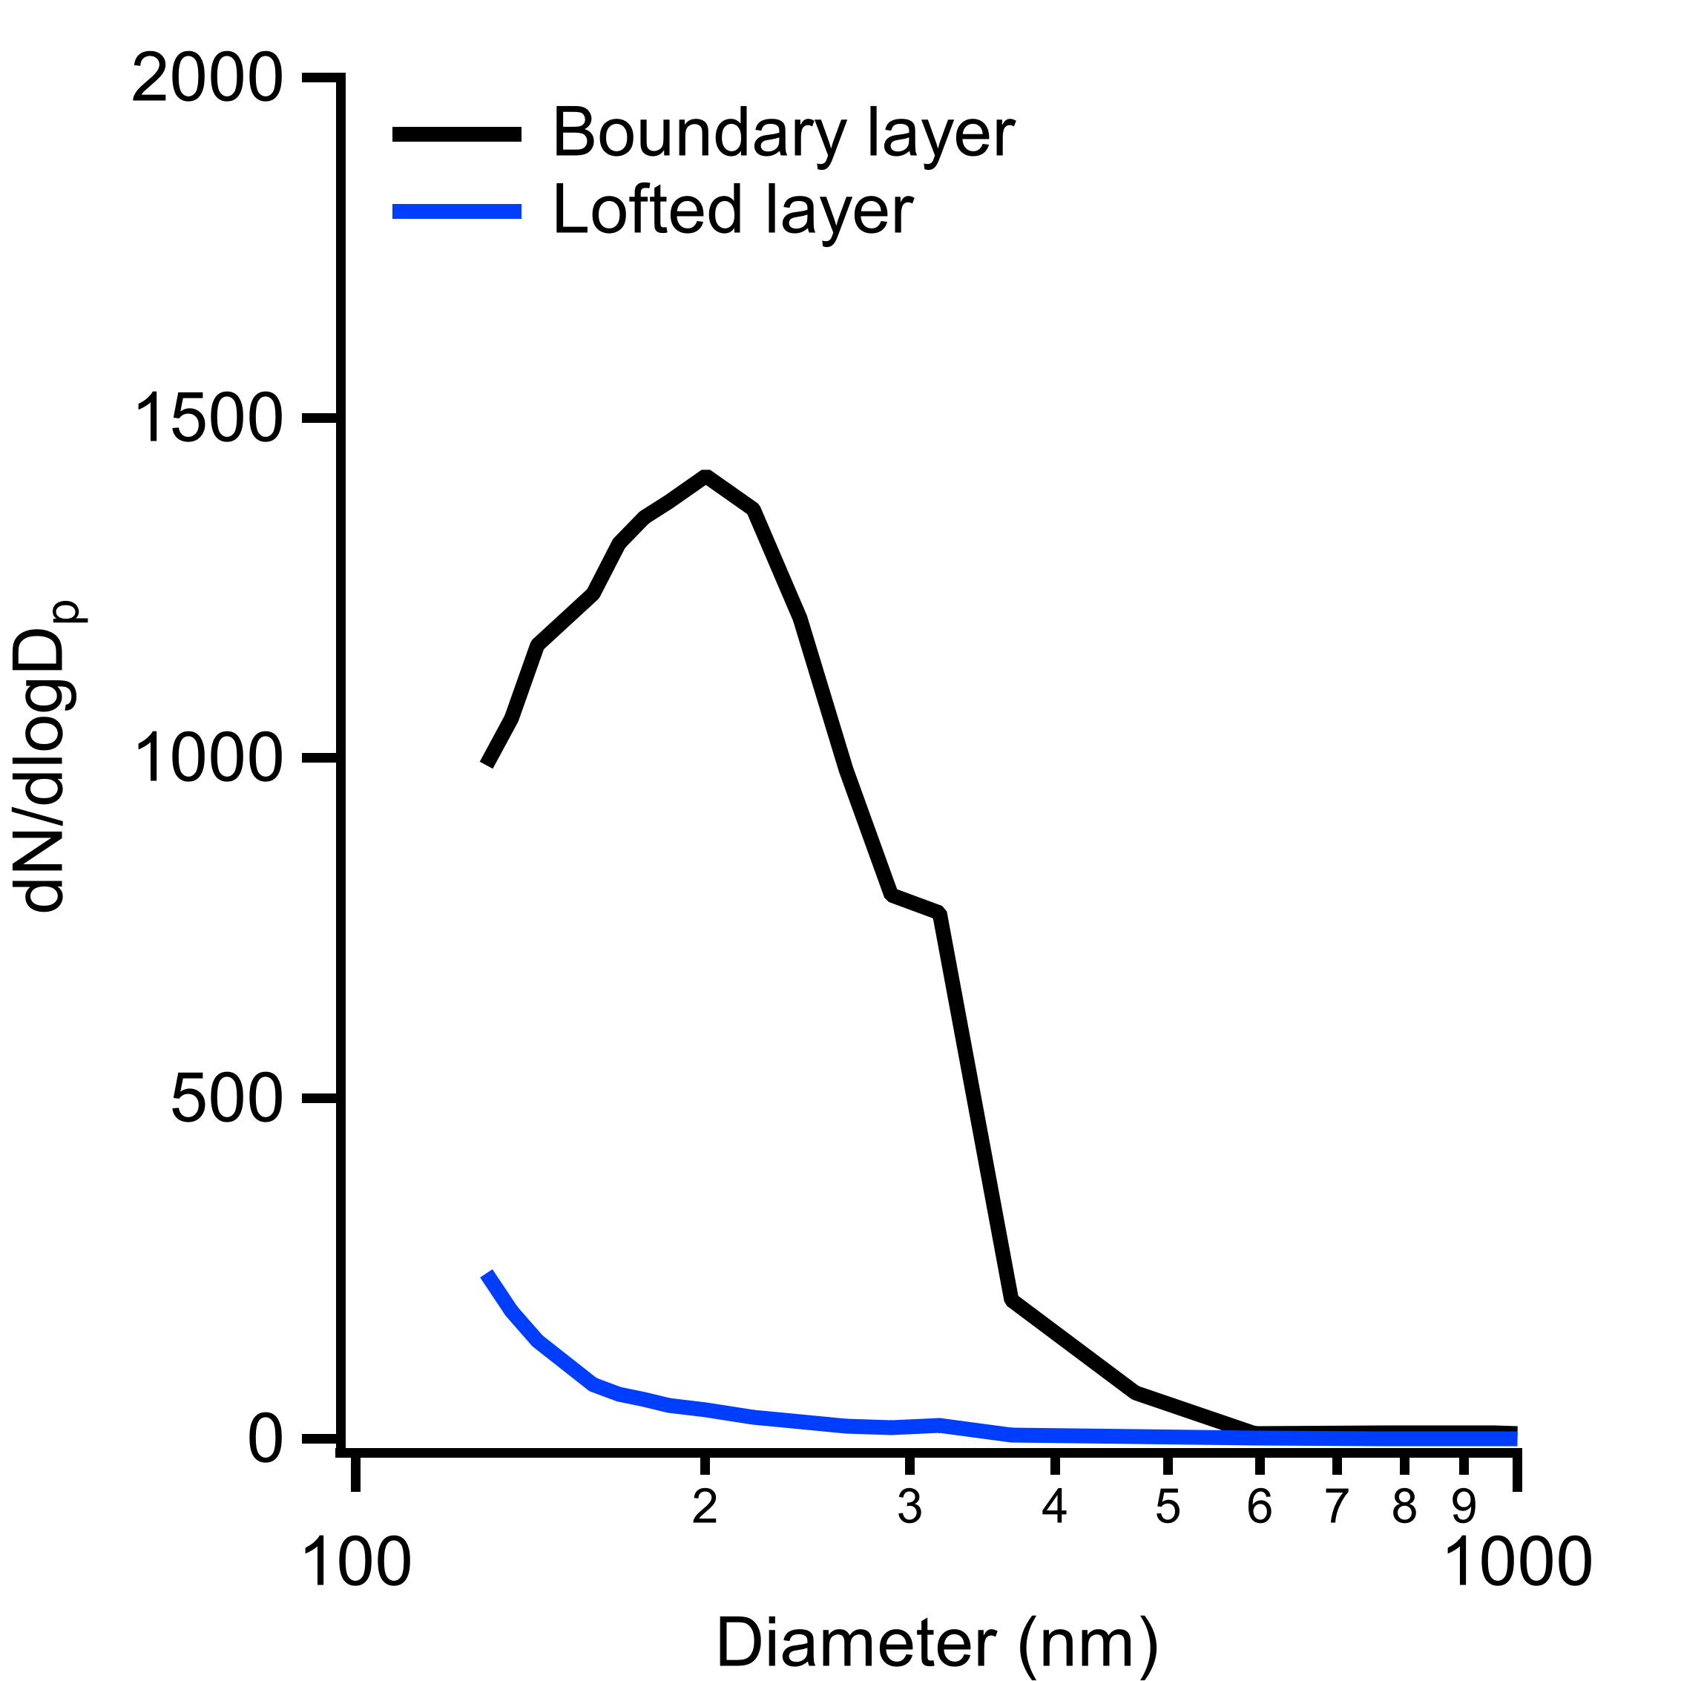
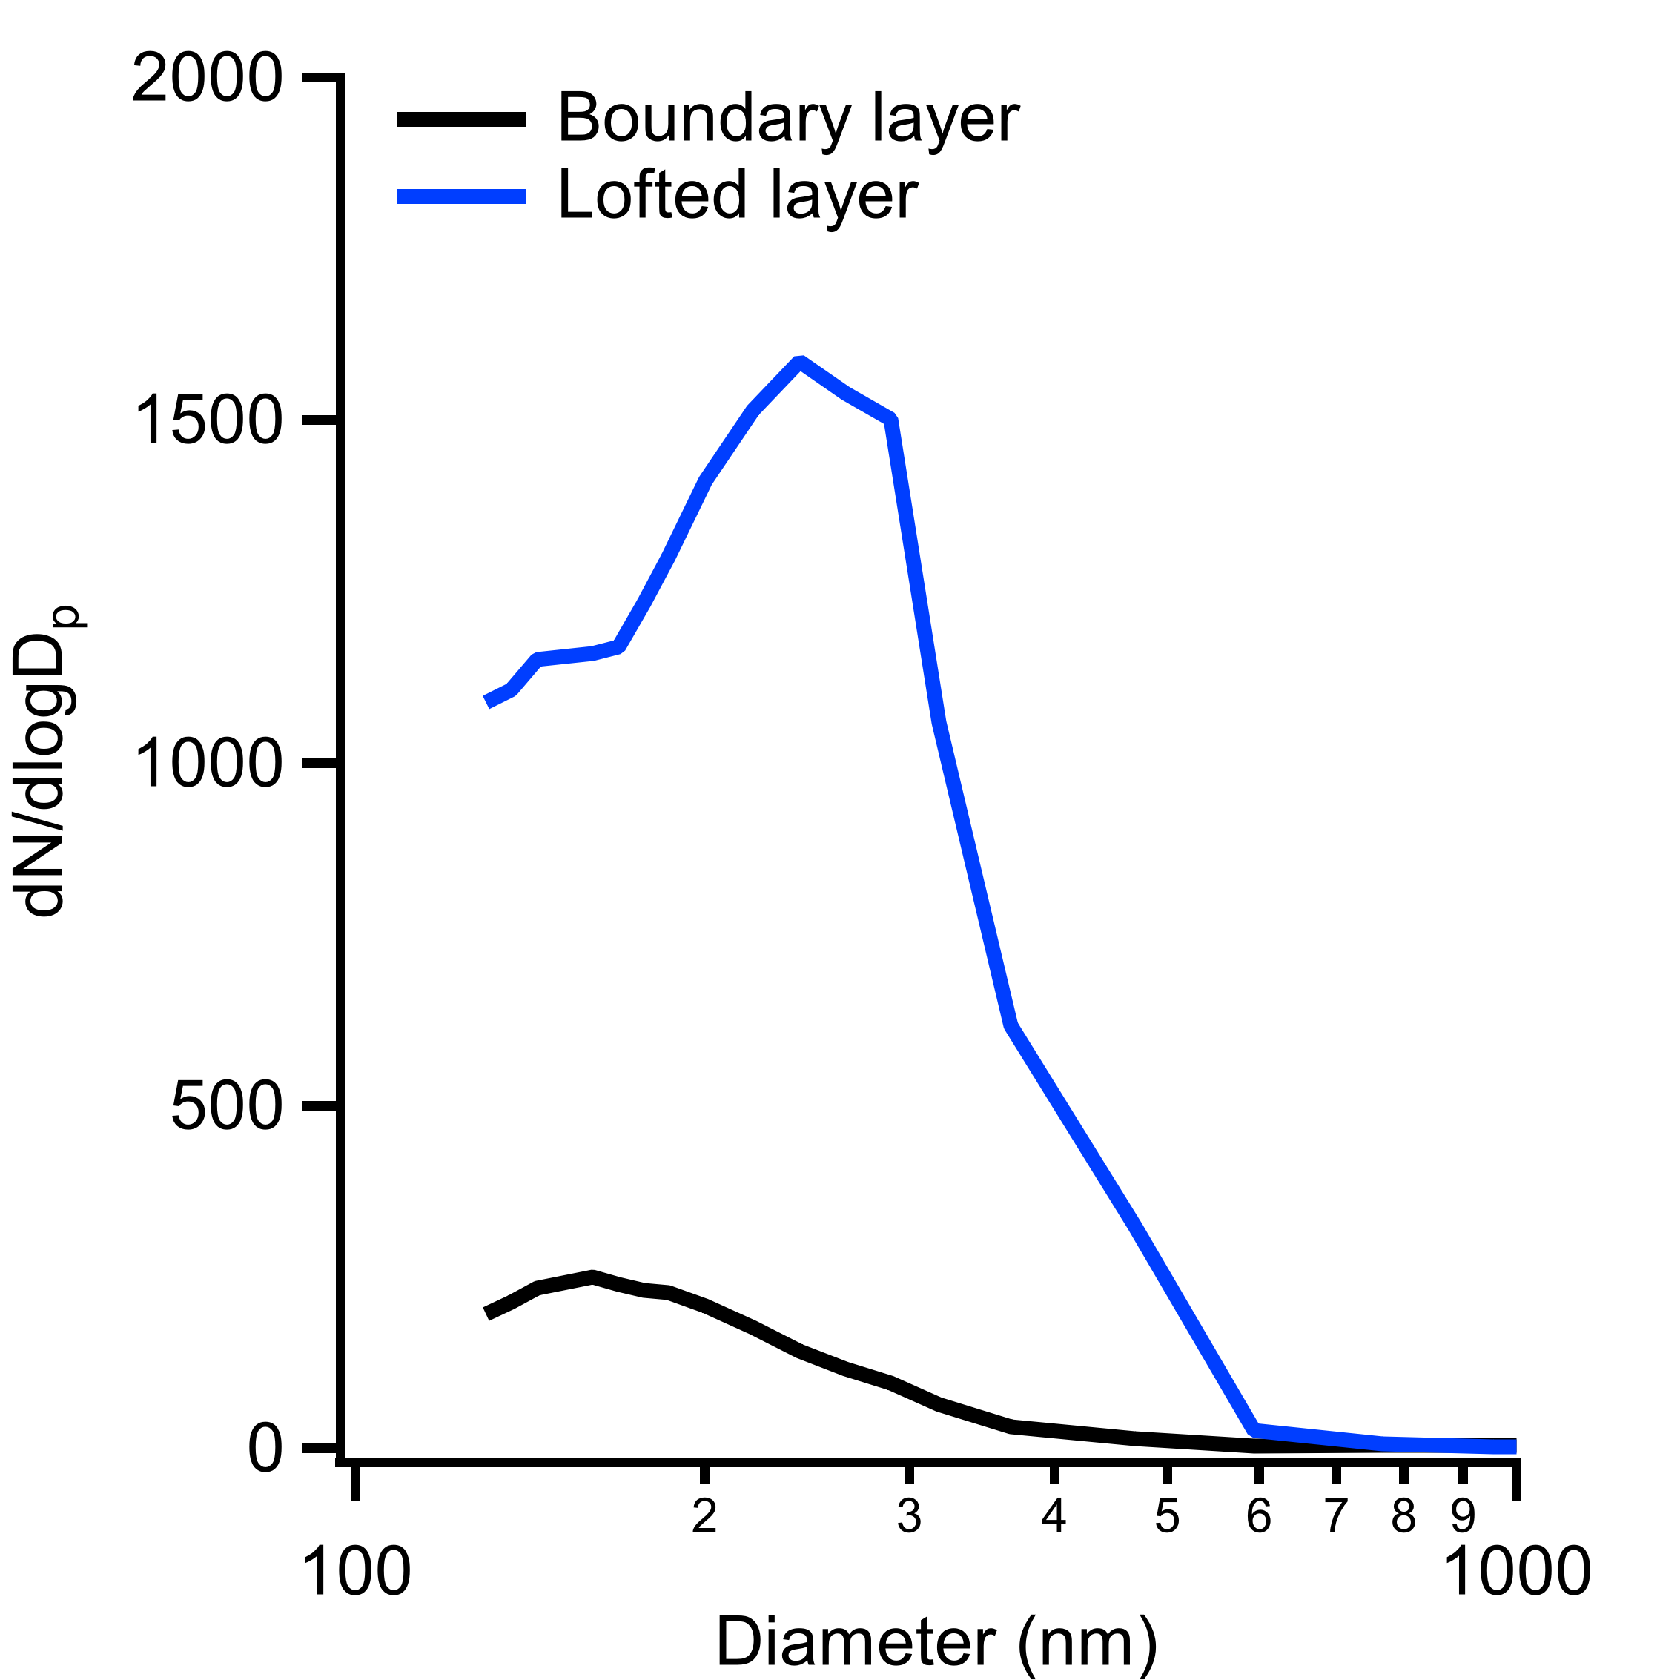
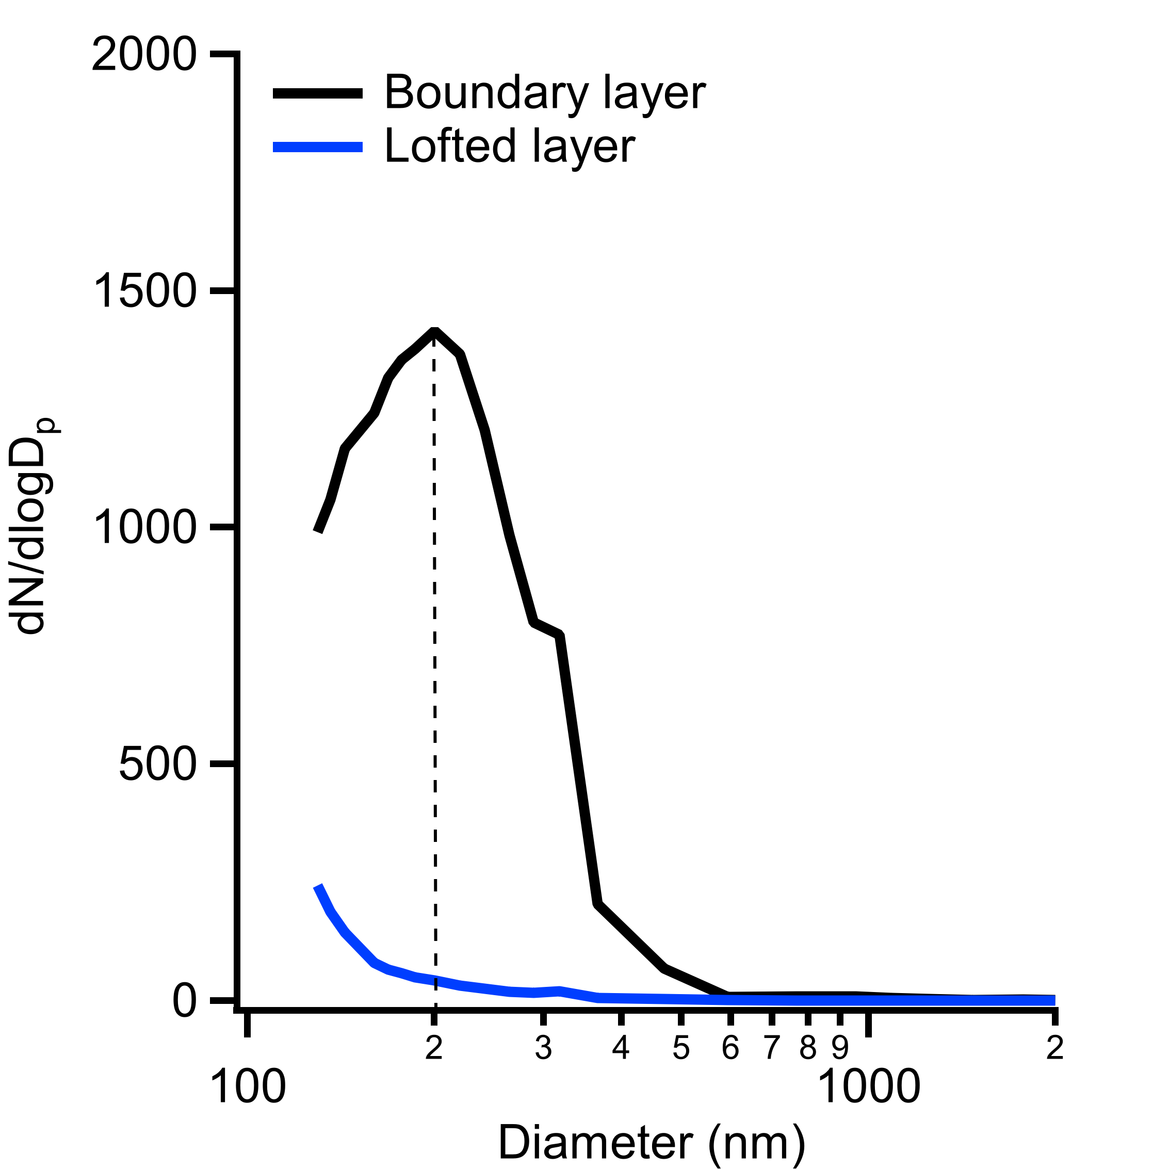
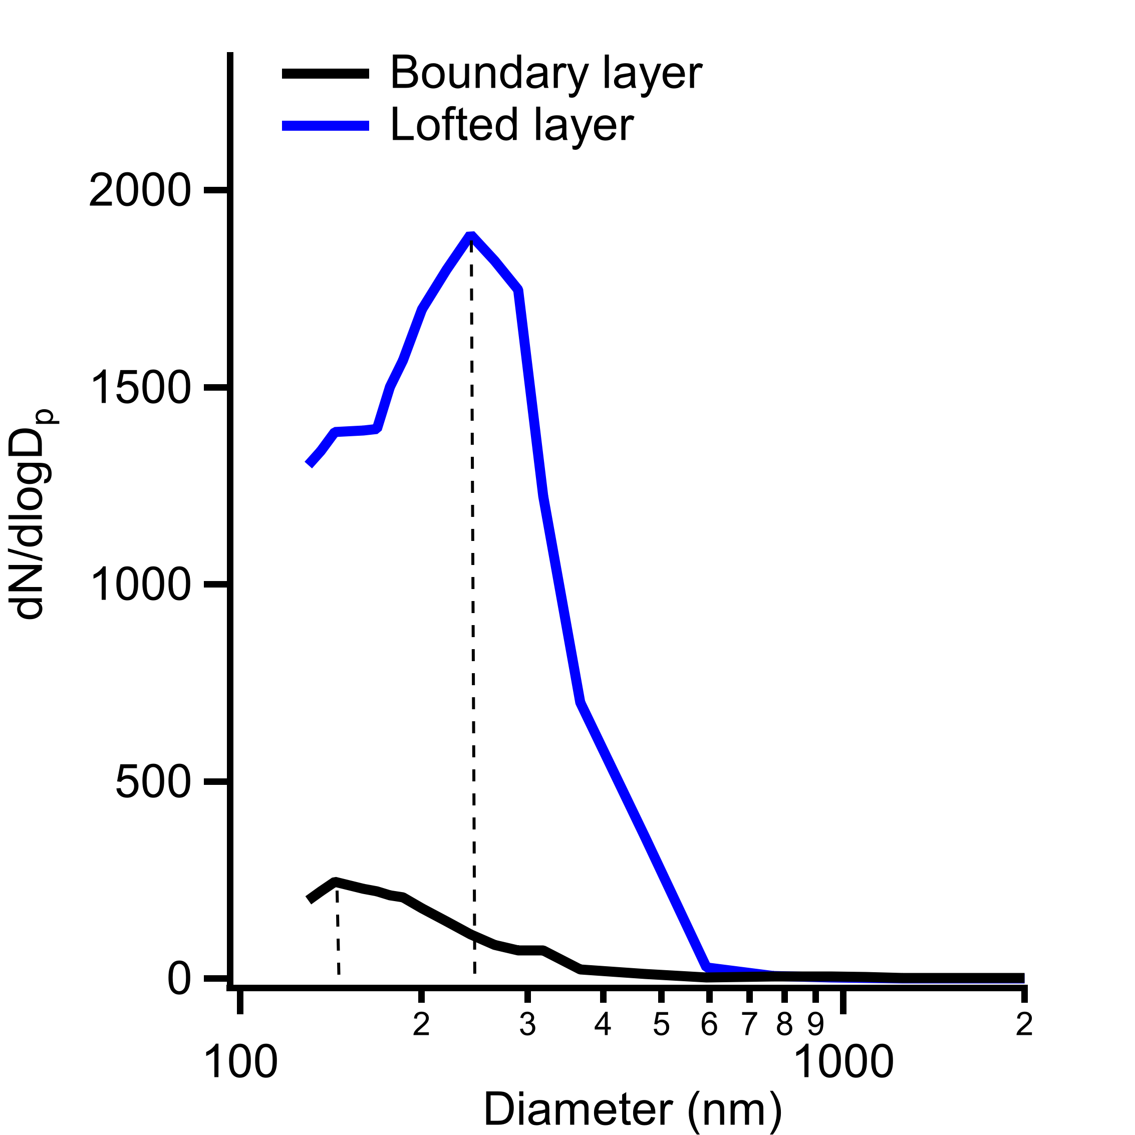
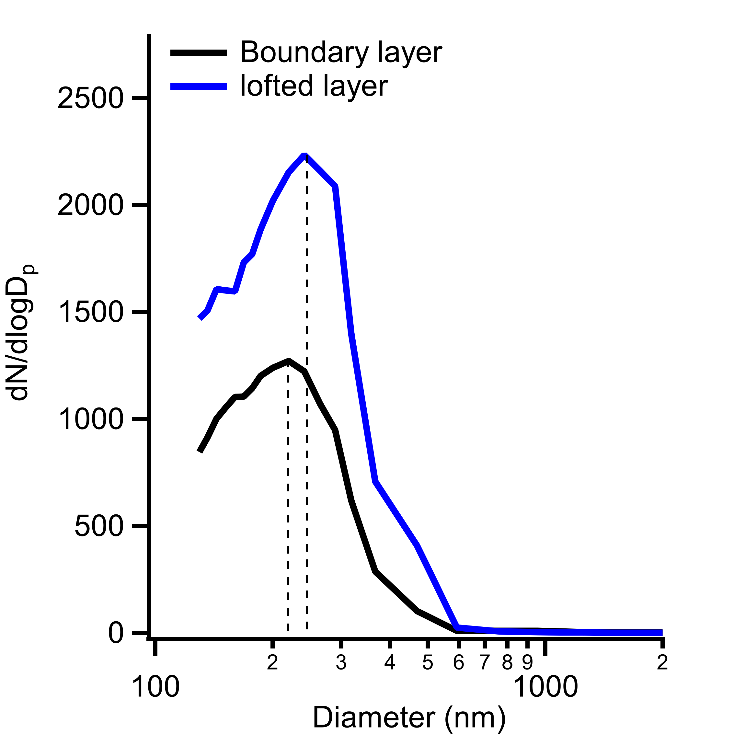
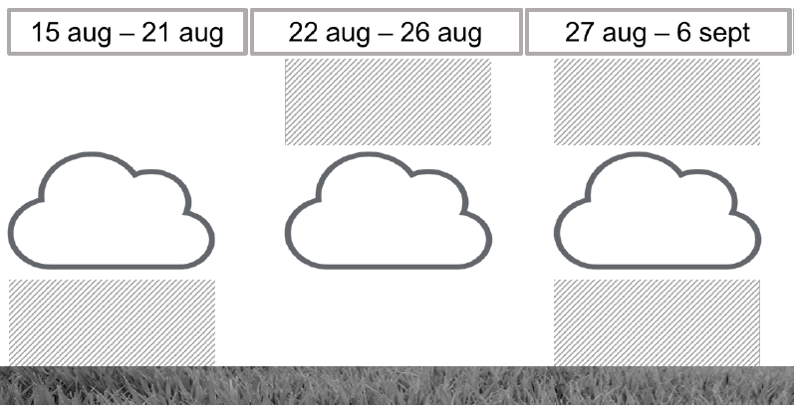
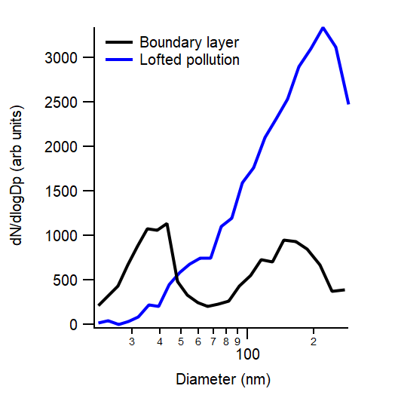
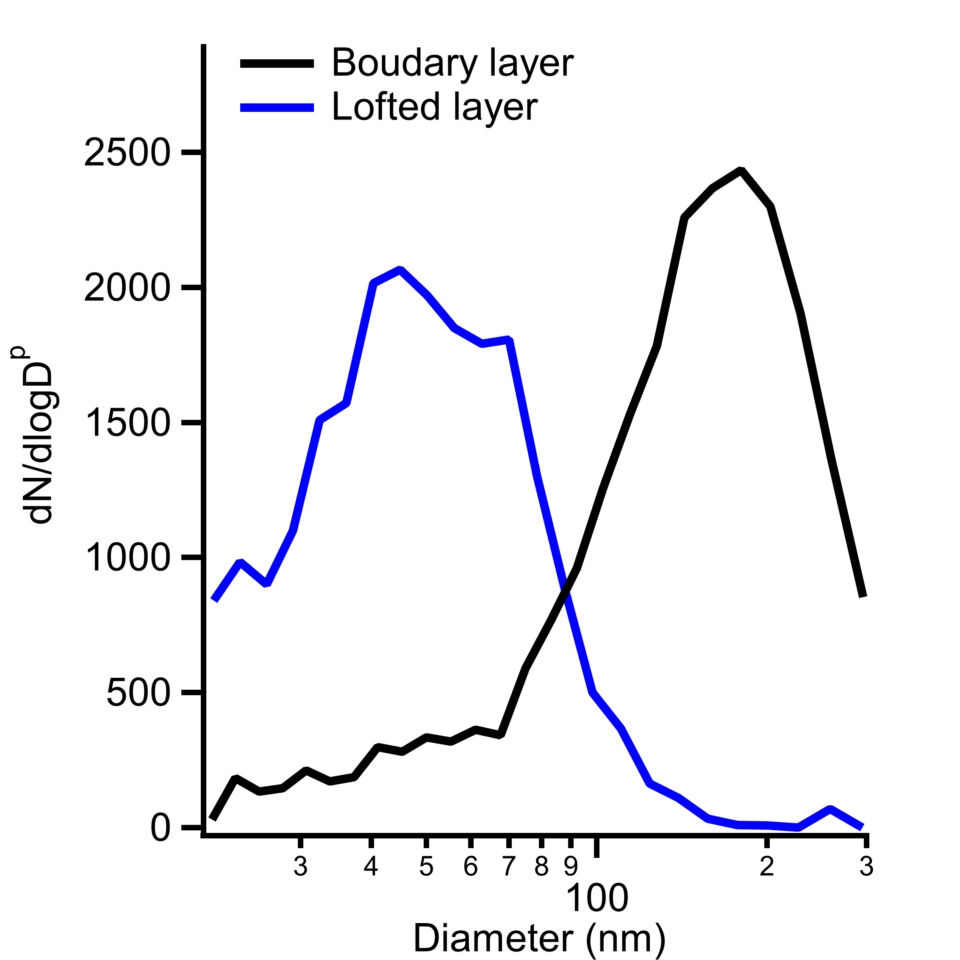
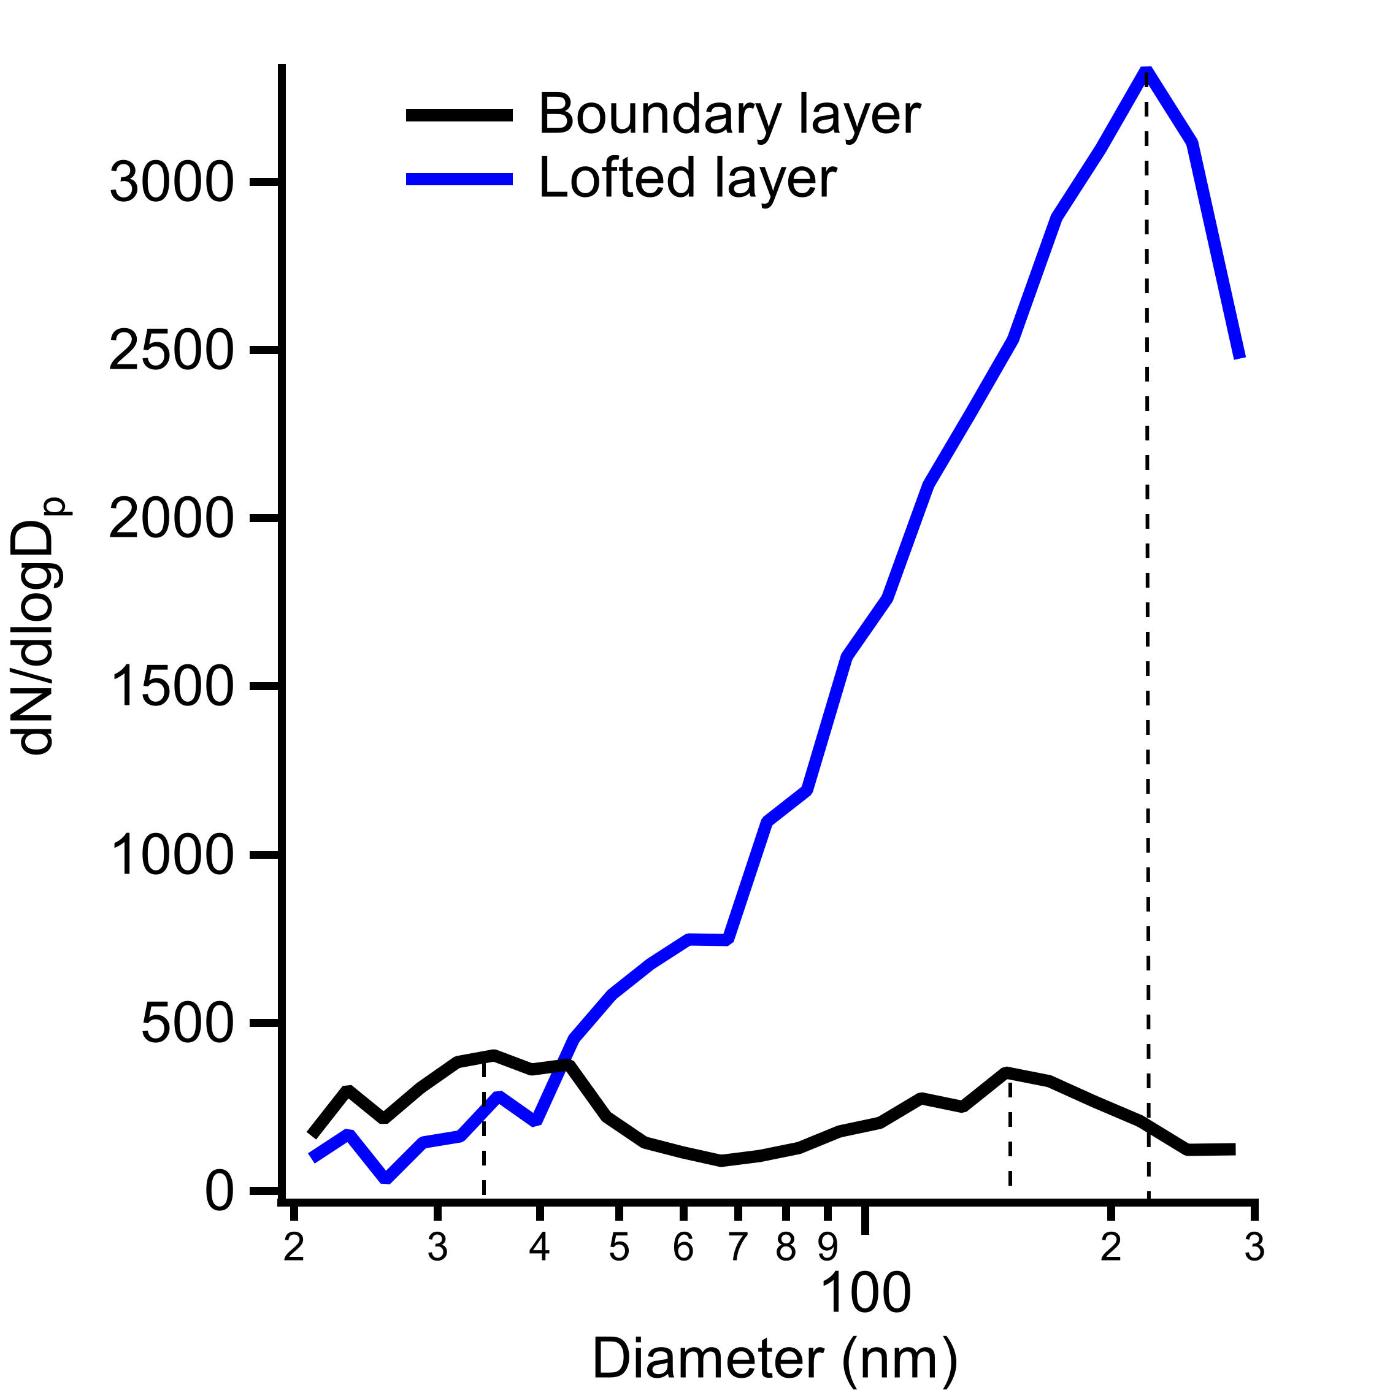
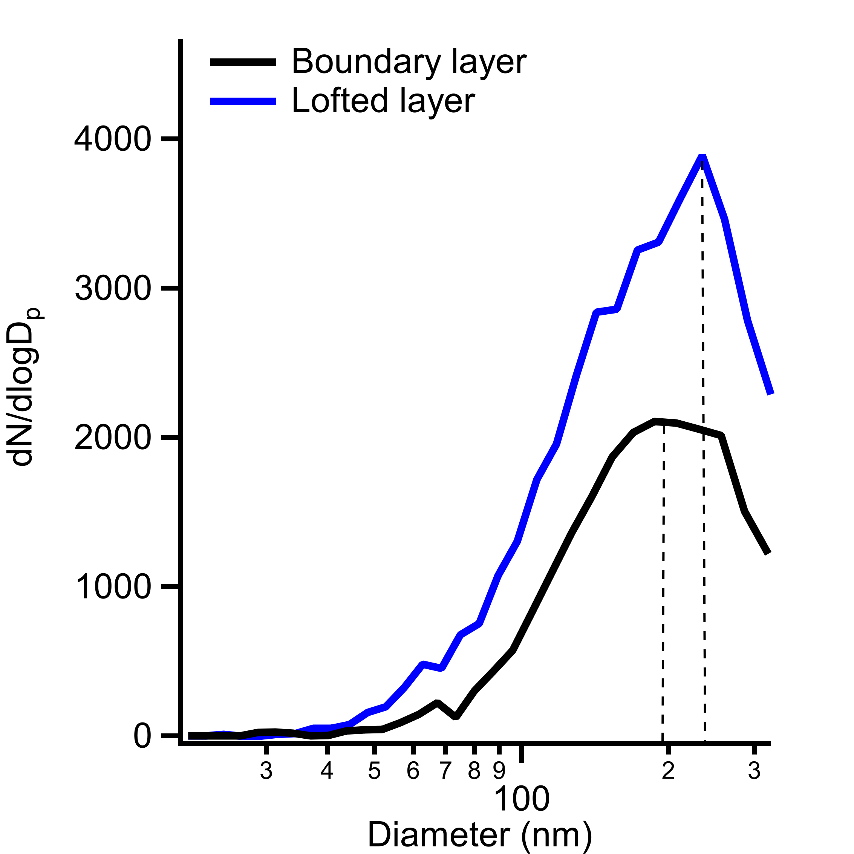
Size Distribution
C031
C037
C045
C045
Example: C031
C037
PCASP
0.12-3 µm
SMPS
0.02-0.35 µm

Slide 9
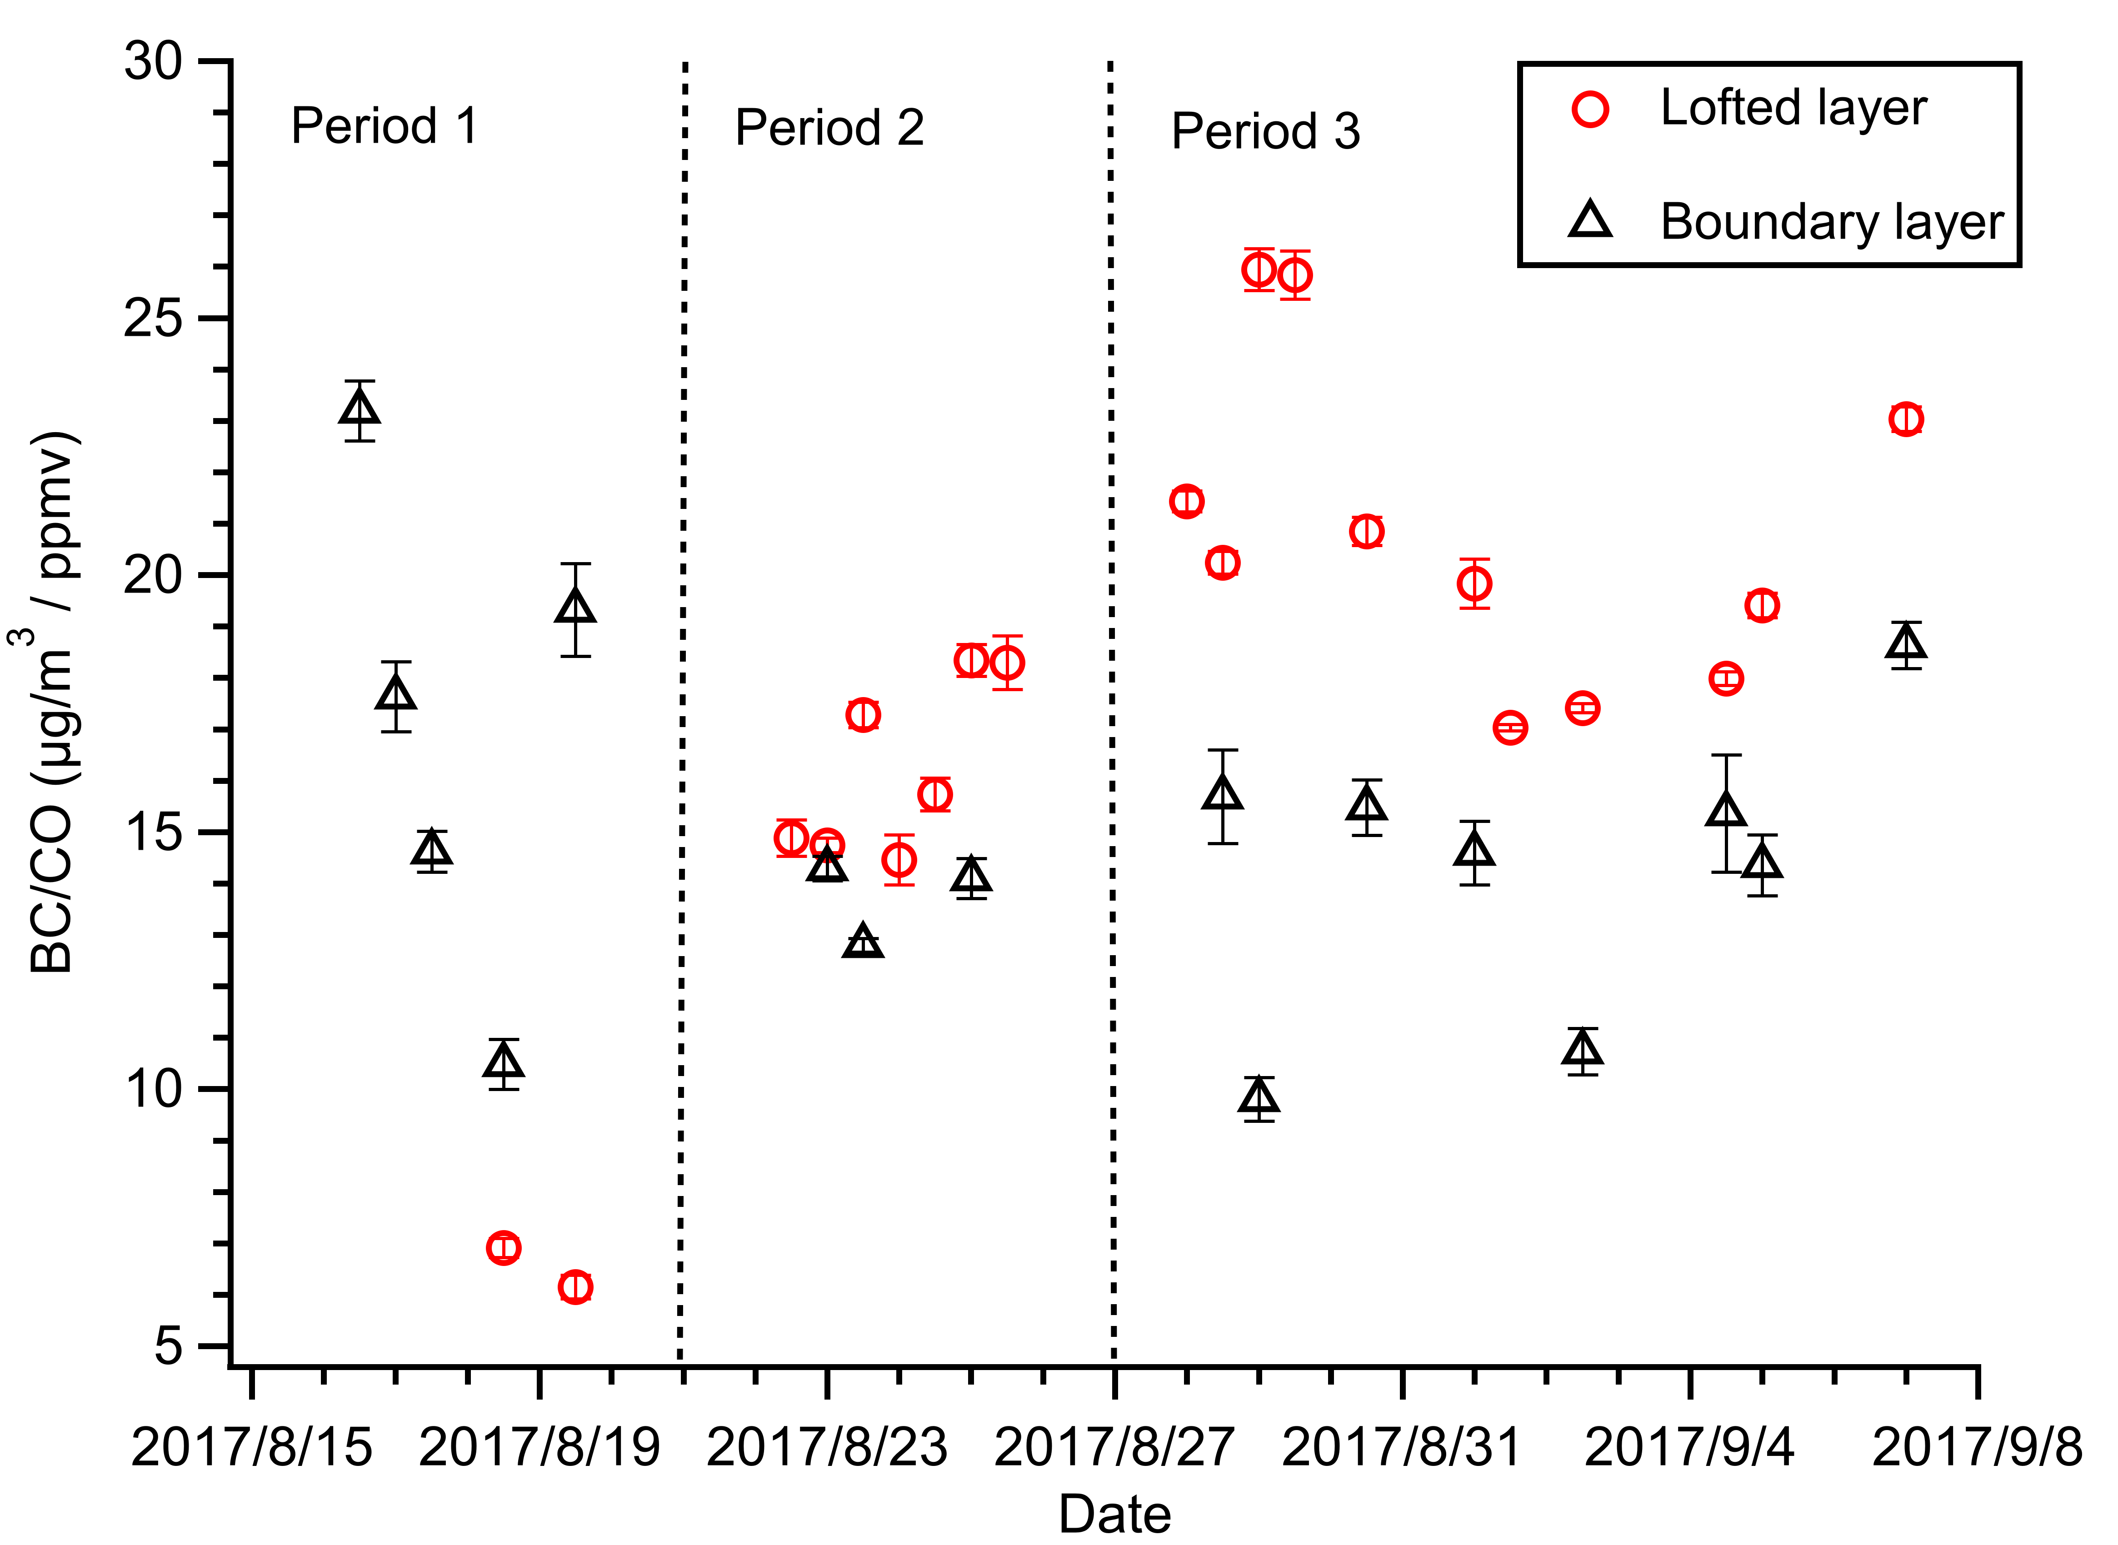
ΔBC/ΔCO
 | Boundary layer | Lofted layer
Period 1 | 17.05±4.30 | 6.53±0.38
Period 2 | 13.73±0.66 | 16.25±1.57
Period 3 | 14.33±2.65 | 20.82±2.92
 | BC/CO (μg sm⁻³ /ppmv) | Reference
Emission Inventory: Extratropical forest | 6.54 | Andrea and Merlet, 2001
Emission Inventory: Extratropical forest | 5.74 | Akagi et al., 2011
Emission Inventory: Tropical forest | 6.99 | Akagi et al., 2011
Emission Inventory: Savanna | 7.34 | Akagi et al., 2011
Large shrubs Burn | 18 | Pratt et al., 2011
DABEX: African BB | 9±1 | Capes et al., 2008
BORTAS-B: Canadian boreal forest | 0.61-3.28 | Taylor et al., 2014
ARCTAS-A: Asian boreal forest | 9±5 | Kondo et al. 2011
ARCTAS-B: Canadian boreal forest | 2±2 | Kondo et al. 2011
Notes:
BC/CO ratios are generally higher in the lofted layer than in the BL in Period 2 &3, while the trend is opposite in Period 1.
In period 1, it’s assumed that BC deposit into BL while CO not, and there is no further injection of lofted BB aerosols, leading to the very low BC/CO ratios in the lofted layer.
The variation in Period 2 &3 may be from the difference in source or the removal process.

Slide 10
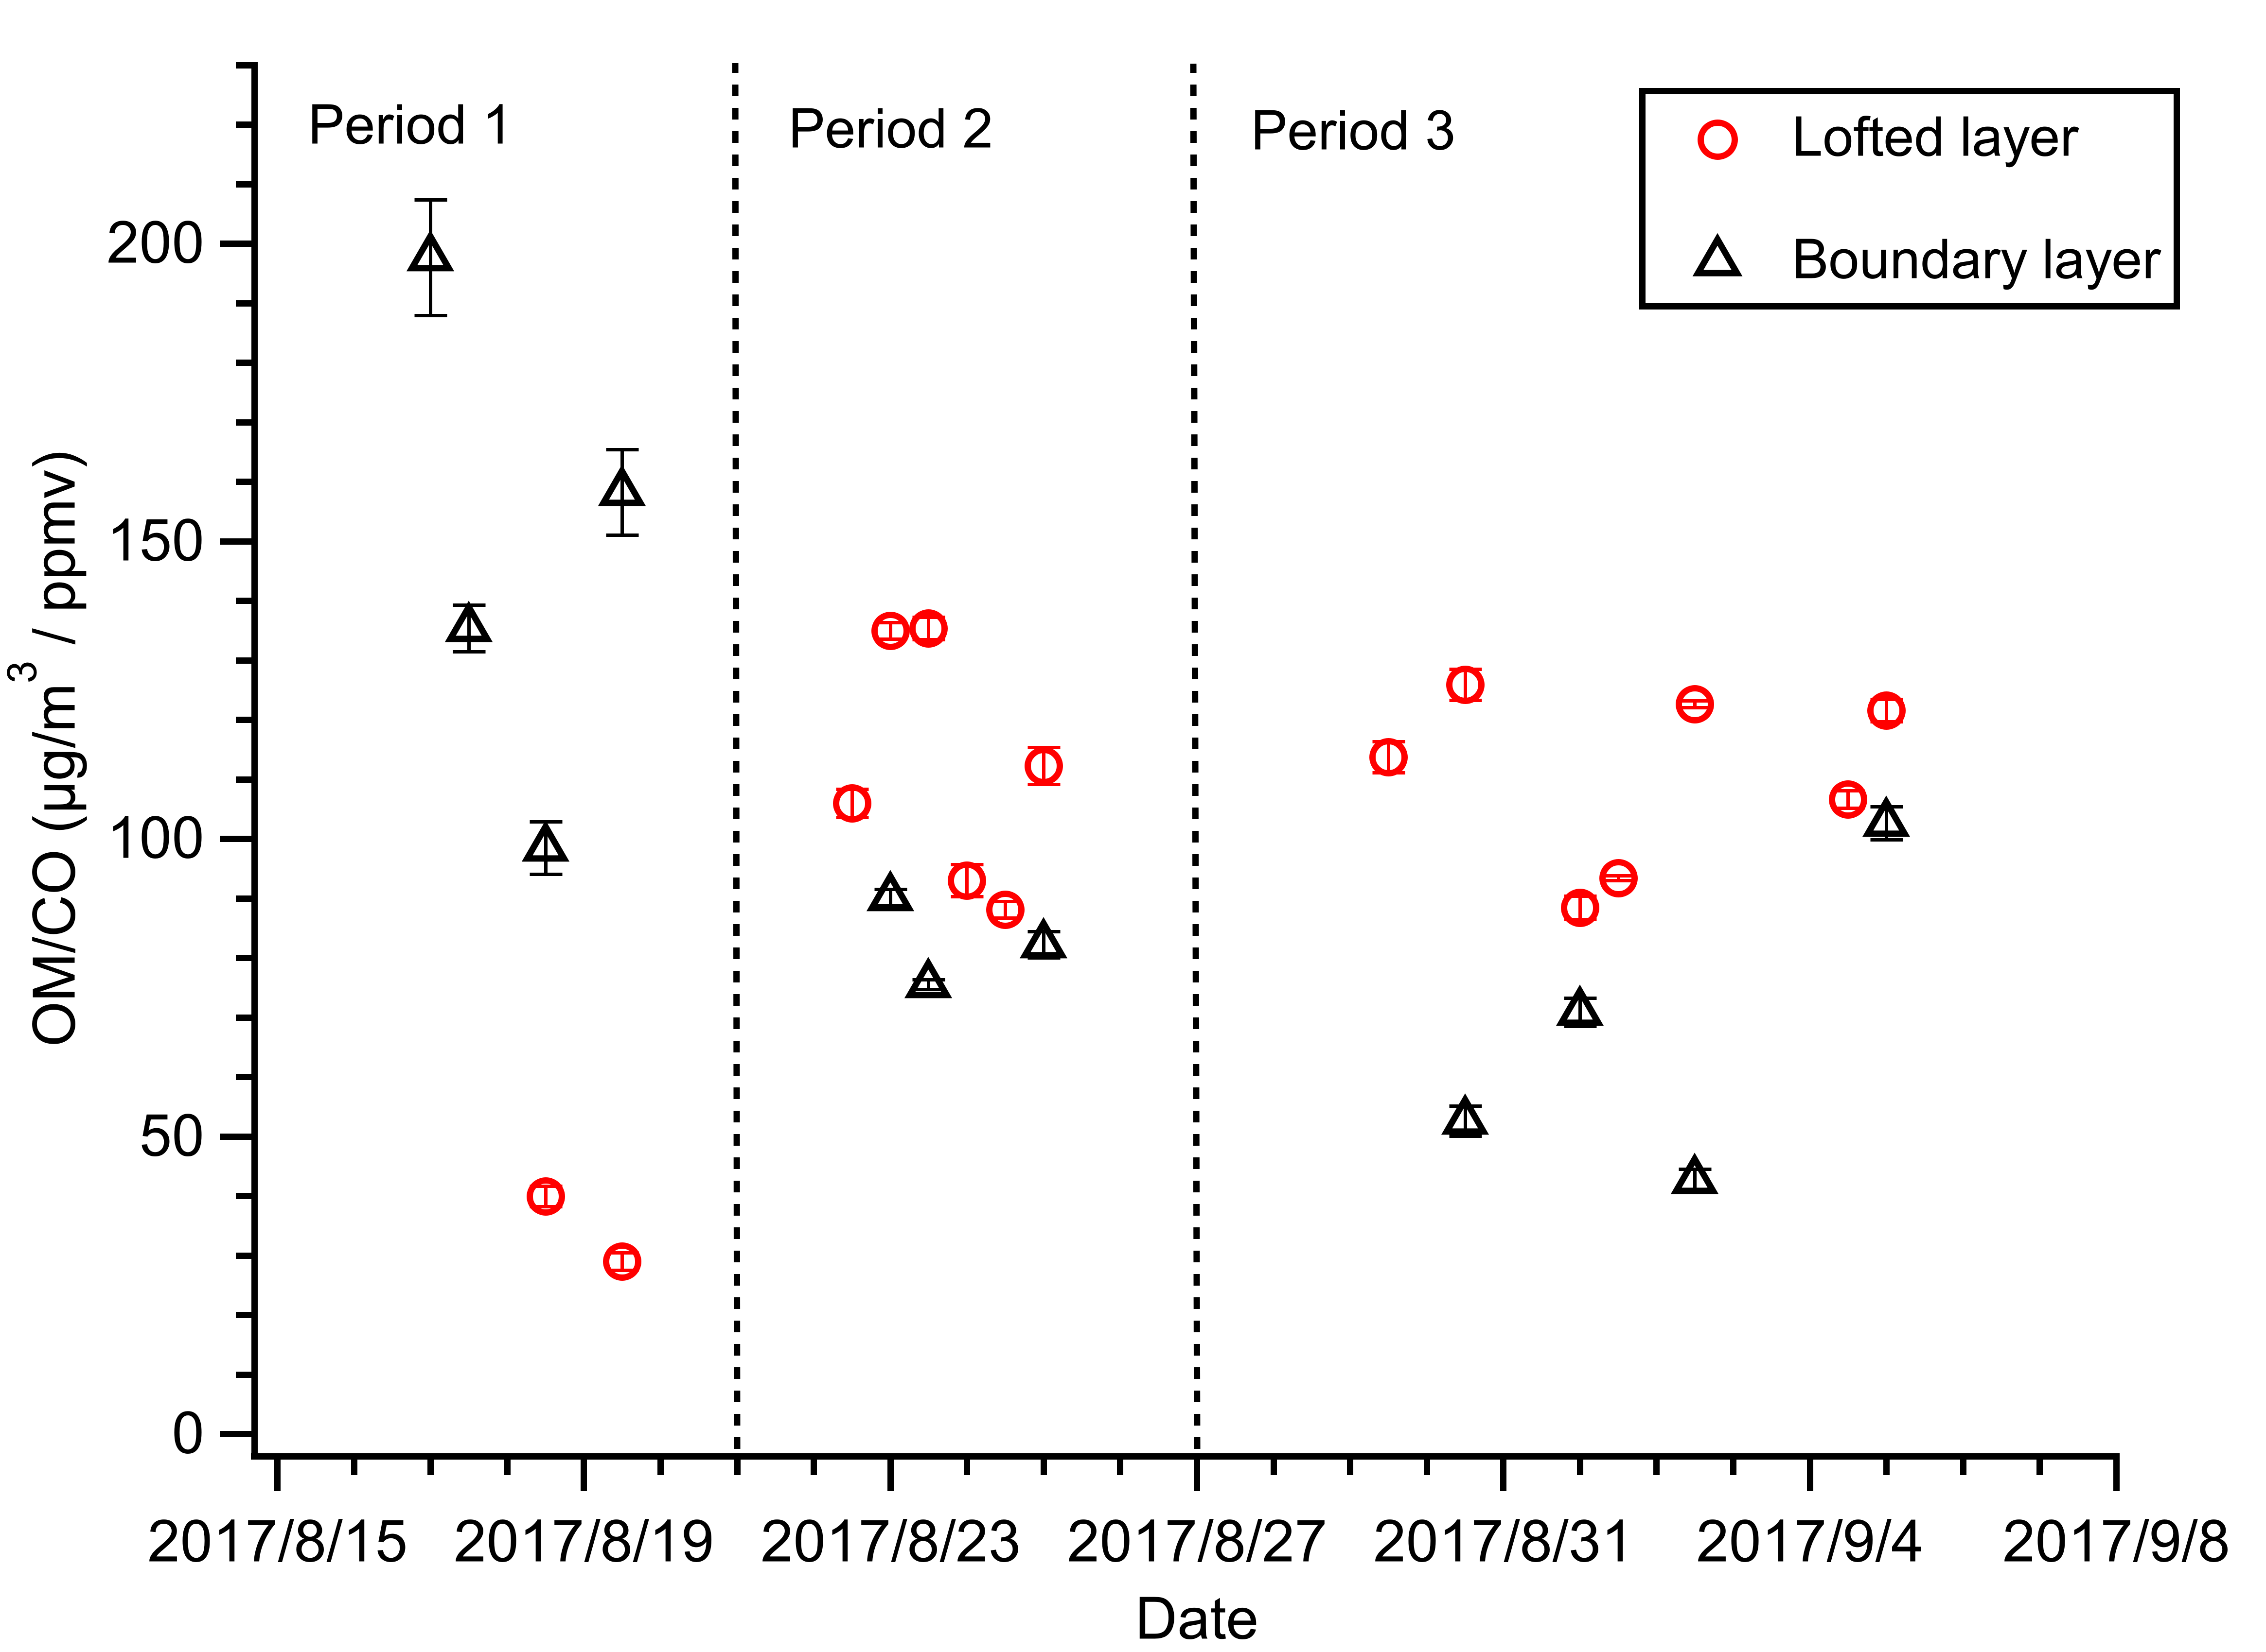
ΔOM/ΔCO
 | Boundary layer | Lofted layer
Period 1 | 147.5±36.0 | 34.5±5.5
Period 2 | 82.6±6.0 | 111.6±18.5
Period 3 | 67.2±22.8 | 110.3±13.7
 | OM/CO (μg sm⁻³ /ppmv) | Reference
Emission Inventory: Extratropical forest | 151-170 | Andrea and Merlet, 2001
Emission Inventory: Extratropical forest | 132-150 | Akagi et al., 2011
Emission Inventory: Tropical forest | 95 | Akagi et al., 2011
Emission Inventory: Savanna | 78 | Akagi et al., 2011
Large shrubs Burn | 82 | Pratt et al., 2011
DABEX: African BB | 71±4 | Capes et al., 2008
BORTAS-B: Canadian boreal forest | 0.4-174 | Taylor et al., 2014
ARCTAS-B: Canadian boreal forest | 120 | Kondo et al. 2011
Notes:
OM/CO ratios show a similar trend to BC/CO, which are generally higher in lofted layer than boundary layer in Period 2 and 3, but opposite in Period1. However, OM/CO show less variation in the same layer, except the similar decreasing boundary layer trend with BC/CO in Period 1. The difference between OM/CO and BC/CO is likely to correlate with different evolution processes. The evaporation and further oxidation of BB POA and SOA formation may lead to OA loss or net OA enhancement, while BC not. Furthermore, the discrepancy may also indicate the different scavenging efficiency between OM and BC during transport.

Slide 11
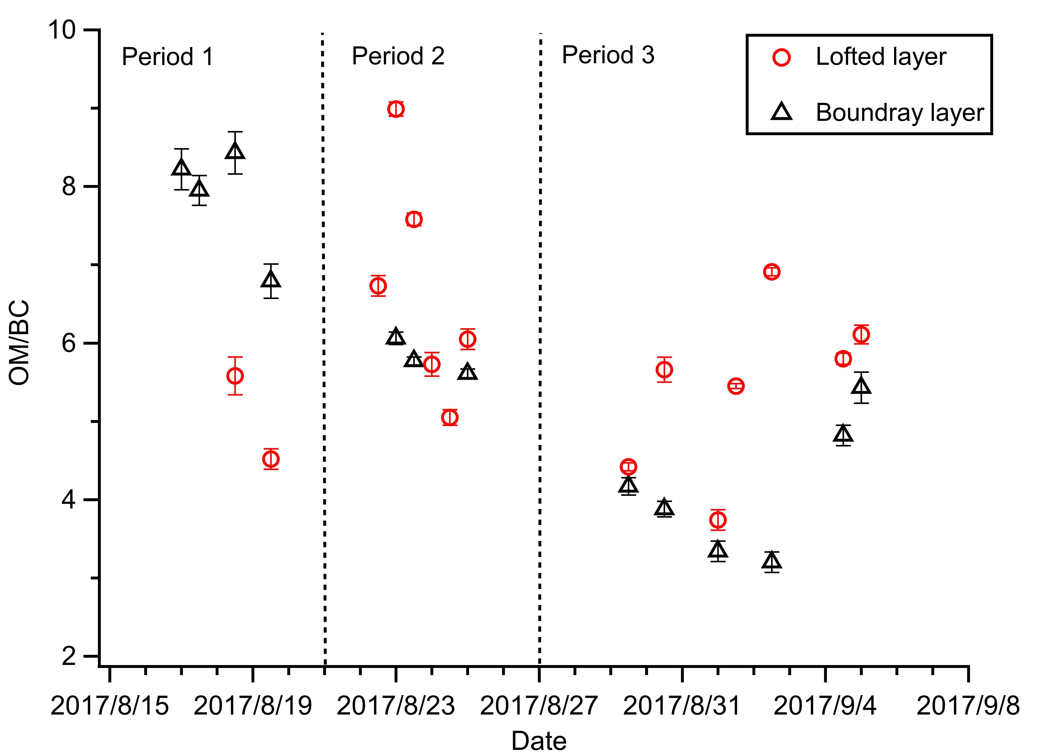
OM/BC ratio
 | Boundary layer | Lofted layer
Period 1 | 7.85±0.63 | 5.05±0.53
Period 2 | 5.81±0.19 | 6.69±1.30
Period 3 | 4.14±0.79 | 5.44±0.98
 | OM/BC | Reference
Emission Inventory: Extratropical forest | 23-26 | Akagi et al., 2011
Emission Inventory: Tropical forest | 13.6 | Akagi et al., 2011
Emission Inventory: Savanna | 10.6 | Akagi et al., 2011
Emission Inventory: Crop residue | 4.6 | Akagi et al., 2011
Large shrubs Burn | 4.6 | Pratt et al., 2011
DABEX: African BB | 8.3 | Capes et al., 2008
ARCTAS-A: Asian boreal forest | 13.5 | Kondo et al. 2011

Slide 12
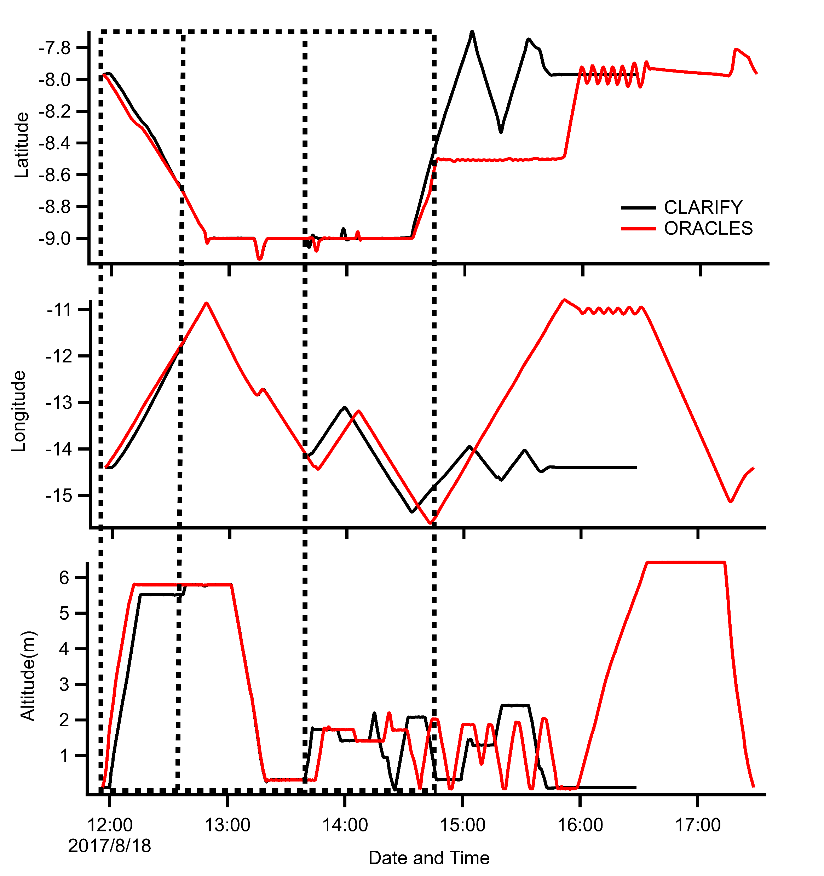
Inter-comparison Flight: ORACLES
1
2
3
Inter-comparison period
(20170818, the dashed box area):
Offset, ORACLES earlier
Match well
Offset, CLARIFY earlier

Slide 13
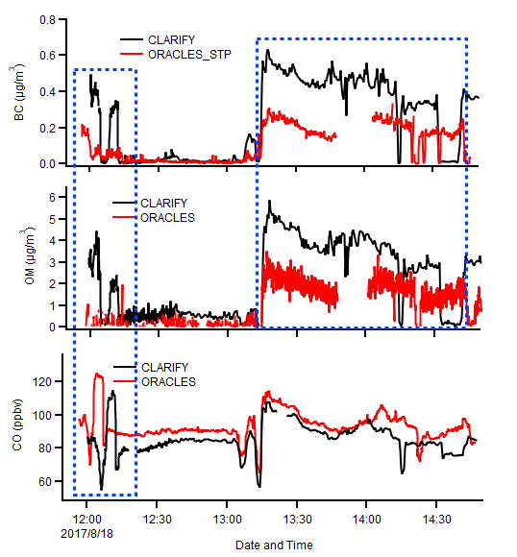
Inter-comparison Flight: ORACLES
 |  | CLARIFY (Boundary Layer) | ORACLES (Boundary Layer)
AMS | OM (μg sm⁻³) | 3.62±0.76 | 1.81±0.51
 | SO₄ (μg sm⁻³) | 2.12±0.31 | 1.78±0.35
 | NH₄ (μg sm⁻³) | 0.66±015 | 0.37±0.09
SP₂ | BC (μg sm⁻³) | 0.43±0.08 | 0.20±0.04
 | BC (# sm⁻³) | 129±24 | 71±15
CO (ppbv) |  | 89.2±6.4 | 96.2±6.6
ΔBC/ΔCO (μg sm⁻³ /ppmv) |  | 10.08±0.54 | 4.65±0.20
ΔOM/ΔCO (μg sm⁻³ /ppmv) |  | 99.5±4.8 | 52.4±1.5

Slide 14
Summary
Internal comparison mostly good
CLARIFY observed aged organics (LO-OOA) and thickly coated BC.
Mostly accumulation mode aerosols.
Some variations in aerosol properties between boundary layer and lofted smokes. (chemical composition, size distribution, OM/CO, BC/CO, BC coatings…)
Next Plan
Run NAME dispersion model: Identify the source variation, the different transport process in boundary layer and lofted smokes.
Compare with ORACLES eastern flights
Compare with fresh BB aerosols in MOYA project.

