Slide 1
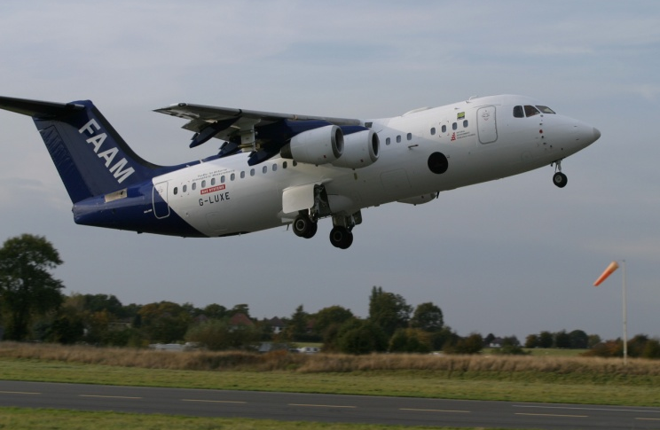
Black carbon, mixing state and optical property determination
Jonny Taylor, HuiHui Wu, Ian Crawford, Keith Bower, James Allan, Dantong Liu, Michael Flynn, Paul Williams, James Dorsey, Tom Choularton, Justin Langridge, Cathryn Fox, Michael Cotterell, Nick Davies, Hugh Coe, Steve Abel, Jim Haywood

Slide 2
Background/Strategy
Talk briefly about the problem of BC optical properties

Slide 3
SP2 details, EXSCALABAR

Slide 4
SP2 particle properties, C037

Slide 5
How absorbing is the aerosol? C037
Compared to Bond & Bergstrom (2006)- dashed line
E_{Abs} = 1.52 (blue), 1.44 (green), 1.50 (red)
AAE = 1.06 ➔ minimal effect from brown carbon

Slide 6
Can we model MAC simply?
Spherically-symmetric particles, using SP2 scattering inversion and absorption forward model

Slide 7
Can we model AAE simply?

Slide 8
Can we model E_{Abs} simply?

Slide 9
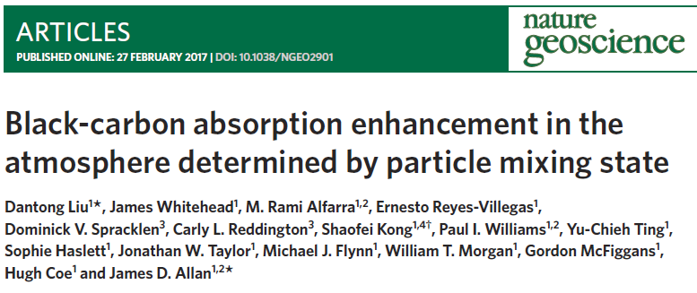
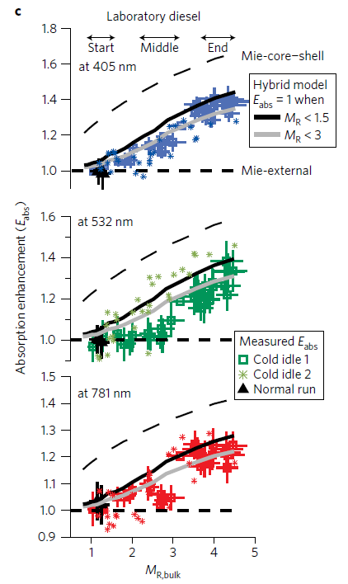
Hybrid model by Liu et al (2017)
Semi-empirical parameterisation of E_{abs} (not MAC!) from lab diesel and Manchester ambient
M_{R} = Mass ratio of non-BC/BC
10
12

Slide 10
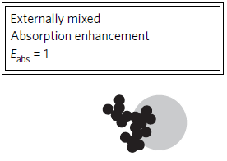
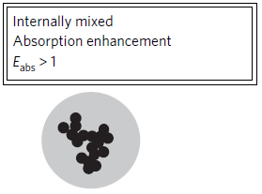
Hybrid model by Liu et al (2017)

Slide 11
Hybrid model by Liu et al (2017)

Slide 12
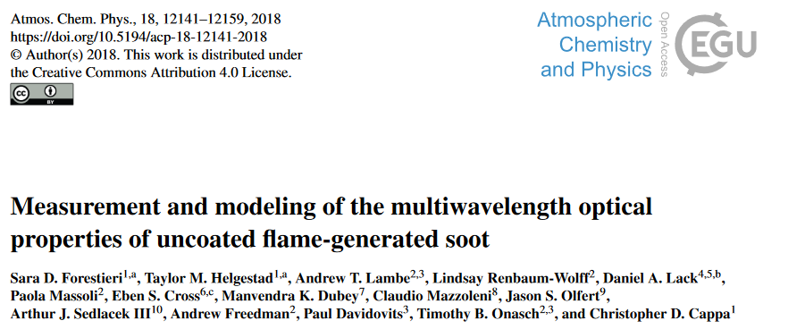
Optical modelling summary
Mie theory underpredicts absorption at shorter λ ➔ AAE too low
RDG underpredicts absorption at longer λ, ➔ AAE too high
All sensitive to BC refractive index
No strong signal from brown carbon
Next steps:
Test out semi-empirical parameterizations
Compare to MOYA(?)

