Slide 1
Analysis of the 19 August 2017 (C032) Case and Plan for Simulations
Zhiqiang Cui¹ and Alan Blyth^{1,2}
¹University of Leeds
²NCAS

Slide 2
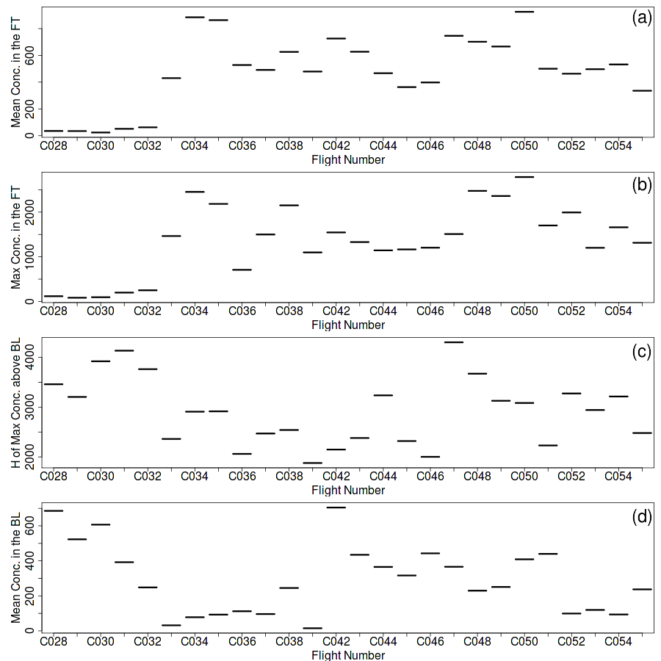
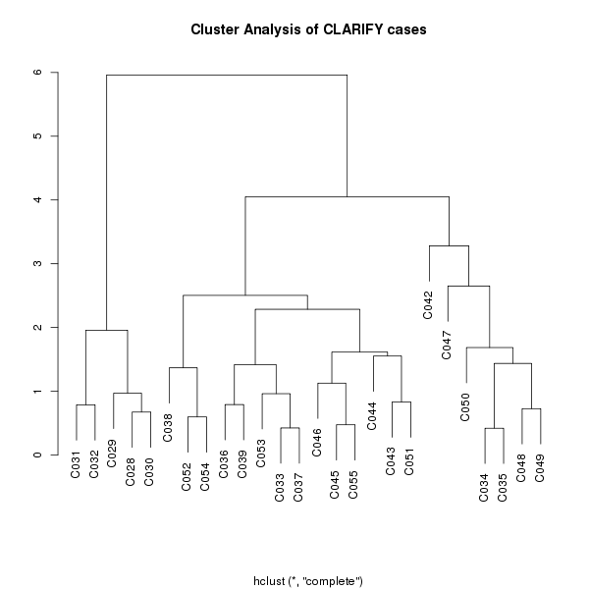
Cluster Analysis
Based on max. and mean N_{pcasp} above BL, the height of max. N_{pcasp}, and mean N_{pcasp} within BL
Two clusters: A and B
B ⊂ B₁ and B₂
max(N) above BL
mean(N) above BL
A
B₂
Z(N_{max}) above BL
B₁
Mean(N)in BL

Slide 3
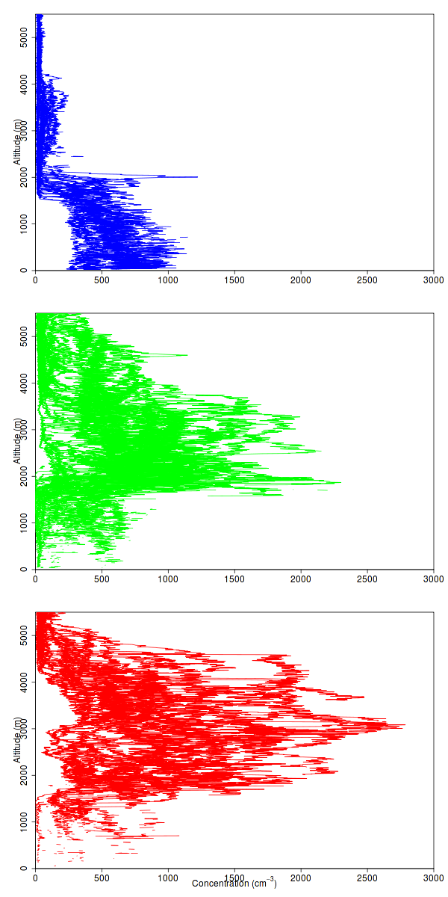
PCASP concentration
C032(19-08-2017)
end of the first scenario (A)
A
clean
Polluted
B₁
B₂
A
B₁
Polluted
clean
B₂
More Polluted and higher
clean

Slide 4
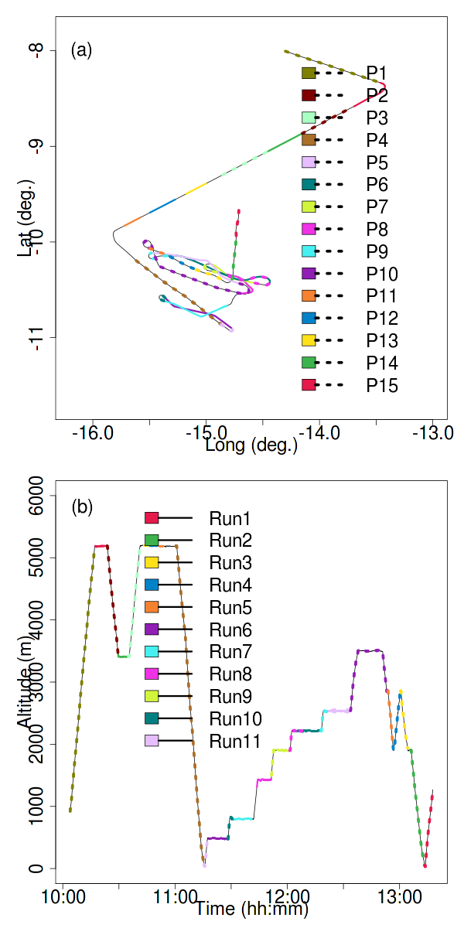
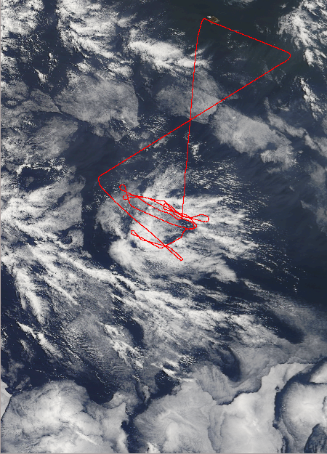
Cloud penetrations
Courtesy of S. Abel
Below-cloud aerosol run

Slide 5
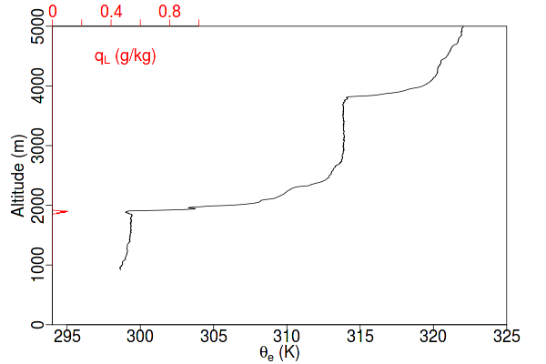
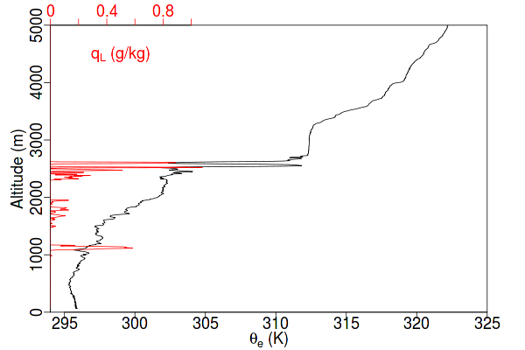
PCASP
P1
P4
Aerosol conc. within the BL ~ 200-700 cm⁻³
Aerosol layer above the BL < 200 cm⁻³

Slide 6
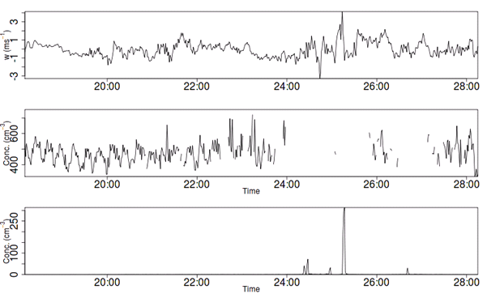
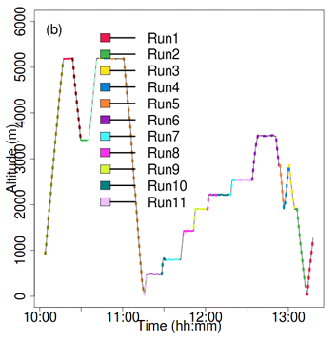
Aerosol in Run 6 just below cloud
W
PCASP
CDP
Run 6
Mean concentration in Run 6 ~ 480 cm⁻³
Repeated patterns in PCASP concentration
Wavelet analysis: the period of the patterns ~ 16 s
No correlation between PCASP and w’,w’t’, TKE

Slide 7
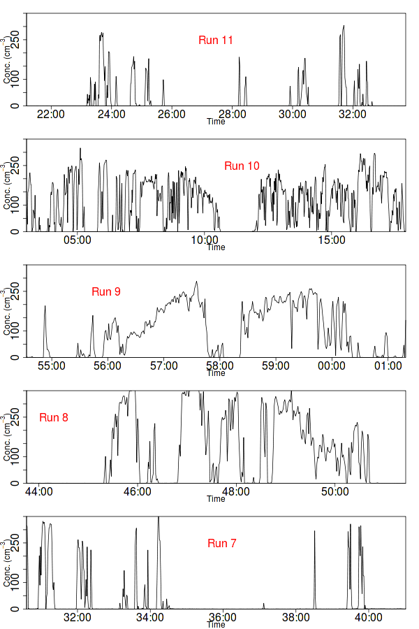
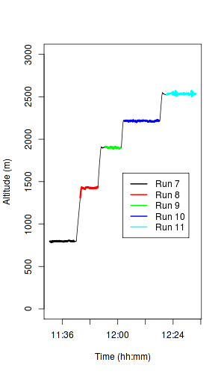
Cloud Penetrations
CDP concentration (cm⁻³)
Convection in Run 11
Sc in Runs 8 – 10

Slide 8
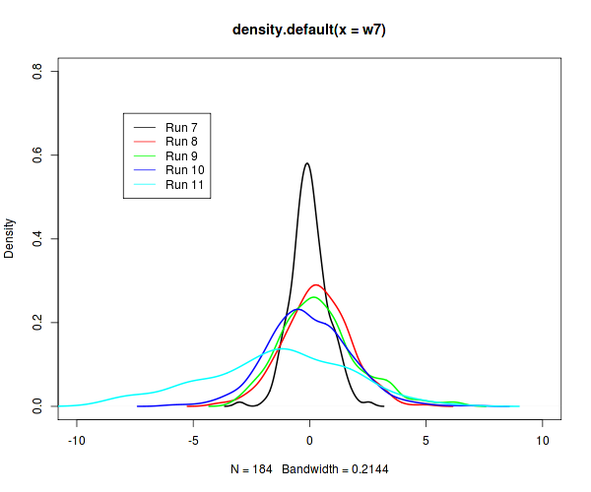
In-cloud w Distribution
Longer tails at higher level: strong w at higher levels
Fat tails at lower ends: more downdraught

Slide 9
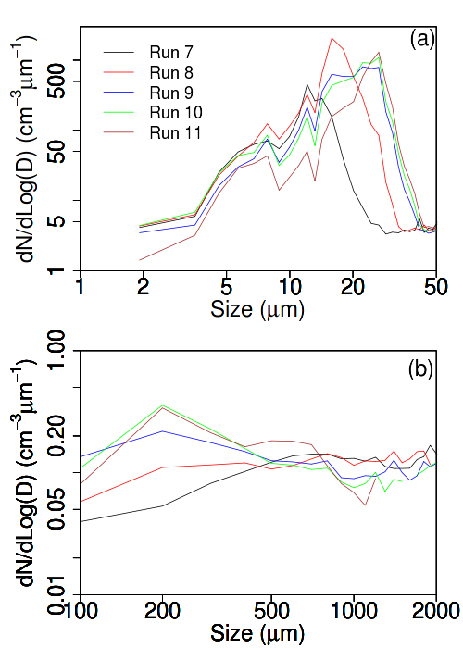
Size Dis. Functions Peaks shift towards large values with increasing height, i.e., Run 7 => Run 11 Growth through collision-coalescence.
CDP
2DS
Concentration of 200 µm-sized drizzle drops increases with height, but Concentration of 1000 µm-sized raindrops decreases with height.
More drizzle drops at higher levels.
More raindrops at lower levels.
CIP

Slide 10
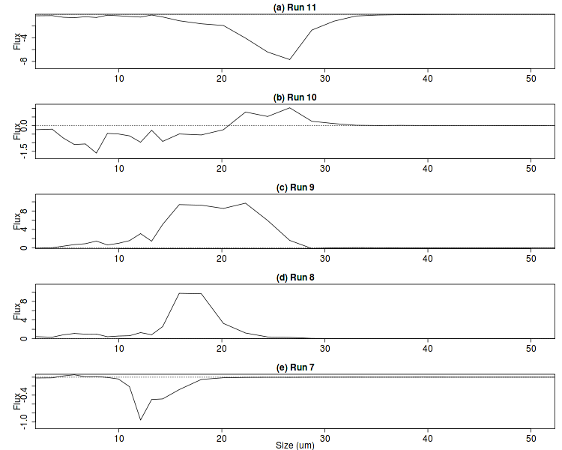
CDP Drop Number Flux (w-w_{terminal})*N(bin)
Upward transport of large drops

Slide 11
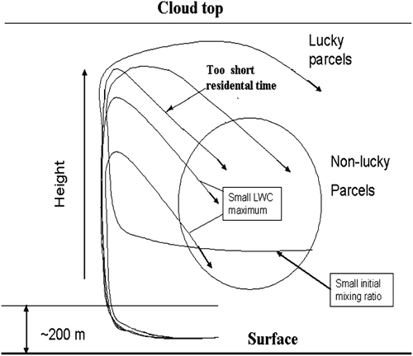
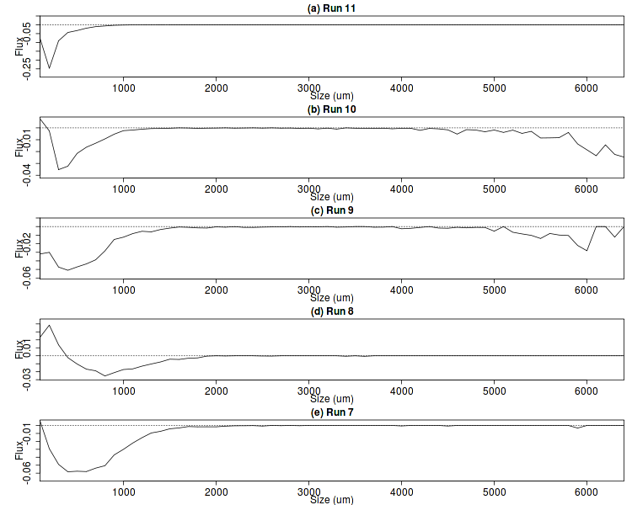
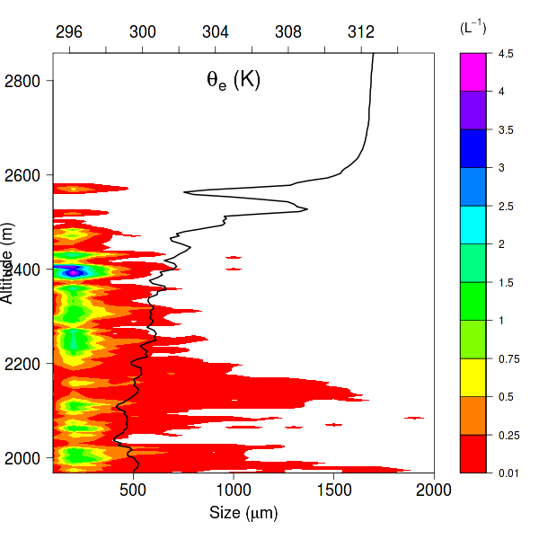
CIP Drop Number Flux (w-w_{terminal})*N(bin)
Magaritz and Pinsky, 2009
Profile run 11

Slide 12
Slopes of profile runs (Height/Distance): 3.2 – 4.1 % Gentle slantwise ascending
Profiles
Profile run
SLR
SLR
Altitude
SLR
SLR
Time

Slide 13
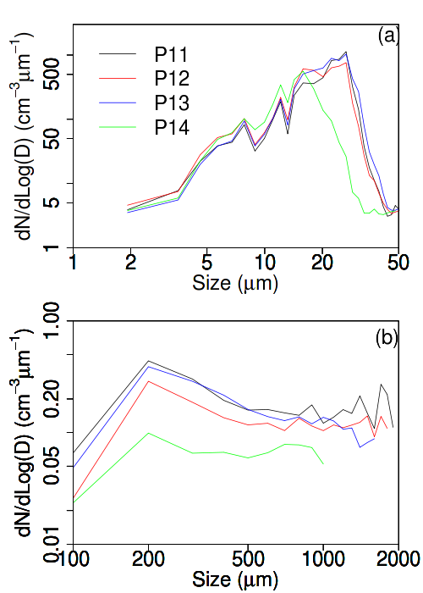
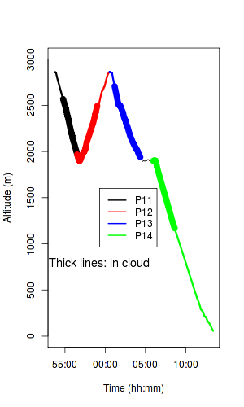
Similar CDP size distribution functions in P11, P12, and P13 (upper part of the clouds)
CDP
CIP

Slide 14
Summary
Two aerosol layers
Below ~2000 m: 200 – 700 cm⁻³
~2500 – 4000 m, < 200 cm⁻³
Five cloud penetrations
Sc and shallow convection
Warm rain process
Upward transport of drizzle drops, and downward of raindrops
Vertical velocities
Very strong for such shallow clouds, close to ±10 ms⁻¹

Slide 15
Plan for Simulations
Use the Met Office’s MONC model
Can the model capture the general feature of the clouds, such as the stratocumulus and the cellular convection?
Investigate
the structure and evolution of the clouds
Aerosol impact on the clouds
The role of aerosol above the BL through entrainment to act as CCN or the effect of radiation

Slide 16
Supplementary slides

Slide 17
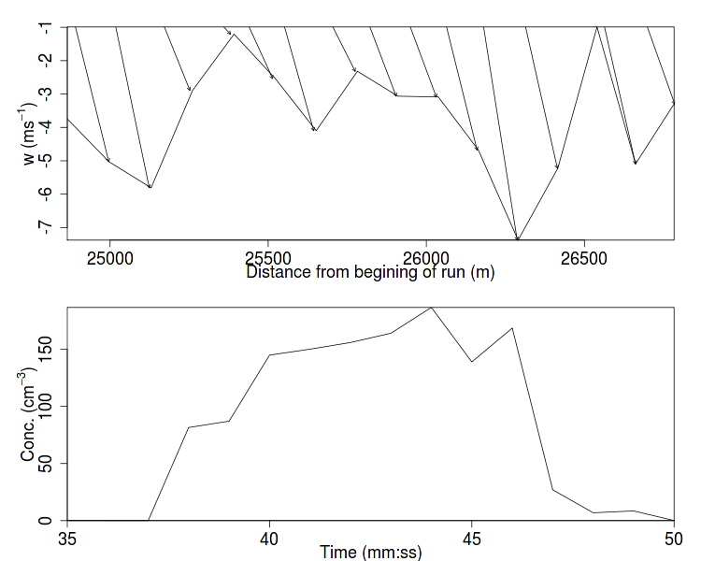
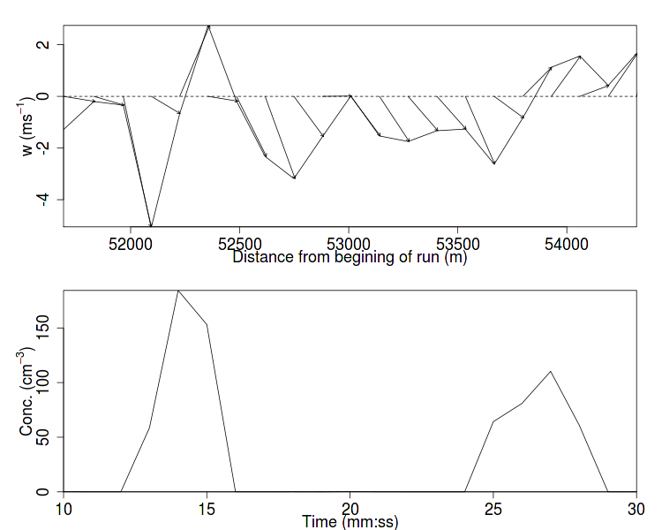
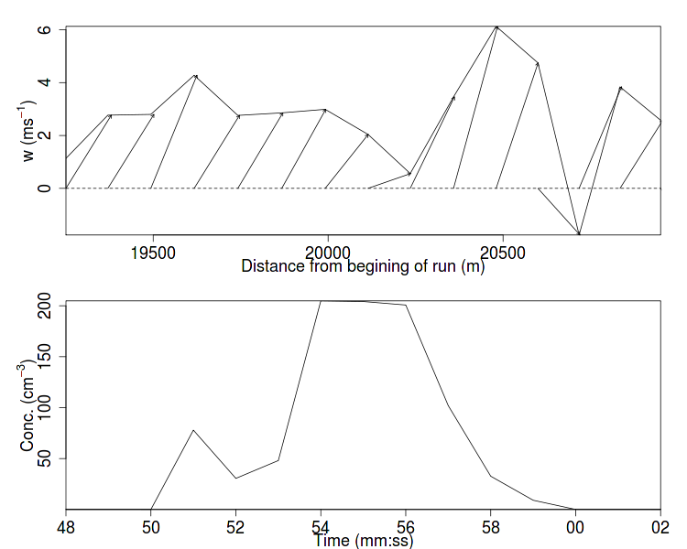
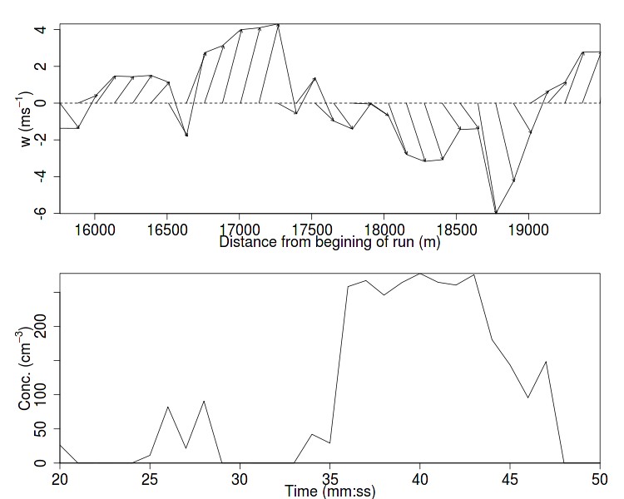
Cloud Types in Run 11
In broad downdraught
circulation
In broad updraught
Dip by downdraught

Slide 18
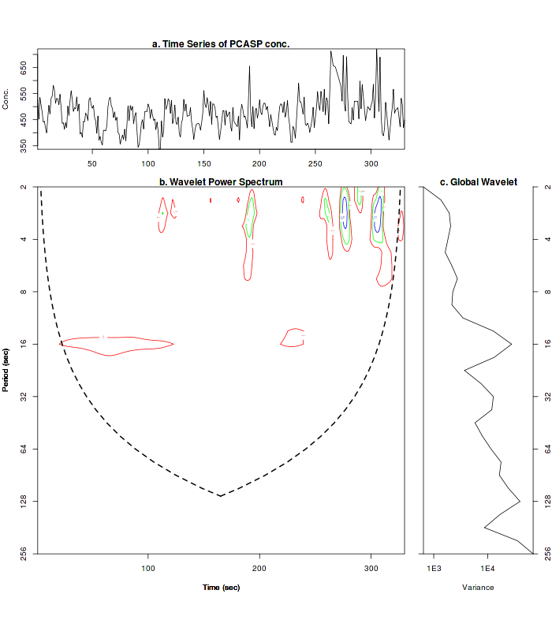
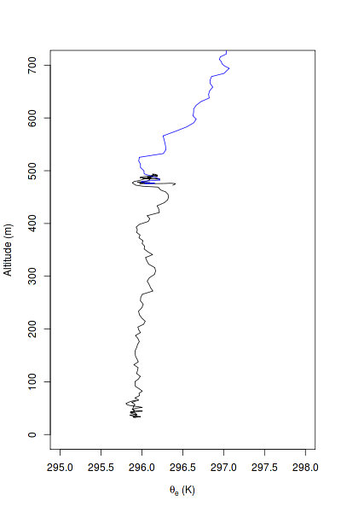
Wavelet Analysis of PCASP in Run 6
Repeated patterns
Period of ~ 16 sec
Other variables do not have such periodicity
w’ (next slide)
w’w’
w’t’
sqrt(u’u’+v’v’+w’w’)
Might be caused by gravity waves
P6 After Run 6
P5 before Run 6

Slide 19
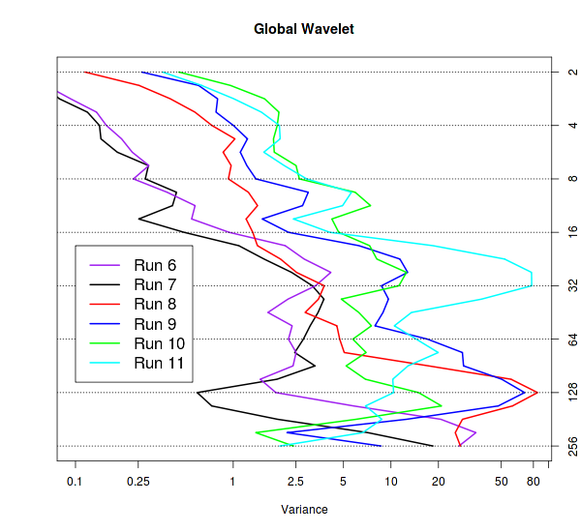
Wavelet Analysis of Vertical Velocity

Slide 20
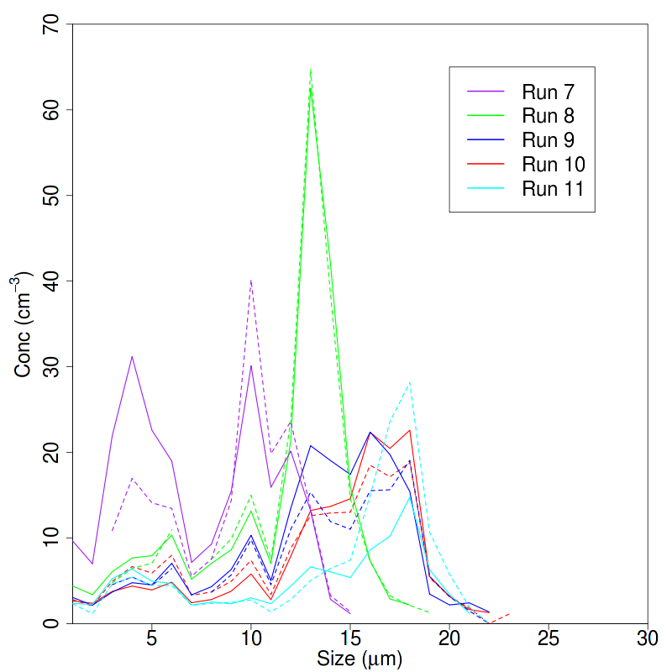
CDP drop size distribution in updraught (solid) and downdraught (dashed)
Both upward and downward exist
More upward flux of large drops in Runs 9-10

Slide 21
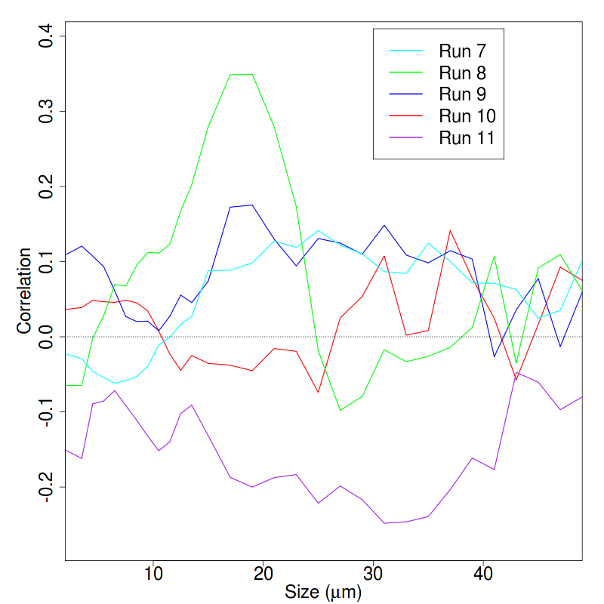
Correlation between w and CDP concentration
Correlations are not great except between 10 – 20 µm in Run 8

