Slide 1
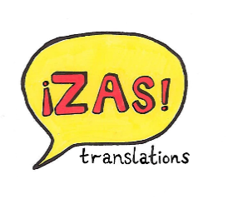
Third Colloquium on Innovation in Modern Languages Education
University of Bristol • 30th June 2016
Global citizenship The Student Translation Business Project: Developing Intercultural Skills in the Global Marketplace
Adam Hill
Fiona Potigny
Dr Isabel Santafé
#LanGW4
Follow us: @Lan_Gw4

Slide 2
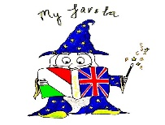
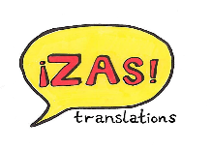
`
Translation Business Project
Project-based learning initiative - run over 10 weeks
Teamwork: 4 different roles as defined by the European Standard EN15038 and mentors
Project Manager, Translator (max. 4), Reviser (max. 2), Proof-reader (max. 2)
The importance of intercultural communication in world trade
Develop entrepreneurial skills in a global context
Gain experience of the translation industry
Empower students

Slide 3
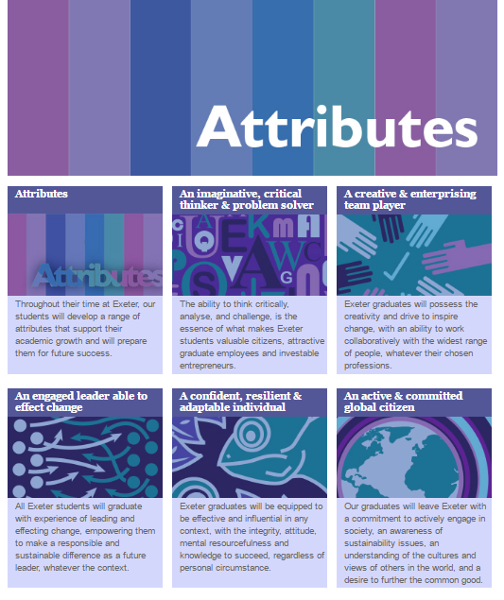
Global citizenship

Slide 4
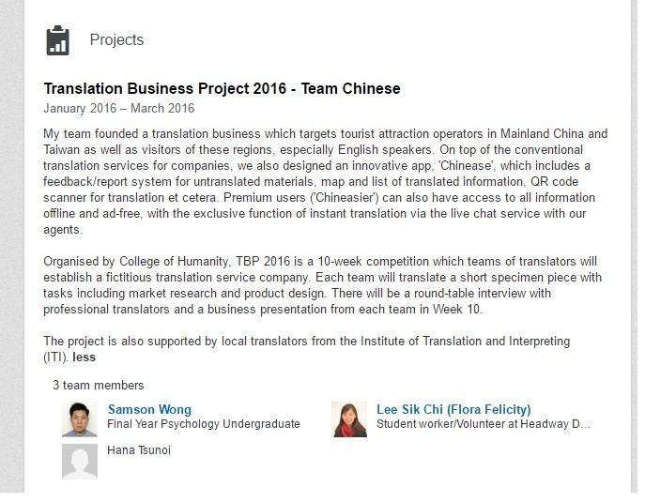
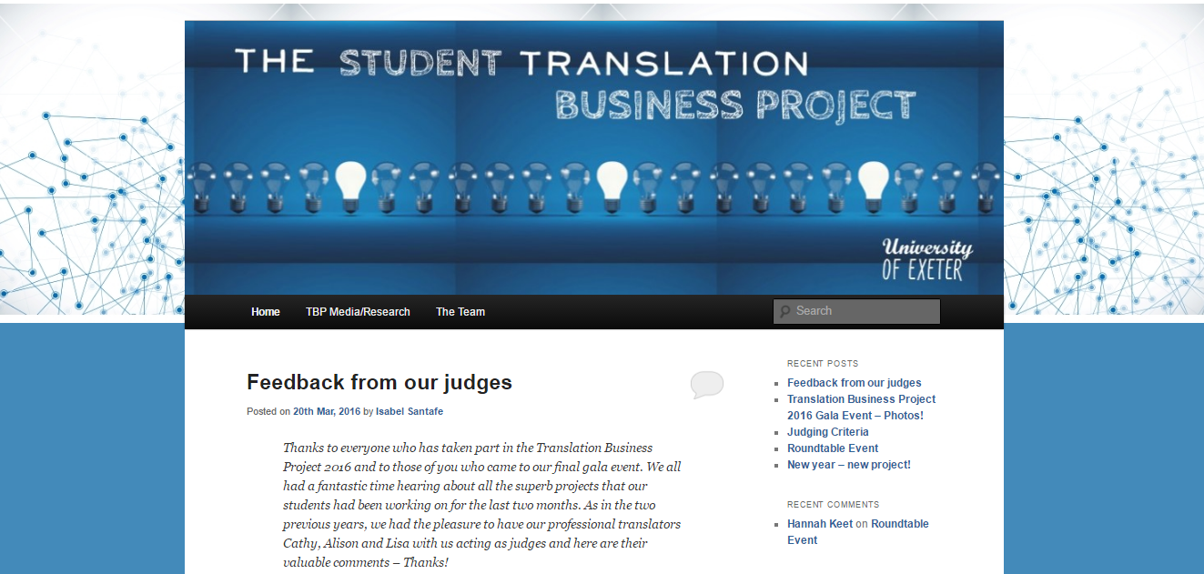
Online media: Visibility
http://blogs.exeter.ac.uk/etbp/

Slide 5
Translation Business Project: Tasks for students
Research the translation industry
Find a niche. Think of your target market/audience
Think of a name, logo and identity for your translation company
Create a translation brief
Find source texts (300 words per translator)
Produce a high quality translation
Produce an invoice
Give a 10 minute presentation in front of a panel of experts

Slide 7
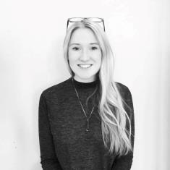
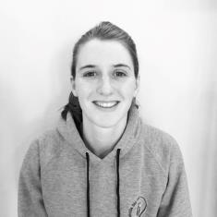
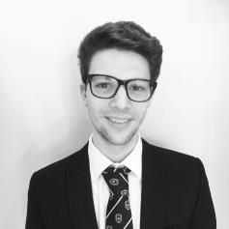
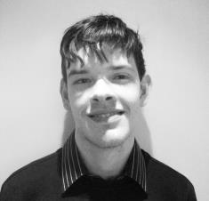
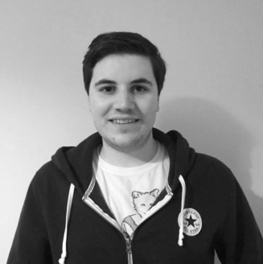
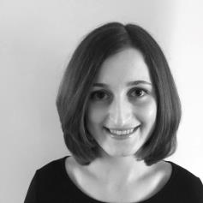
Our Team
FIONA POTIGNY Project Manager & Website Editor
BECKY GREY Translator & Accountant
ADAM HILL Translator & Marketing Officer
JOHN BRANNAN Reviser & Social Media Assistant
ADAM CARPENTER Reviser & Online Publicity
RACHAEL HARDING Proofer & Graphic Designer

Slide 8
Timeline of objectives
Week 3 and 4: Initial meeting, brainstorm and research into our potential competitors. Create website/Facebook/Instagram to promote our brand.
Week 5 and 6: Writing of blog posts to demonstrate our knowledge of the subject area. Translations selected and translated into English
Week 7 and 8: Translations revised and proof read. Research into translation rates. Creation of mock magazine.
Week 9 and 10: Review of all tasks completed to meet the deadlines

Slide 9
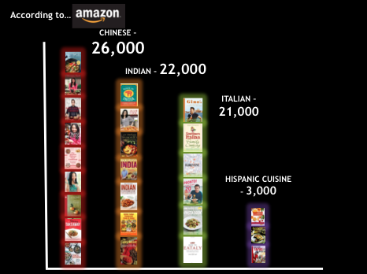
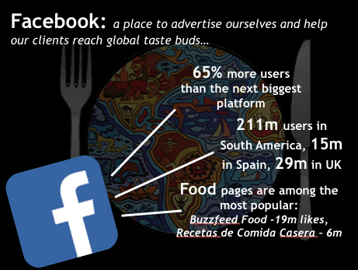

Slide 10
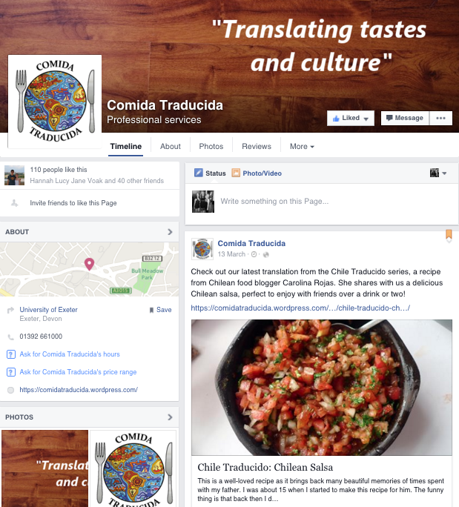
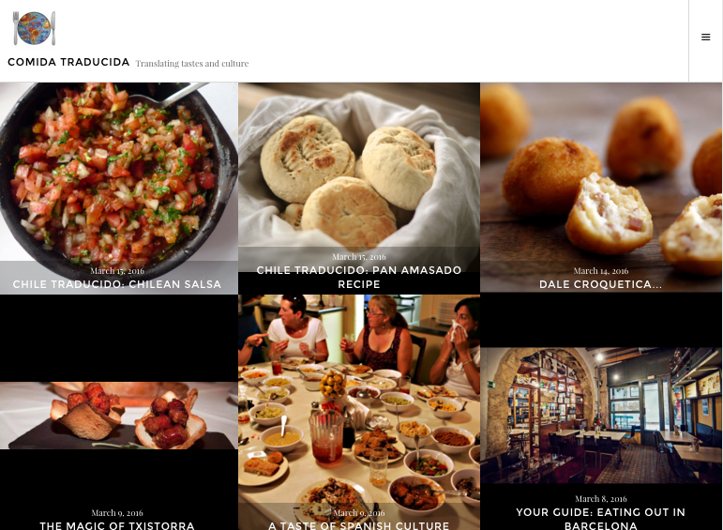
A platform to showcase work to a hungry new market

Slide 11
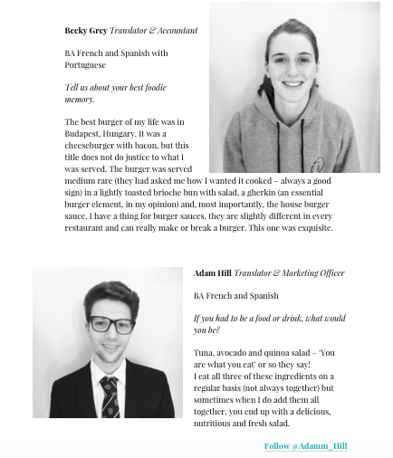
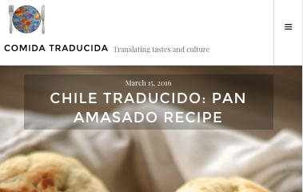
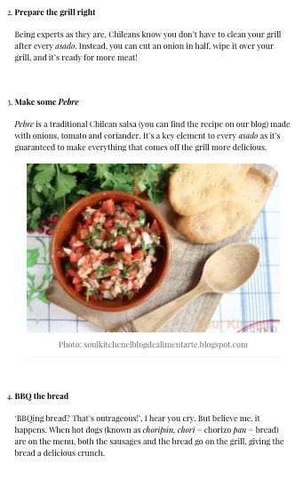
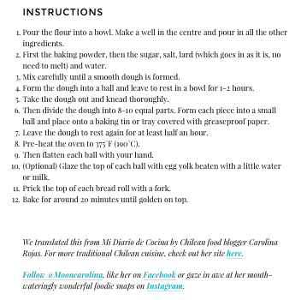
Our website…
…shows approachability
…gives our clients’ work a brand new platform
…reflects our expertise
…is adapted to the Instagram generation

Slide 12
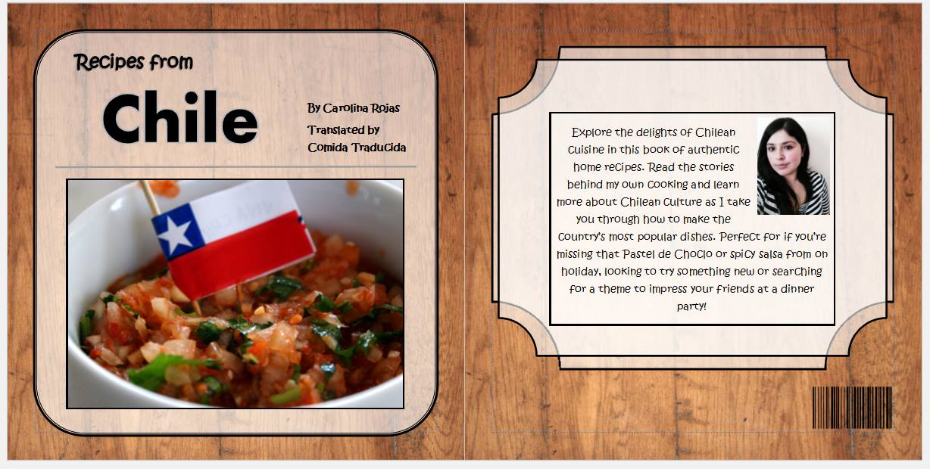
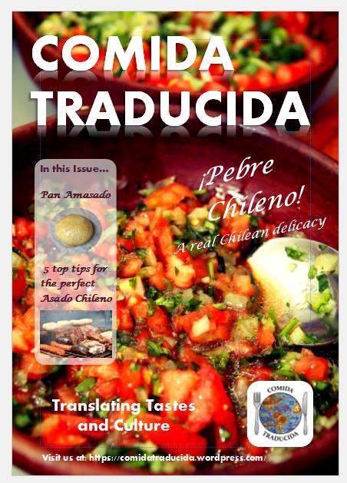
The future is bright for Comida Traducida…
PUBLISHING CONSULTANCY
Translating words, culture and marketability by creating layouts appropriate for the target UK market
LAUNCHING A MAGAZINE
Another way to showcase our clients’ magnificent work (and show off our service!)

Slide 13
WE ARE PASSIONATE LINGUISTS, SOCIAL MEDIA WHIZZ-KIDS, BLOGGERS AND TOTALLY FOOD OBSESSED, MAKING OUR SERVICE OFFERING AS UNIQUE, VARIED AND EXPERT AS OUR TASTES.
TRANSLATING WORDS IS ONE THING, BUT WITH OUR PLETHORA OF SKILLS, WE CAN TRANSLATE TASTES ACROSS BORDERS.

Slide 14
Thank you!
Any questions?

