Slide 1
Classroom Organisation for Integrated Group Reading Information for Teachers and TAs
Getting your classroom IGR-Ready

Slide 2
Classroom Organisation for IGR Information for Teachers and TAs
IGR classrooms have some key classroom organisational features:
Reading is organised using a “carousel” model with a period of 30 minutes of group/guided reading each day
The TA is available to work with the class for at least 4 of the reading sessions
The class is split into 5 or 6 reading groups at the discretion of the teacher including an IGR group of 4 children

Slide 3
Classroom Organisation for IGR Information for Teachers and TAs
Once these features are in place, IGR can begin in the class. IGR includes the following elements:
The IGR group have two sessions each week with the teacher and two sessions
where they read 1:1 with the TA
While the teacher is conducting the IGR session, the TA supports the rest of the
class and may lead group/guided reading with other groups. This work should be
planned by the class teacher.
Where necessary, teachers supplement the training that is given to TA’s so that
they are confident in supporting children with IGR and group reading

Slide 4
The IGR weekly cycle
The integrated group reading approach supports children through multiple experiences of the same text. The approach is cyclical and in each session pupils revisit books they have already read, and in each teacher-led session, they are introduced to a new book. The TA supports the children’s engagement with each book through hearing them read the book one to one, supporting them with creating visual representations of the book, and working with them on a pelmanism game.
The next two slides provide a visual representation of the IGR process.

Slide 5
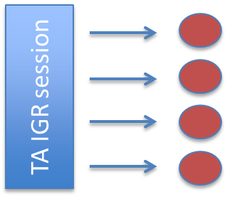
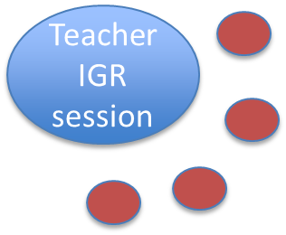
The IGR weekly cycle
Teacher IGR session
TA IGR session

Slide 6
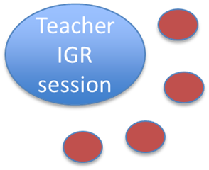
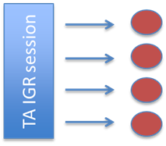
The IGR weekly cycle
IGR Session 1 and 2 | IGR Session 3 and 4
1. Teacher recaps book from previous week and introduces a new book | 3. Teacher recaps book from earlier in the week and introduces a new book
2. TA Supports the children as they draw from the book, reads 1:1 with each child and plays a pelmanism game | 4. TA Supports the children as they draw from the book, reads 1:1 with each child and plays a pelmanism game

Slide 7
Classroom organisation for guided reading
In Classrooms that are IGR-ready, teachers employ a carousel model where reading is taught each day of the week.

Slide 8
Classroom organisation for guided reading
 | Monday | Tuesday | Wednesday | Thursday | Friday
Group1 | Teacher
Group 2 |  | Teacher
Group 3 |  |  | Teacher
Group 4 |  |  |  | Teacher
Group 5 |  |  |  |  | Teacher
Many teachers use a timetable similar to this to organise guided or group reading in their class.

Slide 9
Classroom organisation for IGR
When using the IGR approach, the teacher spends two reading sessions each week with the IGR group. The non-IGR groups continue with the group/guided reading system used by the school. In most schools it is seen as good practice for the teacher to work with each reading group every week. When IGR is being used in the classroom, some possible timetabling options are:
The teacher organises a slightly longer guided reading session for one day each week and on that day the teacher works with 2 non-IGR groups
The teacher organises an extra guided reading session so that there are 6 sessions each week
The school organises for a teacher from outside the class to teach guided reading with one group once a week

Slide 10
Classroom organisation for IGR
 | Monday | Tuesday | Wednesday | Thursday | Friday (longer reading session)
Group 1 | TA |  |  |  | Teacher GR
Group 2 |  | Teacher GR
Group 3 |  |  | TA |  | Teacher GR
Group 4 |  |  |  | Teacher GR
IGR Group | Teacher IGR | TA IGR | Teacher IGR | TA IGR
In this timetable, the teacher organises a slightly longer guided reading session for one day each week and on that day the teacher works with 2 non-IGR groups

Slide 11
Classroom organisation for IGR
 | Monday | Tuesday | Wednesday | Thursday | Friday | Extra session
Group 1 | TA |  |  |  |  | Teacher GR
Group 2 |  | Teacher GR
Group 3 |  |  | TA |  | Teacher GR
Group 4 |  |  |  | Teacher GR
IGR Group | Teacher IGR | TA IGR | Teacher IGR | TA IGR
In this timetable, the teacher organises an extra guided reading session. This could be an extra session for the whole class, or just the guided reading group.

Slide 12
Classroom organisation for guided reading with IGR
 | Monday | Tuesday | Wednesday | Thursday | Friday
Group1 | TA GR |  |  |  | Teacher from outside of the class takes one group for GR
Group 2 |  | Teacher GR
Group 3 |  |  | TA GR |  | Teacher GR
Group 4 |  |  |  | Teacher GR
IGR Group | Teacher IGR | TA IGR | Teacher IGR | TA IGR
In this timetable, the school organises for an extra teacher to visit the class once a week to take a guided reading session with a non-IGR group.

Slide 13
The Role of the TA
What happens when the TA works with the IGR group?
Opportunity for children to draw from the book
Pelmanism game
1:1 reading of the familiar book with the TA
Completion of the Daily Reading Record

Slide 14
The Role of the TA
What is the role of the TA when the teacher is working with the IGR group?
While the teacher is working with the IGR group, the TA supports the teacher by taking responsibility for behaviour management. This allows the teacher to fully focus on the IGR group
While the teacher is working with the IGR group, the TA may support the work of another group. If the TA is involved in group or guided reading, then this should be planned by the teacher.

Slide 15
Communication Between Teacher and TA
Daily Reading Record
Teacher
TA

Slide 16
The Daily Reading Record allows the teacher and TA to communicate about elements of the IGR programme that have been covered, the progress of particular children, and challenges or barriers to progress and learning.
Each IGR classroom has a “Daily Reading Record” booklet. If you require more copies of this document it can be downloaded from the IGR website.

Slide 17
Classroom Audit in Preparation for IGR
Current Classroom Organisation (When in the week do you do guided or group reading? Are the groups differentiated by ability? What are the group sizes? For which sessions is a TA available?)
Integrated Group Reading requires the following features of classroom organisation: Reading is organised using a “carousel” model with a period of 25 minutes of group/guided reading each day The TA is available to work with a group for at least 4 of the reading sessions The class is split into 5 or 6 reading groups at the discretion of the teacher including an IGR group of 4 children
Action Plan for creating an IGR-ready classroom

