Slide 1
What is Integrated Group Reading?
A Summary of the Approach for Teachers

Slide 2
What is IGR?

Slide 3
Essential components of learning to read in English
Texts with a narrative structure (stories)
Grapheme-phoneme knowledge
The ability to sound-through and synthesise from left to right
Knowledge of common simple sight words
Progress through carefully graded texts
Texts matched closely to the current reading ability of the reader
Full engagement with what is being read

Slide 4
What IGR Methodology adds to these:
IGR puts all of these components together
in a systematic, integrated way and adds an
enjoyable teaching methodology
the IGR approach is unique: through the structure of the
methodology, children experience each narrative text at
several interdependent, interlocked levels (story, sentence,
and word), with game-playing functioning as a key motivator
and memory tool at each level
the story-specific games in IGR function as ‘advance organisers’
(Lotto) or ‘overlearning consolidators’ (Pelmanism and Go Fish)

Slide 5
There are 6 basic aspects to IGR
(1) The Linguistic Aspect
If children are introduced to written language
in a way that is congruent with their
acquisition of spoken language,
we make learning to read easier for them

Slide 6
The cross-referencing of orthographic progression and readability levels…

Slide 7
allows us to define words for reading as Expressive vocabulary (the known)

Slide 8
…and Receptive vocabulary (the almost known)

Slide 9
Why this is Important
This means that children can meet words beyond their current reading level in a receptive way (as recognition, by way of the Lotto Game) before they have to read them
Lotto: phonological – visual mapping
This receptive way of encountering words-yet-to-be-mastered makes learning to read easier for them

Slide 10
Example: the Lotto Game for
‘Thunder and Lightning’

Slide 11
(2) The Story-Specific Aspect
All the games we play with children are story-specific, so that there is coherence and
integration for them as they experience
the new text at a succession of linguistic levels
(see page 17)

Slide 12
The contents of an IGR Learning Pack

Slide 13
(3) The Play Aspect
The playing of story-specific sentence, word, and word consolidation games, plus appropriately-levelled phonics games, is fundamental to IGR Lesson Methodology
When children experience reading as an
enjoyable activity that includes the playing of
well-pitched book-related games, they experience
learning as effortless

Slide 14
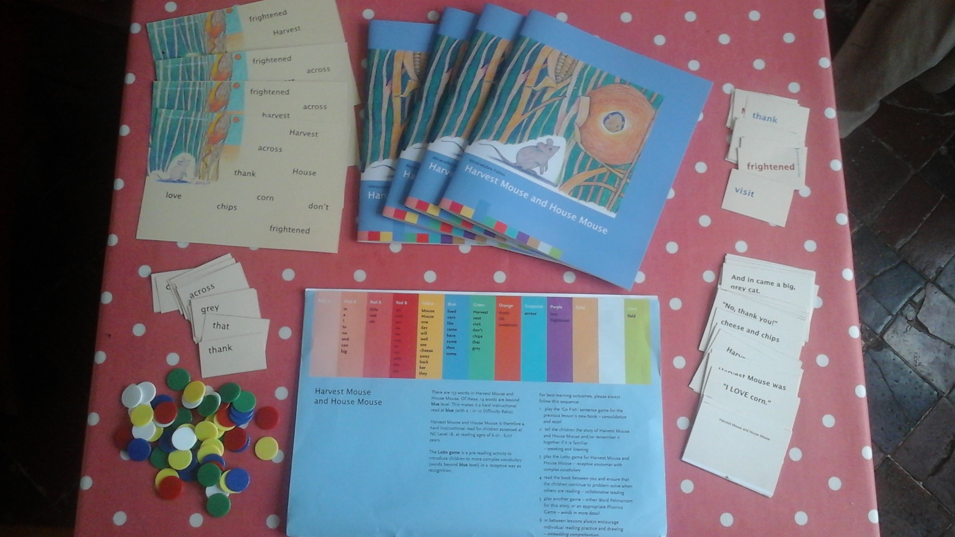
An IGR Learning Pack showing Lotto, Go Fish and Pelmanism Games

Slide 15
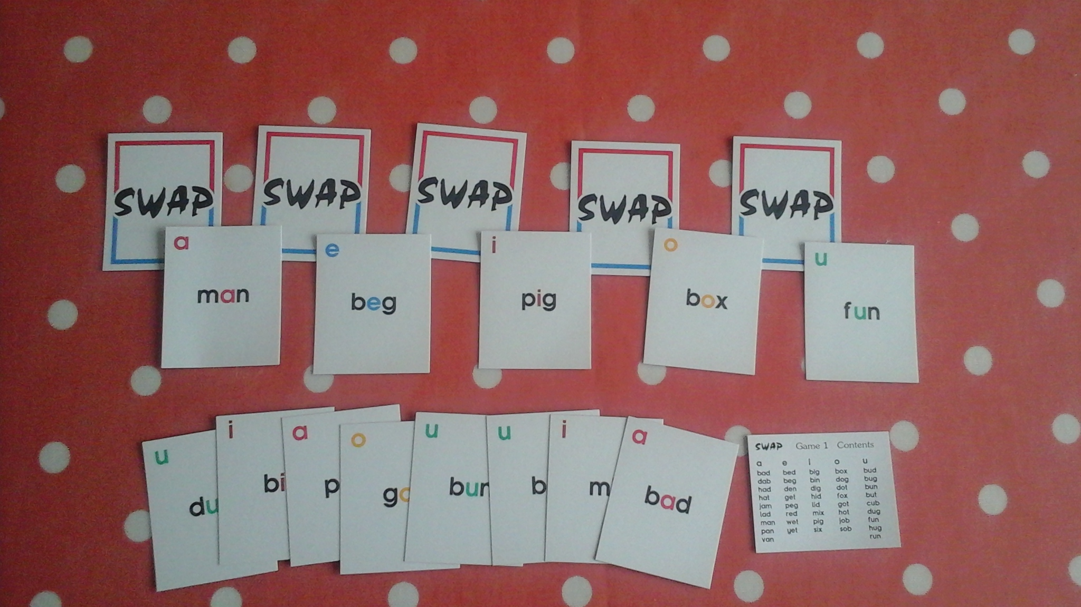
An example of a CVC Phonics Game

