Slide 1
Citizens’ Assemblies & Juries, Online & Offline: Tips, challenges and best practices for public and local authorities
Co-hosted by University of Exeter, Involve and Devon Climate Emergency (DCE)
15th Dec 2021
Patrick Devine-Wright, Alice Moseley, Rebecca Sandover, Fionnguala Sherry-Brennan
ESRC IAA Awards 2019 & 2020
Notes:
Share a case study of a climate assembly conducted in Devon in 2021, the process that led to it, what it aimed to do, how it evolved.
Funding and aims, methods of research

Slide 2
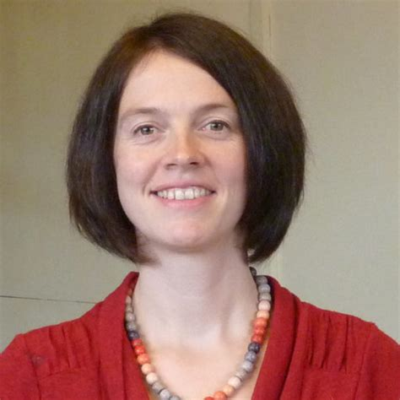
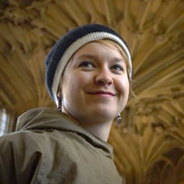
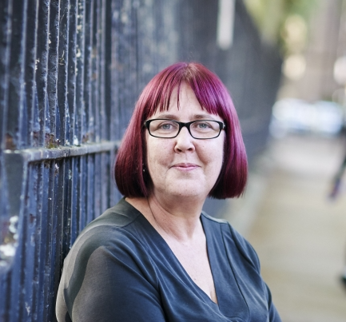
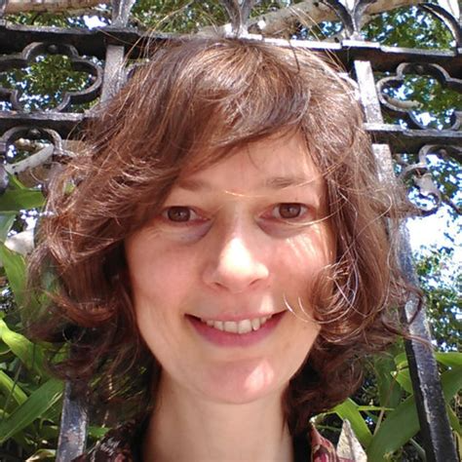
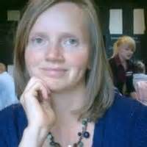
speakers
Alice Moseley – University of Exeter
Emily Reed – Devon Climate Emergency
Kaela Scott - Involve
Fionnguala Sherry-Brennan – University of Exeter
Patrick Devine-Wright – University of Exeter
Rebecca Sandover – University of Exeter

Slide 3
Webinar Programme
Welcome from Patrick Devine-Wright, University of Exeter research team Introduction from Alice Moseley, University of Exeter research team
Poll 1 -Responses from the audience
Kaela Scott from Involve: On her experiences of running the Devon Climate Assembly and challenges/ benefits of online vs offline format, different forms and sizes (eg citizens juries vs citizens assemblies)
Emily Reed from Devon Climate Emergency: Reflecting on The Devon Climate Assembly, the role of CA & CJs within local democratic processes & topic selection
University of Exeter research team: Reflecting on timings of citizen assemblies within democratic process and evaluating CAs
Poll 2 -Responses from the audience
Q&A between speakers
Padlet/Chat Q&A from the audience
Poll 3 -Responses from the audience
· Summary from Patrick Devine-Wright, University of Exeter research team

Slide 4
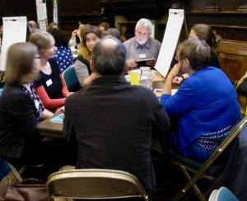
What led us here today? Webinar background
Growing interest in deliberation
For climate issues & others
In particular, online deliberation (Covid)
Yet relatively novel form of public engagement for most
Previous ESRC IAA grant (Jan-Dec 2020) Investigating Perceptions of the Devon Net Zero Citizen’s Assembly Process
&
Current ESRC IAA grant (Feb-Dec 2021) Networks of Exchange: Developing lessons and sharing best practices on Online Public Deliberation
Notes:
Project were focus on getting 'impact' from research, ie not principally about contributing to an academic body of work: co-created with our Devon CC partners, aiming to inform the emerging design of the assembly, and help inform other authorities, individuals or orgs embarking on deliberative public engagement. Similar to what we sometimes label action research, or engaged research.
This webinar one output of the projects, we're also developing a toolkit of guidance on online deliberation, which we'll share following the webinar. There's lots of emerging guidance on this from various sources, which we'll aim to bring together in a single source, along with sharing reflections from our own research experience and the practical experience & reflections of those who ran and were involved in the assembly.
Previous Project:
Explored perceptions, aspirations, concerns of stakeholders and publics in the run up to the assembly
Focusing on perceptions about its purpose, operational aspects and aspirations & concerns
To generate insights for use by local stakeholders, notably Devon Climate Emergency Response Group (DCERG) when undertaking the Citizens’ Assembly
Lessons about communicating with the public, maximising the credibility, impact and perceived legitimacy of the Assembly in the eyes of the public and key stakeholders.
Current project
Impacting on the evolving design of the assembly to support the development of DCC/DCERG Devon pathways to Net Zero process.
To gather critical reflections from participants and practitioners involved
To co-design and co-produce with partners a toolkit on online and digital methods for deliberative democratic processes.
Also to collaborate with leading national organisations to lead webinars on the running of online Mini-Publics.

Slide 5
Our devon climate assembly research
Emergence
XR Influence, Climate Emergency Declaration
Political leadership of the Council
Advisory role, 3 topics covered related to Net Zero Carbon Plan
One of the first County level Climate Assemblies in UK
Council officer & stakeholder perceptions
Legitimacy for bold changes required
Social & political mandate for encouraging wider public behaviour change
Some natural uncertainty beforehand re effects, but also excitement/ optimism
Key findings about online nature of the format
Pushed online due to covid
Generally a very positive experience, with some minor quibbles related to platforms & engaging online
Practical help before & during was valued
Some felt safer, more convenient for some
Quality of discussion high, but some would've liked more time
Online format worked well for a dispersed rural population in a large county
Notes:
Briefly, some background & key findings from our research so far....

Slide 6
Devon Climate Assembly Kaela Scott -Involve

Slide 7
Devon Climate Assembly Emily Reed -DCE
December 2021

Slide 8
Agenda
The Devon Climate Emergency
The Carbon Plan Process
Citizens’ Assembly
4. Keeping up to date

Slide 9
1. The Devon Climate Emergency
Creating a resilient net-zero carbon Devon – where people and nature thrive
Objectives:
Partnership:
Reduce carbon emissions to net-zero by 2050 at the latest
Improve the resilience of Devon’s environment
Prepare communities for a warmer world

Slide 10
2. The Carbon Plan Process
Notes:
Why the interest in holding a citizens assembly? Consultations often don’t reach as broad a group of people as hoped
Part of consultation on the Interim Devon Carbon Plan asked about topics which should go to the Devon Climate Assembly – broad support for the topics identified.

Slide 11
3. Citizens’ Assembly – The process
70-strong panel of Devon’s residents – a representative sample
University of Exeter advised on the process
Convened and facilitated by the Involve Foundation.
Met online for a total of 25 hours during June and July 2021.
Members engaged in learning, dialogue and deliberation about the context of the climate emergency and the specific topics they were being asked to address.
Deliberated the remaining big challenges
How should we encourage people to reduce car use?
How should we encourage people to retrofit buildings?
What should the role of onshore wind energy be in Devon?
Notes:
How the topics were decided – public consultation and other avenues for public deliberation e.g. the Ruby Country Net Zero Beef Farming Forum

Slide 12
3. Citizens’ Assembly – The outputs
The Assembly has proposed a series of resolutions for each challenge, and a set of conditions attached to each resolution
Their report is available online
Generally, the Partnership needs to….
Communicate and inform
Involve communities
Act with urgency
Show ambition
Demonstrate leadership
Be accountable
Work with central government

Slide 13
Caution – I’ve paraphrased this!
Energy
Strong support for onshore wind, particularly when controlled locally by communities
Transport
Strong support for electrification of vehicles. Some support for congestion charging. Little support for increasing car park charging or workplace parking levies. Would want to see sustainable alternatives in place first.
Buildings
Some support for using regulation to require people to upgrade their homes. Specifically, strong support for doing so through the planning system and through linking council tax and business rates to the building’s energy performance.

Slide 14
3. Citizens’ Assembly - What’s next?
The resolutions are being turned into implementable actions by the partnership
17/03/2022 – 14/04/2022 - Public consultation on those actions
Added to the Interim Plan to create a completed Final Plan
Ready for partners to adopt from August 2022
Notes:
We’re consulting on whether the public agree that we’ve interpreted what the assembly has resolved appropriately, and where we are not taking a resolution forward that the public agree with our reason. We are not consulting on whether the public agree with the assembly.

Slide 15
4. Keeping up to date
Sign up to the newsletter - www.devonclimateemergency.org.uk/join
Read more about the Assembly - www.devonclimateemergency.org.uk /CitizensAssembly
Follow and engage with the project on social media
Twitter @devonclimate
Instagram @devonclimateemergency
Facebook @DevonClimateEmergency

Slide 16
Devon Climate Assembly Alice Moseley, Rebecca Sandover, Patrick Devine-Wright, Fionnguala Sherry-Brennan

Slide 17
Timing your citizens’ assembly or jury

Slide 18
Planning & timing your citizens’ assembly or jury
They take TIME
Planning an assembly is an iterative process:
topic selection
question framing and refining
choosing & arranging speakers
choosing information for assembly members
Integration with:
other policies and plans
other local authorities
Notes:
After the tender process, Devon’s climate assembly took approximately two very busy months to arrange plus much more lead in time to plan it, and then time procurement.
The point is that to do them properly, you need sufficient time
No sense running one without adequate time and resources

Slide 19
Timing, priorities, momentum
Choosing the right time & building on/ maintaining momentum
What is the assembly intended to achieve? Feeding into a new climate action plan or another type of plan? This may impact on when you conduct it
Priorities
Establish your priorities:
Moving ahead with pre-existing or predefined actions/ options
Exploring broader public values and priorities, assessing support & generating ideas for new actions
What momentum exists and may need to be maintained in the context of your assembly or jury?
Do you intend to continue the public engagement process in a more ongoing/ permanent manner? How?
Notes:
When you run it will depend on the type of questions you are exploring – e.g. are you feeding into a process to generate an idea of priorities and values, or are you exploring different policy options involving trade-offs, sacrifices & potentially winners & losers?

Slide 20
Evaluating your citizens’ assembly or jury

Slide 21
How to best evaluate your citizens’ assembly?
What to evaluate?
The assembly itself
The output of the assembly
What’s done with the output of the assembly (implementation)
Legitimacy:
Representation of the assembly
Leading by example: Council actions based on recommendations
Capacity to act on assembly recommendations
Collaboration between universities & local authorities
Notes:
The broad scope of our research was to evaluate Devon’s citizens’ assembly and look at what worked and what didn’t work so well – to learn from their assembly and share our findings through various events like this one. Defining success is project-specific as choosing the focus of your assembly and its objectives influence how you evaluate its success. So there are no definitive answers here but some things to consider which can influence what you use to define the success of your assembly (and some of which we’ve already heard about from Emily and Kaela).
When it comes to evaluating citizens’ assemblies and juries, there are different aspects that can be evaluated: (1) the assembly itself, (2) the output of the assembly, and (3) what’s done with the output of the assembly (how it’s implemented).
One of the themes that affects all three aspects is legitimacy. So we can ask, ‘What legitimates an assembly?’
Representation: For example, there may be different responses from businesses and politicians to things/recommendations the assembly endorses, especially if they’re seen as controversial or contentious issues. And what can happen is that people may then question representation (or, ‘Does the assembly really represent the wider public?’). At present, citizens’ assemblies have no legal status compared with public consultation and this lack of legal standing could be used as a reason to not act on assembly findings.
Leading by example: stakeholders and assembly members mentioned how seeing the council lead by example can be seen as a way of legitimising the assembly and its recommendations but this is connected with capacity.
Capacity: Councils have tight, or near non-existent budgets, which affects their capacity to act on recommendations which feeds into thinking about legitimacy. If assembly recommendations have no legal status and aren’t connected with statutory functions capacity to act on recommendations is limited which then calls into question the value and legitimacy of the assembly.

Slide 22
What works? What doesn’t work?
Impact:
Assembly members have a voice
Policymakers value practical & legitimate recommendations
The Carbon Plan
Accountability:
Who or what is accountable to the assembly or its outputs?
What happens after the assembly?
Ask who, what, when, and how.
Notes:
IMPACT – In terms of impact, it’s difficult to talk about overall impact because it depends which ‘group’ you’re in: local authority, business, assembly member, public.
Assembly members valued being given a voice and the whole experience itself;
(WHOSE VOICE IS HEARD …our research found that there were concerns about representation of people from more rural areas of Devon but we found that the assembly’s representativeness gave voice to rural concerns particularly through the roads and mobility topic where there have, historically, been inequalities across the county. So in this example, the assembly rejected or only weakly supported strong measures affecting car use. The value of the assembly was to provide a context and process where those rural voices can make themselves heard and indicate the challenge of sustainable transitions in the countryside. What we don’t yet know is how conventional politics/structures will respond …)
Stakeholders who are focused on policymaking value resolutions and conditions that are practical, can be implemented and are seen as legitimate by wider groups.
The impacts on, in this case, Devon’s Carbon Plan are produced at different layers of governance so, in local policy spaces, there are different priorities and timelines because processes aren’t necessarily joined up across layers, and this is what we’re beginning to see here when considering the impact of the assembly on the plan, and the impact of Devon’s Carbon Plan itself.
ACCOUNTABILITY – Where does accountability lie? and what happens after the assembly? In Devon, there are multi-partner working groups within the council which oversee the interpretation of the assembly’s recommendations and their integration into policy and the partners have responsibility to deliver some of the actions, even though some partners don’t have any democratic pressures. But there isn’t, at the moment, a method for the public or assembly members, to hold the council to account even though there appears to be interest in climate change in the community.
So when evaluating your assembly, it’s worth thinking about what happens afterwards: is there a public consultation? or a way of keeping the public informed or involved? And asking who is responsible for what, by when, and how?

Slide 23
Speaker Q&A

