Slide 1
DA Framework WP3 Introduction
Sibel Kazak
Pamukkale University
21 May 2018
Exeter, UK

Slide 2
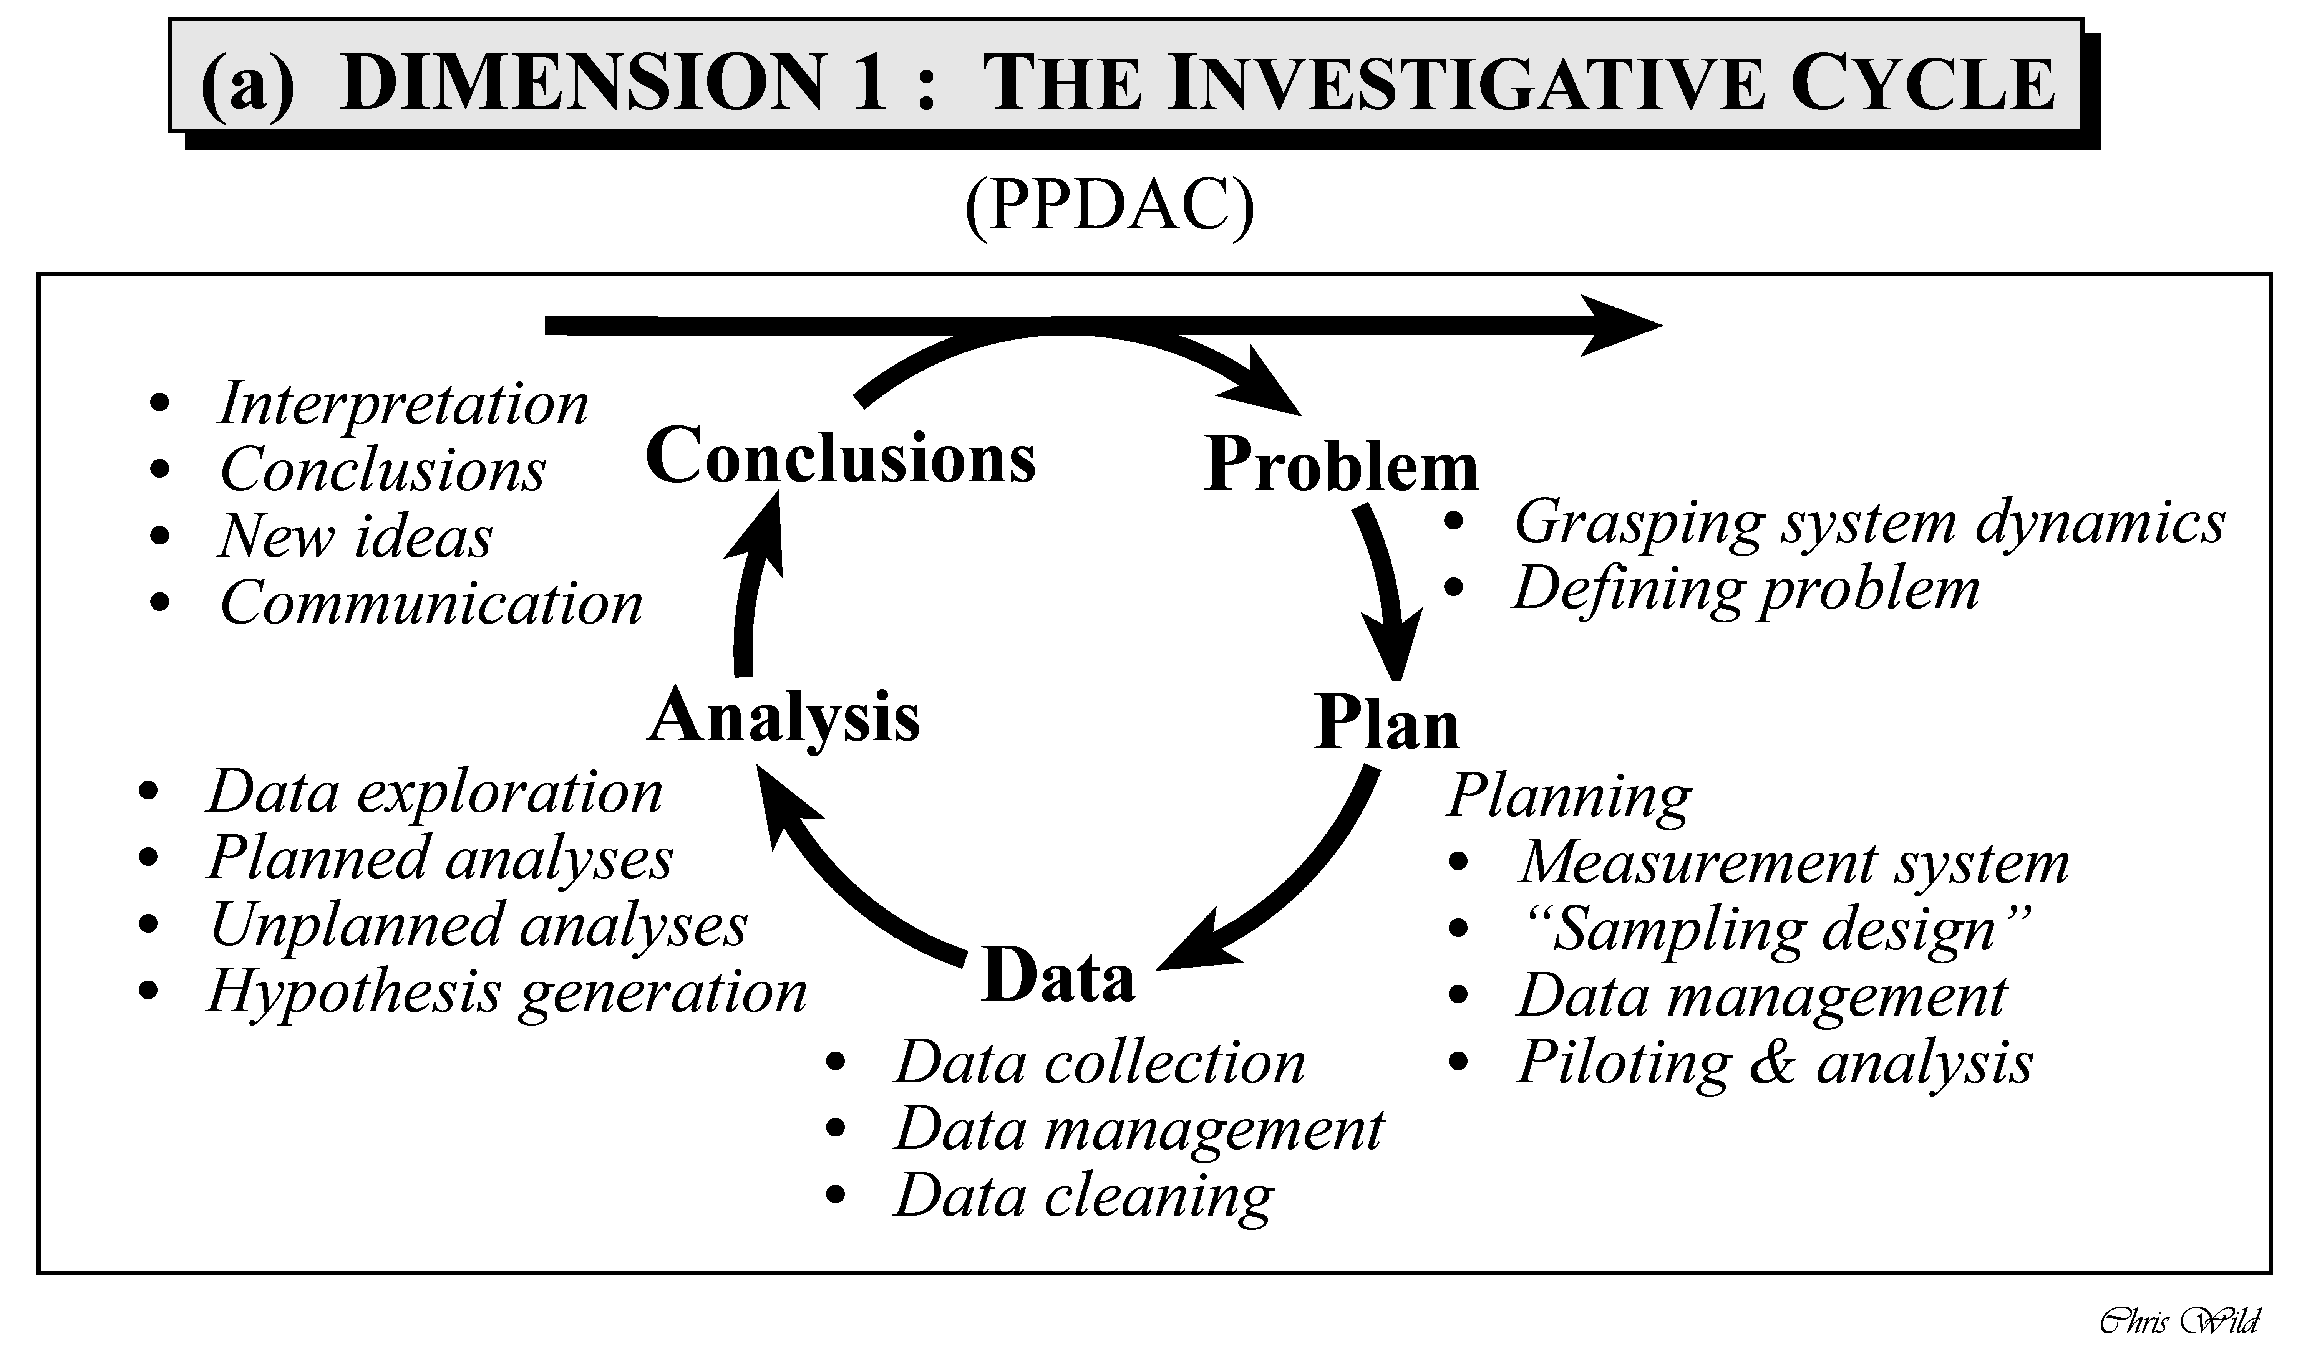
(PPDAC investigative cycle in Wild & Pfannkuch, 1999)

Slide 3
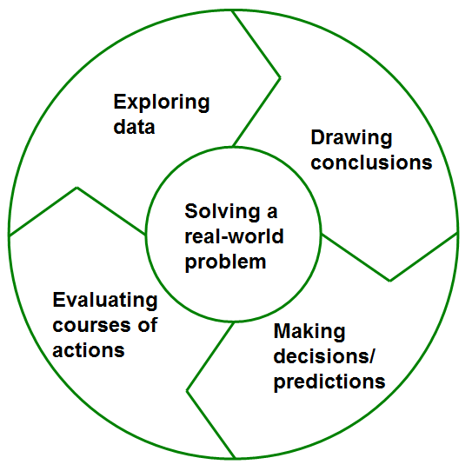
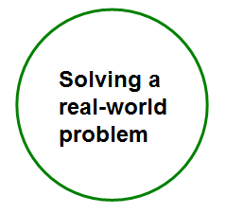
Data Analytics (DA) - a process of 'engaging creatively in exploring data, including big data, to understand our world better, to draw conclusions, to make decisions and predictions, and to critically evaluate present/future courses of actions'
Component 1:
Investigative cycle of DA
Solving a real-world problem
Figuring out how to act to solve a problem by acquiring more knowledge (Wild, Utts, & Horton, 2018)

Slide 4
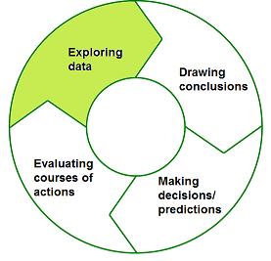
1) Exploring data
Investigative cycle of DA
Understanding the system that the data come from
Defining the problem (see PPDAC investigative cycle in Wild & Pfannkuch, 1999)
Identifying precise informational goals
Formulating specific questions to be answered using data (Wild, Utts, & Horton, 2018)
Acquiring, extracting and categorizing data
Deciding on what entities to obtain data
Reorganizing data, merging data from different sources, cleansing data (Wild, Utts, & Horton, 2018)
Analyzing data
data visualization tools (i.e. tables, graphs)
appropriate calculations (i.e. mean, median, standard deviation, quartiles, p-value etc)
statistical models (i.e. probability distributions)

Slide 5
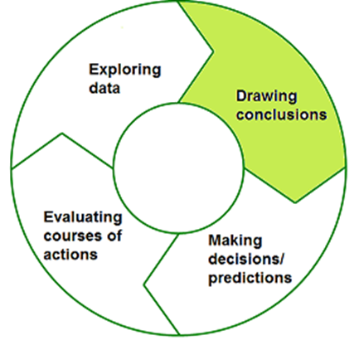
2) Drawing conclusions
Investigative cycle of DA
Using data as evidence for generalizations beyond describing the given data
(see informal statistical inference described by Makar & Rubin, 2009)
extrapolate
‘‘How it might relate to some wider universe’’
‘‘What you can see
in the data you have’’
e.g. «From these two samples, we infer that the physical fitness in sixth grade is probably higher than in seventh grade» (Makar et al, 2011, p. 168)
(Wild, Utts, & Horton, 2018, p. 11)

Slide 6
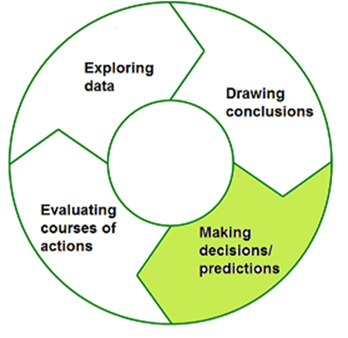
3) Making decisions/predictions
Investigative cycle of DA
An articulation of uncertainty (see informal statistical inference described by Makar and Rubin, 2009)
‘we are confident in our inference [in the level of] something like 9 of 10’ (Makar et al., 2011, 168)
‘an observed result is “surprising” or “unlikely” or that one result is more or less likely than another’ (a qualitative way) (Makar & Rubin, 2018, p. 276)
‘Abstracting and communicating what has been learned’ (Wild, Utts, & Horton, 2018, p. 11)

Slide 7
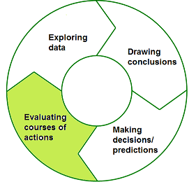
4) Evaluating courses of actions
Investigative cycle of DA
Evaluating courses of actions in connection with the problem defined earlier
What actions need to be taken? For example,
Collect more data
Ask experts (i.e. MET Office scientists)
Make recommendations for school principal to have more recycle bins in the school

Slide 8
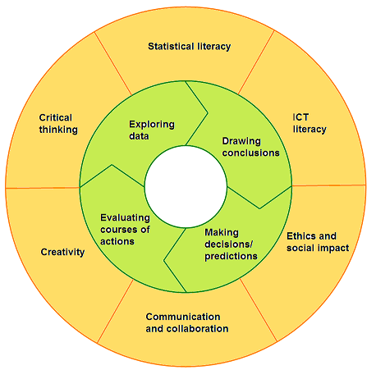
Component 2:
Learning skills for DA

Slide 9
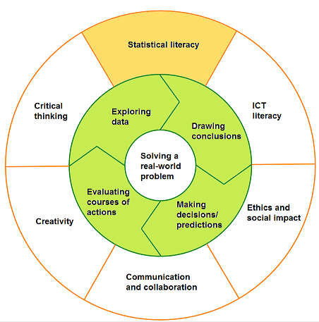
Learning skills for DA
Statistical Literacy
The ability to understand, interpret and evaluate statistical information or data-based claims where they are contextualized
The ability to communicate their opinions about this statistical information and their concerns about the soundness of statistical arguments (see Gal, 2002)
Understanding of basic statistical concepts and fluency for statistical procedures and techniques (see Ben-Zvi & Garfield, 2004)

Slide 10
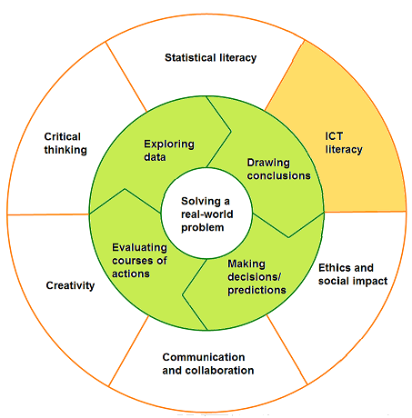
Learning skills for DA
ICT Literacy
The ability to use technology or computing capabilities to understand and solve problems and to communicate statistical information

Slide 11
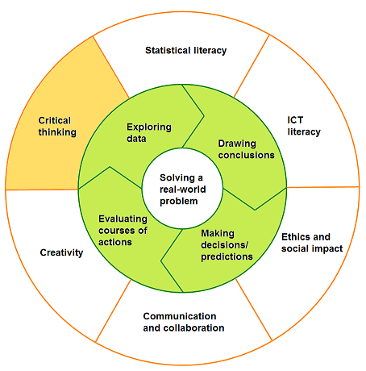
Learning skills for DA
Critical Thinking
The ability to reason effectively
The ability to analyze and evaluate data-based evidence and arguments
The ability to interpret and make conclusions based on the best analysis
The ability to reflect critically on processes in solving problems

Slide 12
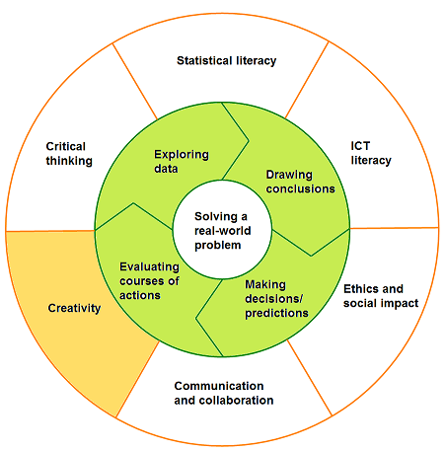
Learning skills for DA
Creativity
The ability to use different approaches/techniques in a particular task
The ability to generate new ideas and methods
The ability to be open to new diverse perspectives

Slide 13
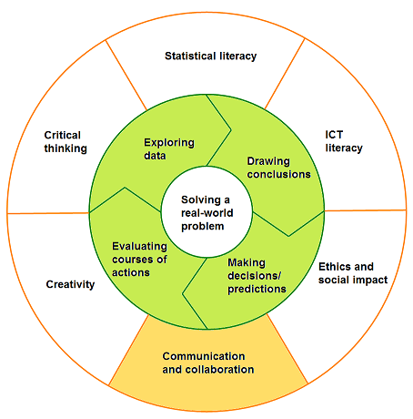
Learning skills for DA
Communication and Collaboration
The ability to use available tools and language effectively in articulating thoughts/ideas in the problem context
The ability to work with others effectively in groups

Slide 14
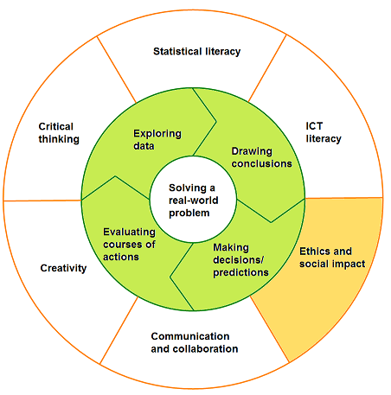
Learning skills for DA
Ethics and social impact
The ability to take responsibility to both act and refrain from certain actions with the interests of society at large in mind
The ability to demonstrate consciousness about the challenges in the digital age (see Ananiadou & Claro, 2009)

Slide 15
WP3 – Pilot Projects (September 2018-March 2019)
Teachers
Design pilot projects either individually or in collaboration with other local schools or across the partnership
Familiarise themselves with new applications/tools for use during the pilots (small budget for staff development)
Researchers
Support pilot project design by ensuring teachers understand the objectives and approach
MET office

Slide 16
WP3 – Pilot Projects (September 2018-March 2019)
2 iterations
1st pilot project will inform the 2nd pilot project
Focus
Weather/climate change in relation to the interests of young people
Or should we call it ‘weather events’?
Planning
Pilot project time and duration?
Student number?
Delivery within or out of school hours?
Discuss more tomorrow ☺

Slide 17
WP3 – Pilot Projects (September 2018-March 2019)
Learner-centred and dialogic learning
focusing on co-creation and encouraging students to think creatively about how data can illuminate societal challenges of importance to them
emphasising learning based on questioning rather than recall (which can put young people off learning maths, because they fail to see its relevance)
teaching through encouragement, feedback and dialogue to drive thought and deepening lines enquiry around causality, correlation, prediction and the representation of uncertainty

Slide 18
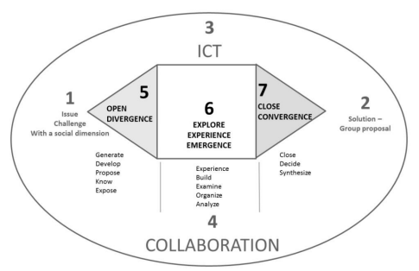
Pedagogy: Unpacking skills
DA Framework:
Investigative Cycle & Learning Skills
Collaborative and critical thinking skills
Thinking Together Approach
Awareness - Teaching L2L2 skills
Ground rules
Creative skills
Technology-enhanced pedagogical framework for collaborative creativity (Pifarre & Marti, 2018)

Slide 19
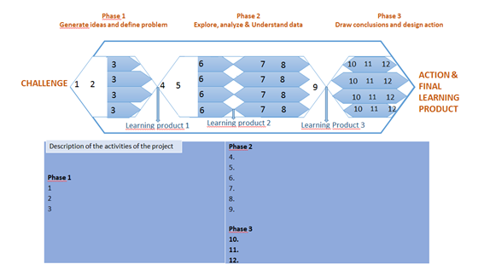

Slide 20
WP3 Pilot Project Delivery
Sibel Kazak
Pamukkale University
22 May 2018
Exeter, UK

Slide 21
WP3 – Pilot Project Delivery
An example from Spain (15 min) 9.30-9.45
Baloon activity
Small group discussions (by grade level: primary, lower secondary, upper secondary) (45 min) 9.45-10.30
Content and technology
Skills and pedagogy
Presentation, discussion and conclusions (45 min) 10.30-11.15 (let’s grab a coffee and keep discussing)

