Slide 1
Abrupt shifts in national land use and food production after a climate tipping point
Paul Ritchie, Greg Smith; Katrina Davis; Carlo Fezzi; Solmaria Halleck-Vega; Anna Harper; Chris Boulton; Amy Binner; Brett Day; Angela Gallego-Sala; Jenny Mecking; Stephen Sitch; Tim Lenton; Ian Bateman
Tipping Points Reading Group
23rd January 2020

Slide 2
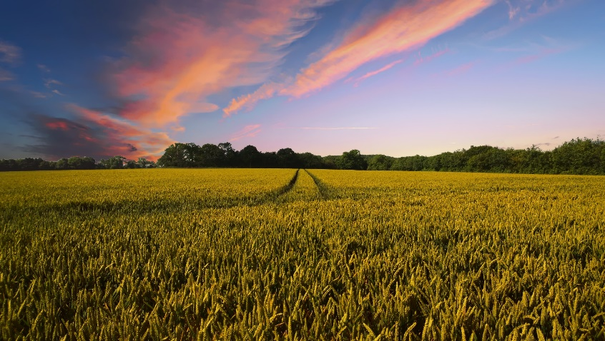
Introduction
72% of land in the United Kingdom is used for agriculture
Agriculture contributed around £24 billion of revenues to the UK economy in 2015 as well as meeting the majority of our food consumption needs
Provides employment for close to half a million people, as well as ecosystem services
National Statistics 2019 Agriculture in the United Kingdom, Contributions of UK Agriculture 2017
Images by Pete Linforth and Free-Photos from pixabay.com

Slide 3
Current distribution of arable farming in GB
30% of all agricultural land is arable and contributes approximately 40% of the total farm income
Cold, wet and mountainous regions of north west Scotland more suitable for livestock farming
Warm dry climate and lowlands of East Anglia beneficial for arable farming
Generally, arable farming is more profitable in Great Britain than livestock farming
Agricultural census data 2010

Slide 4
Key Questions
How will climate change impact agricultural land use?
How would a climate tipping point affect agricultural land use?
To what extent could widespread irrigation mitigate negative impacts?

Slide 5
Scenarios
Irrigation
Climate change No irrigation | Climate change With irrigation
Climate tipping point No irrigation | Climate tipping point With irrigation
1
2
Climate change
3
4

Slide 6
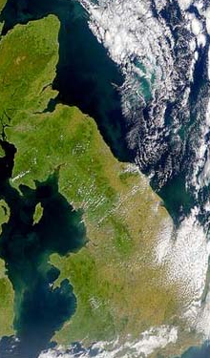
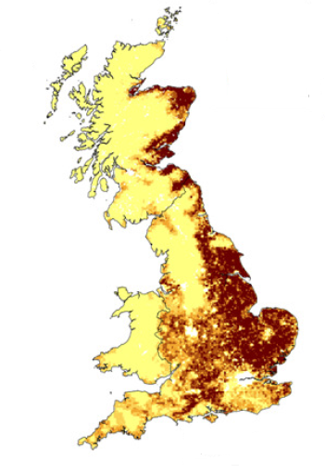
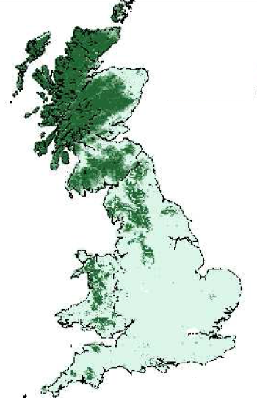
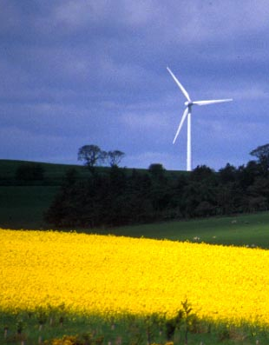
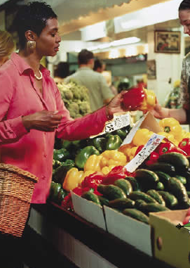
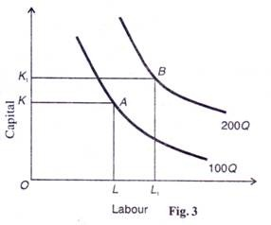
Agricultural Model
Simplified version of agricultural model developed by Fezzi and Bateman, which was subsequently used in the UK National Ecosystem Assessment
DATA
ECONOMETRIC MODEL
OUTPUT
ENVIRONMENT
ECONOMIC
THEORY
POLICY
MARKET

Slide 7
Agricultural Model – Data
PHYSICAL ENVIRONMENT
MARKETS ETC.
POLICY
Soils
Output prices
Agricultural subsidies
Temperature
Input costs
Environmental Policy
Rainfall
Technology
Intervention

Slide 8
Agricultural Model – Economic Theory
Economic theory/farmer decisions: how best to utilise their land
Arable farming more restrictive but offers better profits so will be chosen over livestock farming if both practices are suitable
Model output: share of agricultural land devoted to arable

Slide 9
Agricultural Model – Validation
Modelled arable area calculated on 2km x 2km grid compared with the 2010 agricultural census data
Model calibrated using observational climate data from 1980 - 2010

Slide 10
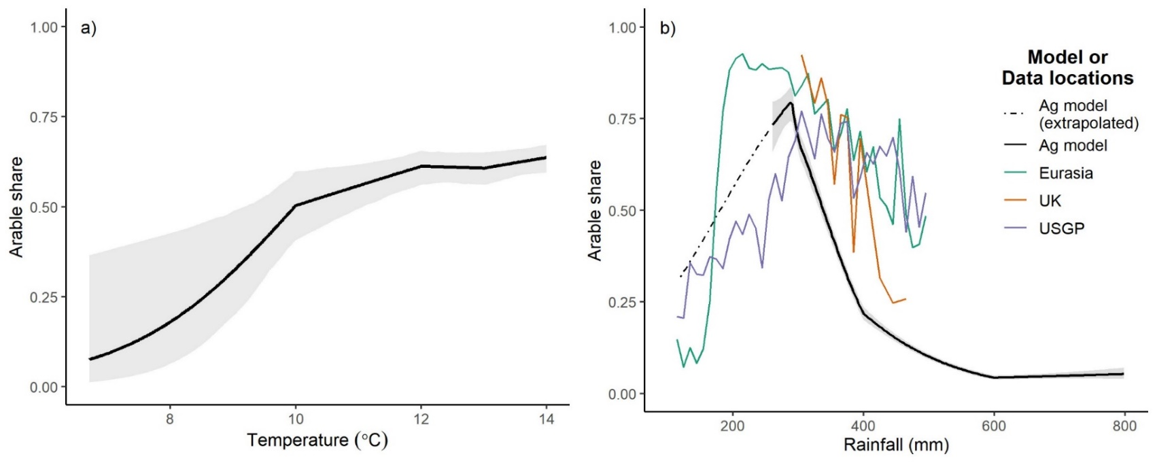
Impact of temperature and rainfall on arable share
In the model arable share increases with increasing temperature or decreasing rainfall and has optimal rainfall of ~300mm
Functional form of rainfall needs extending as future projections lie outside range of current GB data
Apply conservative linear extrapolation for lower rainfall based on data from Eurasia and US Great Plains
Climate Change Initiative, Version 2.0 (European Space Agency, 2017),
Harris et al., Updated high-resolution grids of monthly climatic observations—the CRU TS3.10 Dataset. Int. J. Climatol. 34, 623–642 (2014).

Slide 11
Climate change (AMOC maintained)
Use growing season temperature and rainfall from HadRM3-PPE-UK for the time span 2020 to 2080, which forms part of the UK Climate Projections (UKCP09)
HadRM3-PPE-UK is forced under the medium emissions scenario SRES-A1B
Modelled climate data is bias corrected to observational climate data

Slide 12
Climate change, no irrigation

Slide 13
Climate change, with irrigation

Slide 14
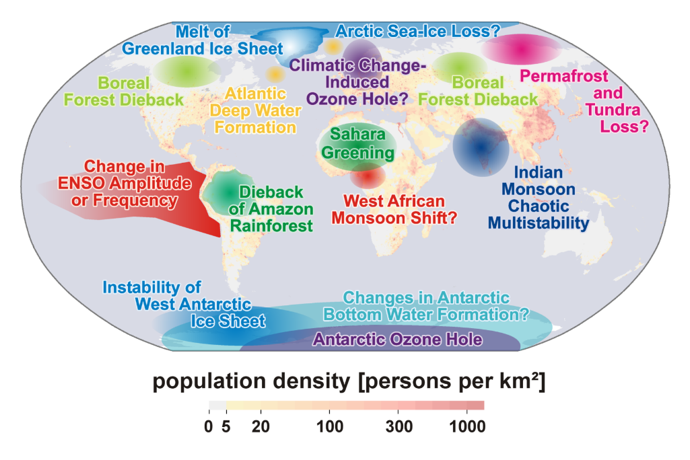
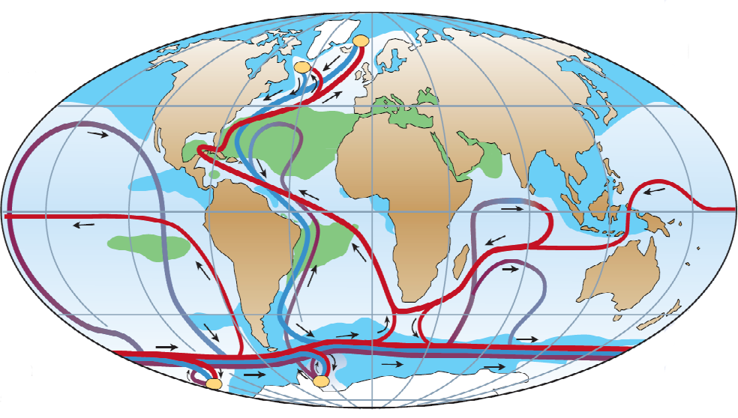
Climate tipping point – AMOC
Collapse of the Atlantic Meridional Overturning Circulation (AMOC) would have a direct impact on GB
AMOC is a temperature and salinity driven circulation current in the ocean and is responsible for the warmer climate of GB compared to other regions of the same latitude.
Lenton et al., 2008
Rahmstorf, 2002

Slide 15
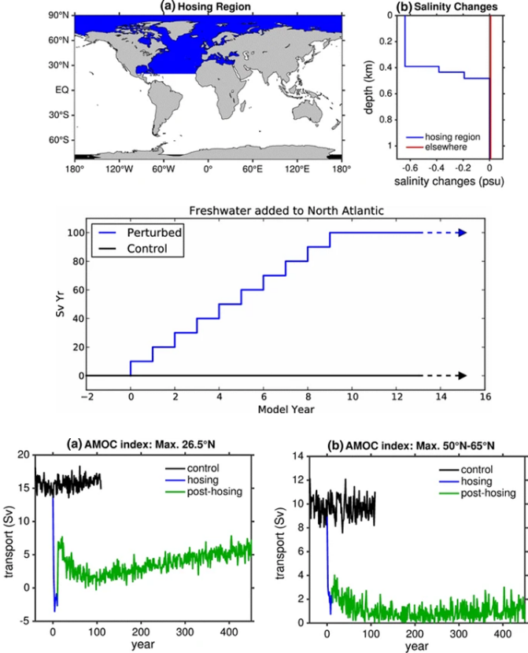
AMOC collapse experiment
Use climate output from a control run and hosing experiment of the HadGEM3 model
Hosing experiment adds freshwater to the North Atlantic iteratively over 10 years
Creates a fast and idealised collapse of the AMOC
Jackson et al., 2015, Mecking et al., 2016

Slide 16
Climate tipping point (AMOC collapse)
Difference between runs overlaid onto climate change data provides future climate projection after an AMOC collapse
Linear weighting function applied to simulate an idealised AMOC collapse over the period 2030-2050
AMOC collapse creates a cooler and drier growing season in GB

Slide 17
Climate tipping point, no irrigation

Slide 18
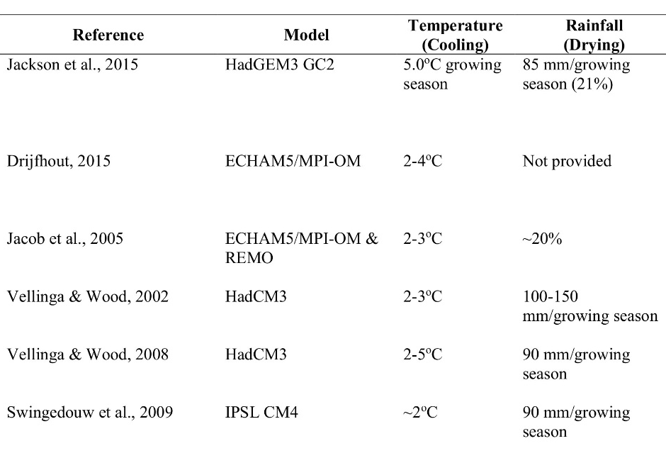
Limiting factors from an AMOC collapse on the share of arable land
Model data used, has large cooling but conservative drying compared to other models.
Though key driver of arable loss is climate drying rather than cooling

Slide 19
Climate tipping point, with irrigation

Slide 20
Irrigation demands
AMOC maintained:
14% of GB to be rainfall limited
Average 18mm demand across irrigated areas
Winter storage of rainfall water may be sufficient
AMOC collapse:
54% of GB to be rainfall limited
Average 70mm demand across irrigated areas
May require spatial redistribution of water

Slide 21
Economic impact on GB agriculture
Major reduction in agricultural value under AMOC collapse scenario
System costs for irrigation estimated at £163.60 per hectare (El Chami et al., 2015)
Irrigation costs greatly outweigh agricultural value
 | Climate change, no irrigation | Climate change, with irrigation | Climate tipping point, no irrigation | Climate tipping point, with irrigation
AMOC | Maintained | Maintained | Collapse | Collapse
Irrigation | No | Yes | No | Yes
Agricultural change value (£M p.a.) | 40 | 125 | -346 | 79
Irrigation cost (£M p.a.) | 0 | -284 | 0 | -807
Net value change (£M p.a.) | 40 | -159 | -346 | -728

Slide 22
Summary
Advancement of arable land to the west and north under climate change, small loss in the south east
Widespread loss of arable land following a climate tipping point (AMOC collapse)
One policy intervention to help mitigate arable loss is to provide irrigation to farmers
Irrigation costs appear prohibitive and would require storage and/or large spatial redistribution of water
Reference: Ritchie et al., Abrupt shifts in national land use and food production after a climate tipping point, Nature Food 2020

