Slide 1
Stochastic data adapted AMOC box models
Ruth Chapman
Supervised by Peter ashwin and Richard wood

Slide 2
Contents
Three and Five box model of the AMOC
Bifurcation and rate-dependent tipping
Noise tipping
Noise parameter estimation and results
Further work

Slide 3
Three and Five box model of the AMOC

Slide 4
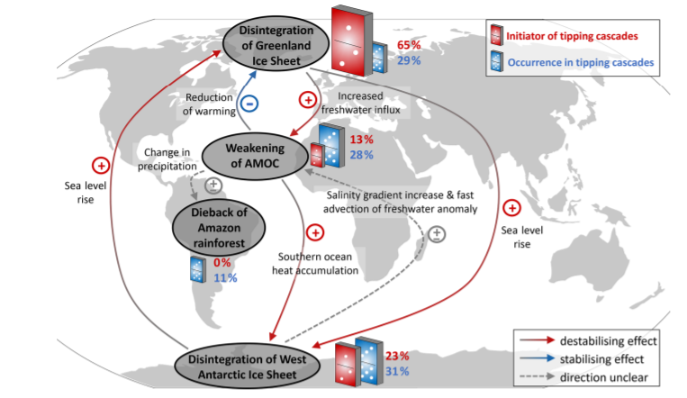
N.Wunderling et.al., 2021, Earth System Dynamics, 12(2)

Slide 5
IPCC, 2021: Summary for Policymakers. In: Climate Change 2021: The Physical Science Basis. Contribution of Working Group I, to the Sixth Assessment Report of the Intergovernmental Panel on Climate Change, MassonDelmotte et.al., Cambridge University Press. In Press.

Slide 6
Climate model hierarchy
# Scales
Ocean/ Atmosphere High Res.
GCMs
Ocean/ Atmosphere Intermediate complexity
Earth system Intermediate complexity
Conceptual models
Climate box models
# Processes
H.Dijkstra, 2013, Nonlinear climate dynamics, Cambridge University Press
Notes:
Useful to frame the work we’re doing in a wider context. Box models are along the bottom of this graph, by adding additional processes such as hosing (ice sheet melting) we can shift to the right slightly, but still in bottom left.
High resolution models take lots of computing, can we get accurate enough results from the conceptual models which are easier and quicker? 5box model, we do this by calibrating to parameters of higher order models.

Slide 7
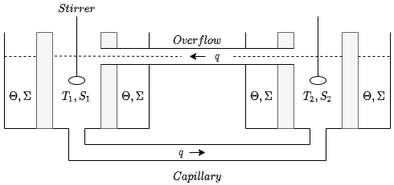
Stommel Two-box model
H.Stommel, 1961, Tellus 13, 224-230
Notes:
This is the basis of the two box model. Our ocean masses do not mix readily, but with this model there is a circulation patter where they can exchange heat and salt. Each box has it’s own salt and temperature, here indicated by the subscripts 1 and 2.
We can write down an equation for the evolution of both the salt and temperature for each box depending on the inflows and outflows and their strengths, as well as some exchange through the porous walls.

Slide 8
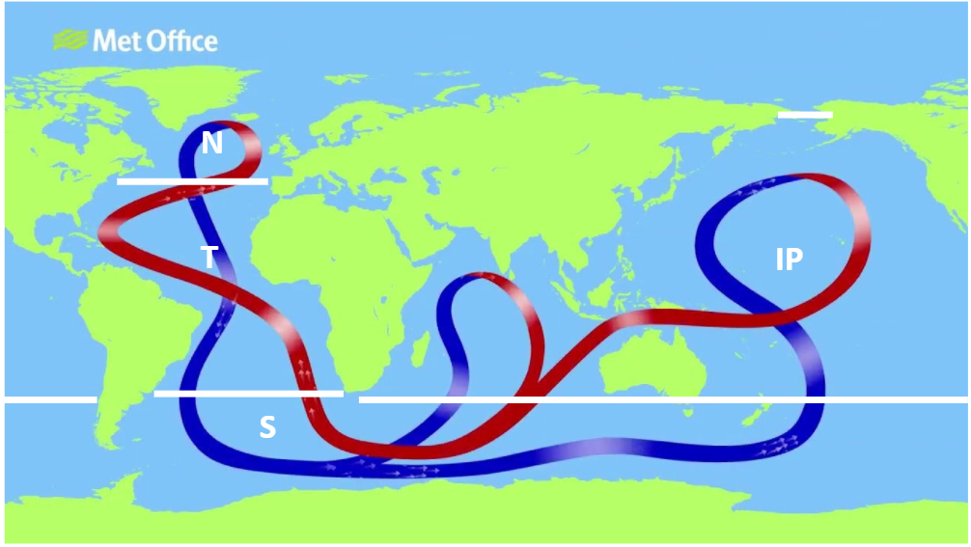
AMOC
N = North Atlantic
T = Tropical Ocean
S = Southern Ocean
IP = Indo-Pacific
B = Bottom Waters (under boxes at surface)
Map from MetOffice.com, boxes drawn by Richard Wood
Notes:
This is the process we’re trying to model. Most complex/ important part is the overturning in the north Atlantic. Hot water sinks down into bottom waters. Box boundries are defined by sharp gradients in salinity since ocean masses don’t really mix.
AMOC is driven by differences in temperature and salinity.
Circulation due to – loses heat as it moves towards Scotland, and evaporation of freshwater makes it more salty. Both these things make water more dense so it sinks.
Climate change means that there is more heat energy stores in the ocean and there are more freshwater inputs into the north Atlantic. - Water is warmer and less salty so is less dense and reduce the sinking seen in N box, weakening the circulation.

Slide 9
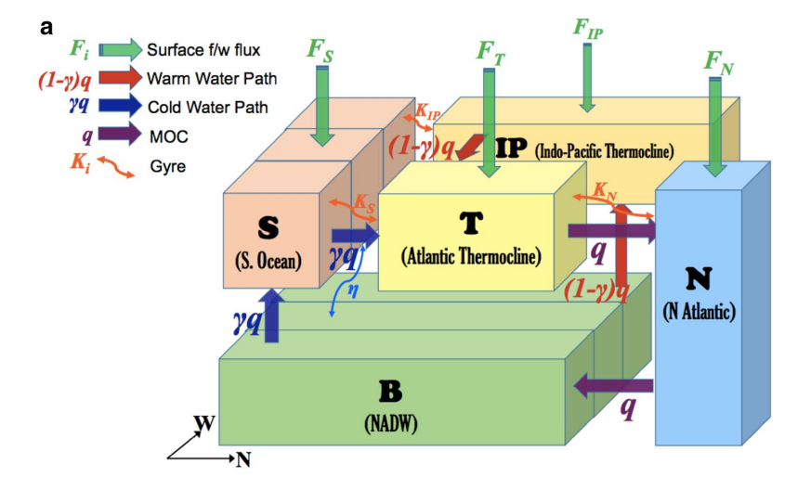
Wood, R. et al. (2019),Climate Dynamics, 53(11), 6815-6834

Slide 10
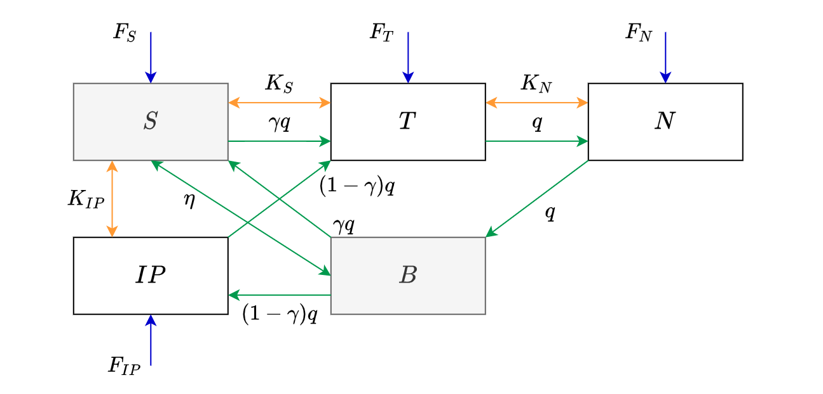
Five-box model
F are Freshwater surface fluxes
K are wind driven fluxes
Eta is a mixing parameter
q is the advective flux due to AMOC
Gamma is proportion of cold water path
S = Southern Ocean
T = Tropical Ocean
N = North Atlantic
IP = Indo-Pacific
B = Bottom Waters
H.Alkhayuon et. Al., 2019, Proc.R.Soc, A475, 2090051 and Wood, R. et al. (2019), Climate Dynamics, 53(11), 6815-6834
Notes:
Schematic of five box model. We have freshwater inputs shown and K, wind driven fluxes. Considering the green arrows, we can follow the path of the AMOC – think od map shown. We can see upwelling out of the bottom water where the water is heated and rises. We can see the water moving northwards, from S and IP through T to N. and then the sinking from N to B. There is also a mixing parameter between B and S.
Reduction to three box model assumes S and B are constant. This can be seen in Wood et.al.2019.

Slide 11
Five Box model Equations
q = λ[α(T_{S} – T_{N}) + β(S_{N} – S_{S})]
α,β are thermal and haline coefficients
Wood, R. et al. (2019), Climate Dynamics, 53(11), 6815-6834
Notes:
Talk about tipping points here
2 decidedly different states for the different circulations
We can see this tipping clearly in the phase portrait when we force the model with freshwater in the north Atlantic
Model parameters??
Conservations eqns

Slide 12
Three box Simplification
q = λ[α(T_{S} – T_{N}) + β(S_{N} – S_{S})]
α,β are thermal and haline coefficients
Wood, R. et al. (2019), Climate Dynamics, 53(11), 6815-6834
Notes:
Change eqn of q on both slide
AND conservations of freshwater, salt and volume

Slide 13
What are we aiming for?
Wood, R. et al. (2019), Climate Dynamics, 53(11), 6815-6834

Slide 14
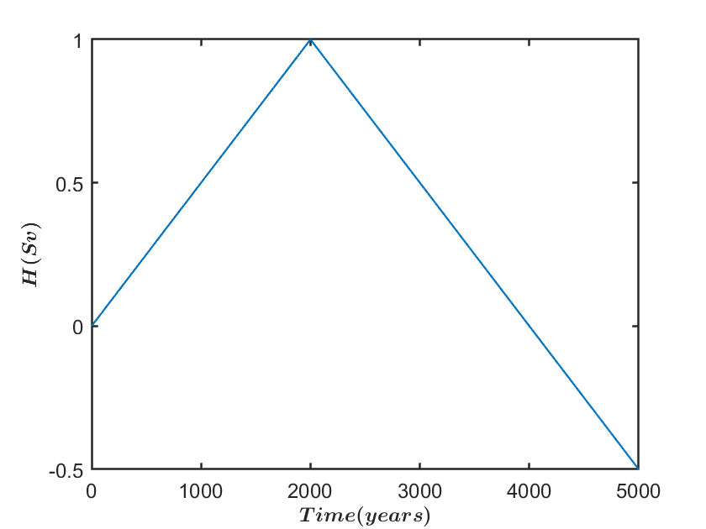
Hosing function over 5000 years, referred to as H11
Hawkins et.al., 2011, Geophysical Research Letters 38(10)
Notes:
1Sv is generally used for hosing functions as it’s a standard know to tip most systems, but it is completely unrealistic. We might expect something like 0.1Sv in reality

Slide 15
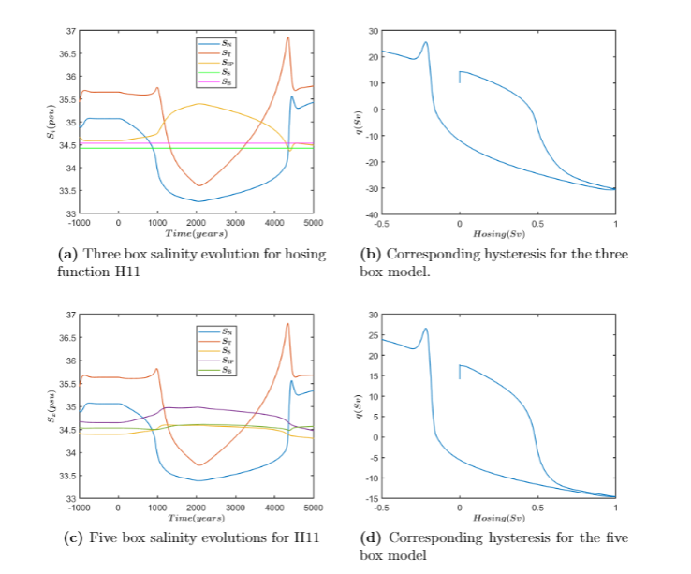
Hosing Functions
A reproduced versions of Wood et.al.,2019 with the three and five box model forced under the H11 forcing
Notes:
**new slide**

Slide 16
Bifurcation and rate-dependent tipping

Slide 17
Bifurcation Diagram of box model
1
2
3
4
5
5
4
1
2
3
H.Alkhayuon et. Al., 2019, Proc.R.Soc, A475, 2090051
Notes:
Red dash- limit cycle
Red- source

Slide 18
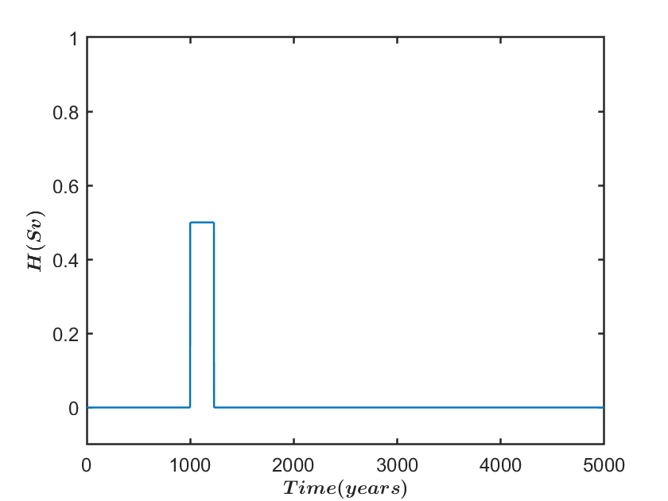
Bifurcation tipping for three-box model
Tpert = 230years
H.Alkhayuon et.al., 2019, Proc.R.Soc, A475, 2090051
Notes:
Considering bifurcation tipping, 3 box model with 2xCO2 parameters to idealize climate change scenario. Alkhayuon et.al.2019. This is applying hosing which looks like a box/ step function. Different coloured lines are how long the perturbation was applied for. We see that the longer perturbations result in tipping where shorter ones do not. Dotted line is the saddle equilibrium. So this tipping is both bifurcating, and depends on how long the hosing is applied for.

Slide 19
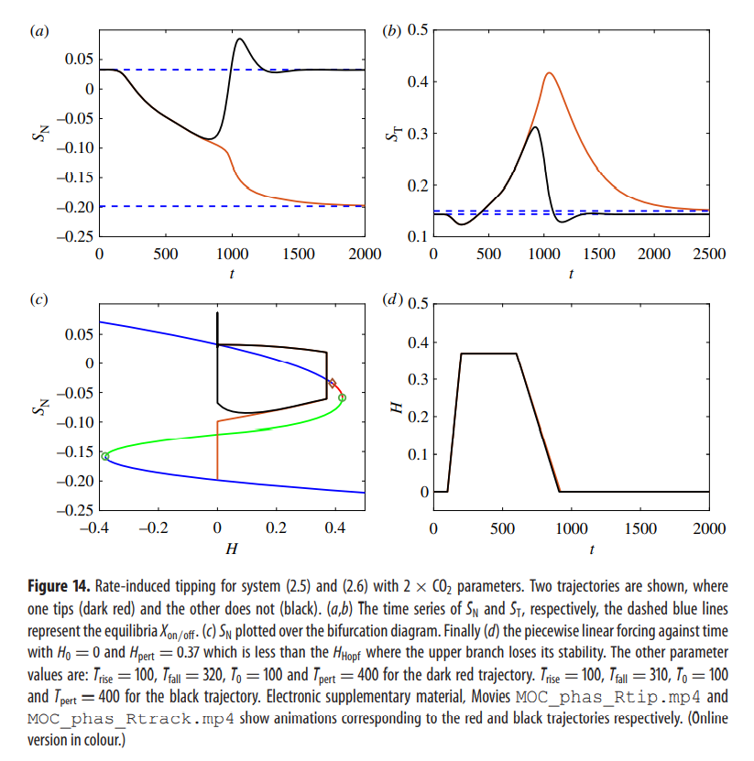
Rate Dependent tipping for three-box model
H.Alkhayuon et.al., 2019, Proc.R.Soc, A475, 2090051
Notes:
For three box model and 2xCO2. Very small difference in rate of reduction of hosing results in dramatic tipping of system, bottom left.

Slide 20
Different types of tipping
Bifurcation tipping ✓
Rate-dependent tipping ✓
Noise tipping

Slide 21
Noise tipping

Slide 22
Adding stochastic processes
Where f describes the corresponding differential equation, dW is the Brownian motion and σ a parameter which multiplies the noise. Later, the matrix of σ’s will be known as L, the spectral densities.
Brownian motion as defined in the usual way.
W(0)=0 with probability one
ΔW = W(t) – W(s) for 0 ≤ s < t ≤T is a Gaussian random variable, mean zero and variance one.
Increments of W are independent for non-overlapping time-steps
Higham, D. (2001),SIAM Review, 43, 525-546
Notes:
**new slide**
Degenracys of noise?

Slide 23
Euler-Maruyama method
Now we have converted to and SDE, a standard ODE solver such as ode45 cannot be used. We have used the Euler-Maruyama Method as follows;
where h is the step size Δt and ΔW = W(t_{j}) – W(t _{j-1}) .
Using this method and an approximation of g done by eye we can produce the results in the following slide.
Higham, D. (2001), SIAM Review, 43, 525-546

Slide 24
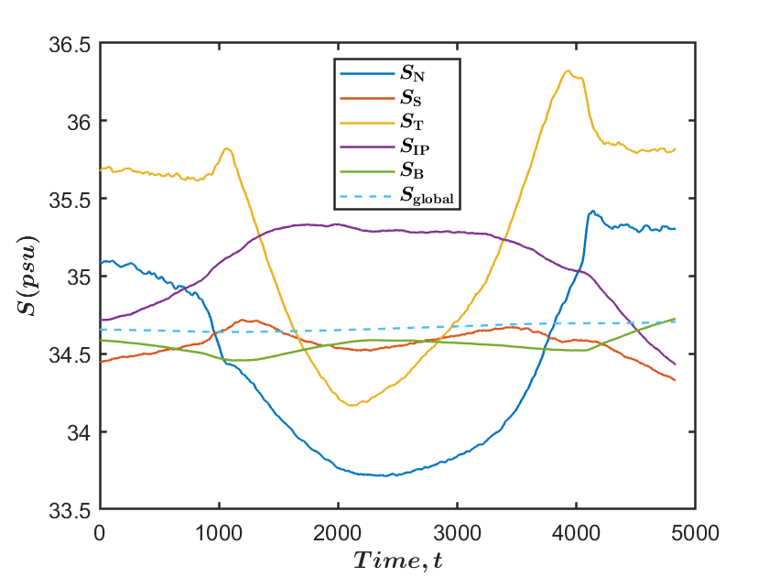
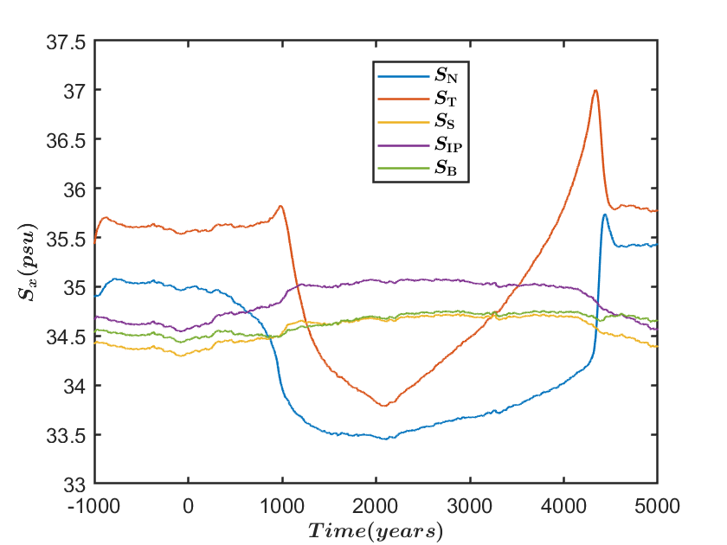
Stochastic adapted model, estimated noise parameters
Wood, R. et al. (2019), Climate Dynamics, 53(11), 6815-6834
Reproduced Fig.3a from Wood et al. (2019), FAMOUS A data as averaged for the five boxes and forced with H11.
Five box model with H11 Hosing and a noise parameter of $σ_{11}$= $σ_{12}$=2e-6, $σ_{21}$=$σ_{22}$=0.
Notes:
**new slide**
So far it does not look like the inherent noise in the GCM data will be enough to tip the system – could it be enough in combination with another forcing, e.g: the step function hosing

Slide 25
Bifurcation Diagram of box model
1
2
3
3
1
2
H.Alkhayuon et. Al., 2019, Proc.R.Soc, A475, 2090051
Notes:
Noise?

Slide 26
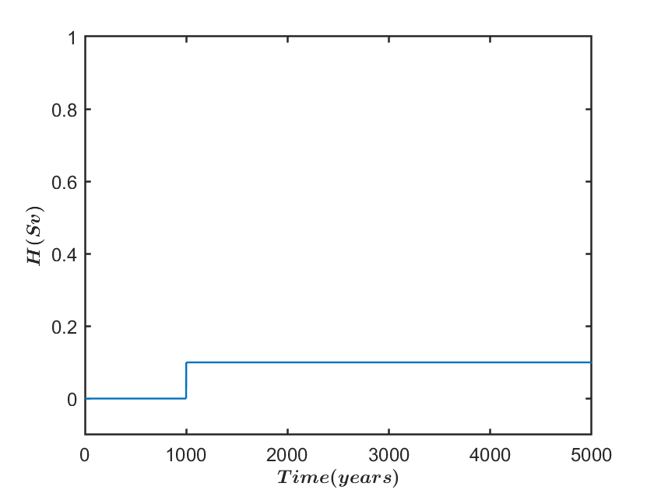
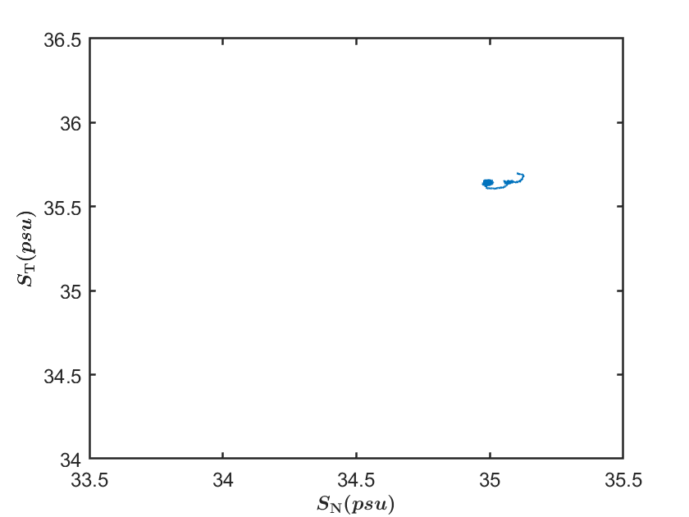
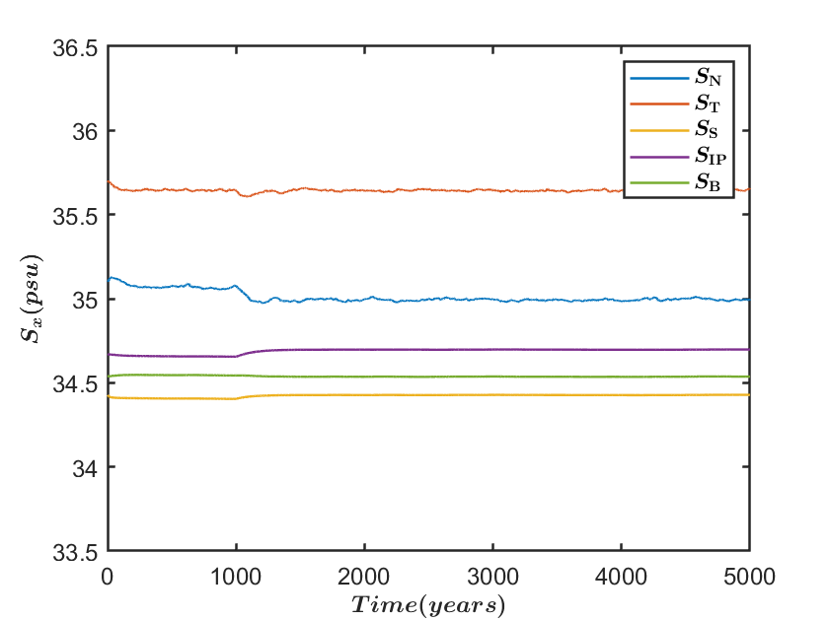
We force the three box model with a step function of hosing, 0.1Sv, system does not tip, we just shift the stable equilibrium
1

Slide 27
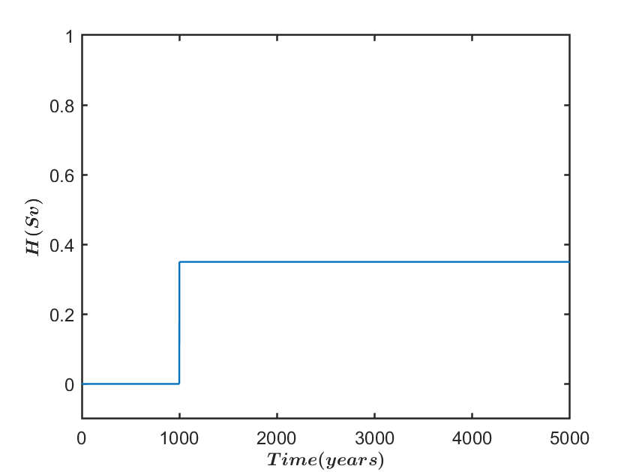
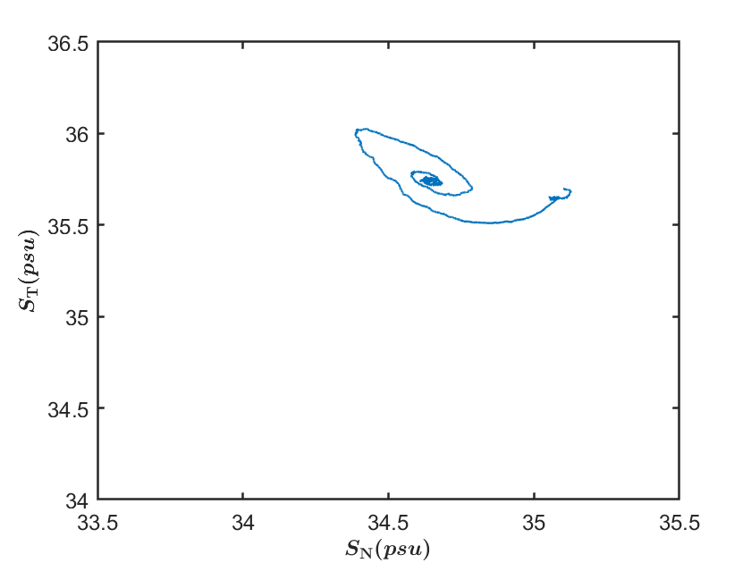
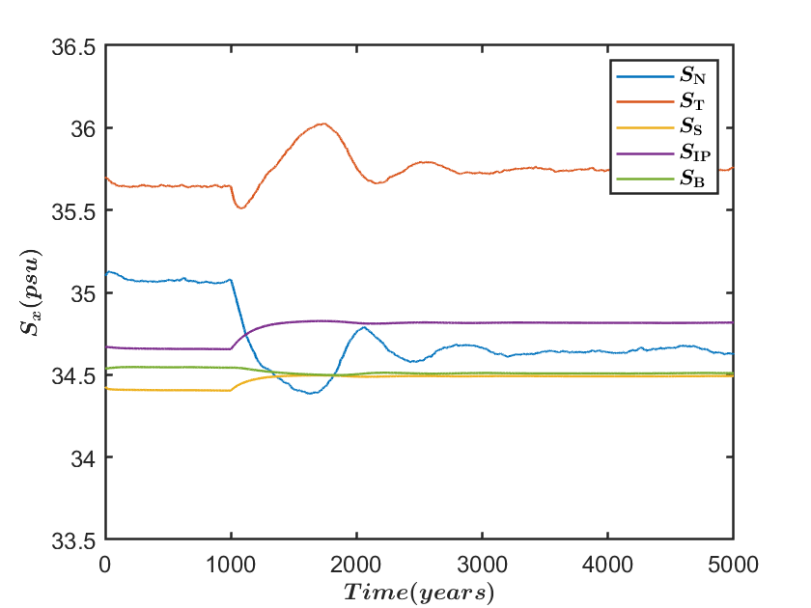
We force the three box model with a step function of hosing, 0.35Sv, the system does not tip but we pass Hhopf, which is subcritical so spiral back to stable equilibrium
2
Notes:
Subcritical hopf
H=0.35 pushes system close to Hhopf, so we see the unstable limit cycle but we haven’t crossed Hhopf to se decay back to the stable on state

Slide 28
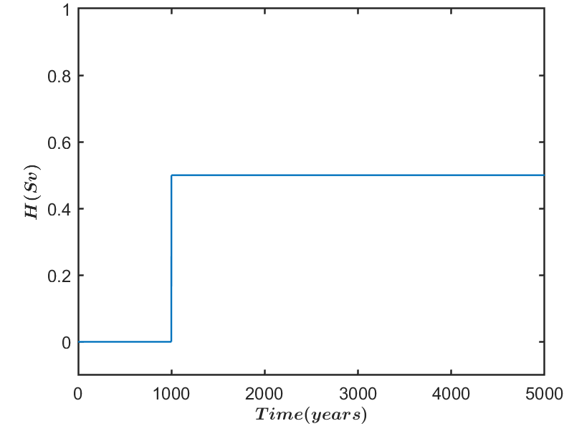
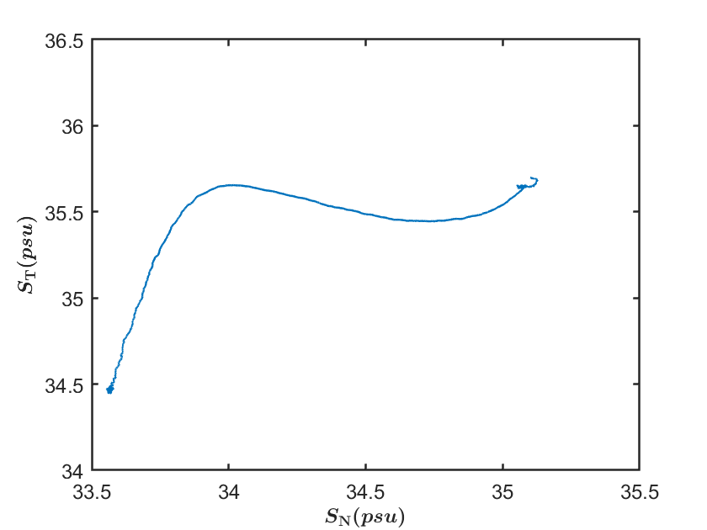
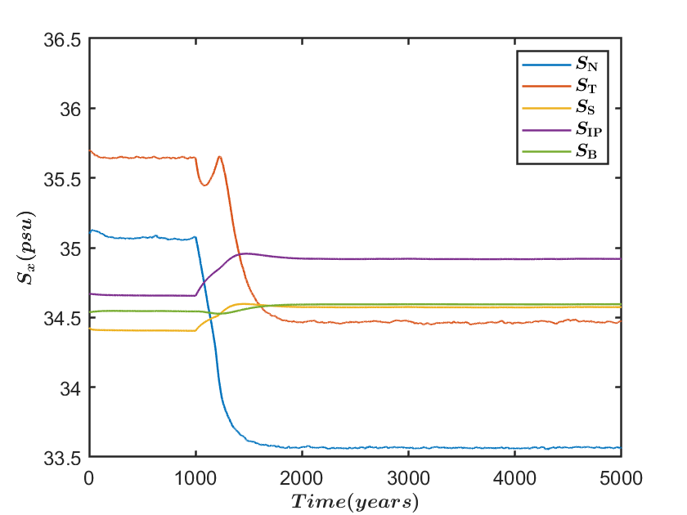
We force the three box model with a step function of hosing, 0.5Sv, system very clearly tip to the off state
3

Slide 29
Noise Parameter Estimation and Results

Slide 30
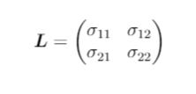
Discretization based approximated-likelihood estimation
Approximated negative log- likelihood function
Det. of matrix
Q is the identity due to how the Brownian motion was defined. Θ are the unknown parameters of the system, in this case a vector of σ’s.
After all the inverse functions, transverse and determinants, this gives a scalar value for each step of the Euler-Maruyama, k, which are then summed over. This function is then minimised to find the values of sigma to minimise the function, l.
Sarkka, S. and Solin, A. (2019), Applied stochastic differential equations, Cambridge University Press
Notes:
**new slide**

Slide 31
Noise parameter estimation for FAMOUS A averaged data with H11 hosing

Slide 32
Noise parameter estimation for FAMOUS A averaged data with H11 hosing- first 1000 years of data only

Slide 33
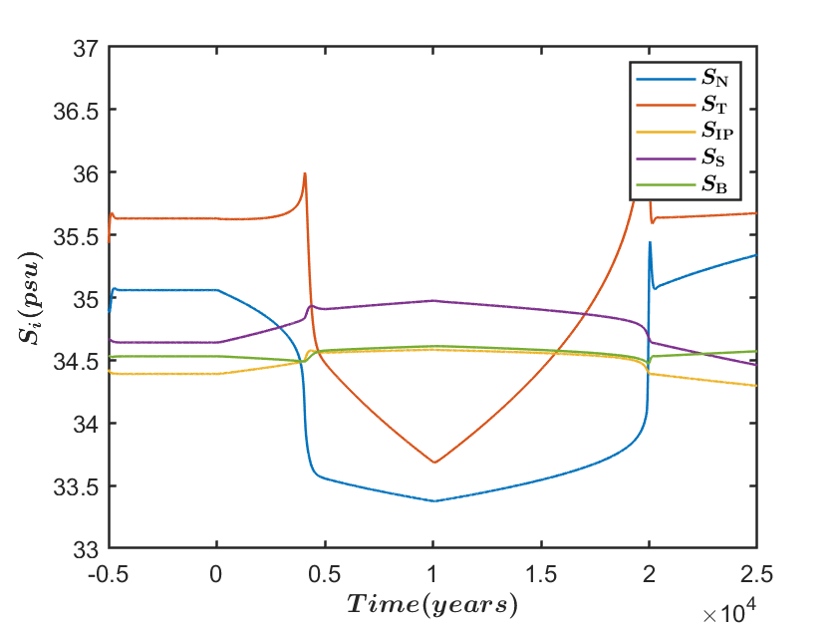
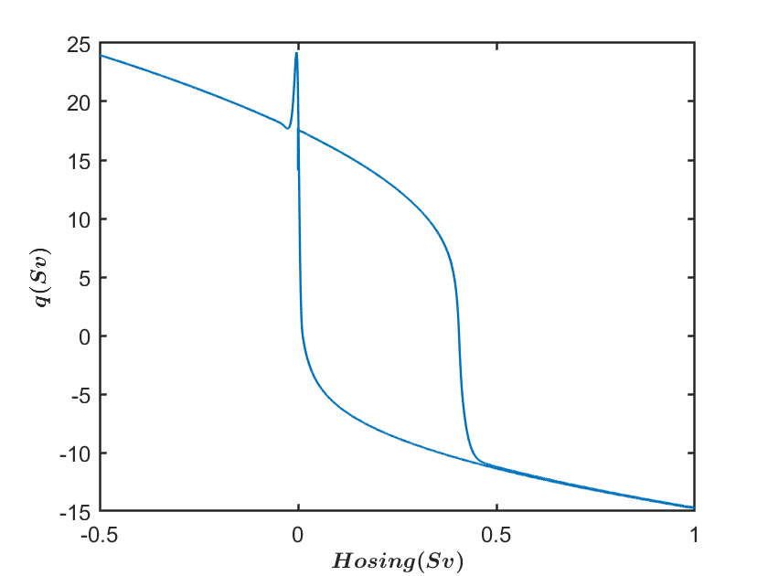
‘Slow’ Hosing
Similar hosing to H11, but 5 times slower over 25000 years
Notes:
**new slide**

Slide 34
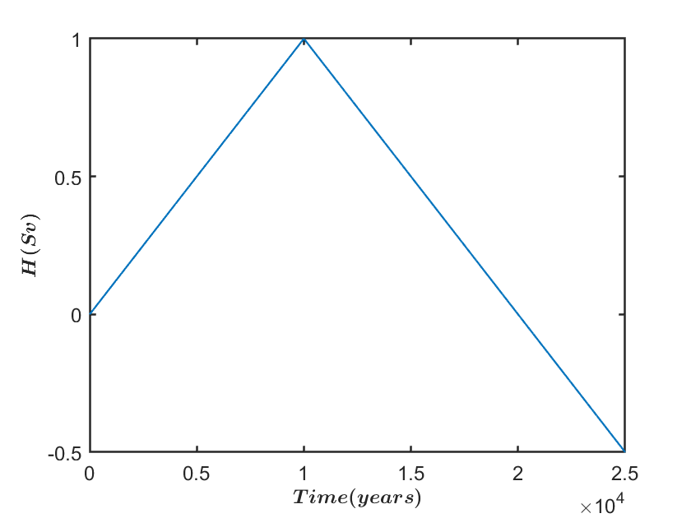
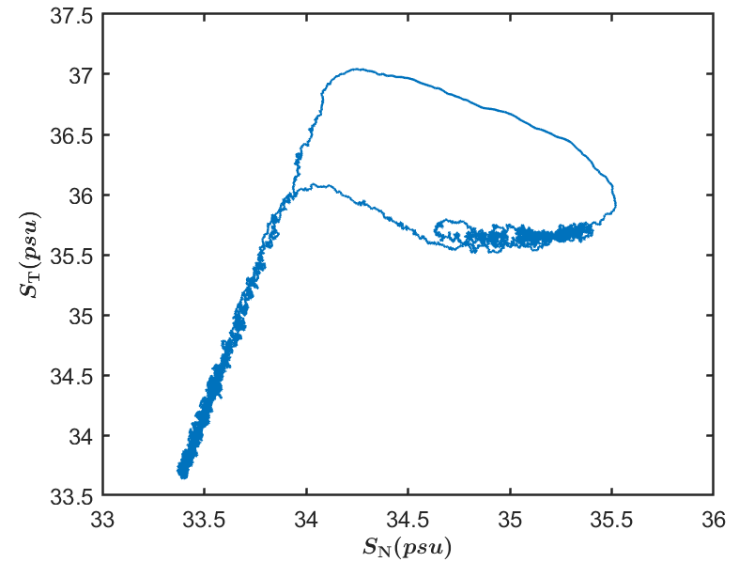
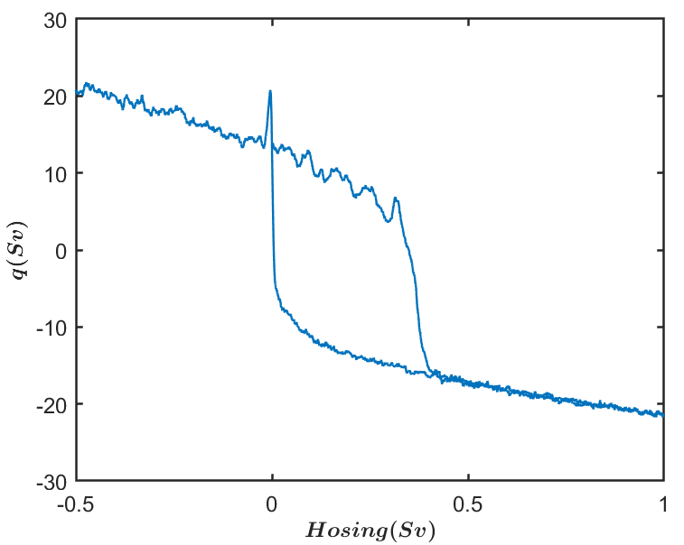
Now slow hosing with noise…
Similar hosing to H11, but 5 times slower over 25000 years

Slide 35
JASMIN/CEDA archive CMIP data
A significant amount of the CEDA (Centre for Environmental Data Analysis) archive is stored within JASMIN Sci servers.
Gaining access to the serves gives access to a large number of GCMs including a number of Met Office models (inc. HadGEM3) and the CMIP 6 suit of models.
There are pre-written recipies in ESM Val Tool which can analyse the data into the form we need for the noise estimation for the box model – that is grid points averaged over the box volumes to produce a time series of salinities.
Is it also possible to calibrate the whole box model to these other GCMs? Would they be better at modelling different parts of the system?

Slide 36
Further work
Is it possible to calibrate the box model to other GCM data? CMIP6 data is being explored. E.g: could we calibrate the model to an unstable GCM?
Are there other ways that we could add noise e.g: F, K or H? Or different types of noise (coloured noise) that should be considered? What is the degeneracy of the noise?
Is it possible to trigger noise tipping with other hosing functions? A possible combination of rate-dependent and noise tipping
Richard Wood is currently exploring CO2 forcing- how would this affect different types of tipping?
Investigating other scenarios of time dependent hosing- Greenland melting?
Notes:
**new slide**
Types of noise
Degeneracy
Noise tipping with a hosing function
Investigating other scenarios of time dependent hosing
CO2 forcing

Slide 37
References
N.Wunderling et.al., 2021, Interacting tipping elements increase risk of climate domino effects under global warming, Earth System Dynamics, 12(2)
IPCC, 2021: Summary for Policymakers. In: Climate Change 2021: The Physical Science Basis. Contribution of Working Group I, to the Sixth Assessment Report of the Intergovernmental Panel on Climate Change, Masson Delmotte et.al., Cambridge University Press. In Press.
H.Dijkstra, 2013, Nonlinear climate dynamics, Cambridge University Press
H.Stommel, 1961, Thermohaline Convection with Two Stable Regimes of Flow, Tellus 13, 224-230
Wood, R. et al. (2019), Observable, low-order dynamical controls of thresholds of the AMOC, Climate Dynamics, 53(11), 6815-6834
H.Alkhayuon et.al., 2019, Basin bifurcations, oscillatory instability and rate-induced thresholds for Atlantic meridional overturning circulation in a global oceanic box model, Proc.R.Soc, A475, 2090051
Hawkins et.al., 2011, Bistability of the Atlantic overturning circulation in a global climate model and links to ocean freshwater transport, Geophysical Research Letters 38(10)
Higham, D. (2001), An algorithmic introduction to numerical simulation of stochastic differential equations. SIAM Review, 43, 525-546
Sarkka, S. and Solin, A. (2019), Applied stochastic differential equations, Cambridge University Press

